Slide 1
Using Data to Manage Your Vending Machine

Slide 2
Part I: Using a Vending Machine to Raise Money Lots of teams, groups and clubs need to raise money to attend regional competitions: Band, choir, rocketry, sports, you name it! They need funds to pay for all sorts of things, like: -Registration -Food -Transportation -Hotels -Uniforms/t-shirts You are part of the FIRST robotics team at your school and your team needs to raise $10,000 to attend this year’s regional competition. To help you meet your goal, your coach has purchased a vending machine for the team. Your school principal has agreed to let the team operate the vending machine on school grounds and keep all of the money it makes to go towards fundraising. You will have 6 months to operate the vending machine.

Slide 3
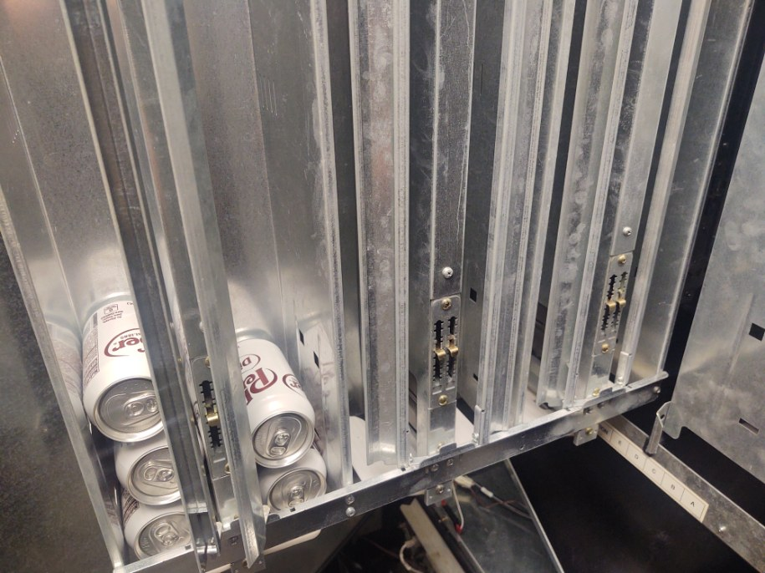
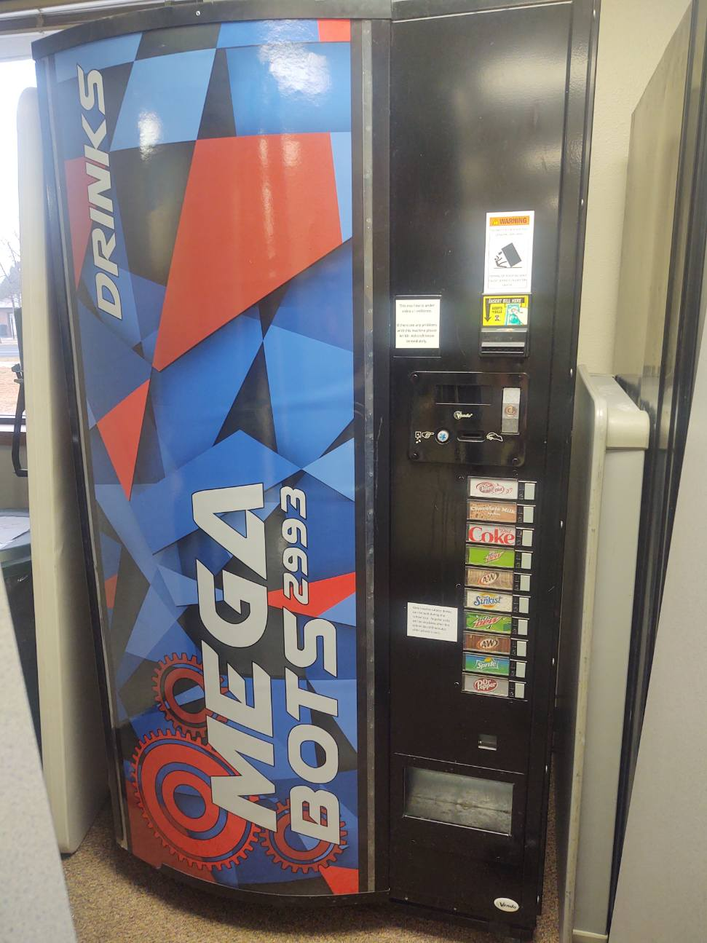
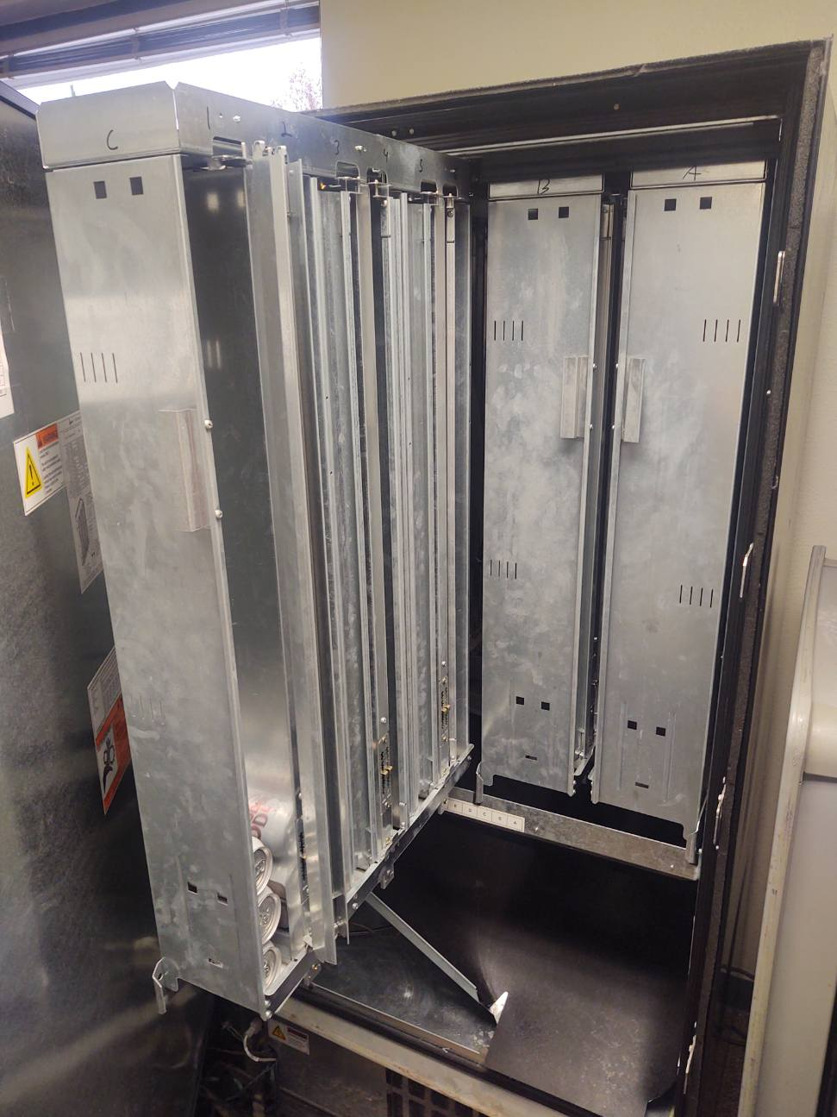
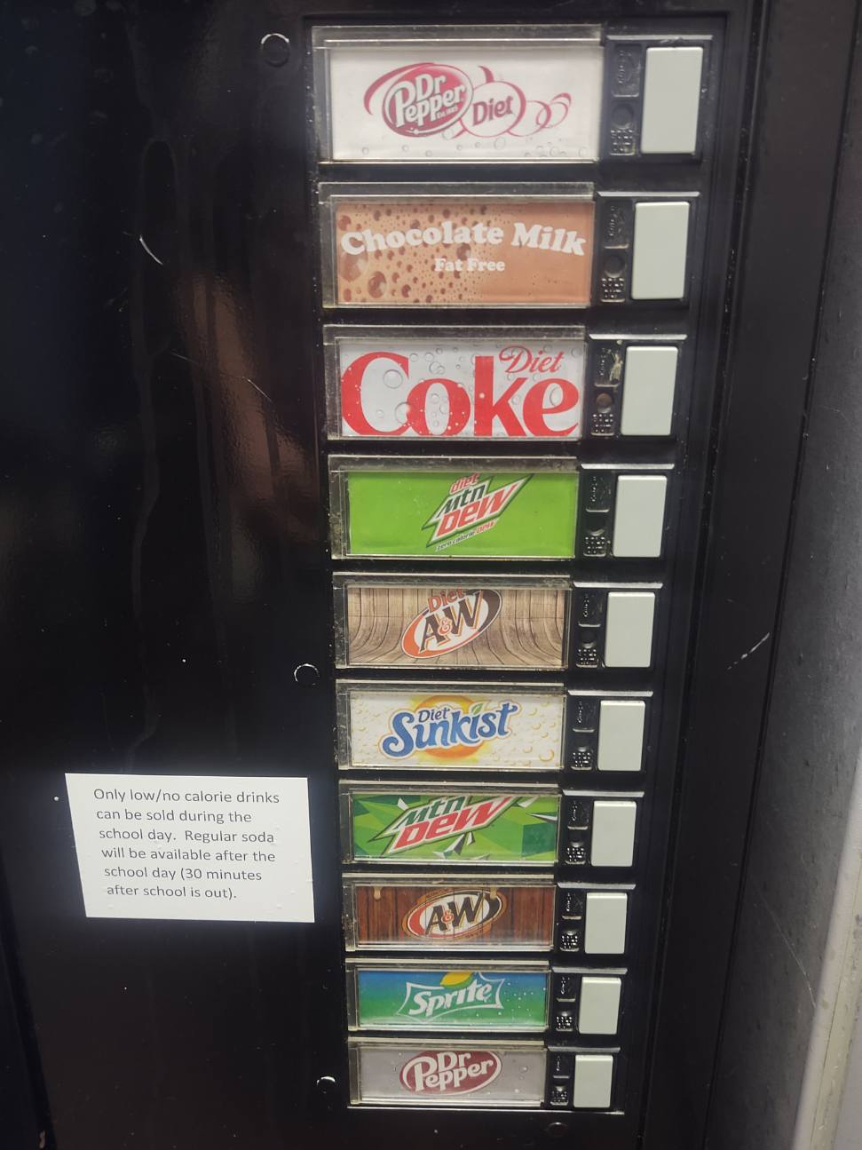
About Your Vending Machine
There are ten total slots that each hold 30 beverages
Each slot correlates with a button on the front of the machine
These panels slide out, and are made up of slots
This is your vending machine!

Slide 4
Your Criteria and Constraints
Your team has complete control over the vending machine, including what to stock it with and how much to charge. There are some criteria and constraints to work around: Criteria: The vending machine needs to sell popular drinks to help your team earn as much money as possible in 6 months. The vending machine is restocked twice a month. Constraints: -Only standard-size 12-oz. cans, 20 oz. plastic bottles, and single-serve milk cartons will fit in the machine. (Note: In real life, most vending machines can only sell one type of container). -Due to federal nutritional guidelines, sodas must be sugar-free. Non-carbonated juice and milk are also allowed.
-There are 10 slots to stock. Each one can hold 15 8 oz. milk cartons, 12 12 oz. cans, or 6 20 oz. bottles.
Discuss: What other criteria/constraints do you see?

Slide 5
What is Optimizing and How is It Used?
Optimizing means to make the best or most effective use of a situation, opportunity, or resource.
Many different types of engineers use optimizing every day!
Agricultural Engineers | Aerospace Engineers | Packaging Engineers
Optimizing feed so animals have the right amount of food to eat | Optimizing payloads so planes and rockets can fly | Optimizing packaging so that it’s easy to transport while minimizing waste
Optimizing irrigation systems so crops stay hydrated without wasting water | Optimizing designs to fly safely without wasting fuel or labor hours | Optimizing packages to perform well for purposes like storage, shipping, and protection

Slide 6
Examples of Optimizing in Engineering
Toyota | Frederick Taylor, 1856-1915
Identified bottlenecks to reduce waste by collecting data throughout manufacturing process – not just at the end. | Famous for studying the results of his established processes – didn’t stop working on making them more efficient.
Data helped them to better plan for busy/slow times, helping them save money – “Just in Time” system is now used by many companies. | Observed workers in a steel mill to optimize shovels, increasing average worker output from 16 to 59 tons per day
“Toyota Production System” regarded as a great example of industrial optimization. | Methods frowned upon today – treated workers like machines rather than people.

Slide 7
Using Optimization in Your Vending Machine
Engineers consider different factors when optimizing: they collect data, then use that data to make things more efficient – helping their companies save and earn more money. This helps to keep prices low for consumers like us!
In this case, you need to optimize the vending machine space to maximize profit.
What factors could you consider when optimizing your vending machine?
What costs more? What could you sell for more? Where will you store extra drinks? How can you collect data on what drinks are selling best?
Notes:
The examples listed above are just talking points – try to get students to generate more

Slide 8
What are Trade-Offs?
Wikipedia defines trade-offs:
A trade-off (or tradeoff) is a situational decision that involves diminishing or losing one quality, quantity, or property of a set or design in return for gains in other aspects. In simple terms, a tradeoff is where one thing increases, and another must decrease.
You’ll need to make trade-offs when deciding how to stock your vending machine. For instance:
One drink may be more popular but have a shorter shelf life.
Another drink may also be popular, but due to its size you can’t fit many in the machine.
You’ll need to weigh these competing considerations in order to make your machine profitable.

Slide 9
Activity #1
Work with your teacher to create a survey to deliver to students outside of your class. Surveying real students will give you hard data on which drinks (that fit within the given constraints) will likely sell the best at your school. You need to identify the ten most popular drinks.
Your survey should:
Give students a wide range of choices – more than 10
Be simple for students to complete
Be delivered however your teacher decides is best for your school
Remember, you need to earn the most money given the space available in your vending machine, so only include the drinks most likely to sell well.

Slide 10
Example Survey
Our class is doing a survey on the most popular drinks to stock a new vending machine with. Please circle any of the following drinks you’d like to purchase:
Diet Coke
Diet Sprite
Diet root beer
Diet orange soda
Lemonade
Fruit punch
Milk
Iced tea
Diet Mountain Dew
La Croix
You can deliver your survey…
-On paper (that respondents will submit to you)
-Via a checklist (you can ask the question aloud and record respondent answers)
-Via online methods like Google forms
Tally up the results to identify the 10 most popular drinks!
Notes:
Create a Google form using our template here – you and your students can customize it with their selections. https://docs.google.com/forms/d/1PKKM0qfeA5qD6fUPBO04G3NBSAd5RpVDoyNsV0cccpo/copy
Good talking point here – what are the benefits of having people select all of the options they like, vs. telling them to select “up to” a certain number?
Good talking point: students can decide to put the same drink in 2+ slots if they think it’s popular enough
This is the end of the first part of the activity. Once students have had time to gather their results, tally them to identify the 10 most popular drinks. Then proceed to part 2.

Slide 11
Part II: Maximizing Performance by Using Data Problem #1: You’ve stocked your vending machine and it has been selling drinks to students for a whole month. You put the most popular drink in slot #1, the second most popular in slot #2, and so on. The team has been restocking drinks as needed and keeping an eye on performance. However, your coach informs the team that the drinks in the #3 ad #5 slots aren’t selling well. Brainstorm: Why aren’t these drinks selling as well as the others?
#6091ba
#9fcc3b
#8d64aa
#f8a81b

Slide 12
Part II: Maximizing Performance by Using Data
Answer: Not all of the students who filled out the survey have the money to use the vending machine regularly. That means that while those drinks are popular, they’re not popular among your real customer group.
How could you redesign the survey in the future to avoid this problem?

Slide 13
Part II: Maximizing Performance by Using Data
Problem #2: The school principal is concerned that some of the drink choices aren’t the healthiest or most sustainable.
Take a look at the Popular Drink Information Chart on nutrition and sustainability.
As you rework which drinks to include in your vending machine, factor in the trade-offs you’ll need to make to achieve profitability while also reducing waste and giving students healthy options.

Slide 14
Activity #2: Final Assessment Write a Letter to Your Principal
Write a 1-page letter to your principal that answers the following questions:
Explain how you would do the survey differently in the future to achieve more useful results
Explain how you would improve slow sales in slots #3 and #5
Decide on, and defend, the trade-offs you made to balance sustainability and health considerations while maximizing profits.
Your paper should be double spaced, 12 pt. Times New Roman font.

Slide 15
References
The Mag. “Frederick Winslow Taylor, the Patron Saint of the Shovel.” Mental Floss, April 27, 2015. https://www.mentalfloss.com/article/63341/frederick-winslow-taylor-patron-saint-shovel.
Corporation., T. M. (0AD). Toyota Production System: Vision & Philosophy: Company. Toyota Motor Corporation Official Global Website. https://global.toyota/en/company/vision-and-philosophy/production-system/.

