Slide 1
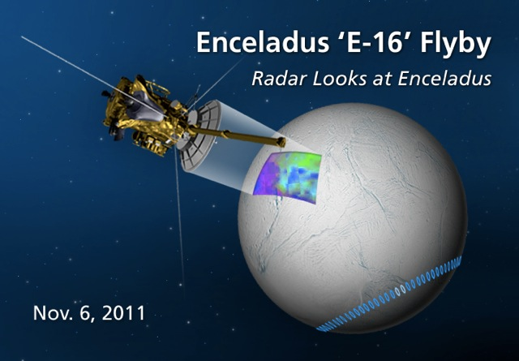
Catching the Perfect SAR Waves!
Play Multimedia

Slide 2
Outline
Wave Basics
Electromagnetic Spectrum Tour
Radio Detection And Ranging (Radar)
SAR vs. ISAR
Applications in Geometry
Rise to the challenge

Slide 3
Wave Basics
A wave is a continuous oscillation of energy in space time.
The frequency of each wave is determined by measuring the number of repetitions an event occurred within a given time period then dividing the number of repetitions by the length of the time period. Frequency: f = # of repetitions/time
The amplitude of a wave is maximum or minimum magnitude of an oscillation.
The wave length is the distance at which the wave's pattern repeats.
Waves are reflected, absorbed, diffracted, and scattered.

Slide 4
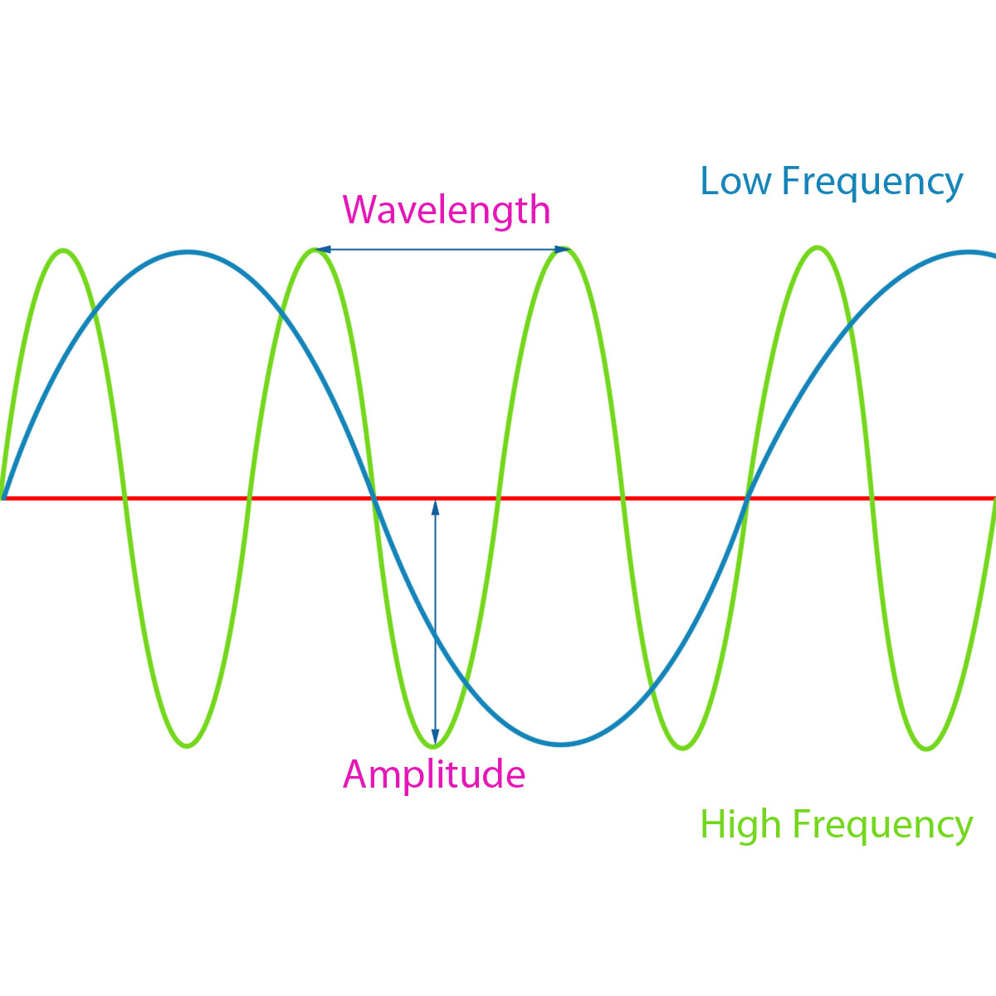
Wave Basics
Wave Multimedia - Run NOW

Slide 5
Electromagnetic Spectrum Tour
Engineers use all types of electromagnetic waves when working, researching, and playing!
There are seven electromagnetic radiation waves: Radio, Microwaves, Infrared, Visible, Ultraviolet, X-rays, and Gamma-rays.
The distinguishing characteristics among waves are: frequency, wave length, and radiation energy.

Slide 6
Electromagnetic Spectrum Tour
Radar systems use radio waves…why do think that is??
Radio waves do not require matter to transport energy; they can transport energy through a vacuum
This makes it possible for satellites to use radars to detect objects outside the Earth’s atmosphere
Radio waves travel at constant speed through a vacuum called the speed of light.
This is very useful when doing ranging calculations

Slide 7
Electromagnetic Spectrum Multimedia

Slide 8
Radio Detection And Ranging
RADAR = Radio Detection And Ranging system
The Radar system detects targets by reflected electromagnetic energy
The Radar system is composed of a transmitter, receiver, antenna, and display.
The transmitter produces rf (radio frequency) pulses of energy.
The antenna propagates the produced rf pulses.
The receiver captures, amplifies, and demodulates the backscatters.
The Radar image is displayed on the indicator.

Slide 9
SAR vs. ISAR
SAR = Synthetic Aperture Radar
The beaming radar antenna is mounted onto a flying platform and sends radio waves to the ground targets.
ISAR = Inverse Synthetic Aperture Radar
The beaming radar antenna is stationary and sends radio waves to the moving target.

Slide 10
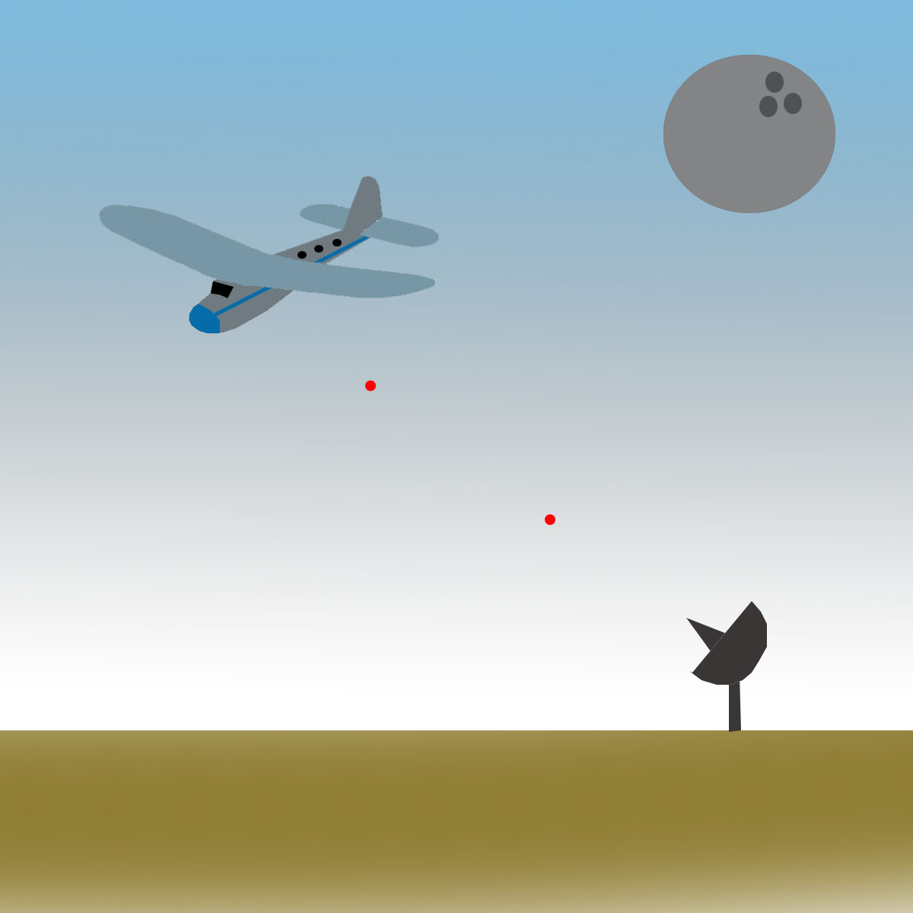
SAR vs. ISAR
SAR Multimedia - Launch Interactive

Slide 11
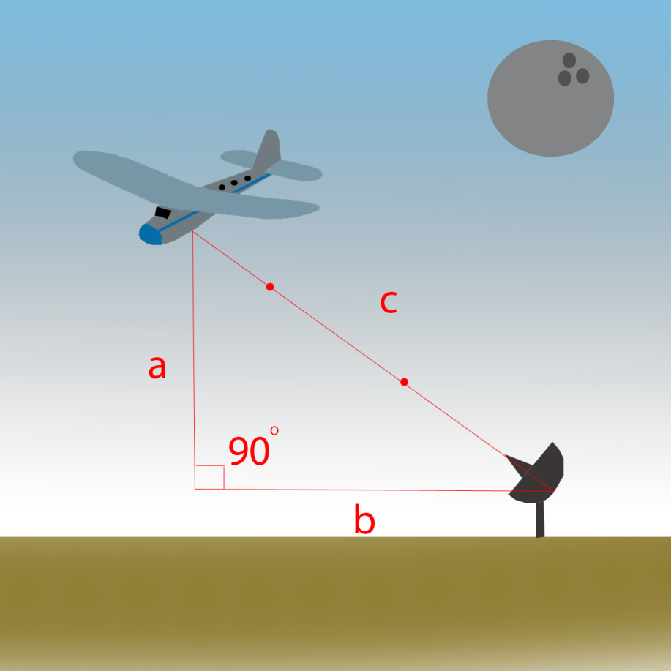
Applications in Geometry
Essentially Radar systems are distance calculating devices.
We can use Pythagorean Theorem to calculate distances.
Pythagorean Theorem:
a² + b² = c² where a, b are the short legs and c is the hypotenuse of a right triangle.

Slide 12
Rise to the Challenge
Pretend you are an engineer working with NASA aviation. Under time and funding constraints, NASA has asked you to construct, calibrate, and evaluate their latest Radar system design. The functional prototype, the radar calibration results in graphical and tabular form, and the distance evaluation results are due in 4 days!

Slide 13
References
Photo Dept. NASA Headquarters, 300 E. St. SW, Washington, DC 20546http://saturn.jpl.nasa.gov/photos/imagedetails/index.cfm?imageId=4399
"Radio Waves & Electromagnetic Fields." Teachers' Domain. 19 Apr. 2007. Web. 29 Jun. 2012. <http://www.teachersdomain.org/resource/hew06.sci.phys.energy.radiowaves/>.
"The Electromagnetic Spectrum" NASA Mission: Science. 20 June. 2012. Web. Web. 29 Jun. 2012. <https://mynasadata.larc.nasa.gov/ElectroMag.html/>
"Video Tour of Electromagnetic Specturm." NASA Mission: Science. 20 June. 2012. Web. Web. 29 Jun. 2012. http://missionscience.nasa.gov/ems/emsVideo_01intro.html/
"Imaging with Radar." Teachers' Domain. 29 Jan. 2004. Web. 29 Jun. 2012. <http://www.teachersdomain.org/resource/phy03.sci.phys.energy.radar/>.

