Slide 1
Name That Metal!
Notes:
Presentation for Name That Metal! Activity> TeachEngineering.org

Slide 2
Metals
copper
aluminum
zinc
iron
brass

Slide 3
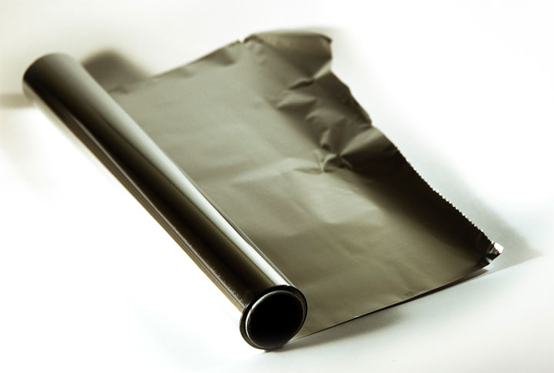
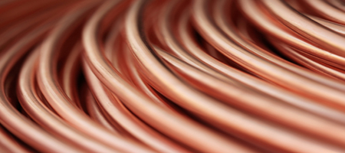
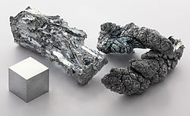
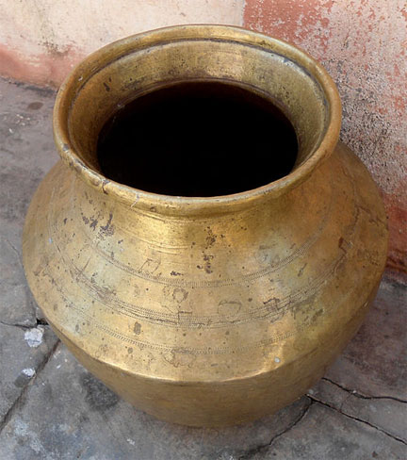
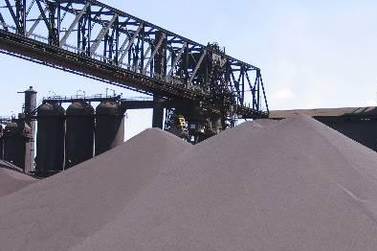
Notes:
Top left: coiled copper pipe; top right: aluminum foil; middle: zinc; bottom left: iron ore pellets; bottom right: brass pot

Slide 4
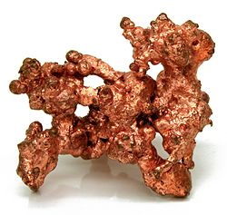
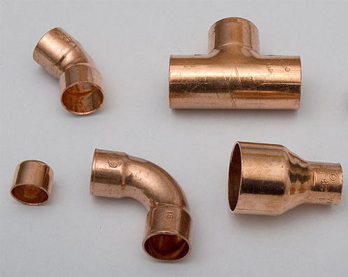
History of Copper
Copper
Earliest known discovery: in 9000 BC in the Middle East
Italians used copper lumps as money in the 6th-3rd centuries BC
Copper wire was used as an insulator in the early 1800s
Historical uses: money, coins, wire, copper tubing in ancient Egypt, thin copper sheets for canvas paintings, coins

Slide 5
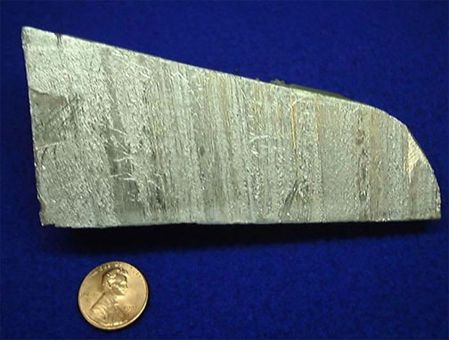
History of Aluminum
Aluminum
Obtained name from Latin for alum, alumen
Earliest traces found around 5300 BC, however not “discovered” until 1800s by Sir Humphrey Davy
Historical uses: fabric dyes, cosmetics
Notes:
Copper penny is shown only for scale.
Show a photo of brown fused aluminum oxides at http://sandblastingabrasives.com/brown-aluminum-oxide-sandblasting-abrasive-coarser-grades-12-through-240-50-lbs-or-more-772.html

Slide 6
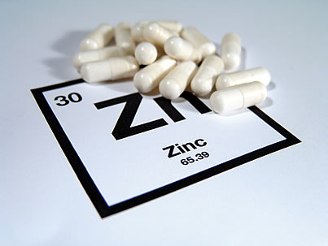
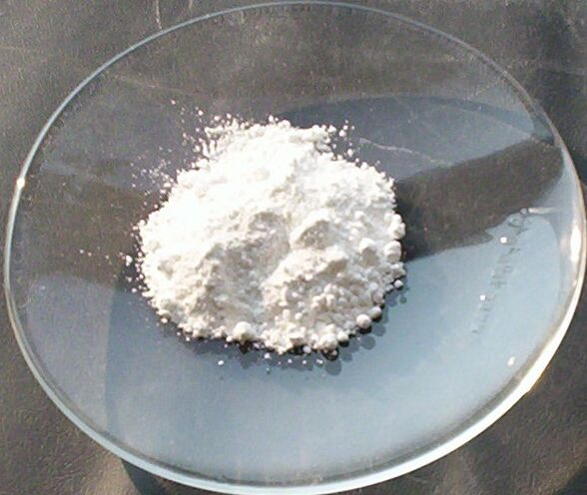
History of Zinc
Zinc
Earliest traces in 20 BC–14 AD by the Romans
Recognized as a separate metal in 16th century
US production began in 1850
Historical uses: healing wounds, sore eyes

Slide 7
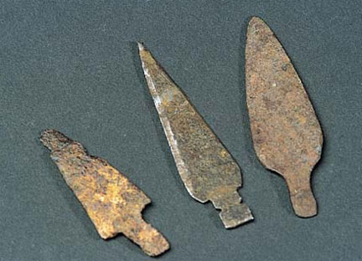
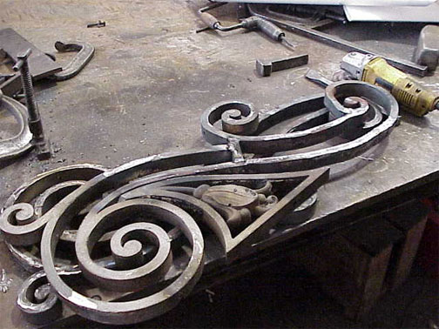
History of Iron
Iron
Known and used since pre-historic times—more than 7,000 years ago
Hittites in West Asia were among the first to use it
After the Dark Ages, Mediterranean people used it
Historical uses: kitchen utensils, jewelry, weapons (knives, arrowheads, spears)
From 1000 BC to present day, iron is the most-used metal

Slide 8
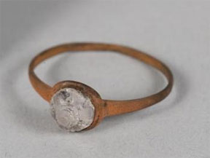
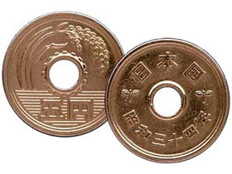
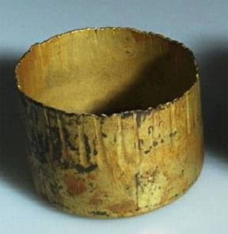
History of Brass
Brass
Copper-zinc alloys produced in the early fifth millenium BC in China
Widely used in east and central Asia by second and third century BC
Romans discovered how to produce brass
Historical uses: coins, jewelry, golden helmets, vessels and bowls

Slide 9
Basic Properties
Metal | Density | Melting Point | Ferromagnetic?
copper (Cu) | 8.96 g·cm⁻³ | 1084.62 °C 1984.32 °F | No
aluminum (Al) | 2.70 g·cm⁻³ | 660.32 °C 1220.58 °F | No
zinc (Zn) | 7.14 g·cm⁻³ | 419.53 °C 787.15 °F | No
iron (Fe) | 7.874 g·cm⁻³ | 1538 °C 2800 °F | Yes
brass | 8.73 g·cm⁻³ | 940 °C 1724 °F | No

Slide 10
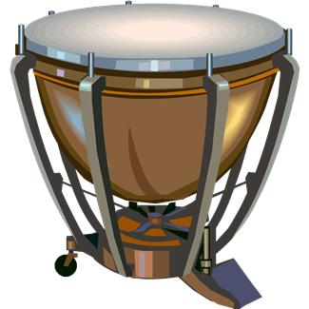
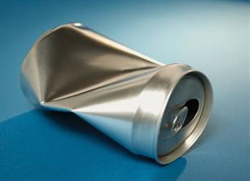
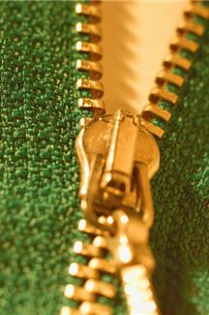
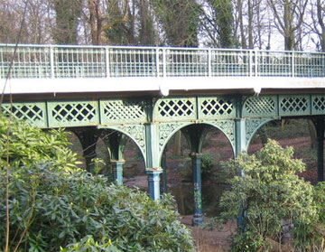
Uses
Metal | Uses
copper (Cu) | Electrical wiring, pipes, building construction, radiators, brakes, gutters, roofs, electric motors
aluminum (Al) | Packaging (cans, foils, bottle tops), airplanes, cars (wheels, impellers, hoods, mirrors), construction (casting, pipes, skylights, rods, ladders)
zinc (Zn) | Batteries, paint, rubber, toothpaste, automotive parts, electrical and hardware industries, window and door frames
iron (Fe) | Machinery, buildings, railings, tools (tie-rods, bolts, straps), bridges, kitchen appliances, automobile parts, ship frames
brass | Zippers, locks, bearings, gears, mirrors, musical instruments, fixtures, art, plumbing, cable connectors and fittings
Notes:
Example use photos: copper timpani/drum, aluminum beverage can, copper battery, brass zipper, iron bridge

Slide 11
References
Copper: http://en.wikipedia.org/wiki/Copper#Applications
Facts about copper: http://geology.com/usgs/uses-of-copper/
Aluminum: http://sam.davyson.com/as/physics/aluminium/siteus/uses.html
Uses of aluminum: http://www.buzzle.com/articles/aluminum-uses-of-aluminum.html
Aluminum: http://www.aluminum.org/AM/CM/ContentDisplay.cfm?ContentFileID=61474&FusePreview=Yes
Uses of zinc: http://wanttoknowit.com/uses-of-zinc/
Zinc: http://en.wikipedia.org/wiki/Zinc#Applications
Zinc fact sheet for health professionals: http://ods.od.nih.gov/factsheets/Zinc-HealthProfessional/
Uses of iron: http://www.buzzle.com/articles/iron-uses-of-iron.html
The iron bridge: http://en.wikipedia.org/wiki/The_Iron_Bridge
Brass: http://science.yourdictionary.com/articles/what-is-brass-made-from.html
Brass tubes: http://www.mehta-group.com/brass-tube-for-general-engineering.html
Facts to know about brass: http://www.ehow.com/list_6620433_metal-brass.html
A brief history of copper: http://www.csa.com/discoveryguides/copper/overview.php
History of zinc: http://www.zinc.org/basics/history_of_zinc
History of iron: http://nautilus.fis.uc.pt/st2.5/scenes-e/elem/e02610.html
Iron: http://www.historyforkids.org/learn/science/mining/iron.htm
Copper: http://www.copper.org/publications/newsletters/innovations/2000/01-brasses/history_brass.html
The history of brass: http://metals.about.com/od/properties/a/The-History-Of-Brass.htm

Slide 12
Image Sources
SLIDE 1:
Question face: Microsoft clipart at http://office.microsoft.com/en-us/images/results.aspx?qu=question&ex=1#ai:MC900434411|
SLIDE 3:
Top left (coiled copper pipe) Missouri State Highway Patrol http://www.mshp.dps.mo.gov/MSHPWeb/PatrolDivisions/DDCC/Units/RuralCrimes/ruralCrimes.html
Top right (aluminum foil) City of Durham, NC http://durhamnc.gov/ich/op/swmd/Pages/RecyclingIsGreat.aspx
Middle (zinc) 2010 Alchemis-hp, Wikimedia Commons http://commons.wikimedia.org/wiki/File:Zinc_fragment_sublimed_and_1cm3_cube.jpg
Lower left (iron ore pellets, pile) 2007 Lars Lentz http://commons.wikimedia.org/wiki/File:LightningVolt_Iron_Ore_Pellets.jpg
Lower right (brass pot) 2012 Adityamadhav83, Wikimedia Commons http://commons.wikimedia.org/wiki/File:Brass_vessel_at_Madhurawada.JPG?fastcci_from=542574
SLIDE 4:
(native copper chunk) 2009 Jonathan Zander, Wikimedia Commons http://commons.wikimedia.org/wiki/File:NatCopper.jpg
Top left (copper pipe fittings) 2007 Torsten Bätge, Wikimedia Commons http://commons.wikimedia.org/wiki/File:Kupferfittings_4062.jpg
SLIDE 5:
Aluminum (rock) U.S. Geological Survey http://commons.wikimedia.org/wiki/File:Aluminum_Metal.jpg

Slide 13
Image Sources
SLIDE 6:
(zinc capsules) National Institutes of Health http://ods.od.nih.gov/images/content/Zinc-Pills.jpg
(zinc oxide powder on plate) 2005 Walkerma, Wikimedia Commons http://commons.wikimedia.org/wiki/File:Zinc_oxide.jpg
SLIDE 7:
(3 iron arrowheads) New Mexico Bureau of Land Management http://www.nm.blm.gov/features/dinetah/disk_images/new_spain/weapons.html
(wrought iron railing) Seattle Parks Dept. http://www.seattle.gov/PARKS/pergola/default.htm
SLIDE 8:
(brass ring) National Park Service http://www.nps.gov/media/photo/gallery.htm?tagID=12790
(brass 5-yen coins) U.S. Mint http://www.usmint.gov/kids/cartoons/coinsoftheworld/html/japan/?s=4
(brass bowl) 2009 Peter Lewis, Wikimedia Commons http://commons.wikimedia.org/wiki/File:BrassSCC1.jpg
SLIDE 10: top to bottom
Copper timpani/drum: Microsoft clipart at http://office.microsoft.com/en-us/images/results.aspx?qu=copper&ex=1#ai:MC900390656|
Aluminum can: Microsoft clipart at http://office.microsoft.com/en-us/images/results.aspx?qu=aluminum&ex=1#ai:MP900341725|mt:2|
Brass zipper & pull: Microsoft clipart at http://office.microsoft.com/en-us/images/results.aspx?qu=zipper&ex=1#ai:MP900309622|
Battery: Microsoft clipart at http://office.microsoft.com/en-us/images/results.aspx?qu=batteries&ex=1#ai:MC900434731|mt:1,2|
Iron bridge: 2007 Nigel Cox, Wikimedia Commons http://commons.wikimedia.org/wiki/File:Liverpool,_The_Iron_Bridge,_Sefton_Park,_L17_-_geograph.org.uk_-_342444.jpg

