Slide 1
Bone Repair & Calcification
> WHAT BIOMEDICAL ENGINEERS NEED TO KNOW <
Notes:
Forces are exerted on the body at all times, but why do some bones break?
What forces cause them to lose their structure?
After a bone break occurs, the body must attempt to repair the bone. How does the body create new bone matrix to be used in repair?
When the injury is beyond the body’s ability to heal, what are some surgical methods of restoring the bone to its original structure and function?
This is part of what biomedical engineers do: creating devices that can be used to repair fractures too severe for the body to heal on its own.
Forced to Fracture Presentation > TeachEngineering.org

Slide 2
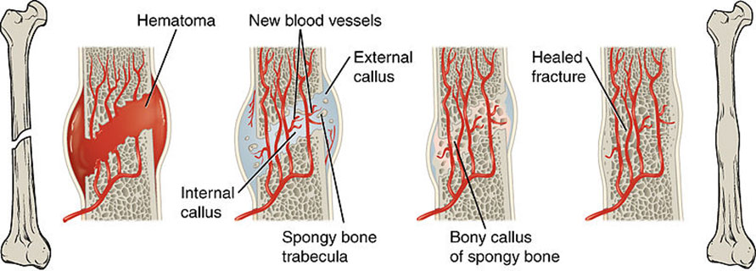
Phases of Fracture Healing
Notes:
A fracture not only breaks the bone, but also severs nerves and blood vessels, which causes blood to accumulate around the injury site, creating a hematoma (blood clot).
The blood in the hematoma is gradually replaced by fibrocartilage tissue (called a callus) that holds the ends of the broken bone together and helps hold them in place while internal pathways of new blood vessels reform.
The soft fibrocartilage tissues are gradually replaced by new bone matrix as the osteoblasts have time to secrete new minerals that harden into bone.
The excess bone of the callus is gradually dissolved in a process called remodeling until the bone more closely resembles its original form
Image source: 2013 OpenStax College, Wikimedia Commons http://commons.wikimedia.org/wiki/File:613_Stages_of_Fracture_Repair.jpg

Slide 3
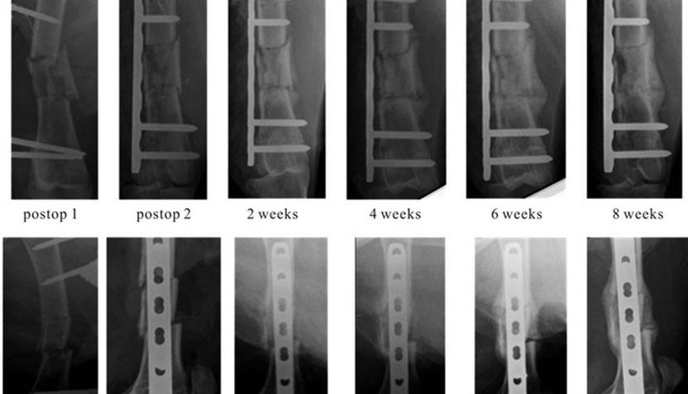
Healing Times & Calcification
Notes:
As the days post-fracture increase, the formation of the callus around the fracture site becomes visible.
Image source: M. Wullschleger, R. Steck, R. Matthys, J. Webster, M. Woodruff, D. Epari, K. Ito and M. Schuetz, "A New Model to Study Healing of a Complex Femur Fracture with Concurrent Soft Tissue Injury in Sheep," Open Journal of Orthopedics, Vol. 3 No. 2, 2013, pp. 62-68. doi: 10.4236/ojo.2013.32012

Slide 4
Bone Fracture Types
Notes:
Transverse - A fracture at a right angle to the bone’s long axis. A fracture straight across the bone, usually the result of sharp, direct blows or stress fractures caused by prolonged running.
Oblique – A fracture that is diagonal to the bone’s long axis, often with a has a curved or sloped angle.
Spiral – (aka torsion fracture) A fracture in which part of the bone has been twisted. Often caused by a twisting motion or force, such as planting your foot while the rest of your leg keeps twisting.
Comminuted – A fracture in which the bone is broken into several pieces.
Avulsion – A fracture in which part of the bone is separated from its main part.
Impacted – A fracture in which bone fragments have been driven into each other.
Fissure – An incomplete fracture in which the crack is only in the outer bone layer.
Greenstick – A fracture in which only one side of the bone is broken. The bone usually has a bend to it and the fracture is located at the outside of the bend. Considered an incomplete fracture in which the bone is bent; occurs most often in children because their bones are not yet as hard as adult bones.
Image source: ASU Ask A Biologist http://askabiologist.asu.edu/how-bone-breaks (Creative Commons)

Slide 5
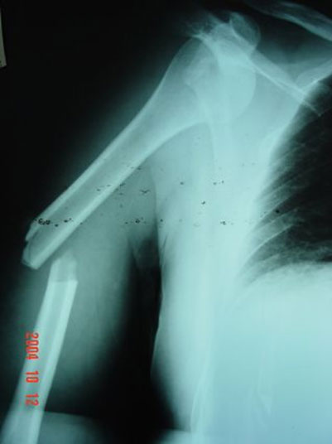
Transverse Fracture
A fracture straight across the bone, usually the result of sharp, direct blows or stress fractures caused by prolonged running.
The break occurs at a right angle to the bone’s long axis.
Notes:
X-ray image of a transverse fracture of the middle-third of the right humerus with anterior dislocation of the glenohumeral joint. It was treated with modified intramedullary nailing.
Image source: National Library of Medicine, National Institutes of Health http://openi.nlm.nih.gov/detailedresult.php?img=2803872_1757-1626-2-9075-1&req=4

Slide 6
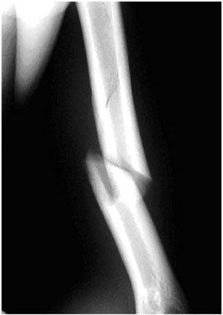
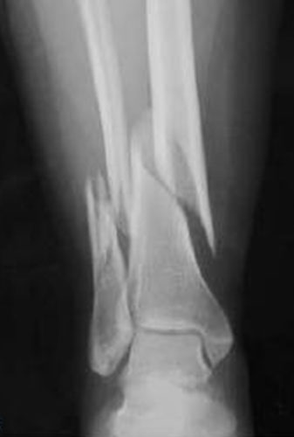
Spiral Fracture
baseball pitcher’s broken arm ➔
A bone fracture caused by a twisting force.
Also called torsion fracture.
Notes:
(left) An s-ray image of a humeral shaft spiral fracture (upper arm) in a major league baseball pitcher.
(right) A spiral fracture of the distal fibular (calf bone) and distal tibial (shinbone) metaphysis.
Image sources:
(left) National Library of Medicine, National Institutes of Health http://openi.nlm.nih.gov/detailedresult.php?img=3863509_CRIM.ORTHOPEDICS2013-546804.001&query=spiral%20fracture&fields=all&favor=none&it=x&sub=none&uniq=0&sp=none&coll=none&lic=none&vid=none&req=4&simResults=3863509_CRIM.ORTHOPEDICS2013-546804.001&npos=1&prt=2
(right) National Library of Medicine, National Institutes of Health http://openi.nlm.nih.gov/detailedresult.php?img=2780589_11751_2006_Article_5_Fig4&query=spiral%20fracture&fields=all&favor=none&it=x&sub=none&uniq=0&sp=none&coll=none&lic=none&vid=none&req=4&simResults=3863509_CRIM.ORTHOPEDICS2013-546804.001&npos=12&prt=2

Slide 7
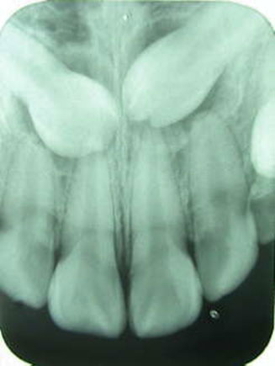
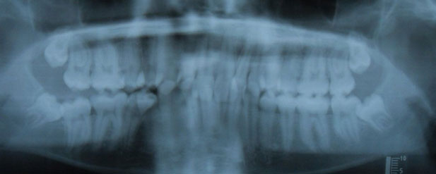
Impacted Bone
Notes:
An x-ray image of impacted teeth. The situation of an impacted tooth is analogous to an impacted fracture, which is when the broken end of a bone is pushed into the other broken end. For impacted teeth, the new teeth push up into other teeth as they are trying to grow.
The arrows point to where the new teeth are pushing into other teeth causing pain.
Image sources:
(left-vertical) 2005 Albert, Wikimedia Commons http://commons.wikimedia.org/wiki/Dentistry#mediaviewer/File:Baihokkhi_kakkhi.jpg
(right-horiz) 2009 Gaming4JC, Wikimedia Commons http://commons.wikimedia.org/wiki/File:Xray_of_four_impacted_teeth.jpg

Slide 8
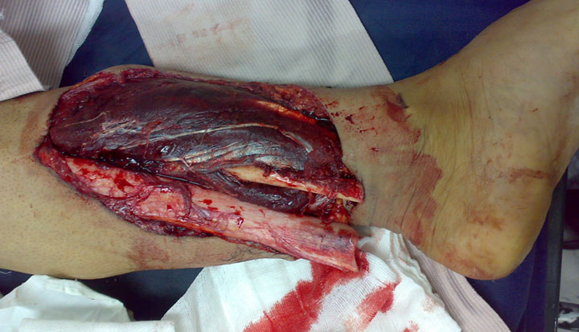
Compound/Open Fracture
Notes:
An open/compound fracture is one in which one end of the broken bone breaks the skin.
In this image, the tibia and fibula both have compound fractures.
Image source: 2008 Saltanat ebli, Wikimedia Commons http://commons.wikimedia.org/wiki/File:Open_fracture_01.JPG

Slide 9
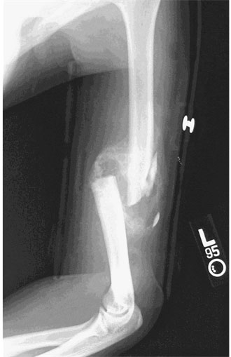
Comminuted Fracture
Notes:
An x-ray image of a comminuted fracture of humerus. Multiple pieces of bone are clearly seen.
Image source: 2004 Bill Rhodes, Wikimedia Commons http://commons.wikimedia.org/wiki/File:Communitive_midshaft_humeral_fracture_callus.jpg

Slide 10
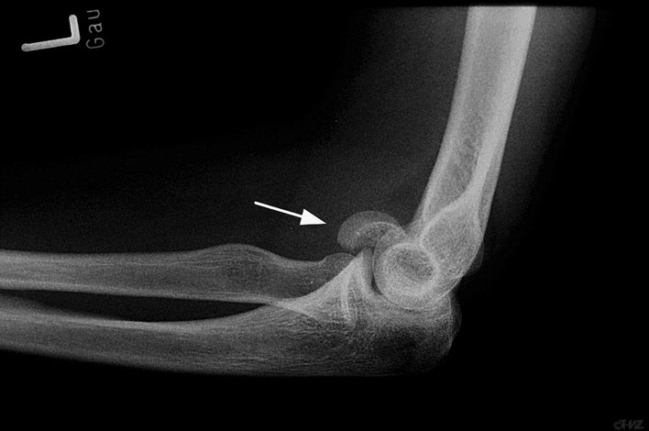
Joint Fractures
Notes:
X-ray image of an elbow fracture. The left capitulum humeri is fractured.
Fractures at joints require special treatment to maintain mobility of the joint. For example, a cast left on too long on an elbow results in calcification, which causes the bone to remain in the same position. Thus, it is essential that joints stay mobile during the healing process.
Image source: 2010 Thomas Zimmermann, Wikimedia Commons http://commons.wikimedia.org/wiki/Category:X-rays_of_elbow_fractures#mediaviewer/File:Capitulum_humeri_Fraktur_2.jpg

Slide 11
Treatment Options
Fracture treatment depends on:
Location, fracture type and its characteristics
The person’s age
The person’s activity level
Bone quality
Notes:
Location and type of fracture: Is the fracture at a joint? Is the bone in multiple pieces or fragments? Is it dislocated or an open fracture?
Patient age: Elderly patients take longer to heal. Children typically heal more quickly.
Activity level: For example, bedridden patients heal more slowly and may experience more complications.
Bone quality: Osteoporotic bones heal more slowly. Other vitamin/mineral deficiencies also have negative effects on healing. What is the bone density and condition? Deficiencies might include osteomalacia/rickets due to vitamin D deficiency, calcium deficiency and scurvy (caused by vitamin C deficiency).

Slide 12
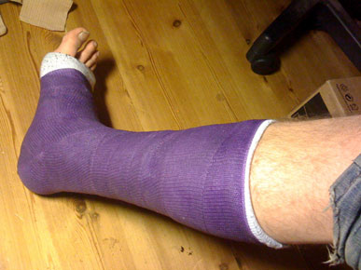
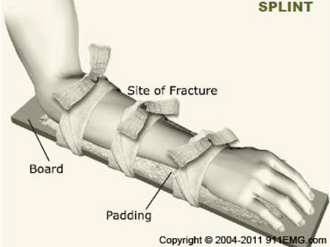
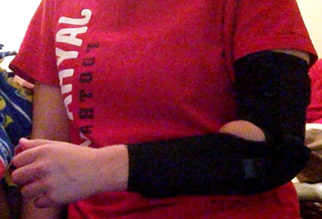
Nonsurgical Treatment Options
Notes:
Splints, casts and braces are designed to immobilize the broken ends of the bone until the body can heal the fracture on its own.
Image sources:
(left) splint: Emergency First Aid http://911emg.com/first-aid-fractures.html
(upper right-cast) 2009 Enareksi, Wikimedia Commons http://commons.wikimedia.org/wiki/File:Short_leg_cast.jpg
(lower right-brace) © Author Megan Ketchum, University of Houston
Show students this inspiring 3D-printed cast that uses ultrasound to speed bone healing (good image) at: http://www.cnet.com/news/3d-printed-cast-uses-ultrasound-to-speed-healing/

Slide 13
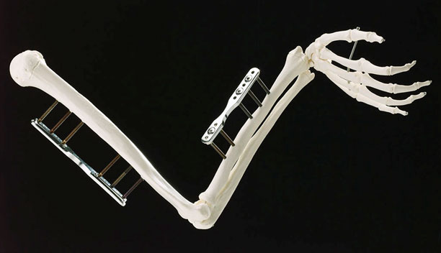
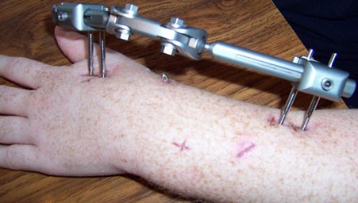
Surgical Treatment: External Fixation
Notes:
Bolts or screws are inserted into uninjured bone surrounding the fracture. Often used to repair open fractures.
Holes in the skin require diligent would care to avoid infection.
Internal fixation involves the placement of plates and/or screws on the bone itself, without the external stabilizing device.
Image sources:
(top) 1999 Professor Mitura of the Technical University of Lodz, Poland, Wikimedia Commons
http://commons.wikimedia.org/wiki/File:Skeletal_arm_showing_diamond_coated_steel_pins_stabilising_broken_bones_by_connecting_them_to_steel_splints._(9672239256).jpg
(bottom-forearm & hand) 2006 Dekkanar, Wikimedia Commons http://commons.wikimedia.org/wiki/File:External_Fixator.JPG

Slide 14
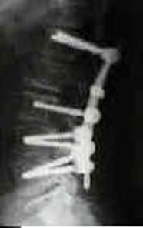
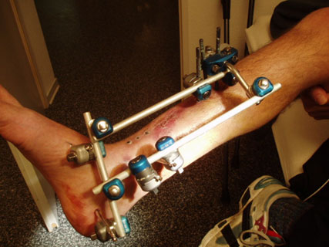
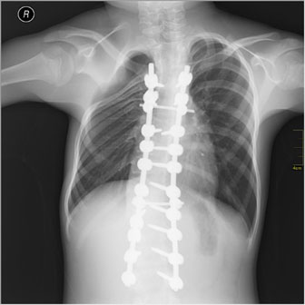
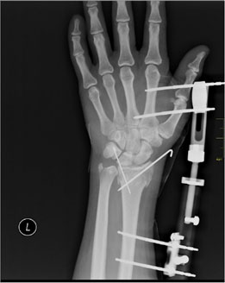
Internal vs. External Fixation
Notes:
Internal fixation – nothing protrudes through the skin
External fixation – part of the stabilizing device is outside the skin; the circular fixator can also be used to lengthen bones.
Biomedical engineers design these types of devices that are used in surgical bone repair.
Image sources:
(top-left) 2008, National Institutes of Health, Wikimedia Commons http://commons.wikimedia.org/wiki/File:LUMBAR_INSTRUMENTATION.JPG
(bottom-left) 2011 Nevit Dilmen, Wikimedia Commons http://commons.wikimedia.org/wiki/File:Medical_X-Ray_imaging_IPV05_nevit.jpg
(top-right) 2005 liegt vor Wikimedia Commons http://commons.wikimedia.org/wiki/File:Gelenkfix.jpg
(bottom-right) 2011 Nevit Dilmen, Wikimedia Commons http://commons.wikimedia.org/wiki/File:Medical_X-Ray_imaging_OEN06_nevit.jpg
Show a video on leg lengthening (external fixation) and how it works at: https://www.youtube.com/watch?v=s1tp-ZoQSoE

Slide 15
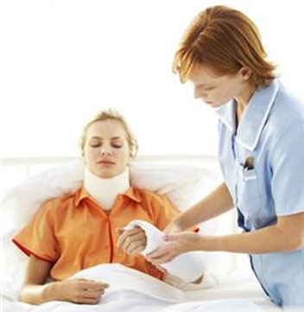
Location of Fracture
Which bones are more likely to break?
Ribs, wrists, fingers, toes, collarbones
Why are certain bones more likely to fracture?
The body is designed to withstand forces.
Legs receive impact while walking and jumping. Thus, leg bones require a significant amount of force to break.
Notes:
Image source: Microsoft clipart: http://office.microsoft.com/en-us/images/results.aspx?qu=cast&ex=1#ai:MP900426551|mt:2|

Slide 16
How Does Treatment Depend on Location?
Certain treatments cannot be used on some fractures due to the location.
For example:
Casts cannot be used on all parts of the body, such as moving joints.
Finger or toes are often treated by using a nearby finger or toe as splint.
The forces the body withstands at certain locations allows some treatments.

