Slide 1
3D Printing Explained

Slide 2
Objective
Students will be able to learn about the parts of 3D printers and how to 3D print.

Slide 3
Table of contents
01
02
03
Introductory Question
All About 3D Printers
The Printing Process
What do you know?
TMI probably.
Creating something out of your mind.
04
05
The CAD Process
Your 1st 3D Print
How do you make stuff?
Finally!

Slide 4
Introductory Question
01
What do you know?

Slide 5
Introductory Question
What do you know about 3D printing?
Discuss in your groups for two minutes and then we will discuss as a class.
01
02
03
04
05
Introductory Question
All About 3D Printers
The Printing Process
The CAD Process
Your 1st 3D Print

Slide 6
All About 3D Printers
02
TMI probably.

Slide 7
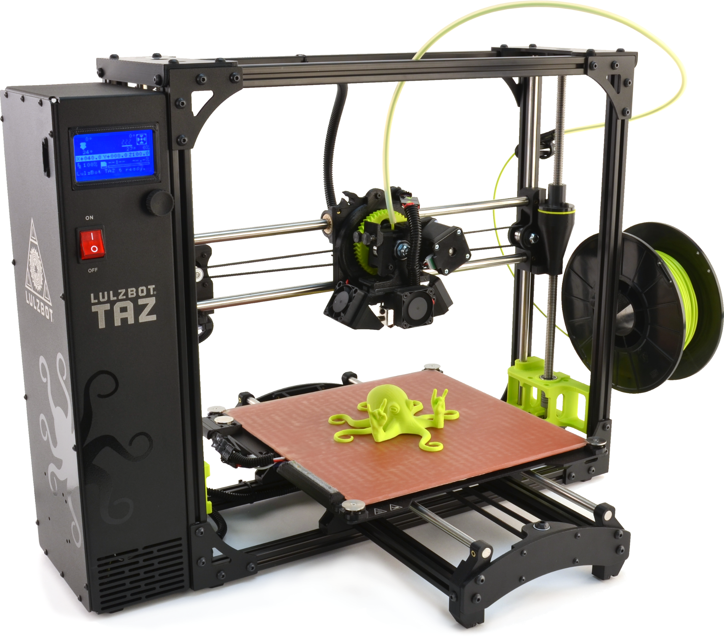
The Many 3D Printers
There are many types of 3D printers. Here’s a selection of them:
Stereolithography (SLA)
Digital Light Processing (DLP)
Fused Deposition Modeling (FDM)
Selective Laser Sintering (SLS)
Selective Laser Melting (SLM)
Electronic Beam Melting (EBM)
Laminated Object Manufacturing (LOM)
Binder Jetting (BJ)
Material Jetting (MJ)
01
02
03
04
05
Introductory Question
All About 3D Printers
The Printing Process
The CAD Process
Your 1st 3D Print

Slide 8
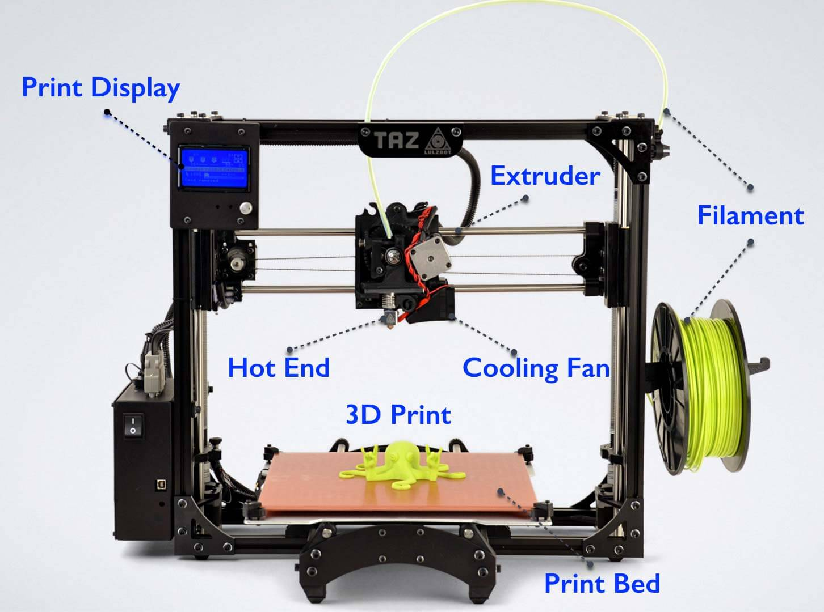
The Parts of a 3D Printer
Almost all printers have these parts. Let’s take a look at them.
01
02
03
04
05
Introductory Question
All About 3D Printers
The Printing Process
The CAD Process
Your 1st 3D Print

Slide 9
The Parts of a 3D Printer
Motherboard or Control Board: Not pictured here, but often behind the Print Display. It is the brain of the 3D printer and it tells the stepper motors how to move. In addition to this, it interprets signals from sensors (like the temperature sensors).
01
02
03
04
05
Introductory Question
All About 3D Printers
The Printing Process
The CAD Process
Your 1st 3D Print

Slide 10
The Parts of a 3D Printer
Frame: Usually made of aluminum, a sturdy frame is critical to ensure successful prints. As the stepper motors move, a frame that isn’t sturdy would cause issues with the way the filament is placed on the print bed.
Some frames are enclosed, but most are open. The reason for the enclosure is to minimize moisture, which can result in air bubbles that when evaporated cause gaps in your prints or uneven levels.
01
02
03
04
05
Introductory Question
All About 3D Printers
The Printing Process
The CAD Process
Your 1st 3D Print

Slide 11
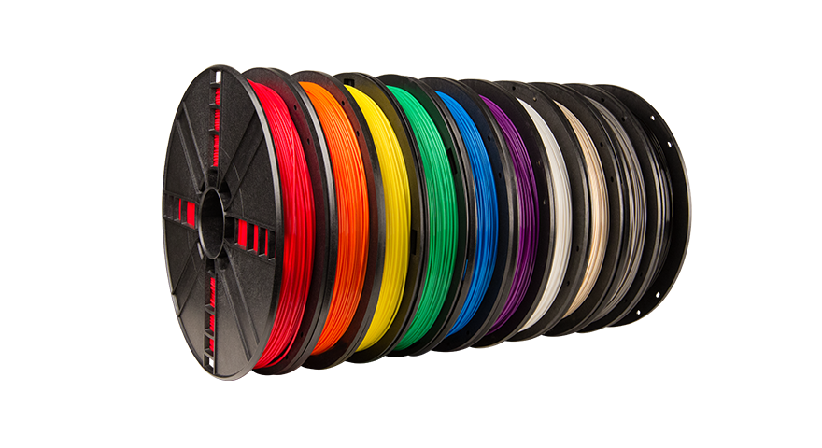
The Parts of a 3D Printer
Print Material: Depending on the type of printer, you will have a different print material. For FDM printers, such as the one pictured here, the print material is known as filament and it comes in spools. You can get many different kinds of filament spools with different colors and different types of materials (including materials that are extremely flexible or extremely strong). Almost all materials made of plastic. This includes PLA, ABS, TPE, etc.
01
02
03
04
05
Introductory Question
All About 3D Printers
The Printing Process
The CAD Process
Your 1st 3D Print

Slide 12
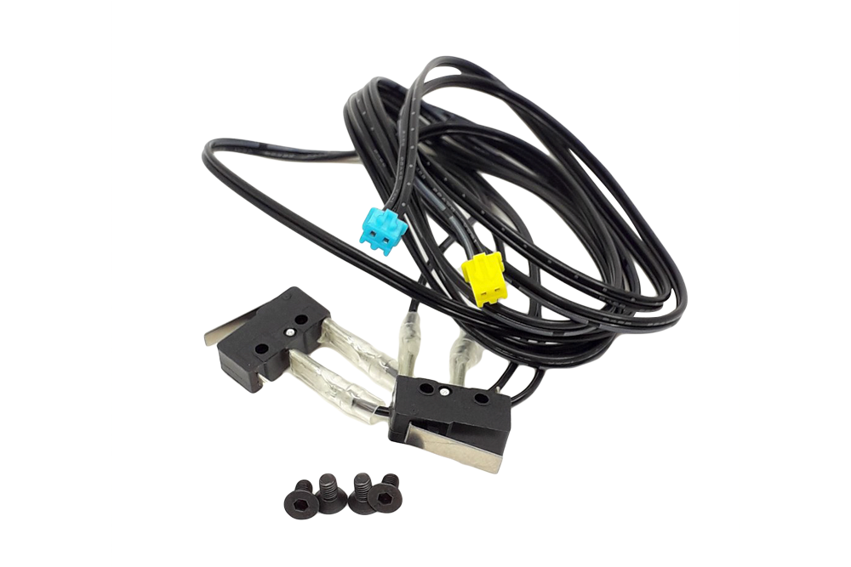
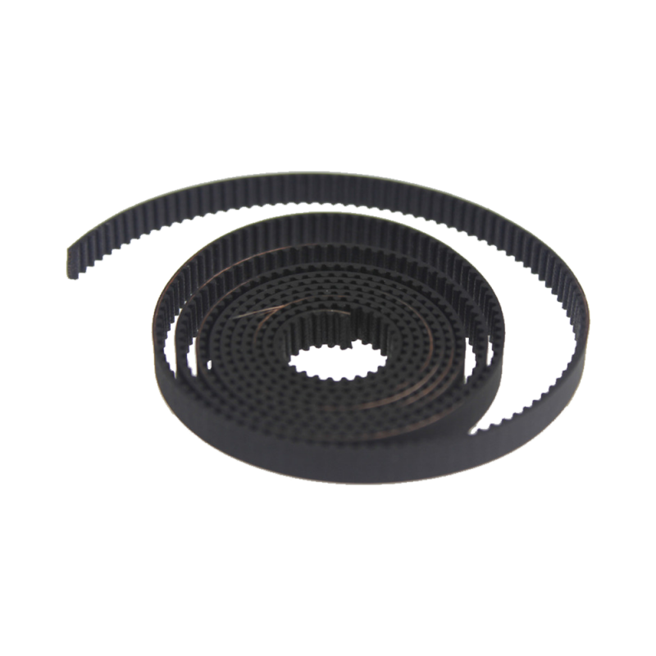
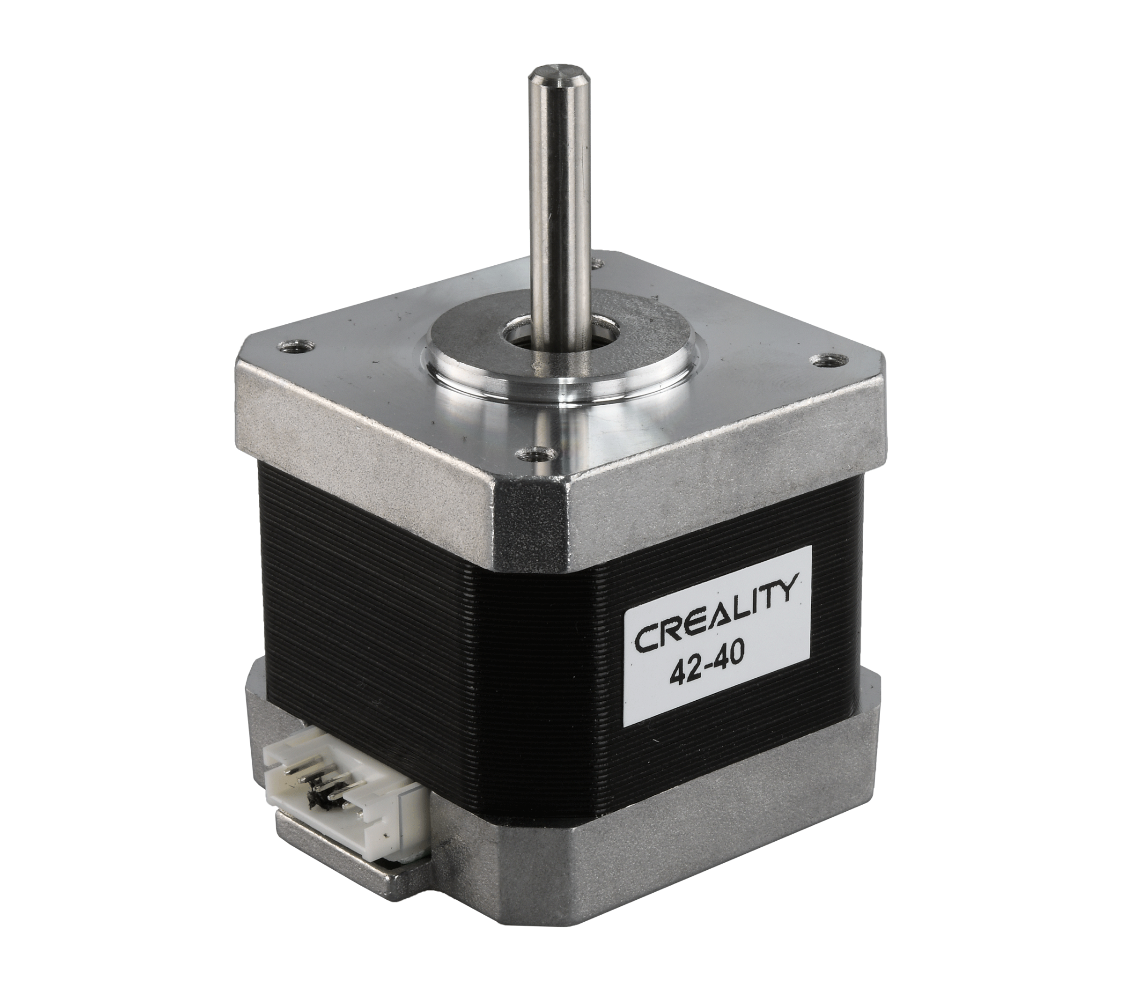
The Parts of a 3D Printer
Motion Control: 3D printers work along three axes. X, Y, and Z. So, most printers have a stepper motor for each of these axes. To help move things around these axes, there are also belts - that help move in the X and Y axes. Threaded rods help move in the Z axis. And lastly, there are end stops, which you can also see here.
01
02
03
04
05
Introductory Question
All About 3D Printers
The Printing Process
The CAD Process
Your 1st 3D Print

Slide 13
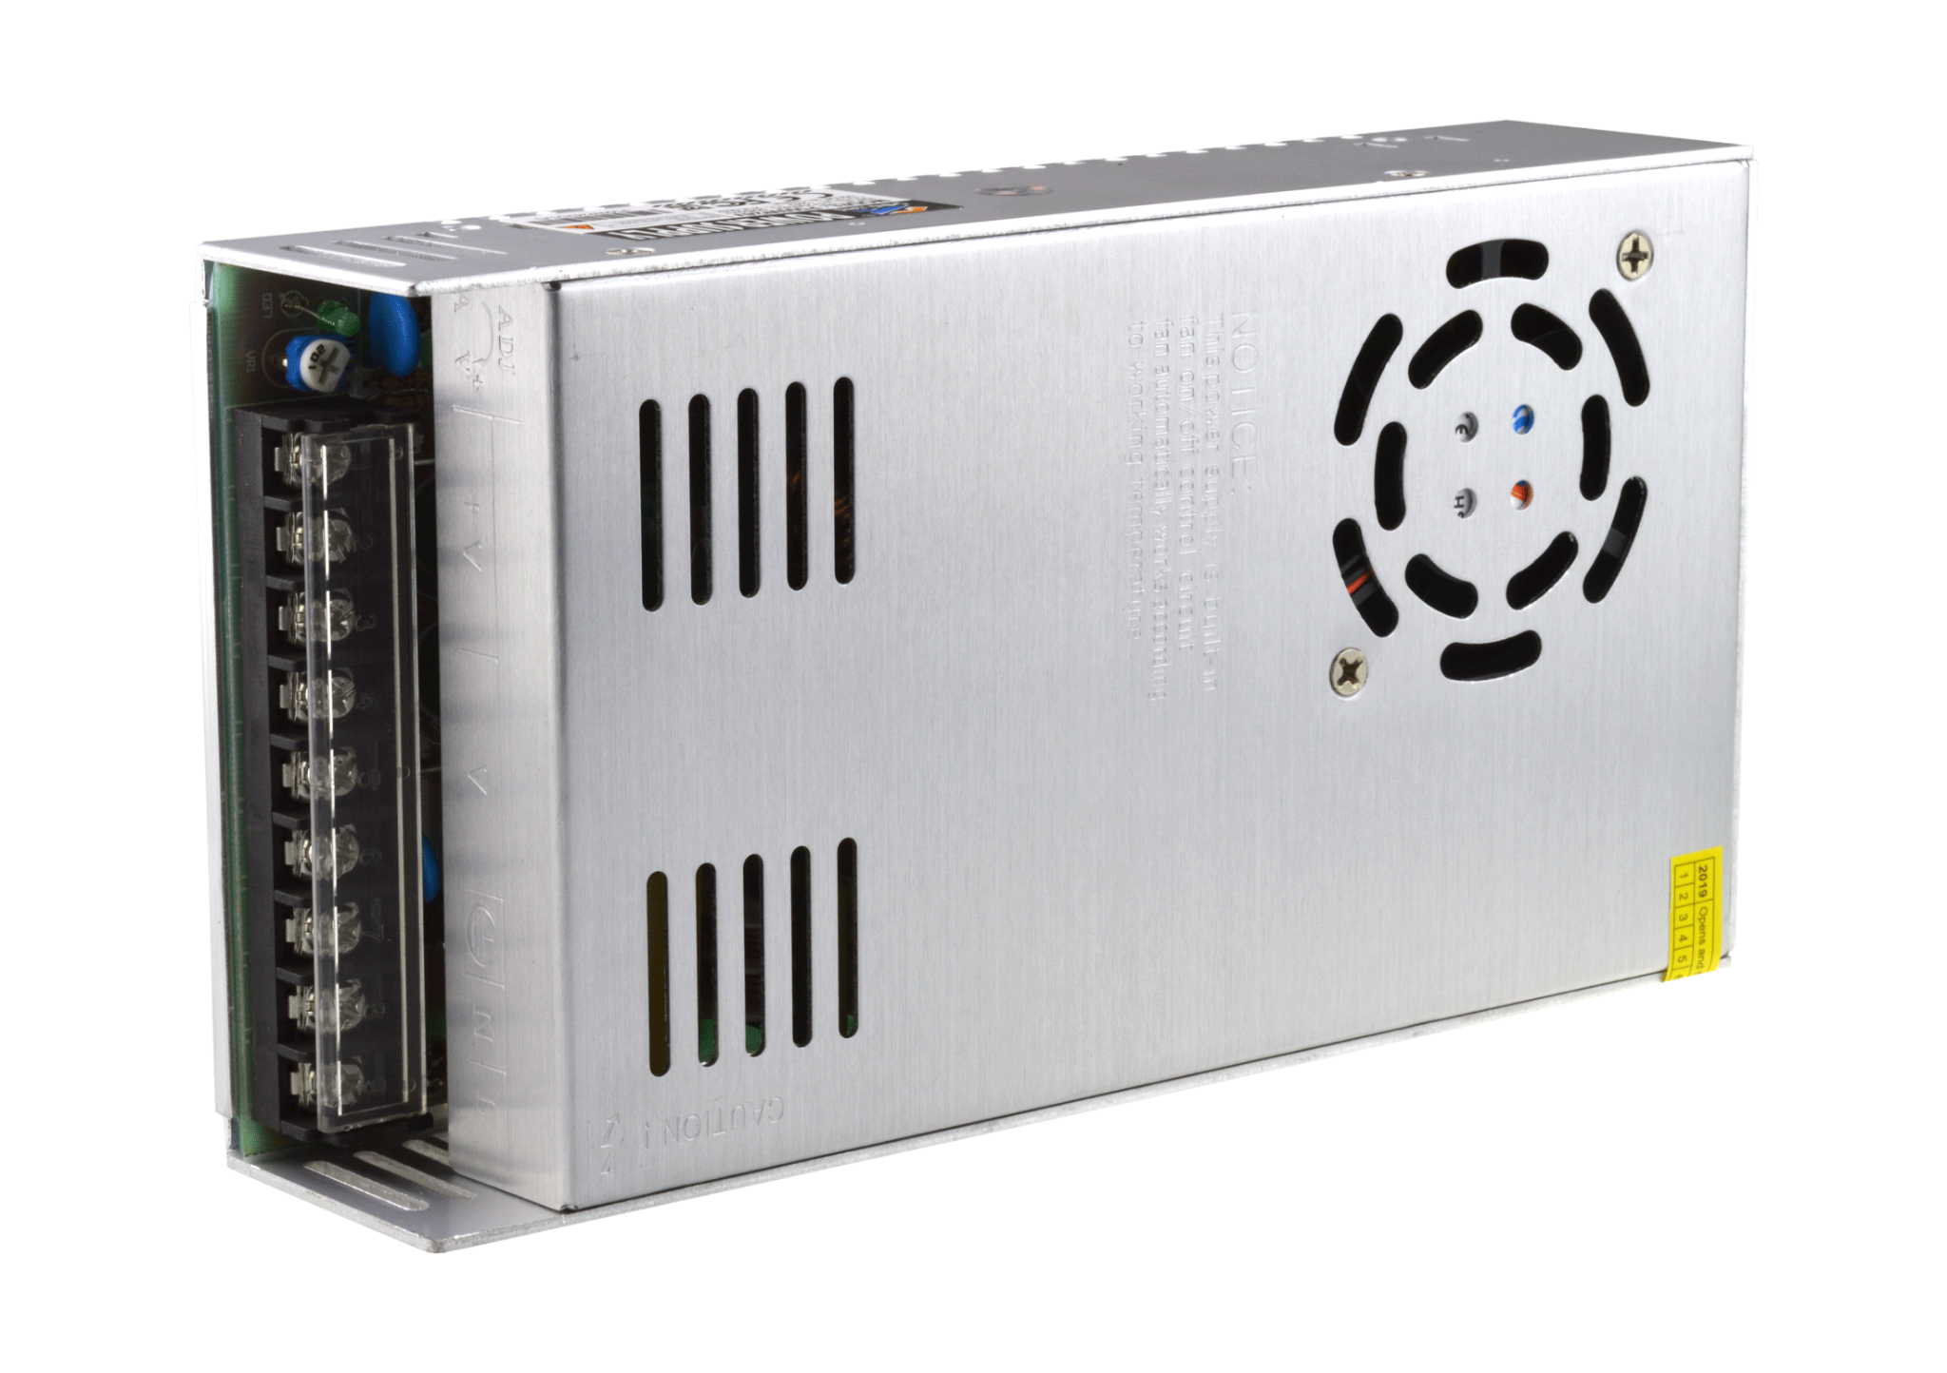
The Parts of a 3D Printer
PSU: One of the most critical parts of a 3D printer is the Power Supply Unit, also known as PSU. Your PSU will also be responsible for giving you what temperature range your printer can work with, which means what materials you can work with since different materials have different temperature requirements.
Most PSUs are mounted directly to the frame, but there are some that are not.
01
02
03
04
05
Introductory Question
All About 3D Printers
The Printing Process
The CAD Process
Your 1st 3D Print

Slide 14
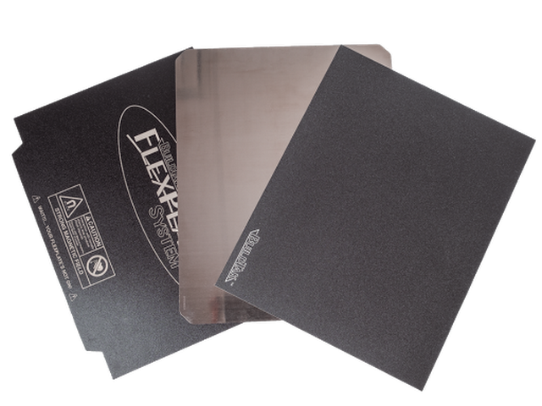
The Parts of a 3D Printer
Print Bed: This is where the filament is placed. Most beds are semi-magnetic to allow for easy detachment from the printer; there are also beds that can be heated and those that are not heated. Here are some example beds:
Glass
PEI
FlexPlate
01
02
03
04
05
Introductory Question
All About 3D Printers
The Printing Process
The CAD Process
Your 1st 3D Print

Slide 15
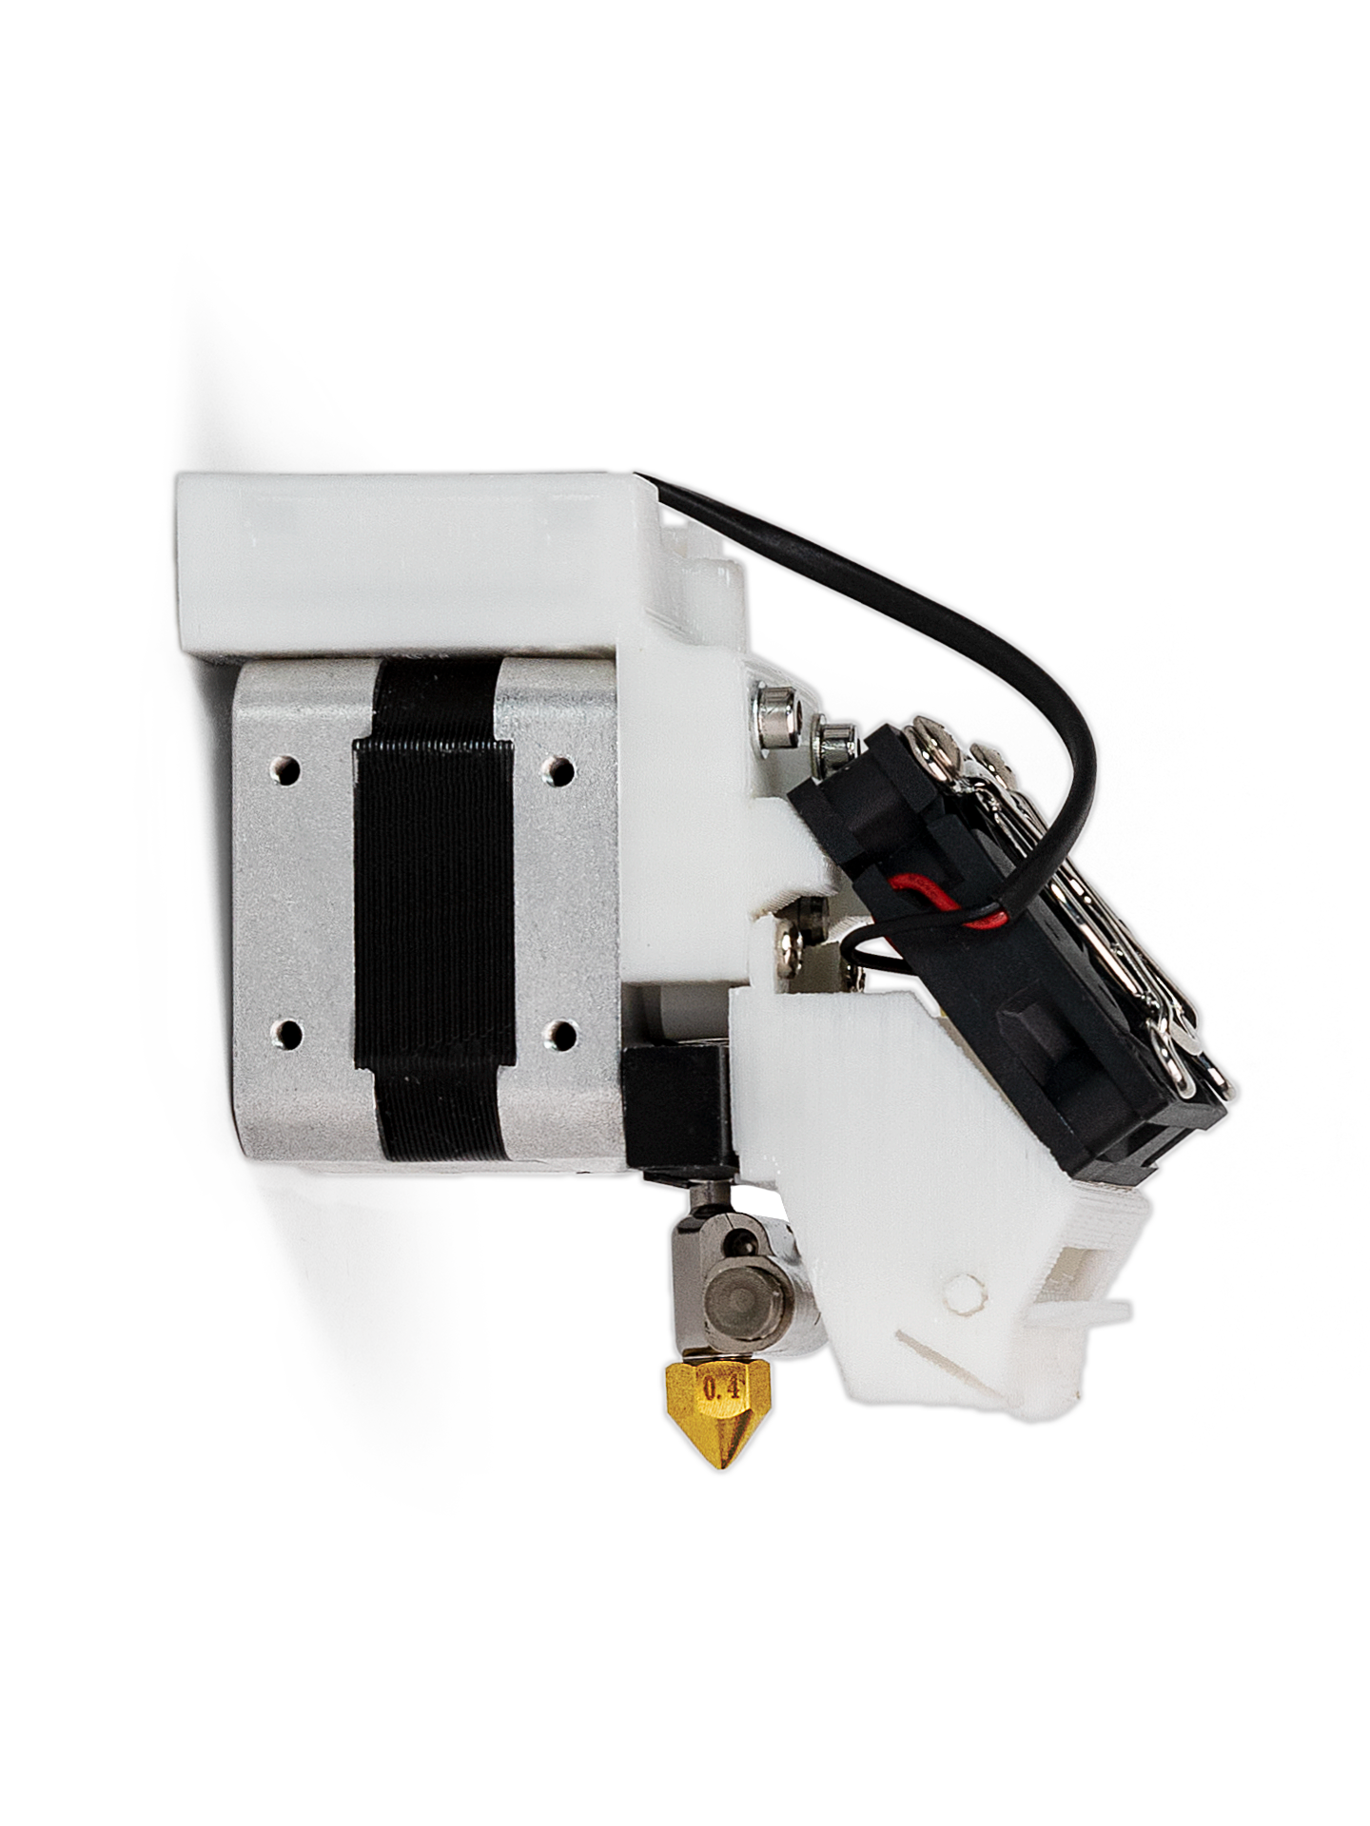
The Parts of a 3D Printer
Extruder: The extruder is made up of a couple of parts, including:
Filament Drive Gear: This pushes the filament into the extruder.
Heat Sink: This ensures that the filament is solid until it reaches the nozzle.
Heater Cartridge: This heats up the filament.
Thermocouple: This is a temperature sensor to maintain right
temperature.
Cooling Fan: This cools down filament once its been set down to set
down the next layer.
Nozzle: The tip of the extruder, from which filament comes out.
01
02
03
04
05
Introductory Question
All About 3D Printers
The Printing Process
The CAD Process
Your 1st 3D Print

Slide 16
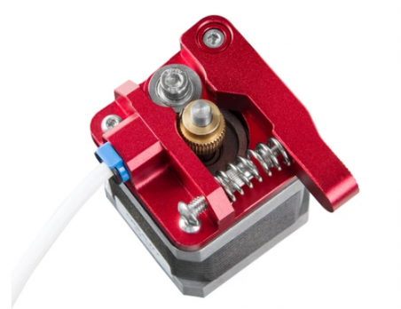
The Parts of a 3D Printer
Feeder System: There are two main types of feeder system, both of which serve to pull the filament from the filament spool and into the hot end.
Bowen Feeder System: For this set up, there are different locations for the cold and hot ends. The Bowen filament tube directs the filament to the hot end.
Direct Feeder System: The cold end and hot end are directly connected. This is primarily used when working with flexible filaments.
01
02
03
04
05
Introductory Question
All About 3D Printers
The Printing Process
The CAD Process
Your 1st 3D Print

Slide 17
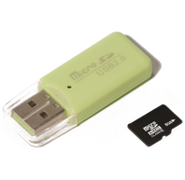
The Parts of a 3D Printer
Connectivity: Most printers come with a USB connection of some sort to directly connect to your computer and start a print. However, it is more common to use the included micro SD card to load the gcode for the printer, which will be explained a bit.
01
02
03
04
05
Introductory Question
All About 3D Printers
The Printing Process
The CAD Process
Your 1st 3D Print

Slide 18
The Parts of a 3D Printer
User Interface: This is the print display shown in the default image here. It’s how you communicate with the printer. You can use it to heat up the extruder or bed as well as select what gcode to use, which will determine what it will print.
01
02
03
04
05
Introductory Question
All About 3D Printers
The Printing Process
The CAD Process
Your 1st 3D Print

Slide 19
The Printing Process
03
Creating something out of your mind.

Slide 20
The Steps
There are three steps to 3D print.
Create a CAD model using CAD software
Export the CAD model as an STL mesh file
Use the STL file in slicer software to create gcode for the specific printer
Let’s go over each step briefly.
01
02
03
04
05
Introductory Question
All About 3D Printers
The Printing Process
The CAD Process
Your 1st 3D Print

Slide 21
The CAD Model
We are going to go into more detail on how to create in the next section, but you first need to identify a CAD software. For our class, we will be using OnShape.
After identifying your software, you can use the software to model what you need to create. There are different CAD programs depending on the type of thing you need to create. Figurines and the like use something closer to Blender. There’s even some software to create DnD models.
01
02
03
04
05
Introductory Question
All About 3D Printers
The Printing Process
The CAD Process
Your 1st 3D Print

Slide 22
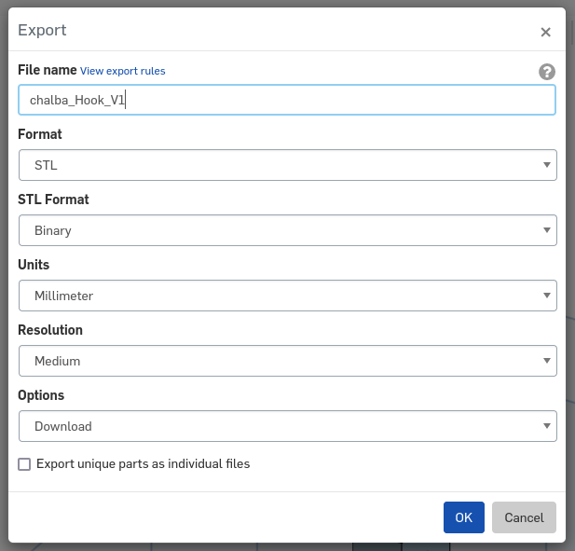
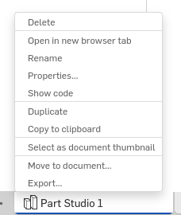
The STL File
Once you have your CAD model, you can have it exported as an STL mesh file. Notice the naming system.
01
02
03
04
05
Introductory Question
All About 3D Printers
The Printing Process
The CAD Process
Your 1st 3D Print

Slide 23
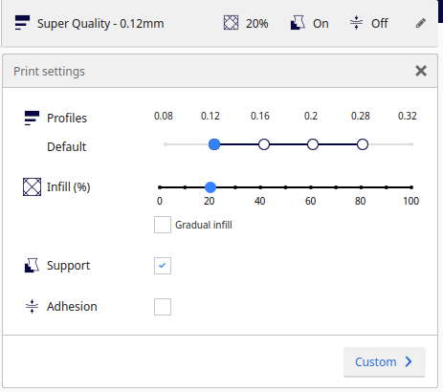
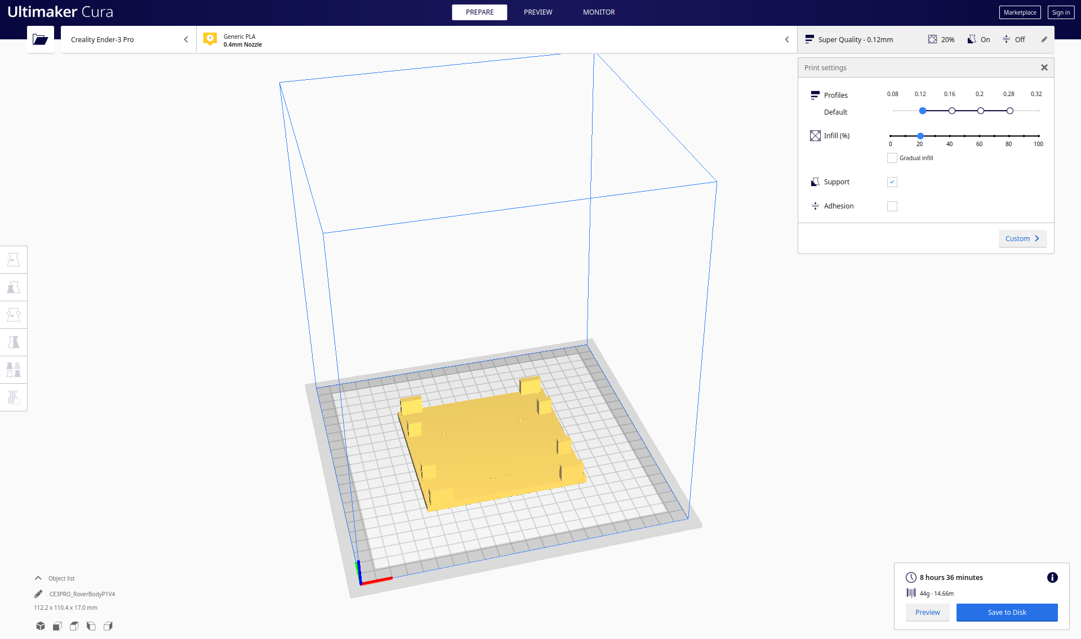
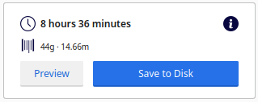
Slicer Software
The next part is something that I will do. All you have to do is to export the file and send it to me, but if you are interested, I use Cura as my slicing software. Here’s what it looks like.
01
02
03
04
05
Introductory Question
All About 3D Printers
The Printing Process
The CAD Process
Your 1st 3D Print

Slide 24
The CAD Process
04
How do you make stuff?

Slide 25
Creating the Model
The most difficult now is creating the CAD model. There are a few steps.
The Problem: What are you trying to solve? Every print needs a purpose, a problem that it solves.
Measurements: Start by figuring out what you need to attach it to and measure the dimensions of it.
Sketching: Try drawing a sketch, given the dimensions.
Modeling: Use the sketch with dimensions on the CAD software (we will work on this together).
Over the next couple of days, your goal is to use these four steps to create your own model for something, given a problem. Let me show you an example.
01
02
03
04
05
Introductory Question
All About 3D Printers
The Printing Process
The CAD Process
Your 1st 3D Print

Slide 26
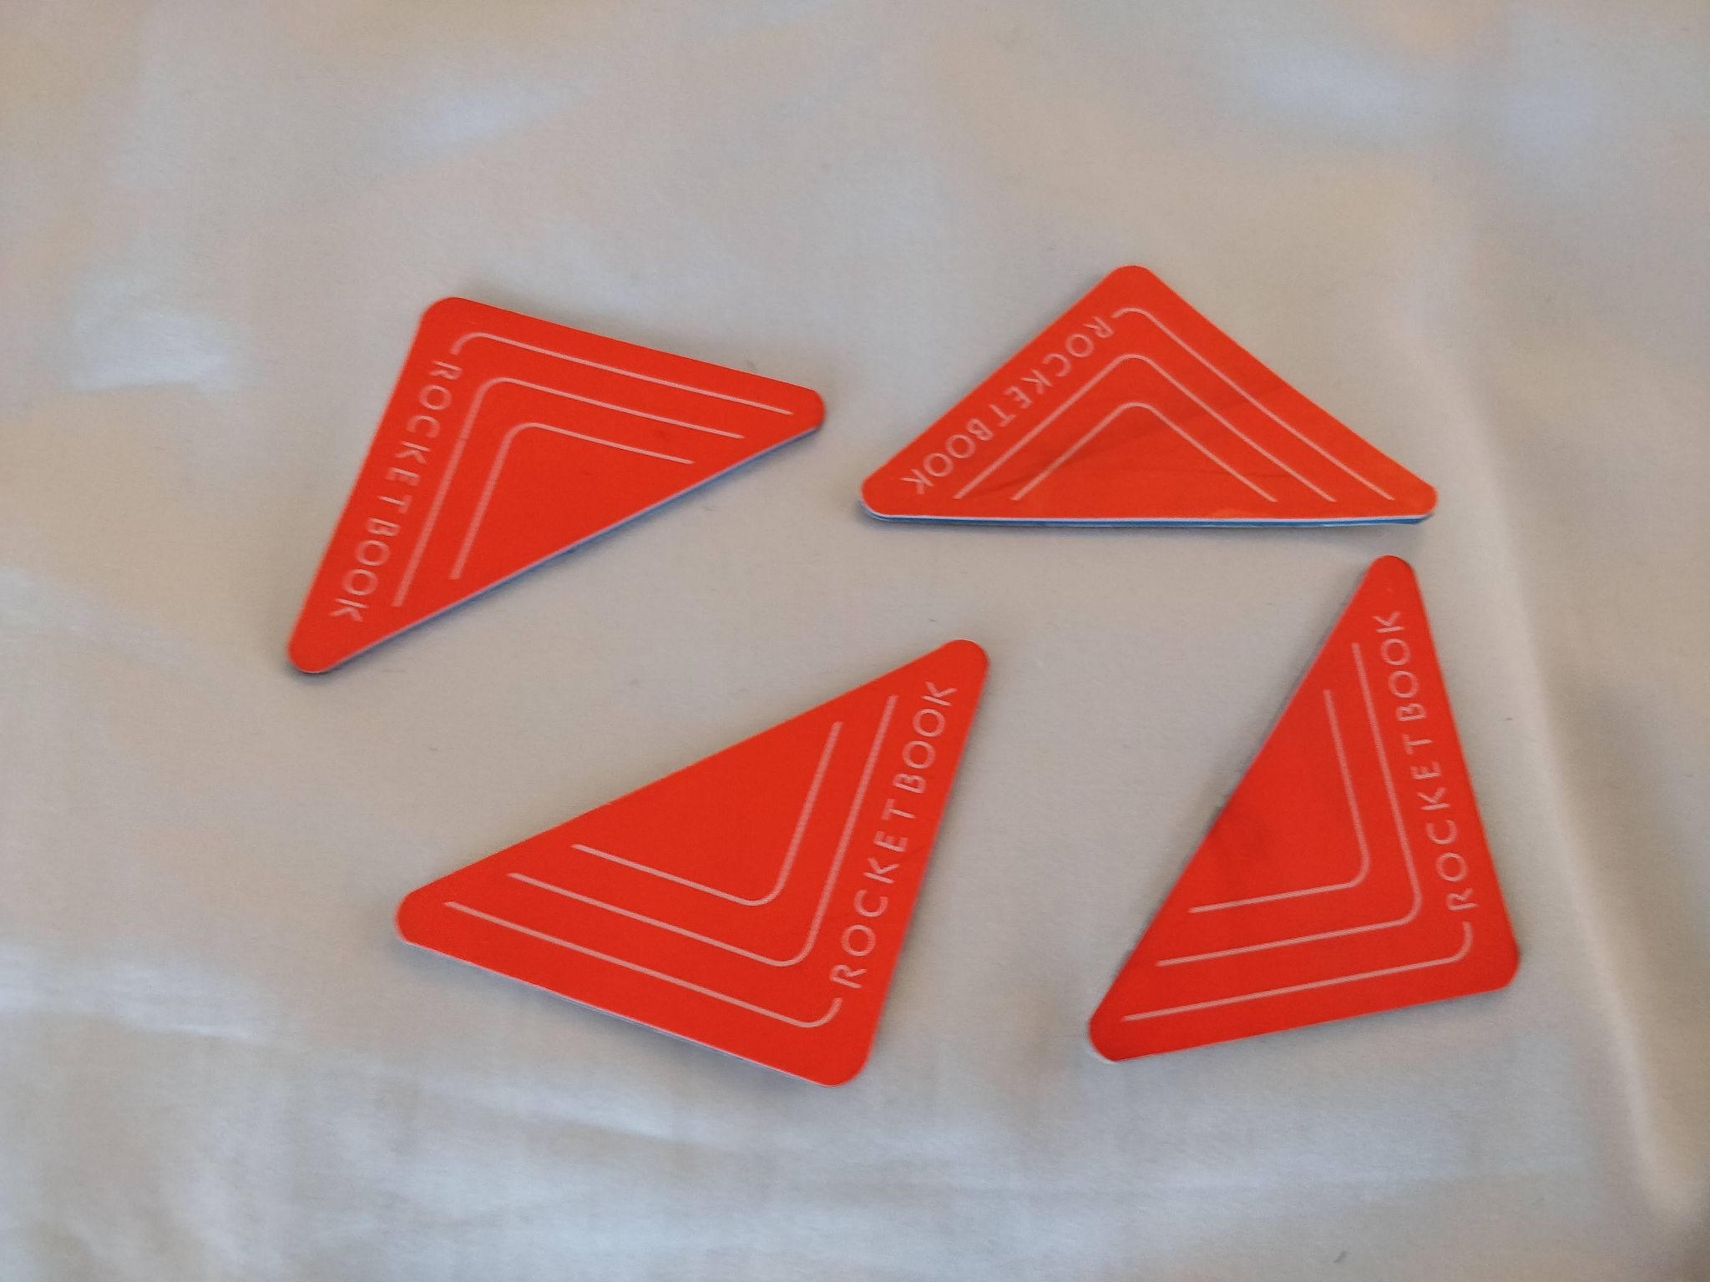
The Problem
I have some really cool stickers that allow me to create a searchable PDF of any whiteboard stuff I write. However, I don’t really have a place to store them and they can stick each other pretty easily. So I decided to print a box. For this print, I’ll also experiment by adding magnets with gorilla glue.
01
02
03
04
05
Introductory Question
All About 3D Printers
The Printing Process
The CAD Process
Your 1st 3D Print

Slide 27
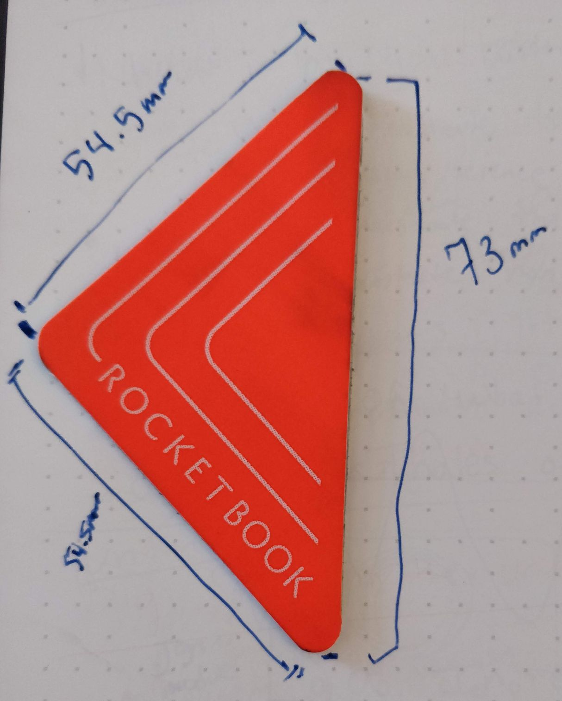
The Measurements
I first measured the size of one of them because I need to make a box for them.
I figured I could insert them sideways, so the box might need to be 60x60mm (the extra is because I need to account for wall thickness and you usually want at least a few mm in thickness).
01
02
03
04
05
Introductory Question
All About 3D Printers
The Printing Process
The CAD Process
Your 1st 3D Print

Slide 28
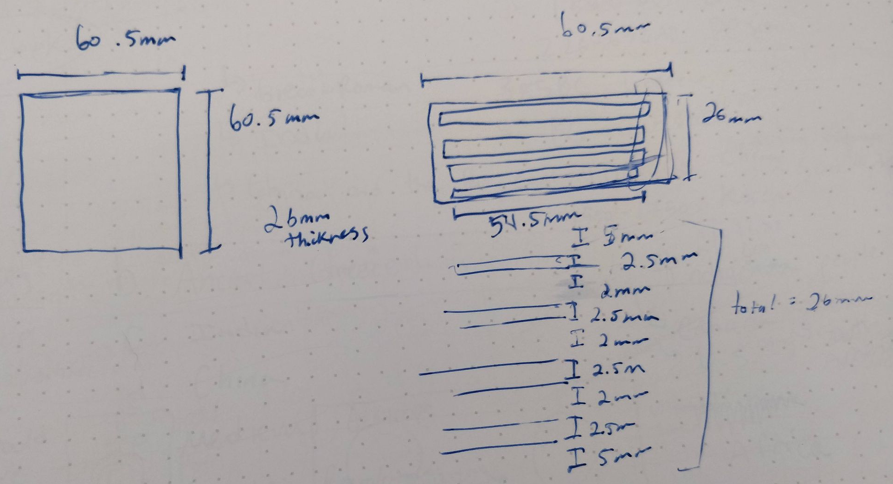
Sketching It Out
So I began to sketch it out.
01
02
03
04
05
Introductory Question
All About 3D Printers
The Printing Process
The CAD Process
Your 1st 3D Print

Slide 29
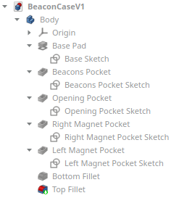
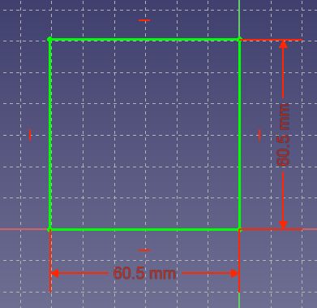
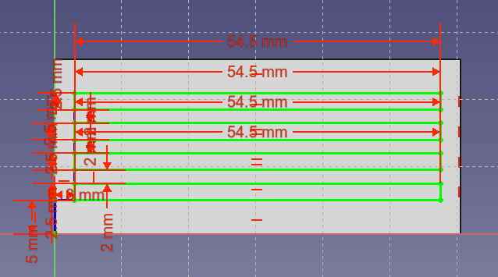
Finalizing the Model
And then began transferring my sketch to my CAD software.
01
02
03
04
05
Introductory Question
All About 3D Printers
The Printing Process
The CAD Process
Your 1st 3D Print

Slide 30
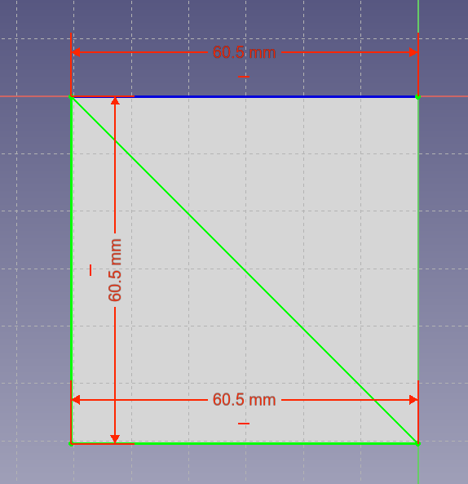
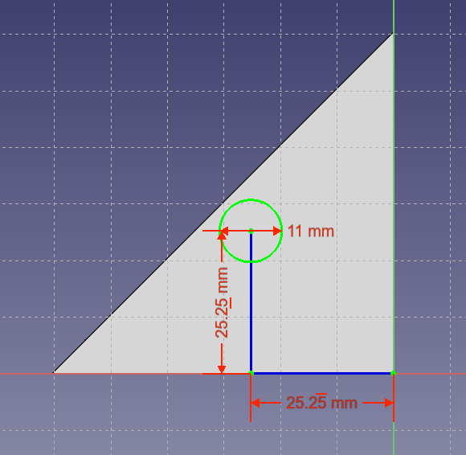
Finalizing the Model
And then began transferring my sketch to my CAD software.
01
02
03
04
05
Introductory Question
All About 3D Printers
The Printing Process
The CAD Process
Your 1st 3D Print

Slide 31
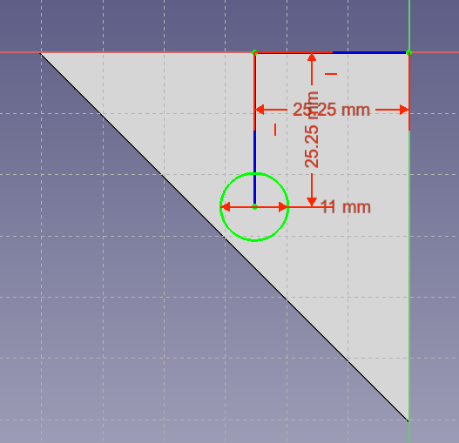
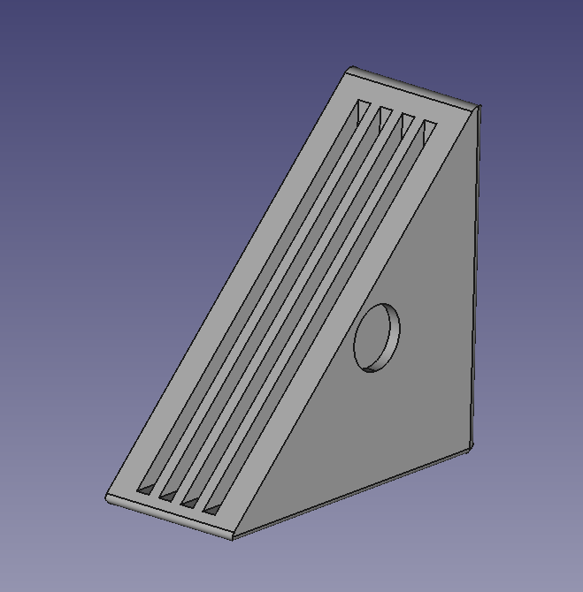
Finalizing the Model
And then began transferring my sketch to my CAD software.
01
02
03
04
05
Introductory Question
All About 3D Printers
The Printing Process
The CAD Process
Your 1st 3D Print

Slide 32
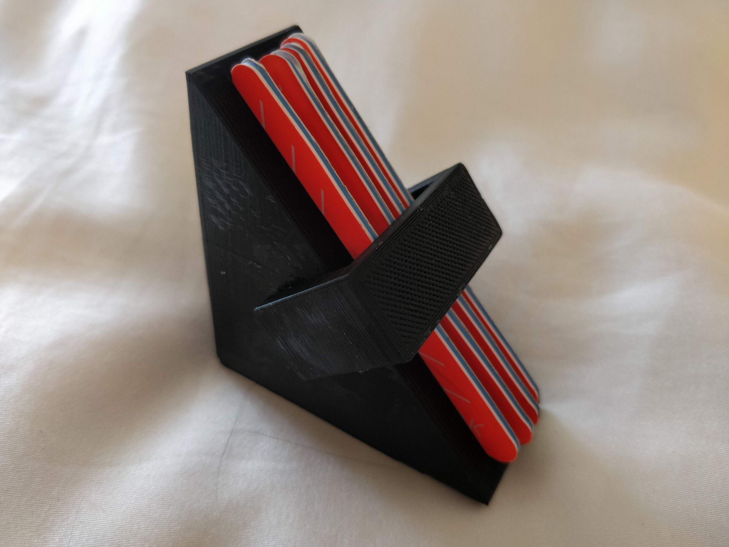
Printing the Model
I also printed a cover for it. Here they both are.
01
02
03
04
05
Introductory Question
All About 3D Printers
The Printing Process
The CAD Process
Your 1st 3D Print

Slide 33
Your 1st 3D Print
05
Finally!

Slide 34
Your Problem
Giving you a problem makes the rest easy, so here’s your problem: you want to hang a mass from a string. While you can use the hook part of the mass, that might not be a good idea because it would be unstable since the hook is tiny and it might apply too much force in one area. You will be fancy and 3D print a hook to hang the mass from the string.
01
02
03
04
05
Introductory Question
All About 3D Printers
The Printing Process
The CAD Process
Your 1st 3D Print

