Slide 1
Creating a 3D Print

Slide 2
Objective
Students will be able to create their first 3D print collaboratively.

Slide 3
Table of contents
01
02
03
Introductory Question
Starting the CAD Process
CAD Software Guide
3D printing questions?!
Baby steps.
It won’t take long.
04
05
Using CAD Software
Preparing Prints
Can you do it?
Let’s go!

Slide 4
Introductory Question
01
3D printing questions?!

Slide 5
Introductory Question
What’s your hook design like? What issues have you encountered so far?
Discuss in your groups for two minutes and then we will discuss as a class.
01
02
03
04
05
Introductory Question
Starting the CAD Process
CAD Software Guide
Using CAD Software
Preparing Prints

Slide 6
Starting the CAD Process
02
Baby steps.

Slide 7
The Steps
Just as a reminder, here are the steps from last time:
The Problem: What are you trying to solve? Every print needs a purpose, a problem that it solves.
Measurements: Start by figuring out what you need to attach it to and measure the dimensions of it.
Sketching: Try drawing a sketch, given the dimensions.
Modeling: Use the sketch with dimensions on the CAD software (we will work on this together).
We already know the problem. Next, you will be getting measurements and sketching.
01
02
03
04
05
Introductory Question
Starting the CAD Process
CAD Software Guide
Using CAD Software
Preparing Prints

Slide 8
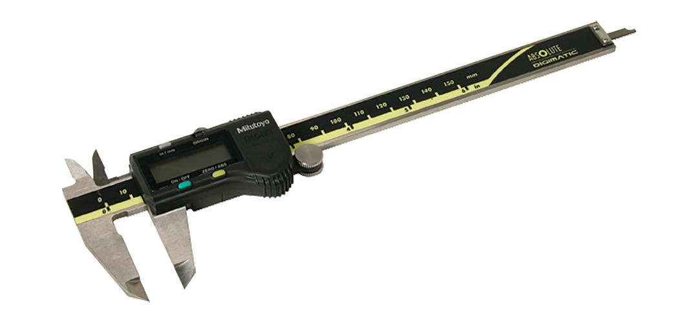
The Measurements
Look at the mass that you have in front of you. You want to create a hook for it, so think about how thick the hook would have to be (you can use calipers to help you out with imagining this). Also think about the length of the hook. Discuss with your groups for the next five minutes and then we will continue to the next step.
01
02
03
04
05
Introductory Question
Starting the CAD Process
CAD Software Guide
Using CAD Software
Preparing Prints

Slide 9
The Sketch
Now that you have written down the measurements, do a sketch. A two-dimensional sketch. For convenience, it might be helpful to create a side view or top view, then the other “dimension” will be created when we make it together.
Spend another five minutes doing this and then we will look at how to model it together.
01
02
03
04
05
Introductory Question
Starting the CAD Process
CAD Software Guide
Using CAD Software
Preparing Prints

Slide 10
Creating the Model
Make sure someone in your group has a computer. Navigate to cad.onshape.com on your browser and create your account.
I’ll make sure at least one person in your group is on the website and I’ll walk around if there are any issues we need to troubleshoot. We’ll take two minutes to do this.
01
02
03
04
05
Introductory Question
Starting the CAD Process
CAD Software Guide
Using CAD Software
Preparing Prints

Slide 11
CAD Software Guide
03
It won’t take long.

Slide 12
A Quick Guide
Let’s take a look at these things together;
How to change default units
How to create a document
Creating a sketch and using sketching tools
Extrusion to make 3D model
How to make additional sketches
How to remove parts of a model (making a hole or pocket)
01
02
03
04
05
Introductory Question
Starting the CAD Process
CAD Software Guide
Using CAD Software
Preparing Prints

Slide 13
Using CAD Software
04
Can you do it?

Slide 14
Your Turn
From now until the last ten minutes of the period, you and your group will create your model. Make sure everyone has a decent understanding and ask for help if you need it - not just from me, but from others around you too.
As you begin 3D printing more frequently, you might make use of students who have been working with CAD software for a while. They will be able to help you not only with 3D printing, but also later cutting - which makes use of OnShape as well.
In the last ten minutes, I’ll show you how to send the print to me again.
01
02
03
04
05
Introductory Question
Starting the CAD Process
CAD Software Guide
Using CAD Software
Preparing Prints

Slide 15
Preparing Prints
05
Let’s go!

Slide 16
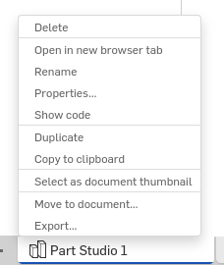
Finding the Export Button
Go down and right click (or double click if you don’t have a mouse) where it says Part Studio 1.
01
02
03
04
05
Introductory Question
Starting the CAD Process
CAD Software Guide
Using CAD Software
Preparing Prints

Slide 17
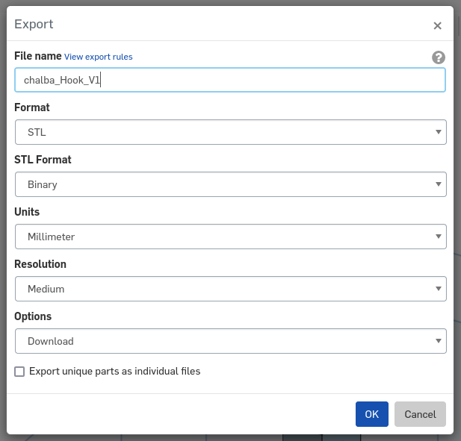
Exporting STL
Export the file with the STL format and with a naming scheme that makes sense. I use chalba to identify my files because “ch” are the first two letters of my name and “alba” is my last name. That makes it easy to find.
01
02
03
04
05
Introductory Question
Starting the CAD Process
CAD Software Guide
Using CAD Software
Preparing Prints

Slide 18
Sending STL
Send the STL file to me via email and I’ll put all of the files from the class on one printer, to be ready for tomorrow.
01
02
03
04
05
Introductory Question
Starting the CAD Process
CAD Software Guide
Using CAD Software
Preparing Prints

