Slide 1
Testing the 3D Print

Slide 2
Objective
Students test their 3D print’s ability to solve their problem.

Slide 3
Table of contents
01
02
03
Introductory Question
Checking Out the Prints
Discussing the Prints
A reflection question.
How do they look?
Let’s talk about it.
04
Testing the Prints
Do they work?

Slide 4
Introductory Question
01
A reflection question.

Slide 5
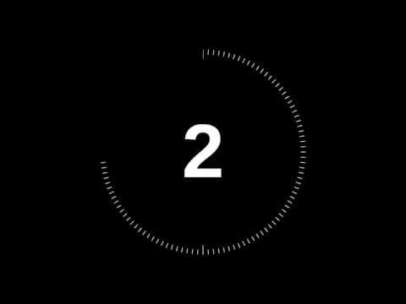
Introductory Question
While I hand out your 3D-printed hooks, think about the following question:
What are the benefits of 3D printing? What else can it be used for? What problems can it solve?
Discuss in your groups for two minutes and then we will discuss as a class.
01
02
03
04
Introductory Question
Checking Out the Prints
Discussing the Prints
Testing the Prints

Slide 6
Checking Out the Prints
02
How do they look?!

Slide 7
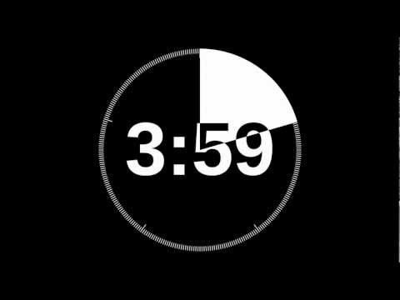
Additional Time and Checking it Out
Some of you may not have fully gotten to where you wanted to get with your 3D prints, so if you need some additional time to design, this is a good time to do that. Let me know if you need help. The most important part is that you have a model created on OnShape.
If you have a 3D print in front of you, take a look at it. Spend the next five minutes discussing:
Does it look as though you imagined it?
What improvements do you think you could make?
Are there any imperfections, things you noticed that you wanted to ask about?
01
02
03
04
Introductory Question
Checking Out the Prints
Discussing the Prints
Testing the Prints

Slide 8
Discussing the Prints
03
Let’s talk about it.

Slide 9
Questions to Get You Thinking
Let’s discuss your 3D prints as a class.
Does it look as though you imagined it?
What improvements do you think you could make?
Are there any imperfections, things you noticed that you wanted to ask about?
01
02
03
04
Introductory Question
Checking Out the Prints
Discussing the Prints
Testing the Prints

Slide 10
Testing the Prints
04
Do they work?

Slide 11
Does It Work?
Can your 3D print solve the problem it was trying to solve? Can it be used to successfully hang your mass from the string? If not, think about what the next iteration might do differently.
01
02
03
04
Introductory Question
Checking Out the Prints
Discussing the Prints
Testing the Prints

