Slide 1
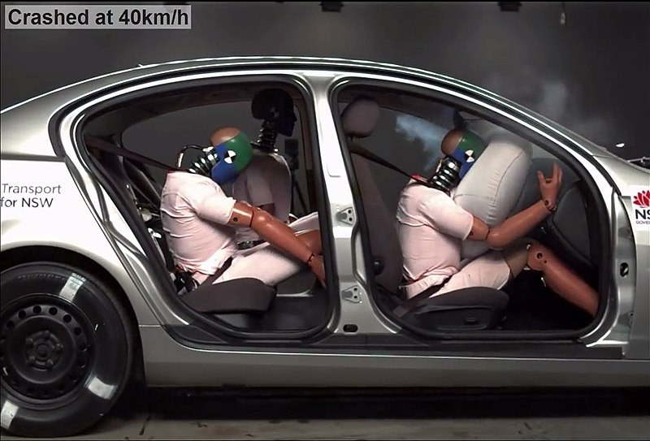
MOTOR VEHICLE COLLISIONS
Every year, car crashes result in:
1.3 million deaths globally
20-50 million injuries
Engineers are essential to our health and safety!
Image Source: Transport For NSW, 2019, CC BY-SA 4.0, https://commons.wikimedia.org/wiki/File:Crash-test-with-airbag-and-safty-belt.jpg
Notes:
Note: 40km/h is about 25mph
The image shows different safety measures: safety belt and airbag (front), safety belt only (back, right) and no safety measure (back, left).

Slide 2
STAYING SAFE: BUCKLE UP PSA!
Video Source: IMMI, 2014, YouTube, https://www.youtube.com/watch?v=fzbCeVQqrxA
Notes:
Show students the 1:35-min video Buckle Up PSA: youtube.com/watch?v=fzbCeVQqrxA

Slide 3
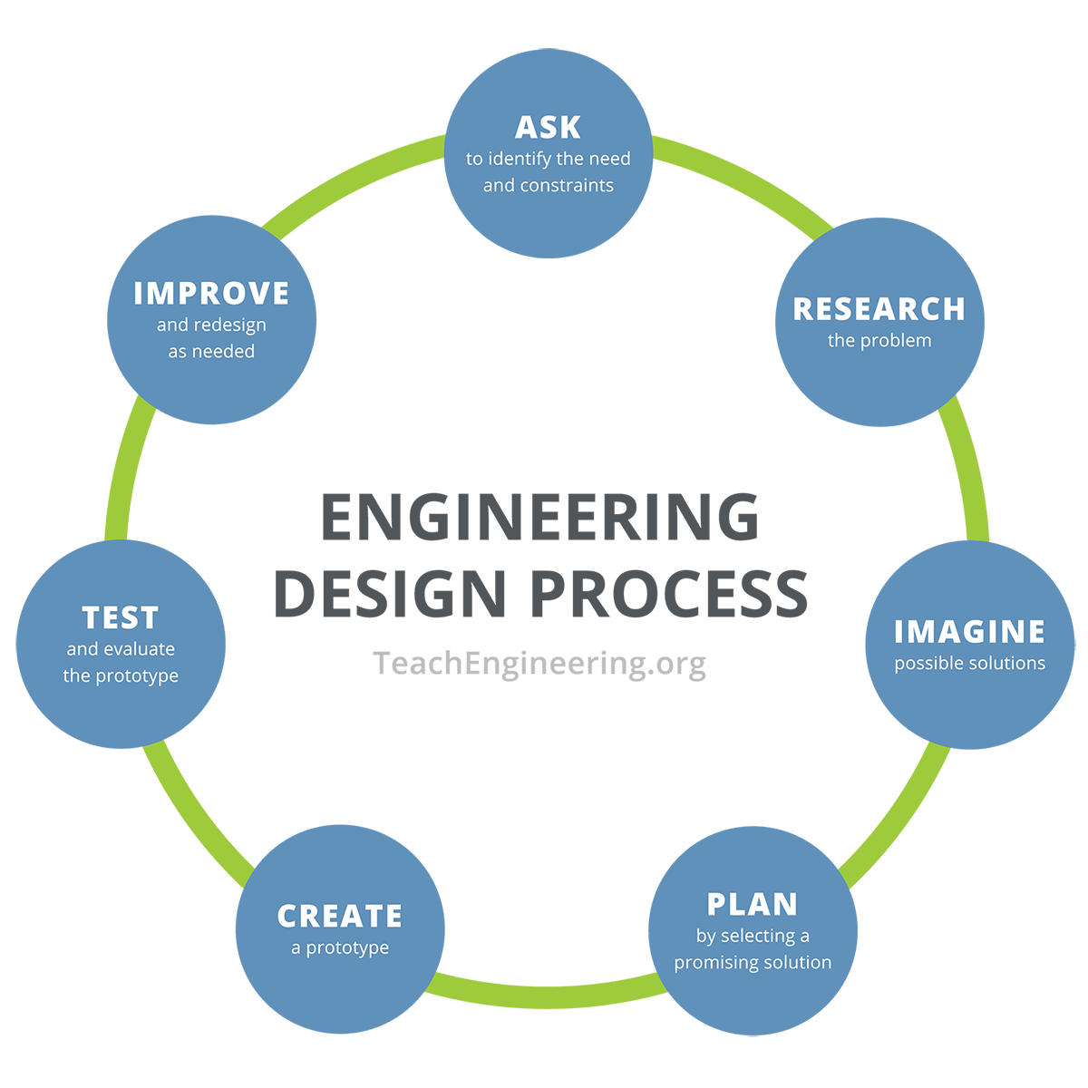
CREATIVE CRASH TESTING CHALLENGE
Today, you will be next-generation engineers.
Your team’s challenge:
Using the Engineering Design Process, come up with the next best design for a vehicle passenger compartment and/or safety features to keep the “passenger egg” safe during a front-end collision, with minimal vehicle damage.
Make sure to follow each step and answer each question in your Creative Crash Testing Worksheet!
Image Source: TeachEngineering, https://www.teachengineering.org/populartopics/designprocess

