Slide 1


Sole Survivors:
A Biomedical Engineering Project

Slide 2
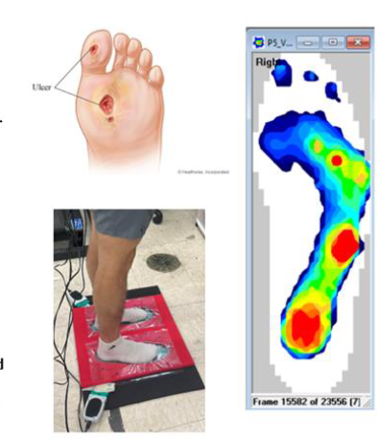
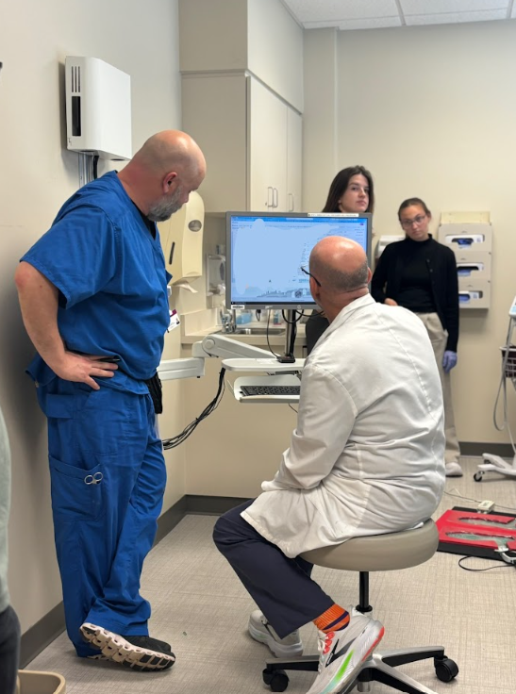
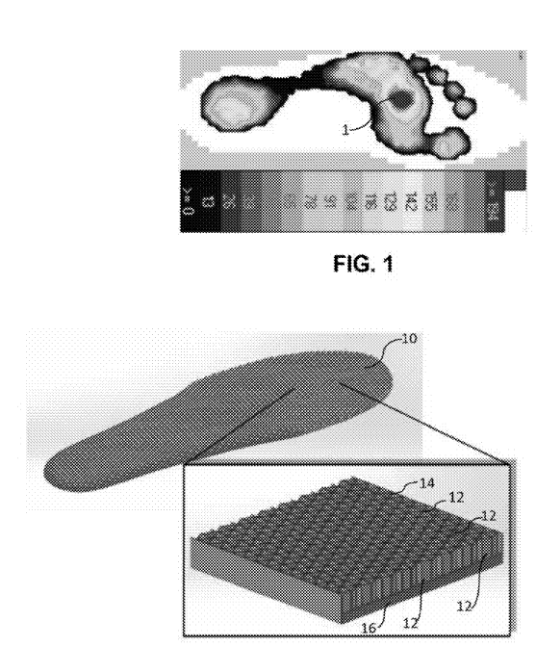
Doctors are doing this in real hospitals
Making things that people use every day! Like cars, phones, shoes, medical equipment
Trio of photos showing a foot with an ulcer, a multi-colored foot pressure scan, and a patient standing on a foot pressure mat.
A doctor in a hospital viewing patient results on a computer while a nurse stands by.
A graphic showing a black and white foot pressure scan and another showing an orthotic that has foam density matching the high pressure areas of the scan.

Slide 3
Understanding the Medical Impacts
Did you know that people with serious foot ulcers have about a 30% chance of not surviving five years, which is about the same rate as many common cancers? - NIH.gov
Each year, more than 100,000 people in the U.S. need serious foot treatment like surgery or special boots because of complications such as diabetes. - The Guardian
4 to 6 out of every 10 patients don’t wear their special medical boots as often as they should. - NIH.gov
If the boots or inserts don’t feel good, patients often stop using them, and their foot injuries don’t heal properly. - Milford Podiatry

Slide 4
Parts of the Foot
Phalanges
Hallux
Toes 2-5
The big toe
Lateral arch
Metatarsal Heads
Outer Foot
Make up the ball of the foot
Calcaneus
Medial arch
The heel region
Inner curve of the foot

Slide 5

Engineering Solutions: A Case Study
Subjects: Employees who stand 6-8 hours per day
Problem: 32% have foot pain
Solution: Orthotics made 67% of people feel better
Weight Distribution
Employees are tested to see where they put the most pressure on their feet.
Material Testing
Materials are tested to see what is most comfortable and durable.
Pressure Mapping
Orthotic prototypes are tested to see if they improve pressure.
BMW Logo

Slide 6
The Physics of Kinetic Energy
Kinetic Energy Formula: KE = ½mv²
This means that moving things have energy.
The heavier something is (mass = m) and the faster it’s going (speed = v), the more energy it has.
Force and Pressure on the Foot
When something hits your foot, it creates a force (like a push).
Force = mv ÷ change in time — the faster something moves or heavier something is, the more force it hits with.
If all that force is in one small spot (like under your heel), it hurts more.
Pressure = Force ÷ Area — so bigger insoles help spread that force out and reduce pain.
What Orthotics Do
Energy dissipation = spreading out pressure and reducing force.
Energy absorption = spring-like recovery of the material.
In diabetic orthotics, dissipation is key for reducing pressure hotspots.

Slide 7
The Engineering Design Process
Research
2. Design
Learn about the foot condition.
Study existing solutions.
Think about what the patient needs.
Pick foam types.
Plan where support is needed.
Build your prototype.
3. Test
4. Communicate
Drop test and collect data.
See what works (or doesn’t!).
Improve your design.
Make a poster of your design.
Share your results with the class.
Use data to convince others your orthotic works.

Slide 8
Foam Types and Material Science
Soft Foam
Medium Foam
Hard Foam
Feels really squishy and comfy. Used where you want more cushioning.
A balance between soft and firm. Good for support and comfort.
Feels stiff. Used to hold up heavy parts of the foot like the arch.

Slide 9
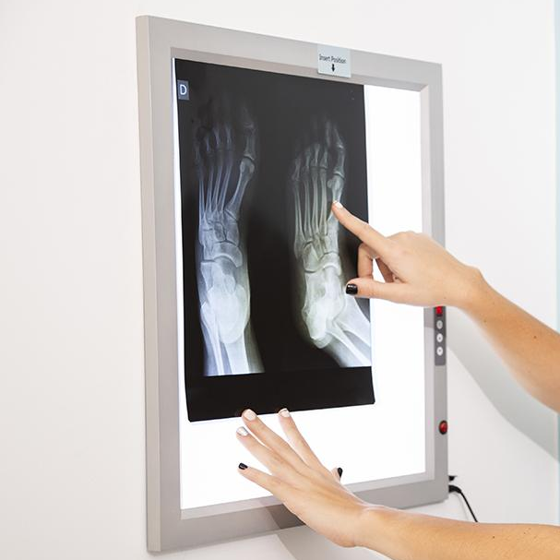
How We Test Our Orthotics
Variables:
Independent – Drop height (30–150 cm)
Dependent – How deep the ball sinks in the dough
Controls – Ball weight
Data Collection:
We drop a metal weight onto kinetic sand with and without an orthotic.
We measure how deep the weight goes.
  Deeper mark = less pressure dissipated
  Shallower mark = more pressure dissipated (better protection)

Slide 10
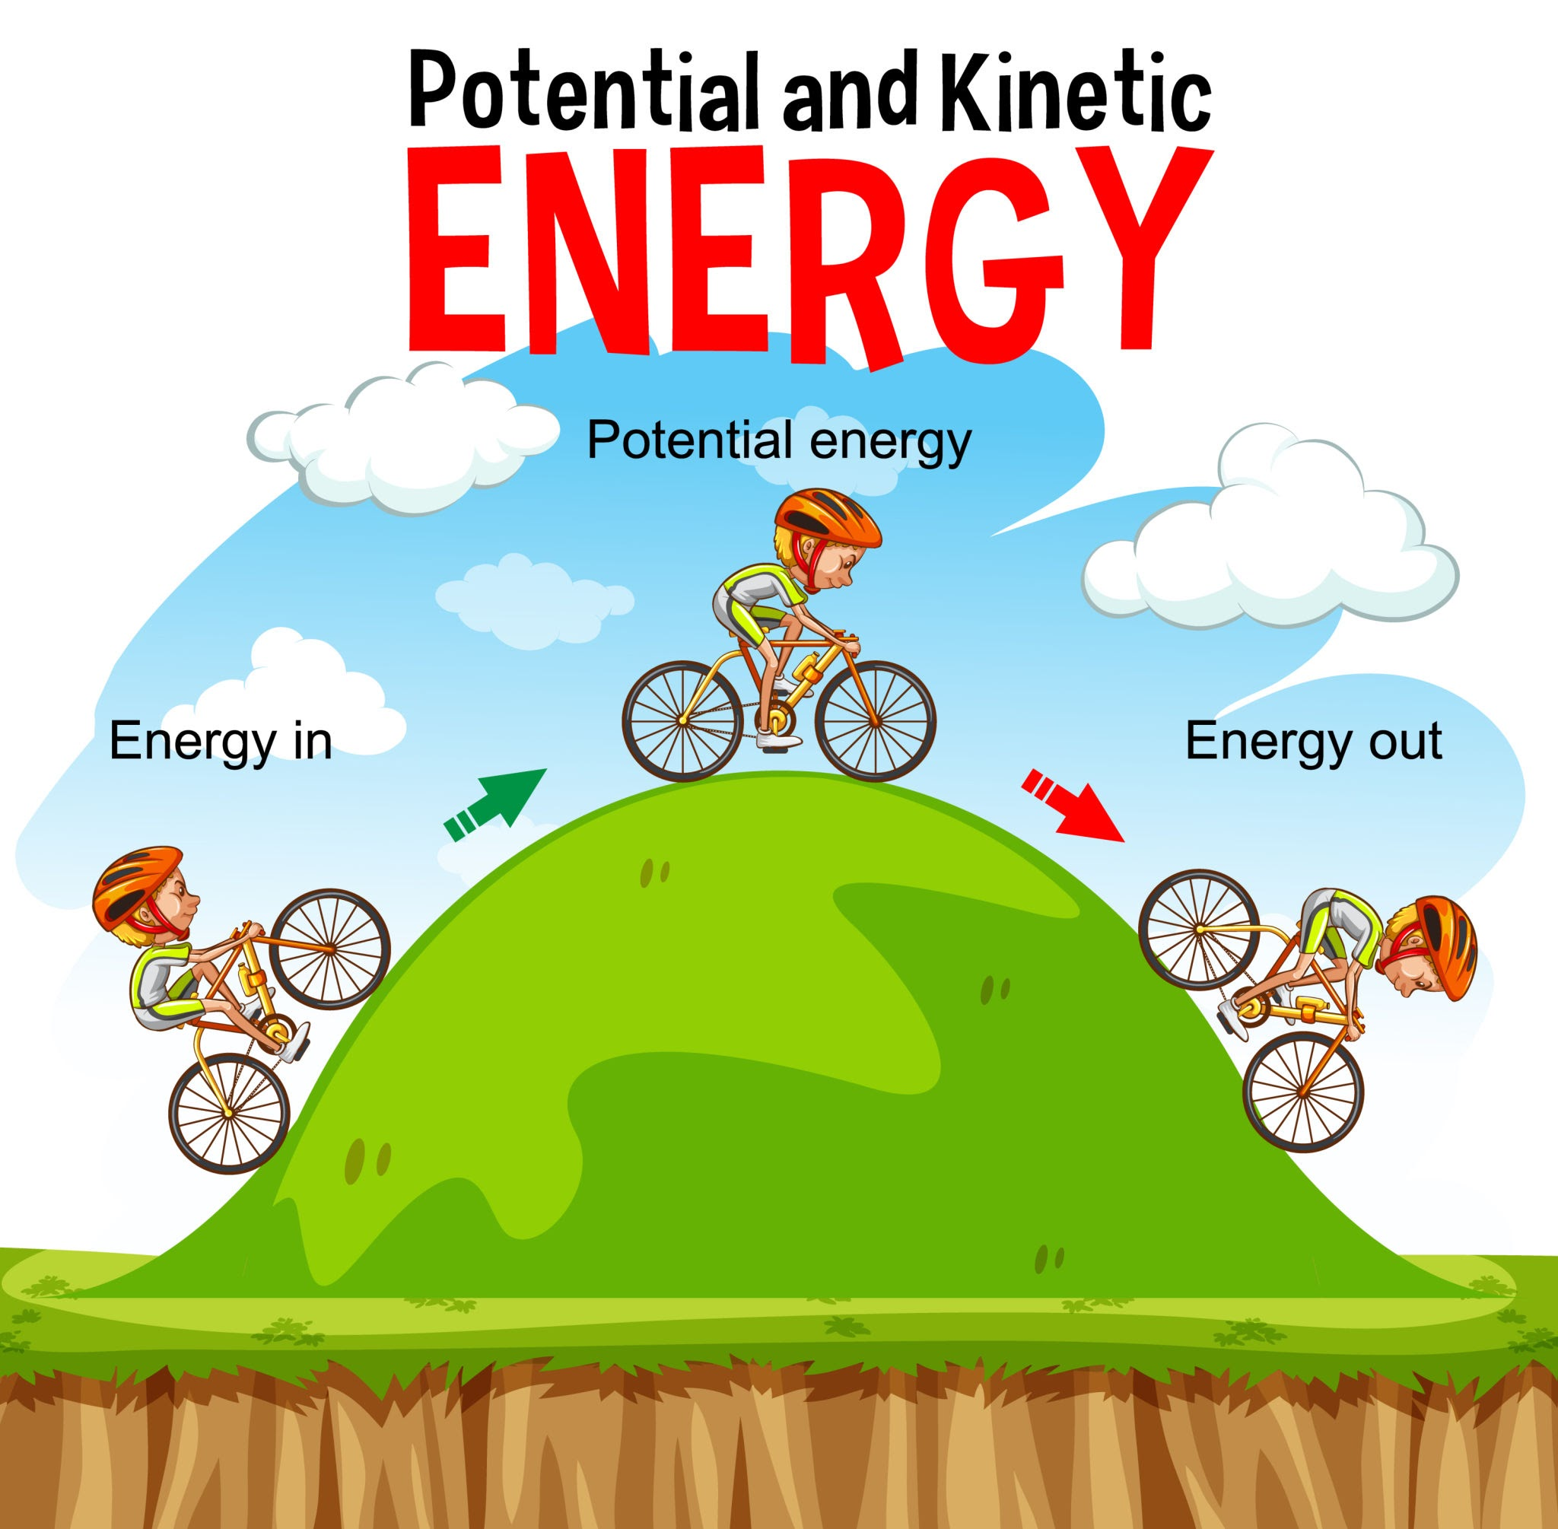
Kinetic Energy Review
Formula:
KE = ½ m v²
(m = mass, v = speed)
The faster something moves, or the heavier it is, the more kinetic energy it has. That’s why a bowling ball rolling fast is harder to stop than a tennis ball at the same speed.
For example:
Mass of object = 2 kg, Speed = 1 m/s
KE = ½ × 2 × (1²) = 1 Joule
When we drop weights from different heights, we’re changing how much kinetic energy they have when they hit the orthotic.
That’s why the force on the orthotic is different depending on the height of the drop.
Infographic explaining that a bike going over a hill gains potential energy as it goes up and kinetic energy as it goes down

Slide 11
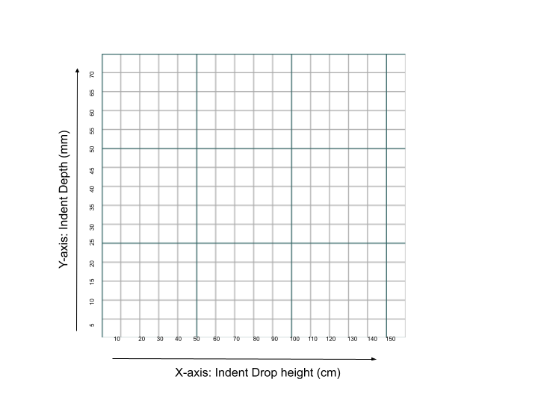
Graphing Your Data
What to compare
With vs. without your orthotic
Drop height vs. impact depth
How much energy the orthotic stops from reaching the dough
Graphing Focus
Look for trends or patterns.
Use your graph to explain whether your design worked.
Include error bars if you’ve learned how.
Graph with indent depth on Y axis and drop height on X axis

Slide 12

Real-World Applications
Current Impact
40% fewer foot ulcers -
60% more patients using their orthotics -
Saves about $4,000 per patient -
Source: NIH
Future Ideas
3D-printed custom insoles -
Smart pressure sensors -
New, high-tech materials -
Source: NIH
Career Options
Manufacturing Assembler: Build medical supplies in a factory - no education needed
Advanced Manufacturing Machinist: Produce supplies with a machine - trade school
Manufacturing Engineer: Design medical products - college degree needed
World Map in black and white
World Map in black and white

