Slide 1


Manufacturing Project Wrap-Up

Slide 2
What Is Manufacturing?
Making things that people use every day! Like cars, phones, shoes, medical equipment
In SC, we manufacture things for aerospace, automotive, medical, and more.
Making things that people use every day! Like cars, phones, shoes, medical equipment.
Includes all the steps from design to engineering to production.

Slide 3
What Is ADVANCED Manufacturing?
Combines STEM topics to solve real-world problems and create better products.
Making things
Making things using high-tech tools:
3D printing
robotics
computer design
Focuses on making things faster, safer, and smarter.

Slide 4
Did We JUST Do Manufacturing?
Yes! In your “Sole Survivors” project, you were a manufacturer!
Planning You researched what problems people had with their feet.
Design You designed an orthotic to fix your chosen problem.
Prototyping You built a sample of your orthotic.
Production Next up: You would try to find a company to buy your product and produce it.
Testing Quality control checks are done to ensure good products.
Distribution Your product would be sent to people who need it.

Slide 5
Skills You Have After this Activity
Engineering Design Process
research → design → test → improve
You used critical thinking—just like real engineers—to design and build a helpful product.
Creating a Prototype
You built and tested a hands‑on model, just like manufacturers do, to see how well your design worked and make it better.
Being a Team Player
You shared ideas and helped each other to create the best design possible together. This is a skill that every future employer will be looking for!
Problem Solving
You figured out challenges, tried new ideas, and fixed problems to make our design work even better. Mastering this skill will make you stand out as a leader!

Slide 6
Careers Related to the Activity
Manufacturing Assembler
Build medical products and orthotics.
No experience required!
Manufacturing Engineer
Design the manufacturing process for medical equipment.
College degree required.
Computer Machinist
Operate equipment and design custom parts.
Trade school or certification required.

Slide 7
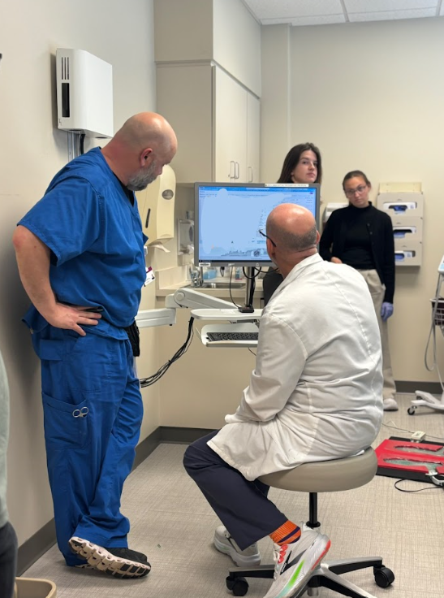
Why This Matters
South Carolina has 8,242 manufacturing companies.
These jobs pay 33% more than the state average.
Manufacturing makes up 17% of all SC’s income (GDP).
A doctor and nurse review patient records

Slide 8
What’s Next?
Stay curious
Ask questions about everything you experience. How can it be improved?
Practice engineering Design your thinking, take steps to solve the problems you see around you.
Develop skills
Take design classes, consider applying to CTE school, practice teamwork.

