Slide 1
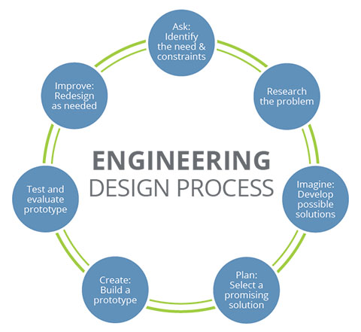

The Engineering Design Process on Toxic Island
(The template for solving any sort of problem.)

Slide 2


Ask: Identify the Need and Constraints
Your problem…
An island nation has been quarantined by the World Health Organization due to an outbreak of a nasty virus. You are tasked with delivering medical goods, food, (and chocolate) to Outbreak Island’s sick inhabitants. However, there are some constraints:
You can’t touch the water or the island. It will contaminate any device immediately.
The medicine is very rare and expensive, so accuracy is imperative!
The people of the island need their supplies delivered quickly.

Slide 3
Outbreak Island
3.7 m (12 ft)
3.7 m
(12 ft)
.

Slide 4

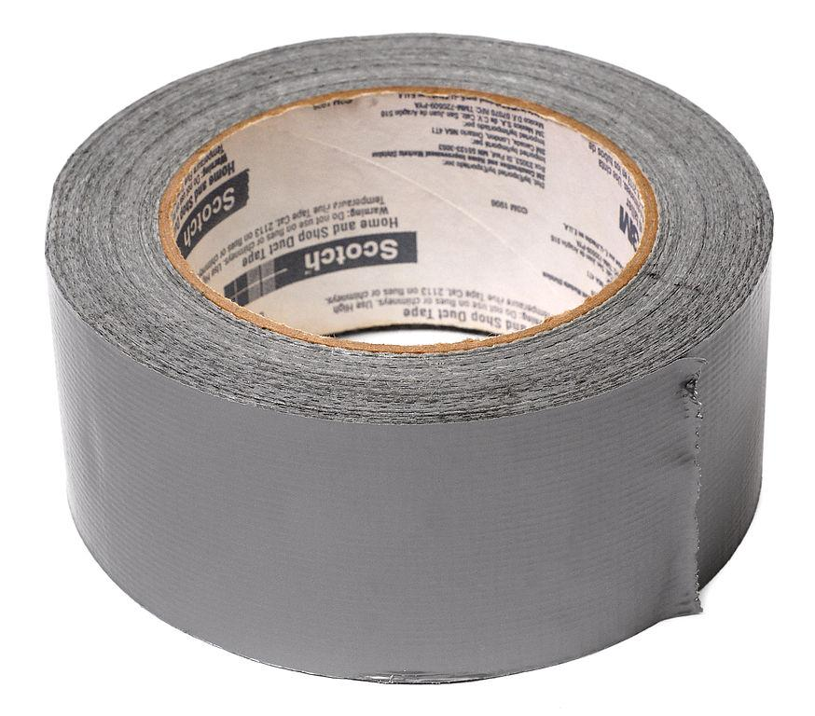
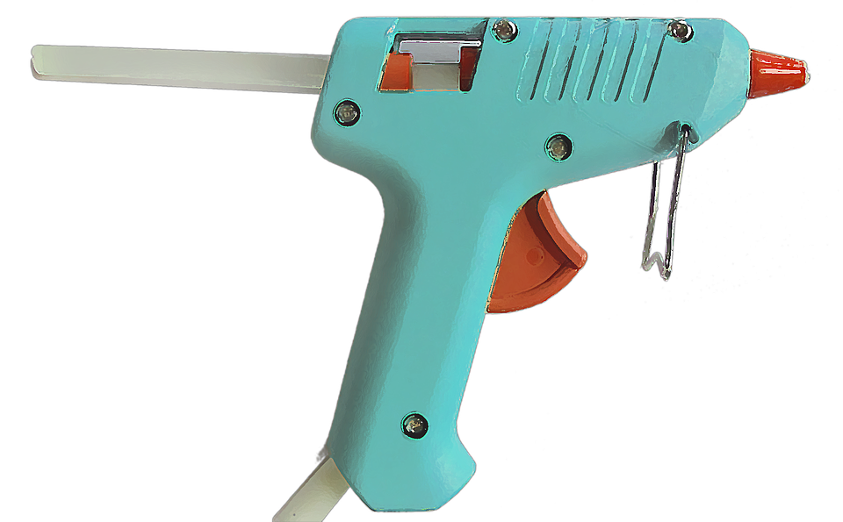
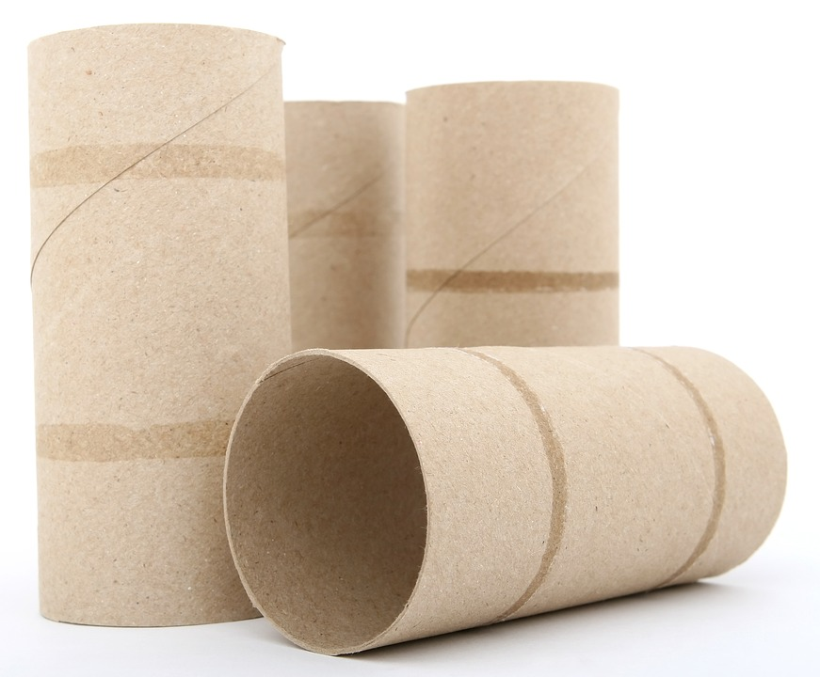
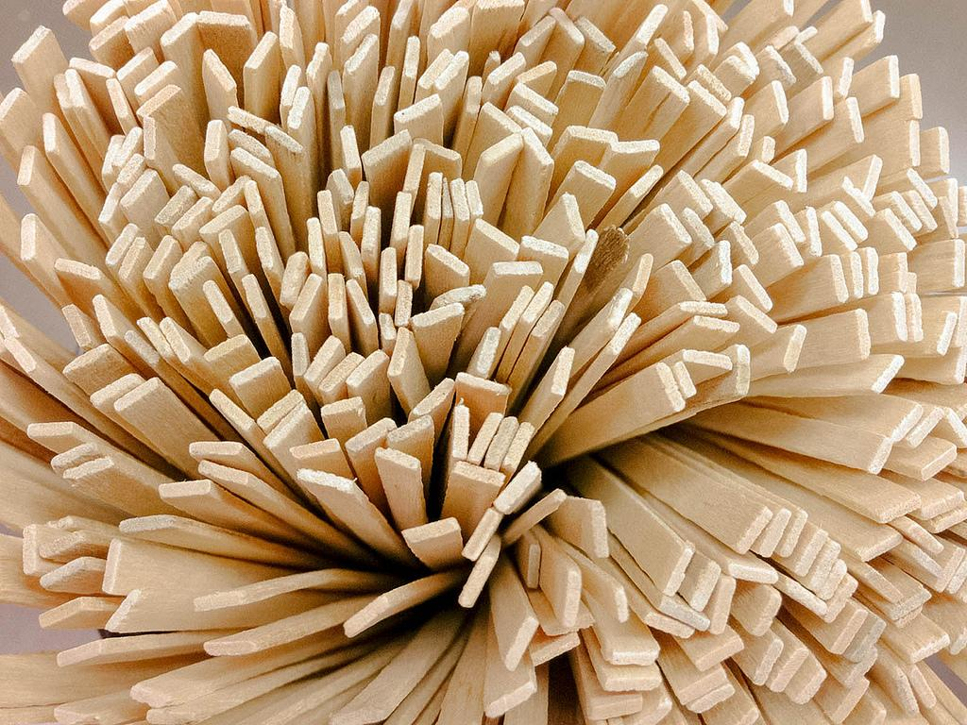

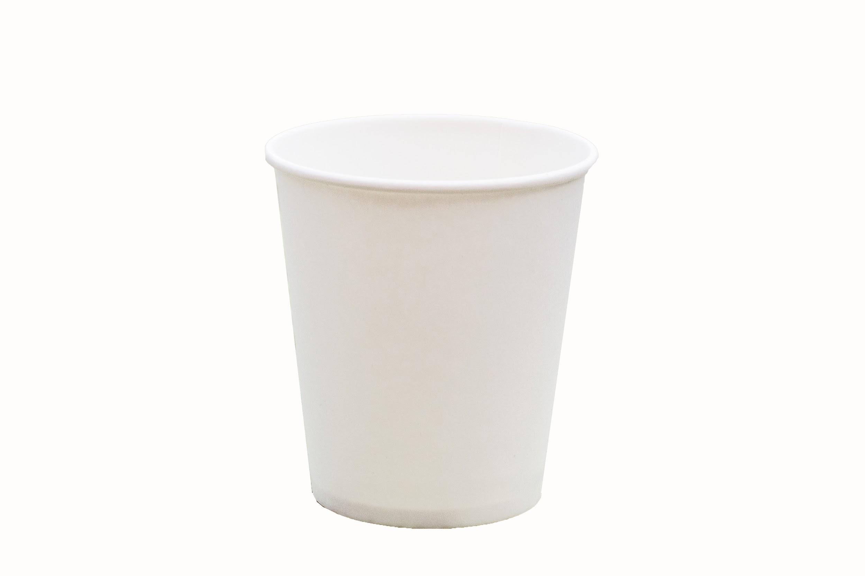
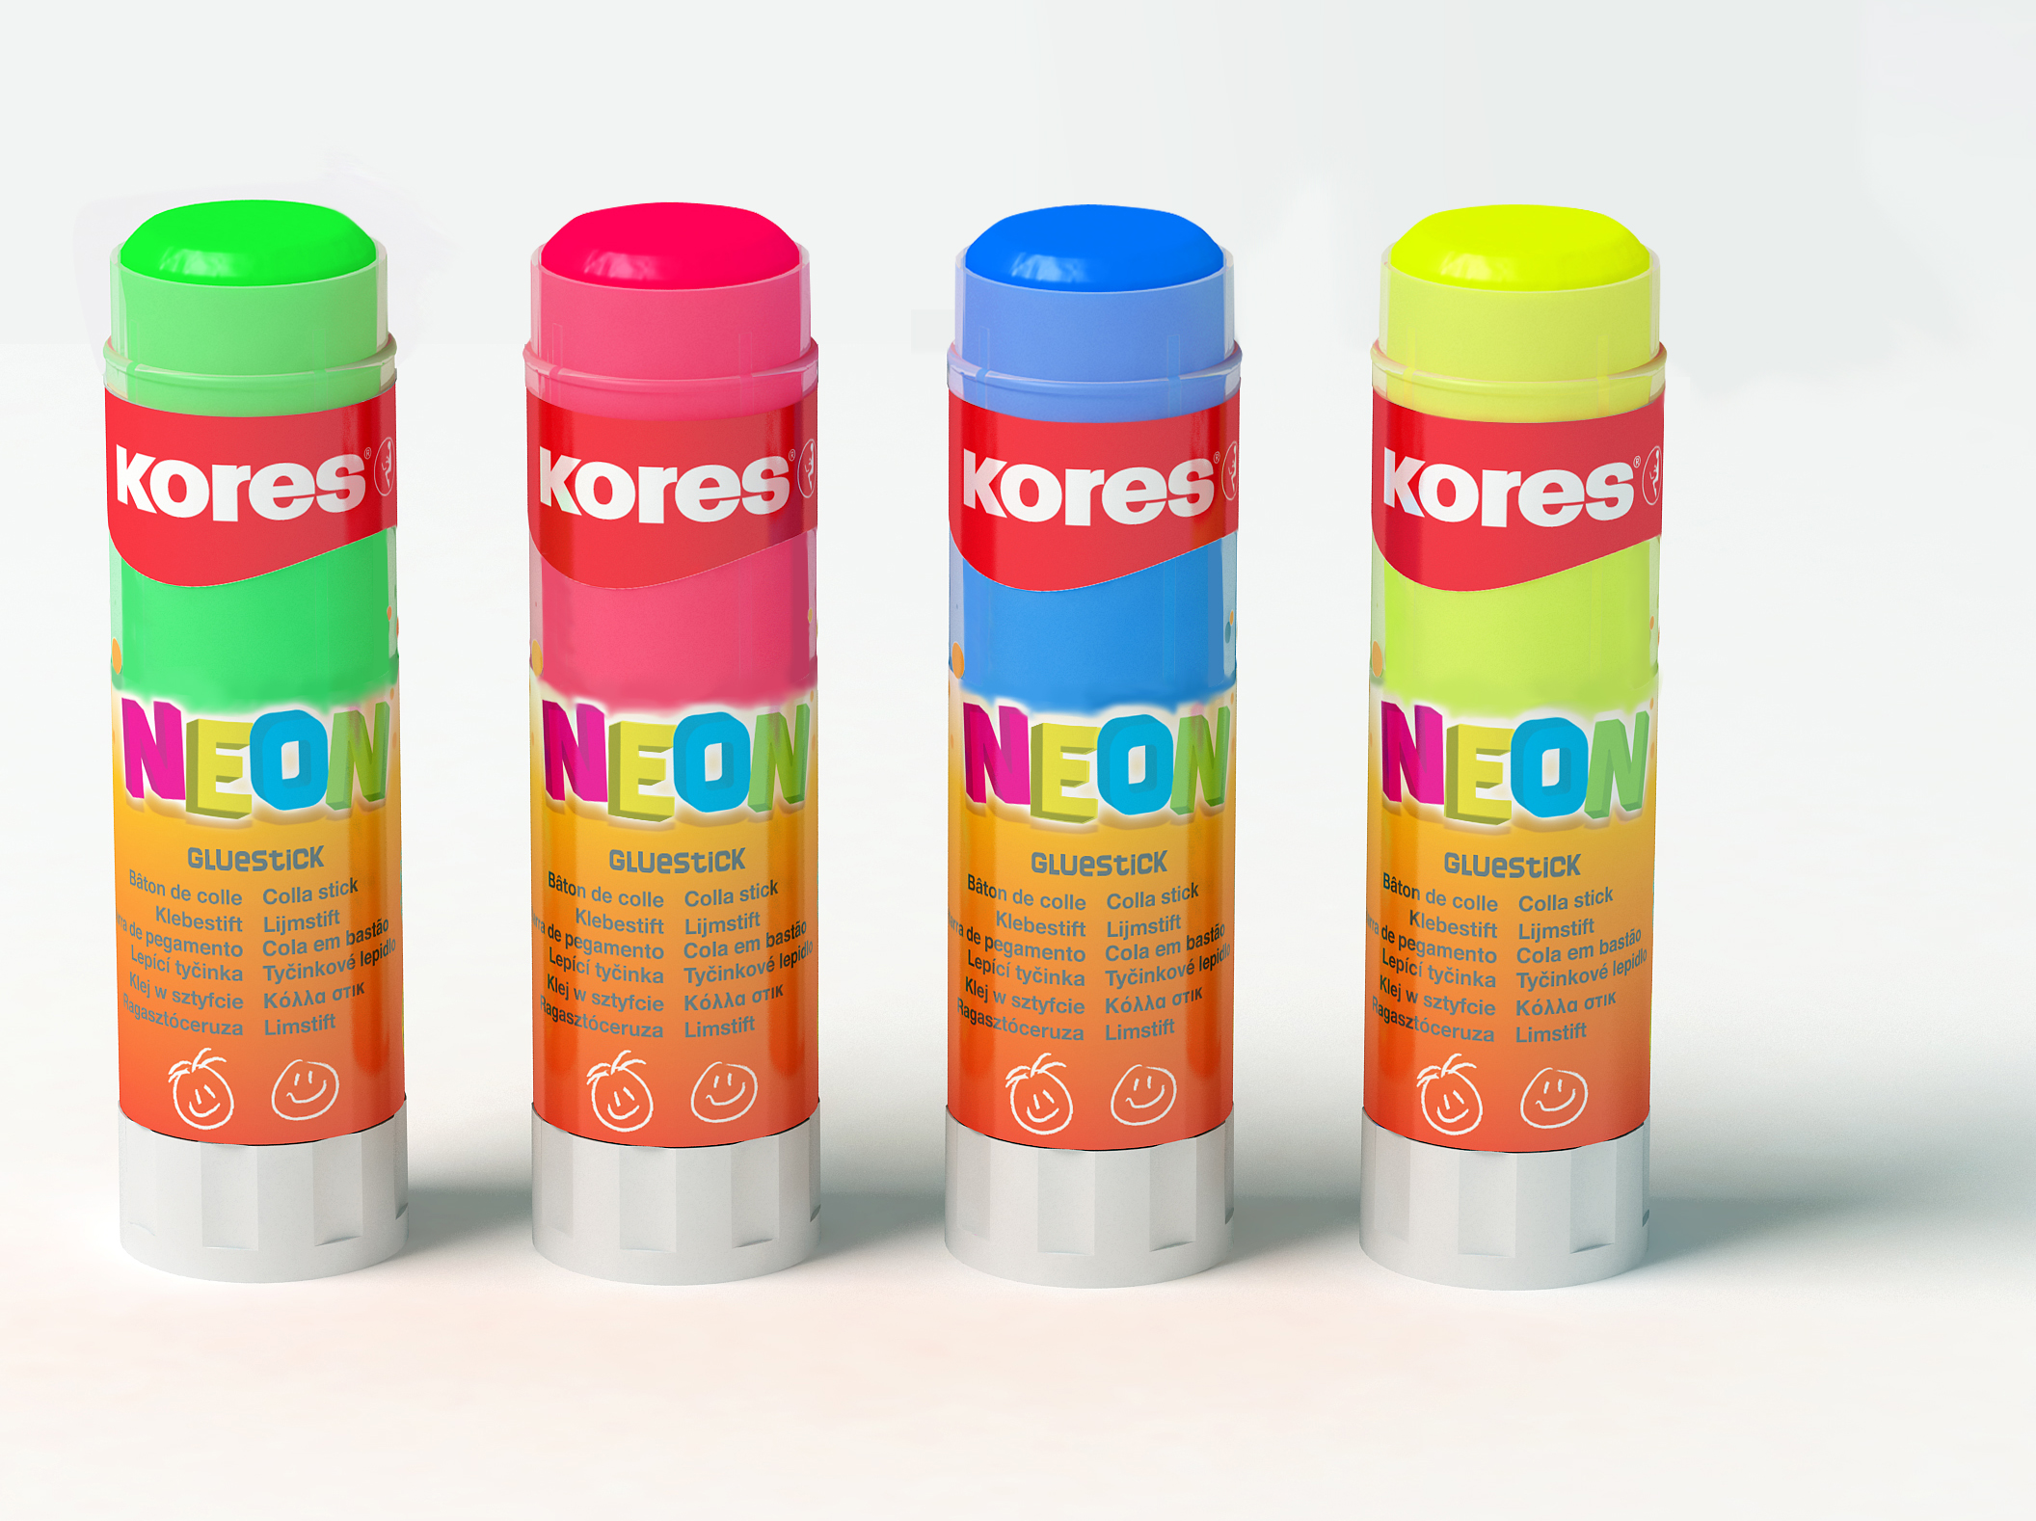
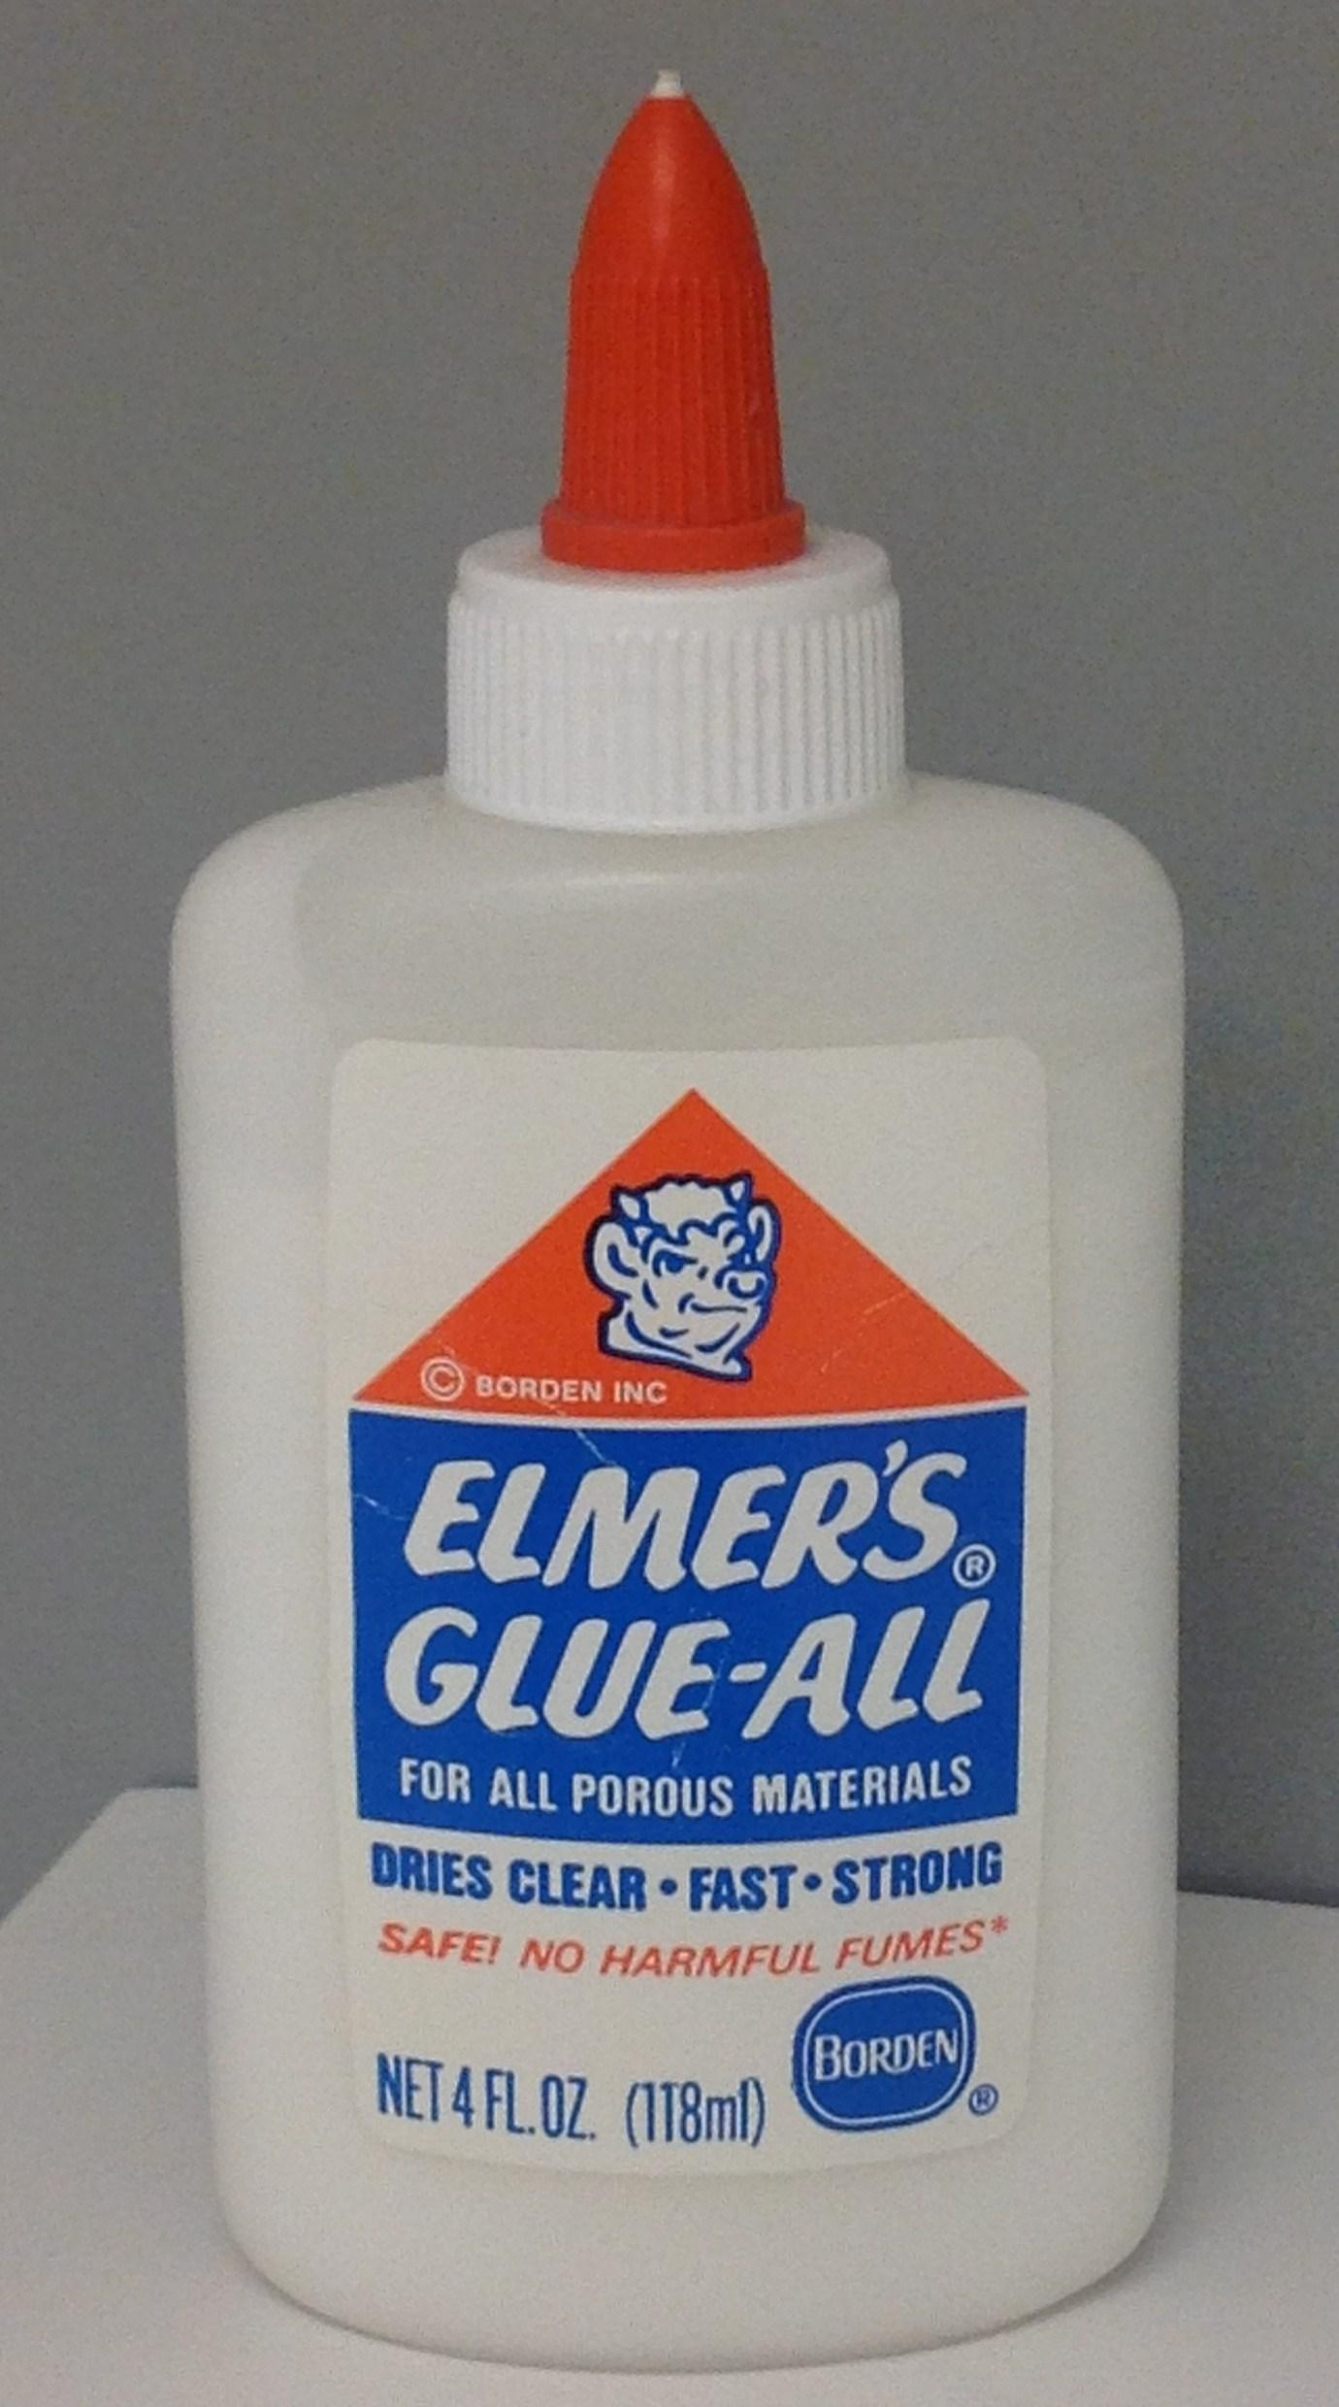
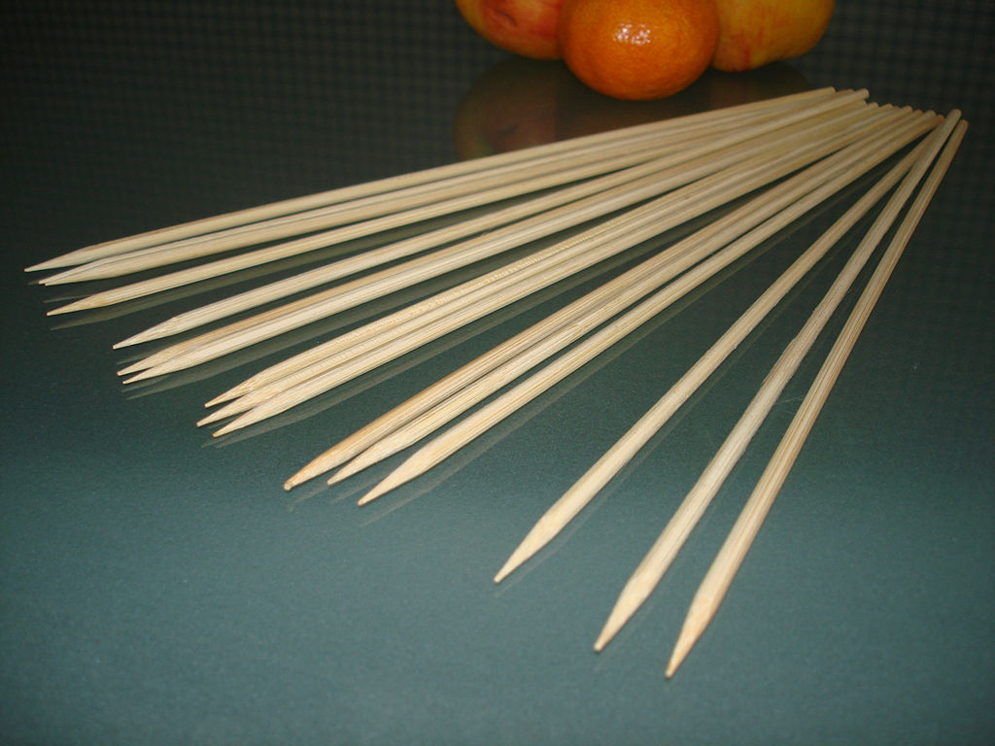
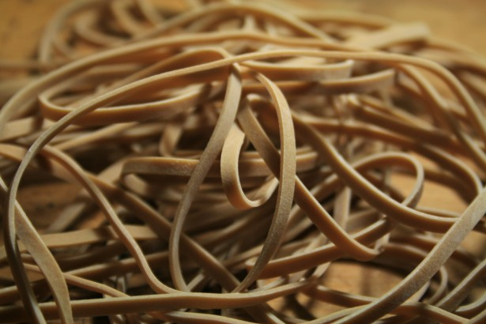
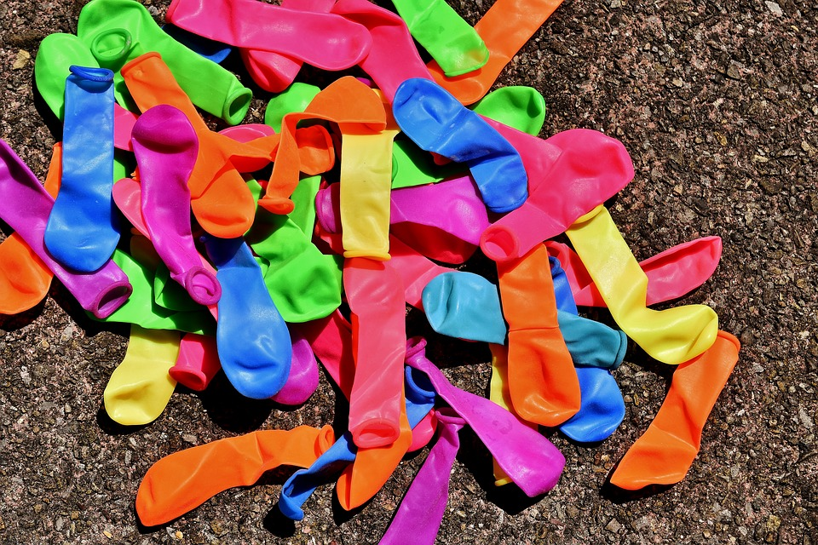
Materials:
Your constraints
Your team will be able to select from a limited variety of materials to deliver the package.
In order for you to use a material, its use must be indicated in your design in some way.
You amount of a particular material may be limited...for example: you can’t use a whole roll of duct tape!

Slide 5
Research the problem
Use any means you have available to research and investigate the problem:
What building materials are available?
Draw from your personal experience. What different methods do companies or organizations use to deliver packages?
Research different inventions that could fill the bill.

Slide 6

Imagine: Develop possible solutions
Get together with your group and compile individual sketchesand ideas on how to solve the problem!

Slide 7
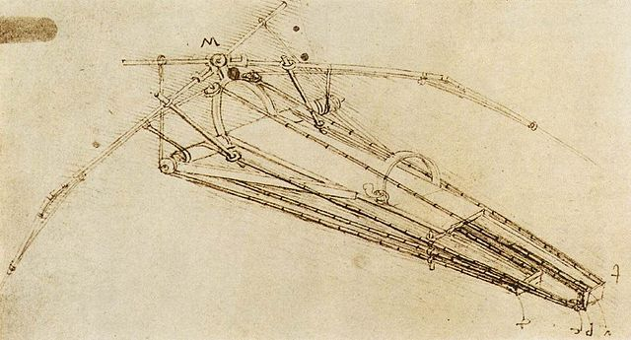
Plan:
Select a promising solution
Your team must now complete a proposed design. It should include all needed materials and a visual of some sort. You may want to include measurements.
Your design will be ssessed at the materials booth. If it is approved, you may go on to select your materials.

Slide 8
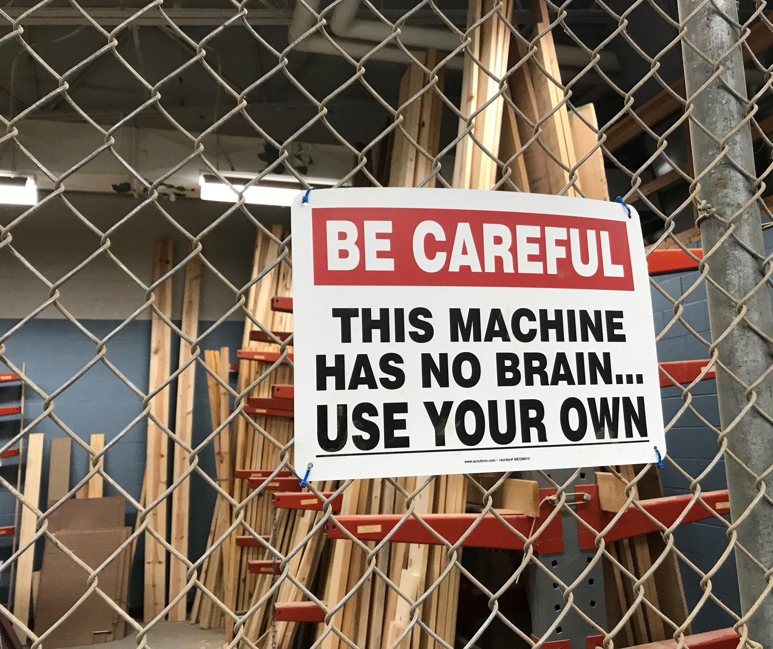
Create:
Build a Prototype
Once you have had your sketch approved and you have acquired your supplies, start building your apparatus.

Slide 9
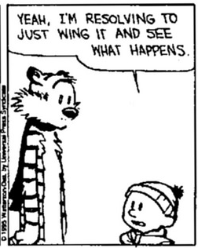
Test: Evaluate the prototype
Once you have confidence in your invention, you need to bring it to the test stations.
You will be given two minutes to deliver your care packages consecutively (back-to-back). This shows that your design will consistently deliver the supplies.

Slide 10
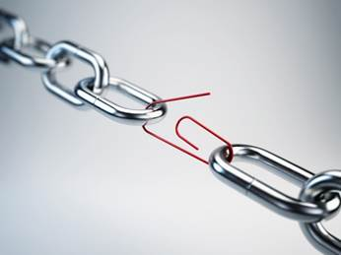
Improve: Redesign as Needed
If you completed the mission, that’s great! How could you do it more accurately? How many times in a row can you successfully deliver the package? Are there ways you could improve the design to make it more accurate?
If you didn’t complete the mission, that is okay too. Redesign and try again!

