Slide 1
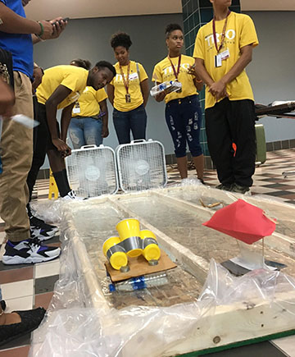
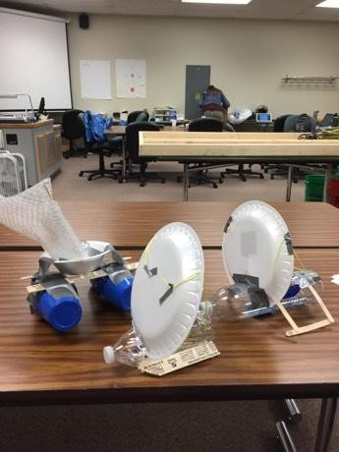
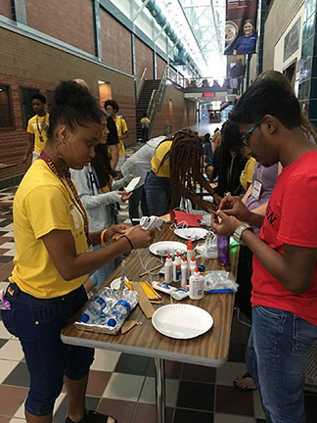
Whatever Floats Your Boat!

Slide 2
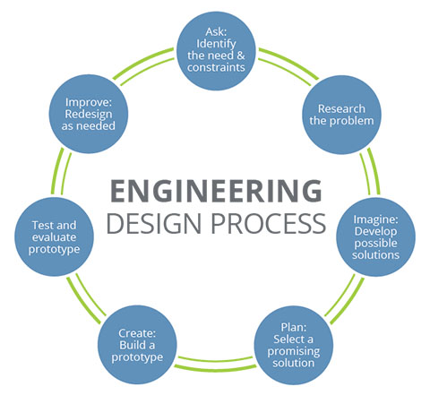

Slide 3
Ask: Identify the Need and Constraints of the Problem

Slide 4
Imagine: Brainstorm possible solutions
Get together with your group and create individual sketches/ideas for the project!
Crazy ideas are good, they lead to creative solutions!

Slide 5
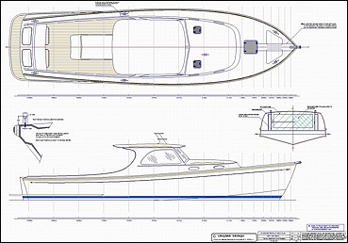
Plan:
Select a promising solution
Draw out some blueprints and ideas!

Slide 6
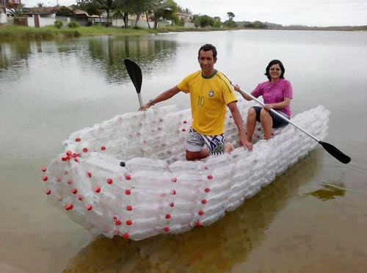
Create:
Build a Prototype
Make your plan come to life!

Slide 7
Test and Evaluate
Think you have the best plan? Test it!
Learn from this and see what can be improved.

Slide 8
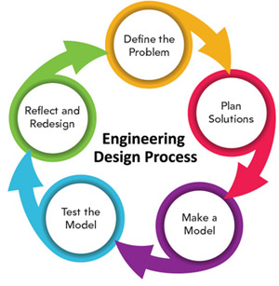
Improve: Redesign as Needed
If your plan worked, that’s great! Now how could you do it more efficiently?

Slide 9
