Slide 1
Algorithms and Everyday Life (Lower Levels)

Slide 2
ALGORITHMS

Slide 3
STEP 1…
STEP 4…
STEP 2…
STEP 5…
STEP 3…

Slide 4
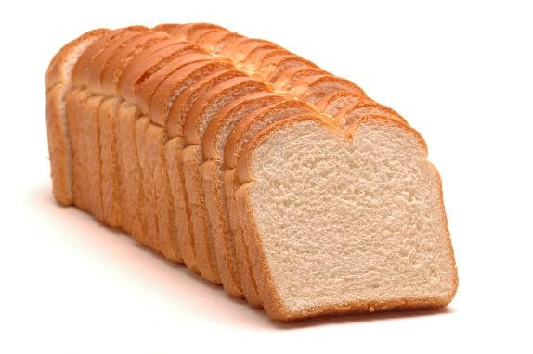
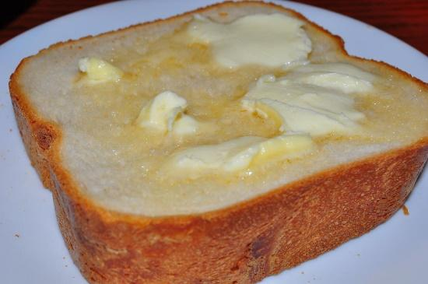
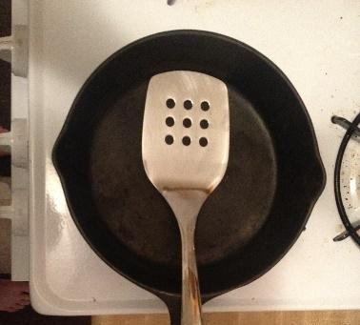
Notes:
https://www.tasteofhome.com/recipes/basic-homemade-bread
https://pixabay.com/en/butter-bread-knife-crumbs-596296/
https://commons.wikimedia.org/wiki/File:Cheese_and_Pickle_Sandwich_Step_2_(8576753601).jpg
https://commons.wikimedia.org/wiki/File:GrilledCheese2.jpg

Slide 5
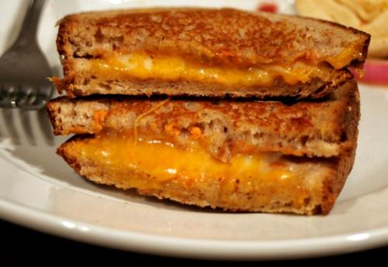
Notes:
https://commons.wikimedia.org/wiki/File:Grilled_cheese_sandwich.jpg

Slide 6
Notes:
https://commons.wikimedia.org/wiki/File:PageRank-hi-res.png

Slide 7
Notes:
https://www.google.com/search?hl=en&biw=1278&bih=602&tbm=isch&sa=1&ei=xVYQW67IKIed0gKH97LQCQ&q=iron+man&oq=iron+man&gs_l=img.3..35i39k1j0l4j0i67k1j0l4.4275477.4277640.0.4277879.8.8.0.0.0.0.115.825.3j5.8.0....0...1c.1.64.img..0.8.825....0.TP7O040Rmzk

Slide 8
Notes:
Images by Alexi Drgac

Slide 9
Notes:
Image by Alexi Drgac

