Slide 1
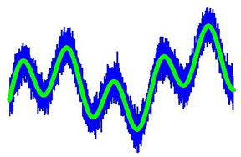
Filtering Separating what you want from what you have
Notes:
Filtering Presentation > Filtering: Extracting What We Want from What We Have lesson > TeachEngineering.org
~
Image source: 2014 Michael B. Wakin and Dehui Yang, Colorado School of Mines

Slide 2
Notes:
A water filter removes impurities to clean the water for drinking.
~
Water filter photo source: 2010 Globalfunky, Wikimedia Commons http://commons.wikimedia.org/wiki/File:Tata_Swach_Water_purifier.jpg

Slide 3
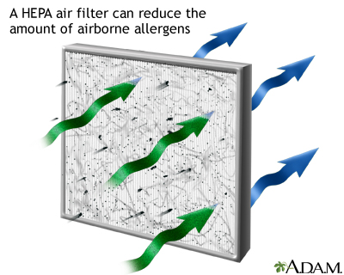
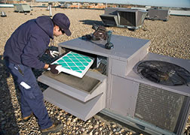
Notes:
Air filters keep dust from passing through so that cleaner air is produced.
A technician inspects the filter on a rooftop air conditioning unit.
A man cleans a (very dirty) vehicle air filter in Afghanistan.
~
HEPA filter drawing source: ADAM, MedlinePlus, U.S. National Library of Medicine http://www.nlm.nih.gov/medlineplus/ency/imagepages/19338.htm
Technician on rooftop photo source: Bureau of Labor Statistics, US Department of Labor http://www.bls.gov/ooh/installation-maintenance-and-repair/heating-air-conditioning-and-refrigeration-mechanics-and-installers.htm#tab-4
Cleaning vehicle air filter photo source: 2010 Chad Chisholm, U.S. Air Force, U.S. Department of Defense http://www.defense.gov/Photos/NewsPhoto.aspx?NewsPhotoID=13344

Slide 4
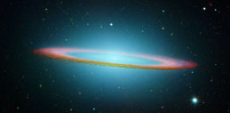
Signals are all around us
Image, video, audio, radio, medical and musical signals…
These signals contain a lot of information
Notes:
An image is a type of signal that contains a great deal of information.
This NASA infrared light image shows the Somobrero Galaxy.
~
Image source: 2003 NASA JPL-Caltech and The Hubble Heritage Team (STScI/AURA), Wikimedia Commons http://commons.wikimedia.org/wiki/File:Sombrero_Galaxy_in_infrared_light_(Hubble_Space_Telescope_and_Spitzer_Space_Telescope).jpg

Slide 5
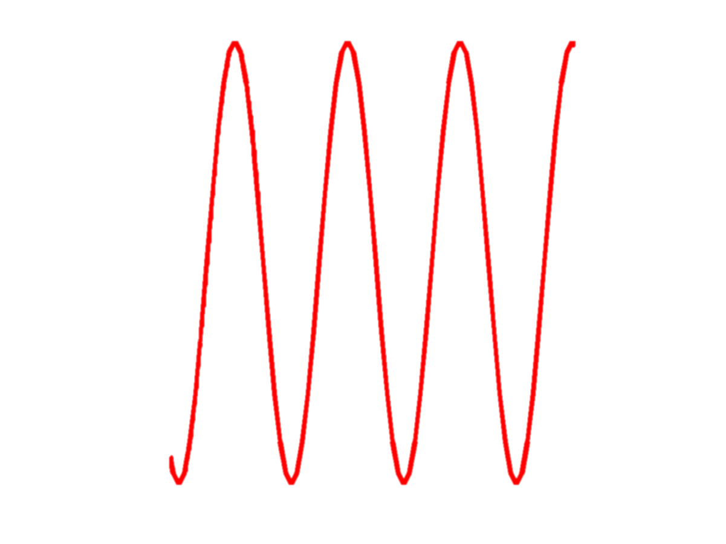
We can also filter signals
signal (we want) + noise (we don’t)
FILTER
signal (we want)
Notes:
Through the use of filtering, an original smooth waveform can be recovered from a noisy waveform.
~
Drawing source: 2014 Michael B. Wakin and Dehui Yang, Colorado School of Mines

Slide 6
Digital Filters
When an image is being processed by a computer/iPhone…
1 0 0 1 0 1 0 0 0 1 0 1 0 0 1 0 1 0 1 0 1 0 1 0 0 0 0 1 0 0 1 0 1
0 0 0 1 0 1 0 0 1 0 1 0 1 0 1 0 1 0 0 0 0 1 0 0 1 0 1 0 0 0 1 0 1
0 0 1 0 1 0 1 0 1 0 0 1 0 1 0 1 0 1 0 0 0 0 1 1 1 1 1 0 0 0 0 1 1
0 1 1 1 1 0 0 0 0 1 0 1 0 1 1 1 1 0 0 0 0 1 1 1 0 1 0 1 0 0 1 0 1
0 1 0 1 0 1 0 1 0 0 1 0 0 1 1 0 0 1 1 1 0 0 0 1 1 1 1 0 1 0 1 0 0
…we can filter it using computation (also known as digital signal processing or DSP)

Slide 7
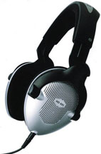
What can filtering achieve?
Noise-cancelling headphones reduce unwanted ambient sounds (noise) by generating an antinoise sound wave to cancel the noise, letting just the music be heard
Notes:
Noise-canceling headphones use filters to remove external noise.
~
Headphone image source: 2008 Hens Zimmerman, Wikimedia Commons http://commons.wikimedia.org/wiki/File:Sennheiser_HD495_headphones.jpg

Slide 8
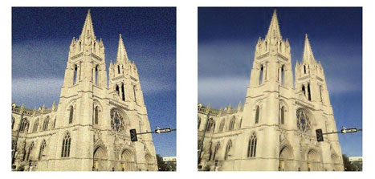
What can filtering achieve?
noisy image
de-noised image
Notes:
A noisy image before filtering (left) and the “de-noised” image after filtering (right).
~
Photographs of the Cathedral Basilica of the Immaculate Conception in Denver, CO, source: 2014 Michael B. Wakin, Dehui Yang and Kyle R. Feaster, Colorado School of Mines

Slide 9
The concept of frequency
Describes how quickly a signal moves
Plays an important role in many types of filters
low frequency
high frequency
Notes:
The red waveform takes a long time to repeat itself, while the pink waveform repeats itself much more frequently in a given length of time. This means that the pink waveform has a higher frequency than the red one.
Waveforms with different frequencies have different rates of oscillation.
~
Image source: 2007 LucasVB, Wikipedia Commons https://commons.wikimedia.org/wiki/File:Sine_waves_different_frequencies.svg

Slide 10
Frequency in music
Notes:
Many real world phenomena have tight connections with frequency.
~
Piano keyboard with music notation for each key’s pitch below it source: 2006 WarX (Artur Jan Fijałkowski), Wikimedia Commons http://commons.wikimedia.org/wiki/File:Pianos_keyboard_with_notes.svg
Bass cleff symbol: Archives of Pearson Scott Foresman, Wikimedia Commons http://commons.wikimedia.org/wiki/File:Bass_clef_(PSF).png
Treble clef symbol: 2007 WarX (Artur Jan Fijałkowski), Wikimedia Commons http://commons.wikimedia.org/wiki/File:Treble_clef_with_empty_staff.svg

Slide 11
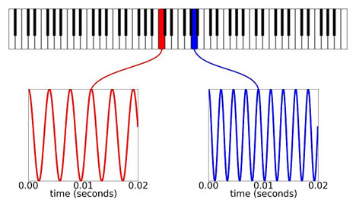
middle C 261.626 Hz
middle A 440 Hz
Notes:
For example, each key on a piano has its own note, which corresponds to a certain frequency at which the corresponding wire in the piano vibrates when the key is struck. The waveform on the left in red shows middle C, which has a frequency of 261.626 Hz. Middle A, shown on the right in blue, has a frequency of 440 Hz. This agrees with our auditory sensation that the pitch of the musical notes on a piano increases as we move to the right on the keyboard.
~
Piano keyboard graphic source: 2006 WarX, Wikipedia Commons http://commons.wikimedia.org/wiki/File:Pianos_keyboard.svg

Slide 12
Spectrum
Hz
27.5
261
4186
440
Notes:
The spectrum is a graphical representation of the range and strength of the frequencies in a signal.
Can you find middle C at 261.626 Hz and middle A at 440 Hz?
What are the other notes and their frequencies?
~
Piano keyboard graphic source: 2006 WarX, Wikipedia Commons http://commons.wikimedia.org/wiki/File:Pianos_keyboard.svg

Slide 13
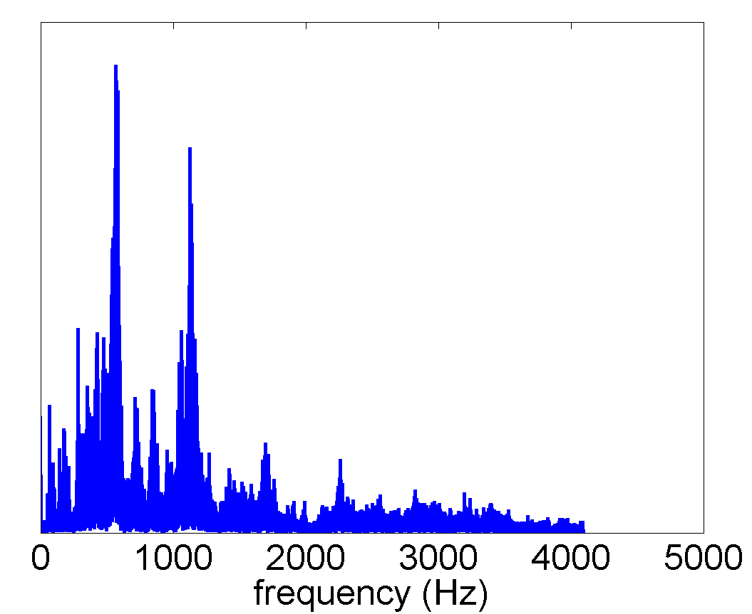
Spectrum of a “real-world” signal
Real-world signals can be thought of as combinations of different frequency components
Notes:
The larger the amplitude at a certain frequency, the more that frequency is represented in the signal. For example, this graph shows the spectrum of a real-world signal. From the spectrum, we clearly see that the signal is mainly composed of two frequencies, which are located at approximately 500 Hz and 1100 Hz, respectively. The spectrum provides a way to visualize the frequency content of the signal.
~
Graph source: 2014 Michael B. Wakin and Dehui Yang, Colorado School of Mines

Slide 14
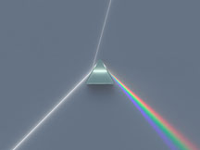
Notes:
Another great example of a spectrum is a rainbow. If we shine a white light through a prism, we can separate the light into different colors that compose that light. Each color corresponds to a different frequency of the electromagnetic wave that our eyes see as visible light. By using a prism in this way, we are essentially looking at the spectrum that composes the incoming light.
~
Dispersive prism illustration source: 2010 Spigget, Wikimedia Commons http://commons.wikimedia.org/wiki/File:Dispersive_Prism_Illustration_by_Spigget.jpg

Slide 15
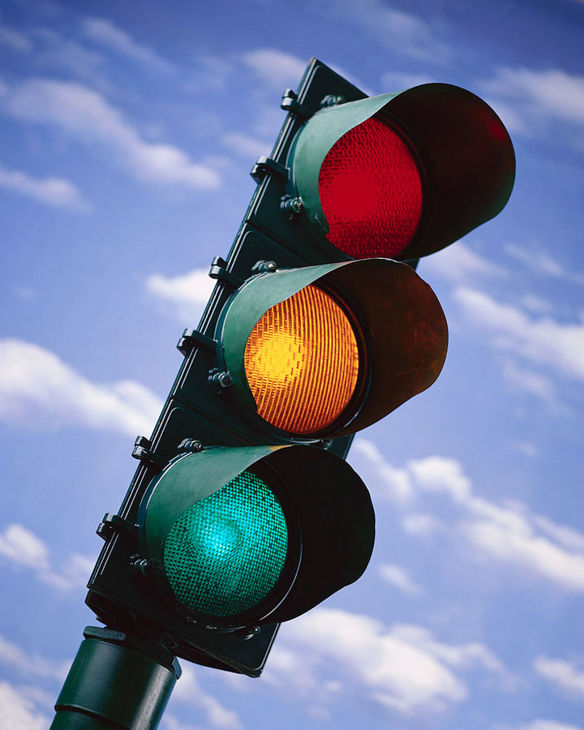
Notes:
This same idea is used in the design of traffic lights. When a traffic light is red, the glass in front of the light bulb acts like a filter, only permitting the frequency corresponding to red light to pass through and blocking the frequencies of other colors.
~
Image source: City of Aurora, CO: https://www.auroragov.org/cs/groups/public/documents/digitalmedia/009929.jpg

Slide 16
Many filters act by
keeping some frequencies (the ones we want) and throwing away others (the ones we don’t)
Notes:
Similar to how traffic lights work, many filters act by keeping some frequencies and blocking others.
Different types of filters exist based on diverse applications. The next slides show examples of four well-known filters in electrical engineering: low-pass, high-pass, band-pass and notch filters.

Slide 17
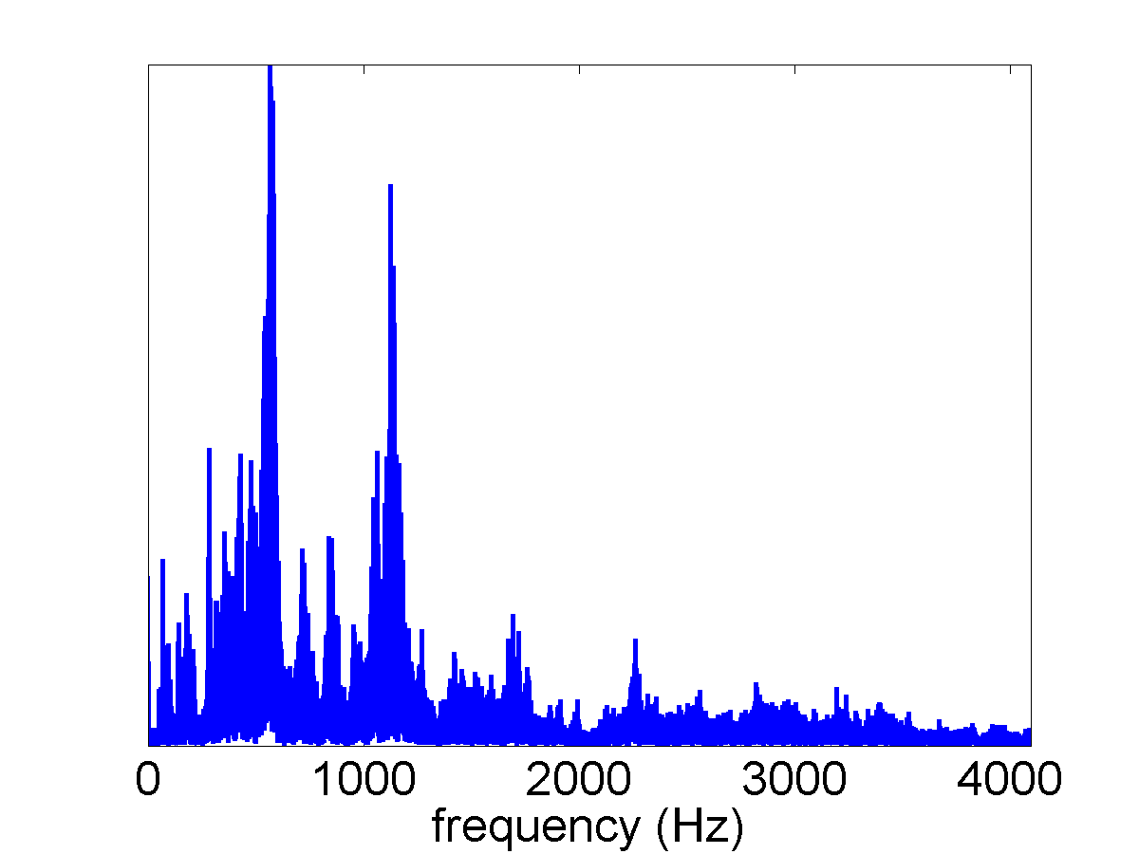
Low-pass filter
Notes:
A low-pass filter is a filter that keeps low-frequency components and blocks high-frequency components.
~
Graph source: 2014 Michael B. Wakin and Dehui Yang, Colorado School of Mines

Slide 18
Low-pass filter
Notes:
An original spectrum before low-pass filtering.
~
Graph source: 2014 Michael B. Wakin and Dehui Yang, Colorado School of Mines

Slide 19
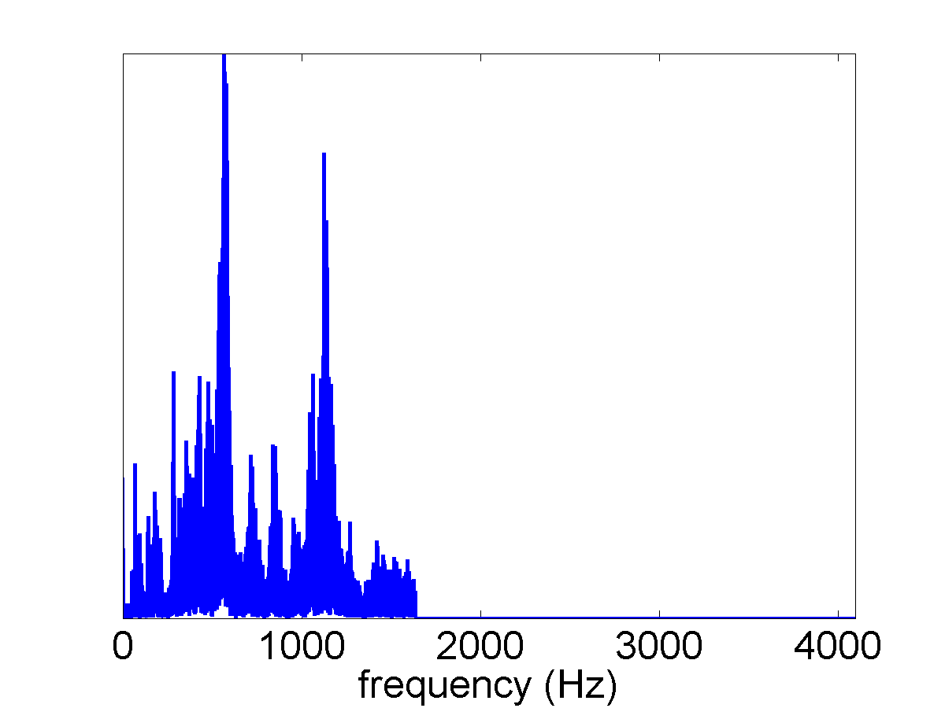
Low-pass filter
Notes:
Spectrum after low-pass filtering.
~
Graph source: 2014 Michael B. Wakin and Dehui Yang, Colorado School of Mines

Slide 20
High-pass filter
Notes:
A high-pass filter is a filter that keeps high frequency components and blocks low frequency components.
~
Graph source: 2014 Michael B. Wakin and Dehui Yang, Colorado School of Mines

Slide 21
High-pass filter
Notes:
An original spectrum before high-pass filtering.
~
Graph source: 2014 Michael B. Wakin and Dehui Yang, Colorado School of Mines

Slide 22
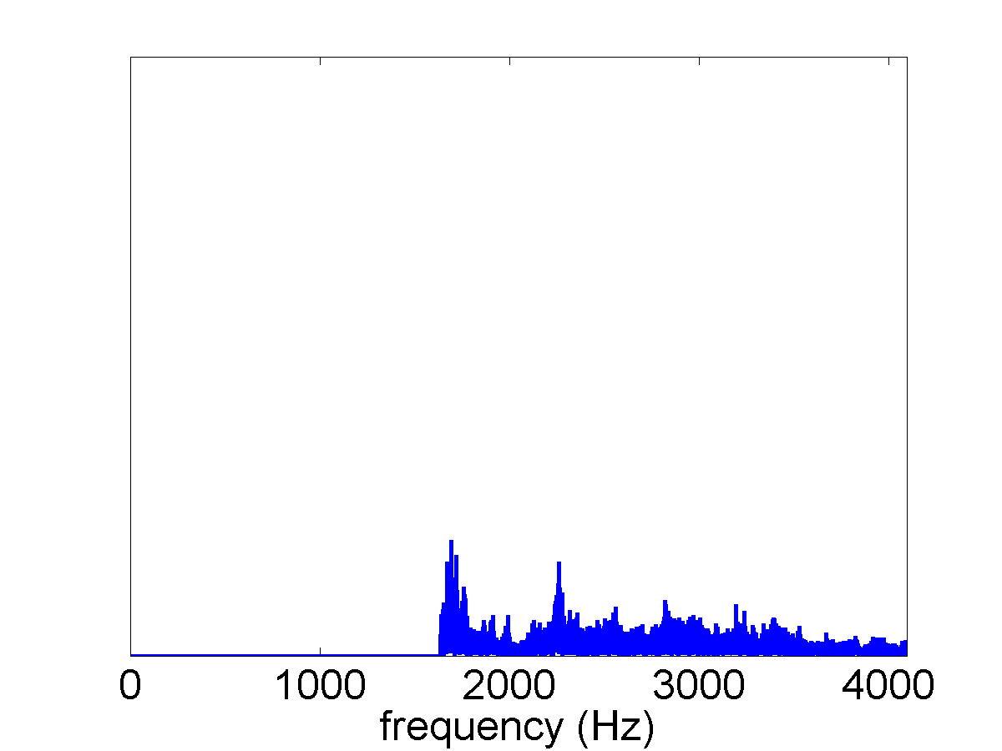
High-pass filter
Notes:
Spectrum after high-pass filtering.
~
Graph source: 2014 Michael B. Wakin and Dehui Yang, Colorado School of Mines

Slide 23
Band-pass filter
Notes:
An original spectrum before band-pass filtering.
~
Graph source: 2014 Michael B. Wakin and Dehui Yang, Colorado School of Mines

Slide 24
Band-pass filter
Notes:
A band-pass filter is a filter that only keeps a certain range of frequency components and blocks any other frequencies outside the range.
~
Graph source: 2014 Michael B. Wakin and Dehui Yang, Colorado School of Mines

Slide 25
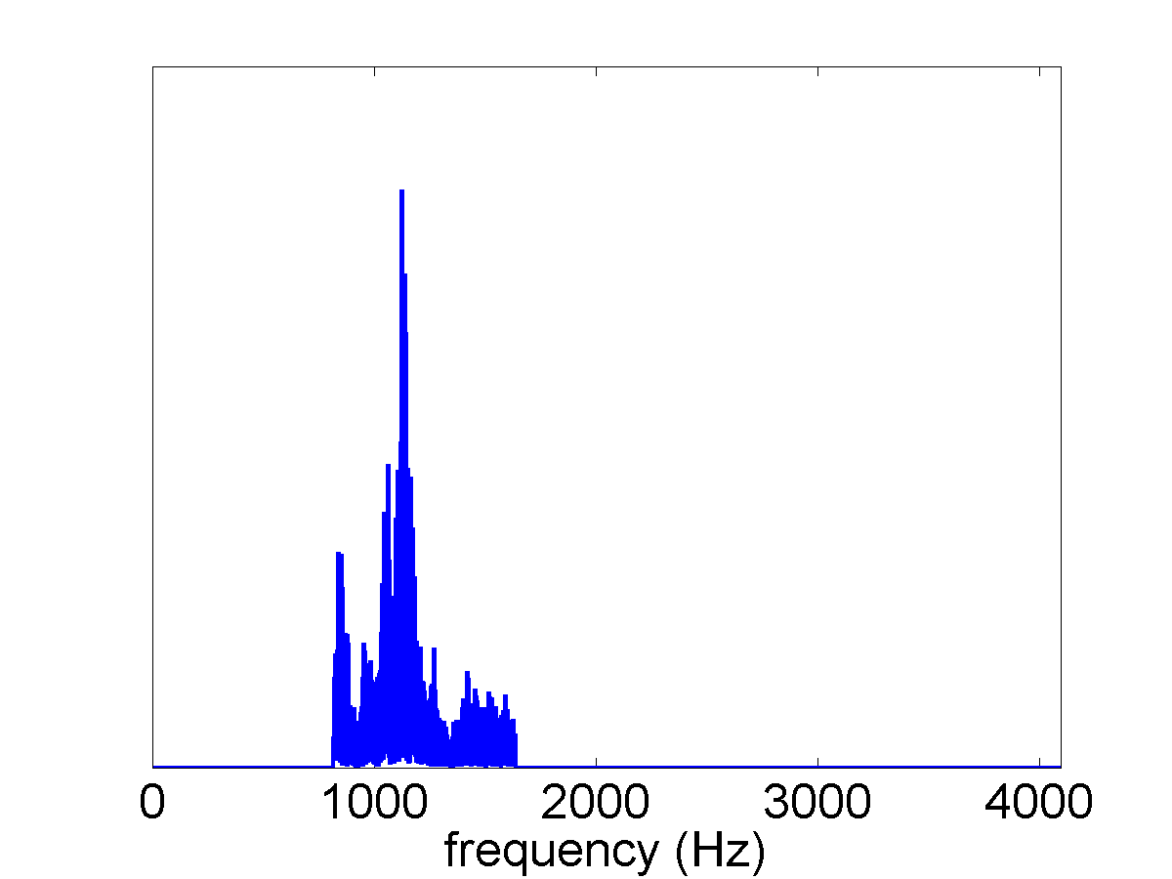
Band-pass filter
Notes:
Spectrum after band-pass filtering.
~
Graph source: 2014 Michael B. Wakin and Dehui Yang, Colorado School of Mines

Slide 26
Notch filter
Notes:
A notch filter is a filter that blocks specific frequency points and does not affect the rest of the signal.
~
Graph source: 2014 Michael B. Wakin and Dehui Yang, Colorado School of Mines

Slide 27
Notch filter
Notes:
An original spectrum before notch filtering.
~
Graph source: 2014 Michael B. Wakin and Dehui Yang, Colorado School of Mines

Slide 28
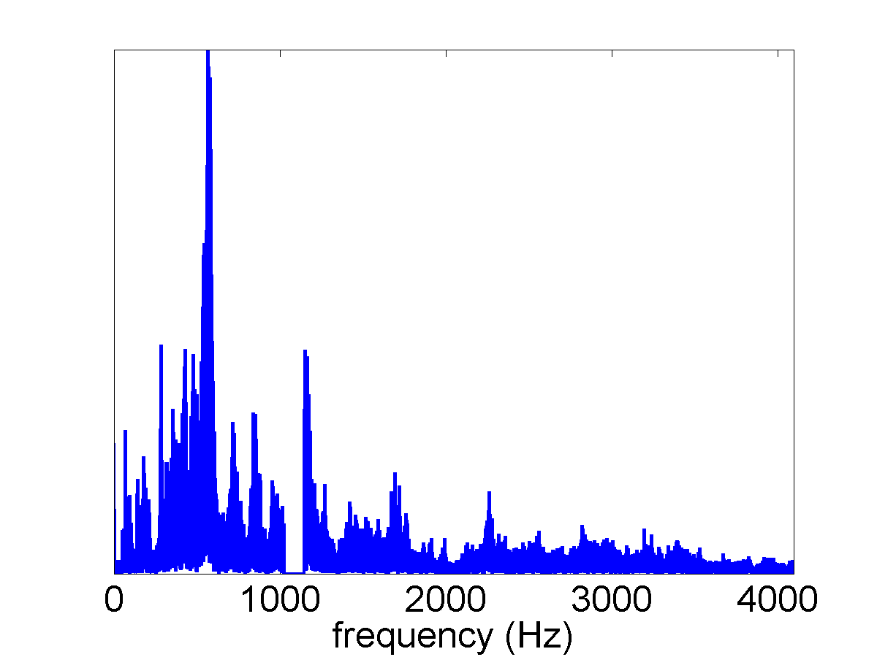
Notch filter
Notes:
Spectrum after notch filtering.
~
Graph source: 2014 Michael B. Wakin and Dehui Yang, Colorado School of Mines

Slide 29
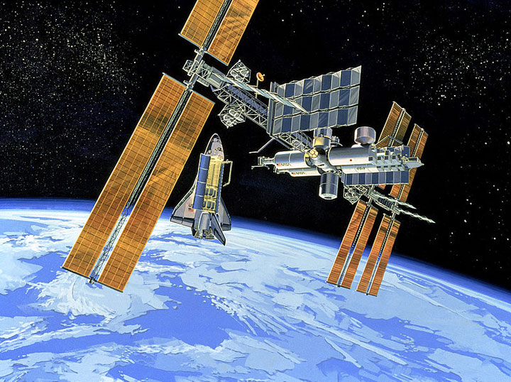
tinyurl.com/filterdemo
Notes:
Next, move on to conduct the associated activity.
URL = http://greneholt.github.io/teaching-dsp/
~
International space station and shuttle image source: 1991 NASA, Wikimedia Commons http://commons.wikimedia.org/wiki/File:SSF_-_1991.jpg

