Slide 1
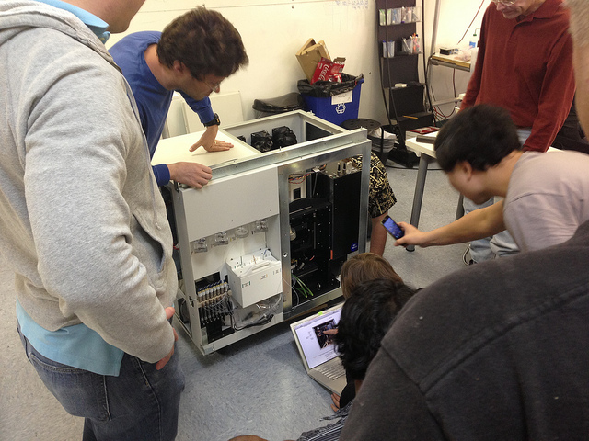
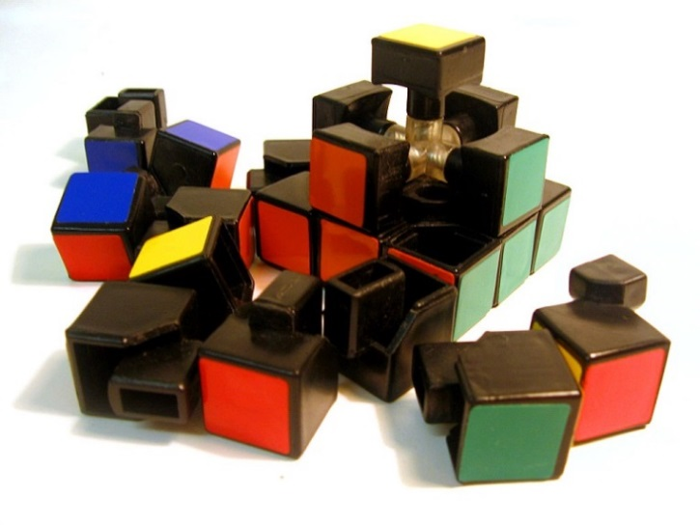
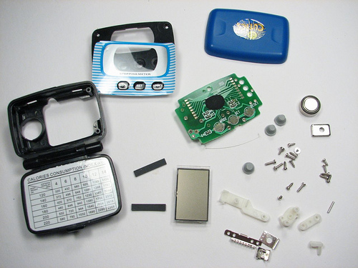
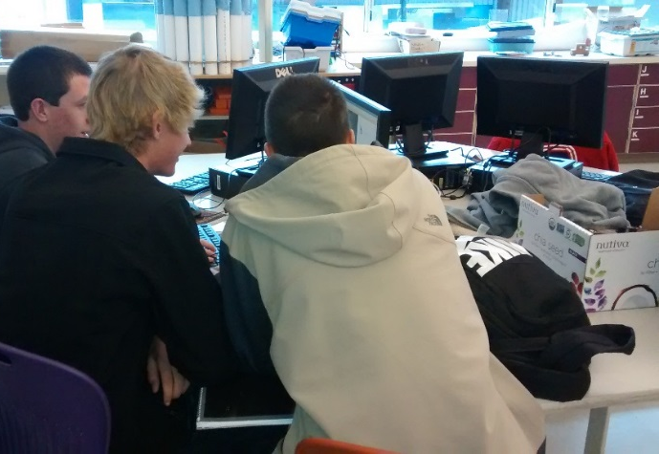
Reverse Engineering Intro
Notes:
Reverse Engineering Intro Presentation, Reverse Engineering Project Activity, TeachEngineering.org
Image sources:
Top left (students taking apart a medical device): 2013 BioCuriousLab’s photostream on Flickr at https://www.flickr.com/photos/biocuriouslab/8689986869/ [Creative Commons licensing at https://creativecommons.org/licenses/by/2.0/]
Top right (disassembled rubic’s cube): 2006 Curis, Wikimedia Commons https://commons.wikimedia.org/wiki/File:Disassembled-rubix-1.jpg [Licensed under CC BY 2.5]
Lower left (disassembled pedometer): 2008 Lenore Edman’s photostream on Flickr at https://www.flickr.com/photos/lenore-m/2279297688 [Creative Commons licensing at https://creativecommons.org/licenses/by/2.0/]
Lower right (3 teens at table): 2015 Alexa Garfinkel (author), Colorado State University

Slide 2
What is reverse engineering?
Reverse engineering is the process of taking apart an object.
But why?!
To understand it better
To see inside to satisfy your curiosity: How does it work?
To examine the structure, function, operation
To duplicate or improve it:
Reduce the cost, improve the materials, reduce environmental impact, etc.
Increase its efficiency and reliability, add features and usefulness, etc.

Slide 3
Group Proposal
What is your project? (device description, cost and source)
What does the device do?
How are you going to take it apart? What tools do you need?
How many parts do you think it contains? What kinds of parts do you think you will find inside?
Rough sketch of the overall device
DUE BY: [ Day 2 ]
D E A D L I N E :
Notes:
Modify and/or add a specific deadline as makes sense for your class and time
Image source:
2013 Victorgrigas, Wikimedia Commons https://commons.wikimedia.org/wiki/File:High_Line_Nyc_Marriage_Proposal.jpg [Licensed under CC BY-SA 3.0]

Slide 4
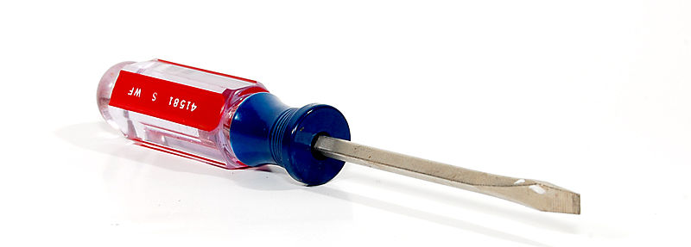
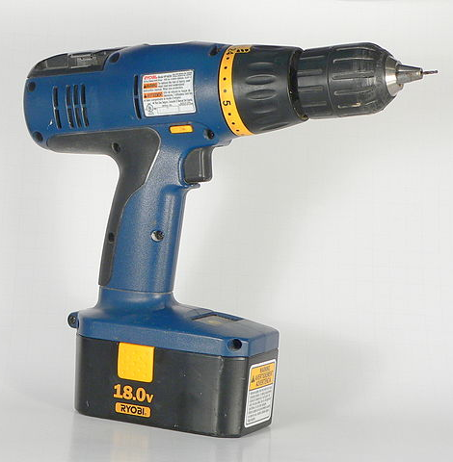
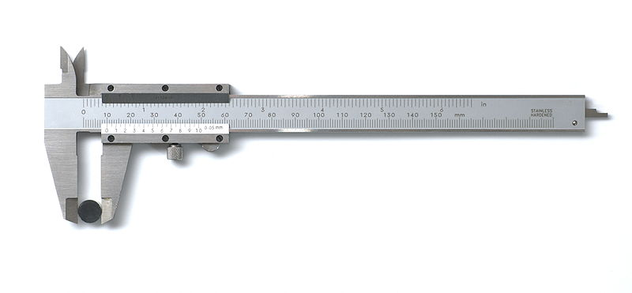
Tools
How will you take it apart?
How will you measure each part?
Notes:
Image sources:
Cordless drill: 2005 Photo by Greg Hume, Wikimedia Commons https://commons.wikimedia.org/wiki/File:CordlessDrill.jpg [Licensed under CC BY-SA 3.0]
Flat-nosed pliers: 2010 Evan-Amos, Wikimedia Commons https://commons.wikimedia.org/wiki/File:Tool-pliers.jpg [public domain]
Flat-head screwdriver: 2007 Fcb981, Wikimedia Commons https://commons.wikimedia.org/wiki/File:Screw_Driver_display.jpg [Licensed under CC-BY-2.5 under GNU Free Documentation License]
Calipers: 2009 Simon A. Eugster, Wikimedia Commons https://commons.wikimedia.org/wiki/File:Caliper_full_view.jpeg [Licensed under CC BY-SA 3.0]

Slide 5
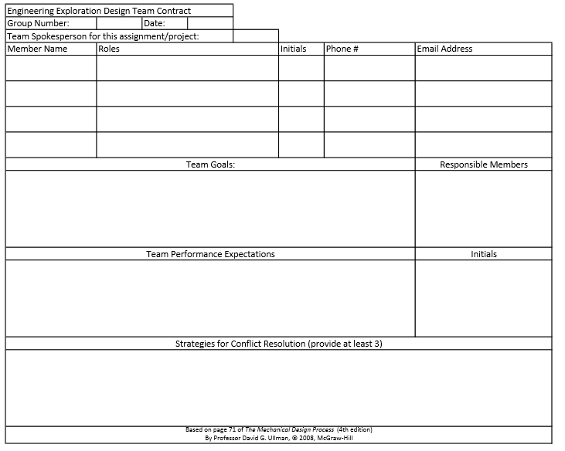
Team Contract

Slide 6
Parts List (BoM)
Bill of Material for |  |  | Names:
Product # | Name | Qty. | Dimension | Function | Interaction with other Parts | Research Cost | Website
1
2
3
4
5
6
7
8
9
10
11
12
13
14
15
16
17
18
19
20
Bill of Materials
Notes:
BOM = bill of materials

Slide 7
Report Requirements
Manual
Purpose of object
Bill of materials
Procedure
How does it work?
How do you put it together?
Sketches
Wrap-Up Report
Team contract (will be checked off before project is started)
Conclusion: What happened? What should your group done differently/same?
3 improvements/changes (or innovations) on device to better assist customers, manufacturers and/or the environment
Sketches and descriptions!
3 Improvements/changes on overall project
Why?
Feedback
Teamwork evaluation
Upload to the homework portal as a doc with:
1. page numbers and
2. header that includes your names and the device name!

Slide 8
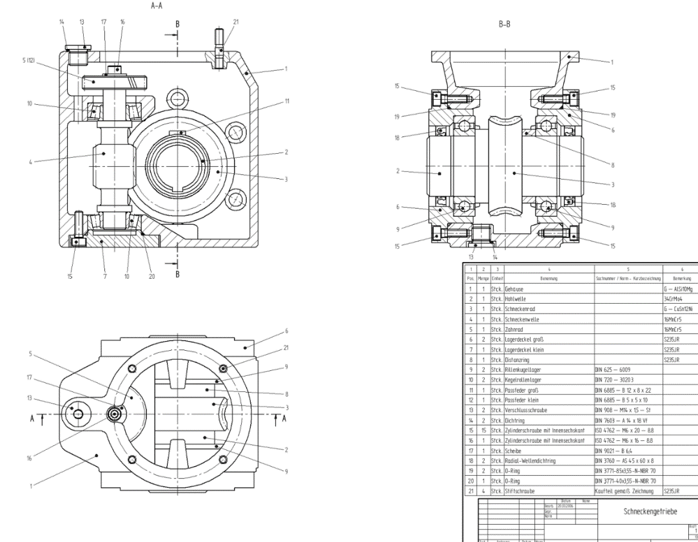
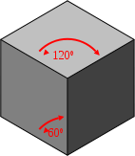
Sketching
by hand or using SolidWorks
Overall sketch with labeled parts (see next slide)
Parts drawn isometrically and orthogonally
“Exploded view” sketch (see next slide)
orthogonal ⬇
⬅ isometric
Notes:
Image sources:
Shaded isometric drawing of cube: 2006 Christophe Dang Ngoc Chan & Mike Horvath, Wikimedia Commons https://commons.wikimedia.org/wiki/File:Perspective_isometrique_cube_gris.svg [public domain]
3-part orthogonal engineering drawing of a worm gear plus BoM: 2006 Thorsten Hartmann, Wikimedia Commons https://commons.wikimedia.org/wiki/File:Schneckengetriebe.png [Licensed under CC BY-SA 3.0]

Slide 9
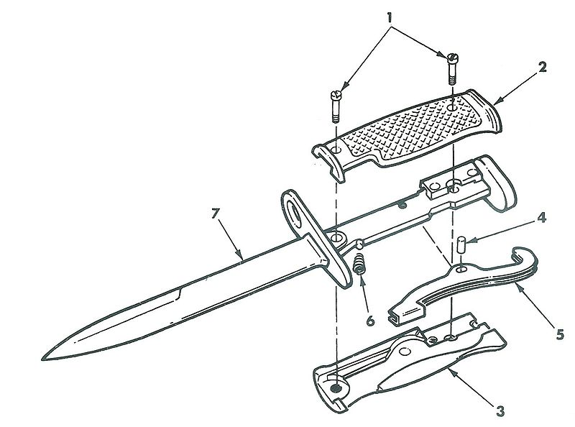
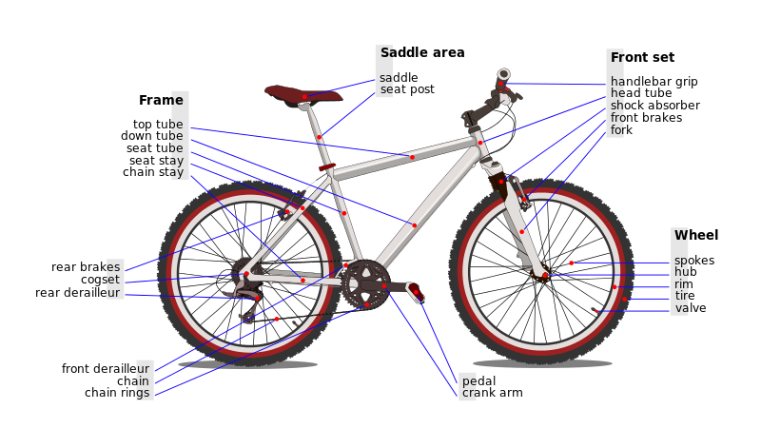
Sketching Examples
⬇ Exploded view sketch
⬇ Labeled parts sketch
Notes:
Image sources:
Exploded view of bayonet knife: 1986 U.S. Army, Wikimedia Commons https://upload.wikimedia.org/wikipedia/commons/thumb/0/0a/Bayonet-Knife_M6_Expl.jpg/800px-Bayonet-Knife_M6_Expl.jpg [public domain image]
Labeled bicycle parts diagram: 2007 Fiestoforo/AI2, Wikimedia Commons https://commons.wikimedia.org/wiki/File:Bicycle_diagram-en.svg [Licensed under CC-3.0 GNU Free Documentation License]

Slide 10
Reverse Engineering Project
overview
Assigned teams of 1, 2 or 3
Object requirements:
Number of parts:
Group of 1: at least 7 parts
Group of 2: at least 10 parts
Group of 3: at least 15 parts
Low-voltage device, for example, no plug-ins; battery-driven is okay)
Unwanted items OR items that cost at most $5 per person
Note: The object will not work after we’re done!
D E A D L I N E S:
Project approval per group by: [ Day 2 ]
Project due: [ Day 12 ]
Notes:
Modify and/or add specific deadlines as makes sense for your class and time.

Slide 11
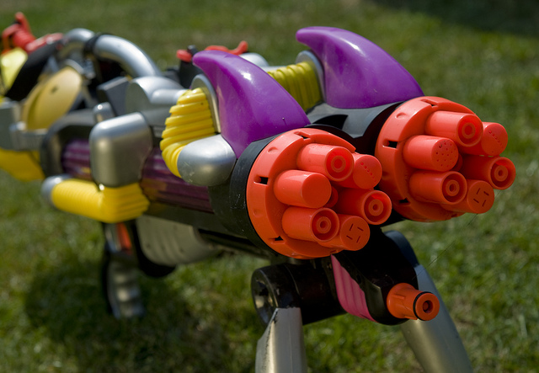
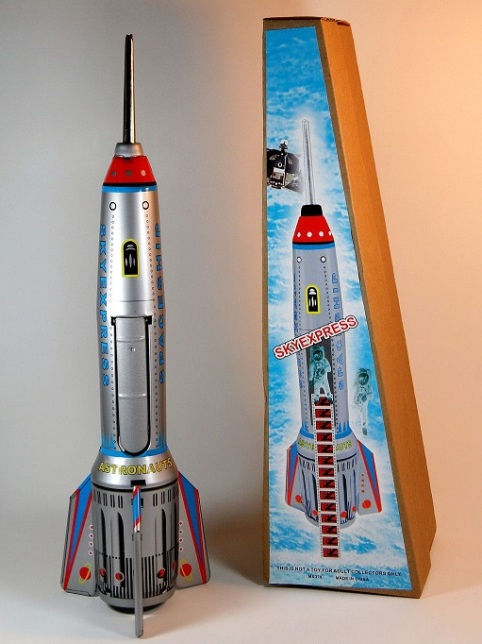
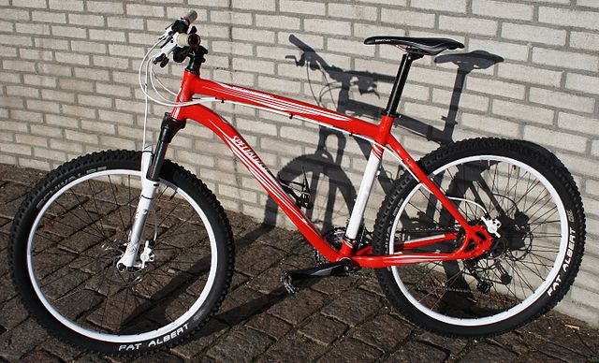
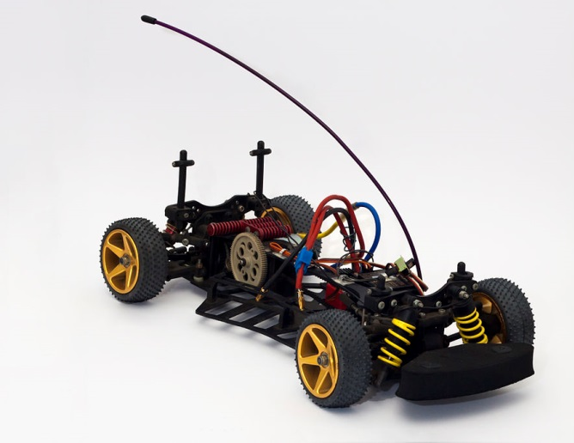
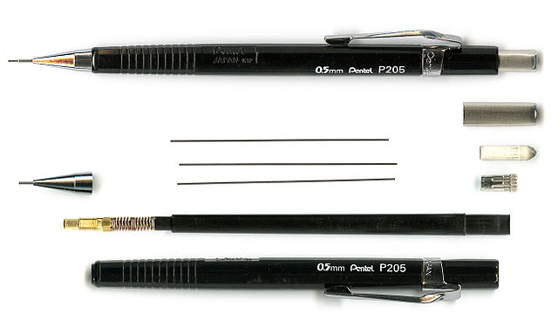
Project Ideas
Notes:
Image sources:
Toy rocket: 2012 D J Shin, Wikimedia Commons https://commons.wikimedia.org/wiki/File:Unknown_Chinese_Maker_Tin_Rocket_Spaceship_Skyexpress_Front_With_Box.jpg [Licensed under CC BY-SA 3.0]
Water gun: 2011 Graham Dean, Flickr https://www.flickr.com/photos/britanglishman/5653390473 [Licensed under CC BY 2.0, https://creativecommons.org/licenses/by/2.0/]
Fishing pole spinning reel: 2006 Jan Tik from Flickr, Wikimedia Commons https://commons.wikimedia.org/wiki/File:Fishing_reel.jpg [Licensed under CC BY 2.0]
Weighted tape dispenser: 2010 Evan-Amos, Wikimedia Commons https://commons.wikimedia.org/wiki/File:Tape-dispenser.jpg [public domain]
Red bicycle: 2012 Victor Vanderberg, Wikimedia Commons https://commons.wikimedia.org/wiki/File:HardtailMountainBike_2010_Specialized_Rockhopper.jpg [Licensed under CC BY-SA 3.0]
Remote-controlled car: 2010 Jfitch, Wikimedia Commons https://commons.wikimedia.org/wiki/File:RC_Race_Car_SST2000.jpg [Licensed under CC BY 3.0, http://creativecommons.org/licenses/by/3.0]
Toy bulldozer truck: https://pixabay.com/en/lego-technic-shovel-construction-717194/ [Licensed under CC0 public domain; https://pixabay.com/en/service/terms/#usage]
Mechanical pencil: 2006 Knulclunk, Wikimedia Commons https://commons.wikimedia.org/wiki/File:Mechpencil05.jpg [public domain]

Slide 12
Overall Project Schedule
Days 1-2: Assign teams, brainstorm and write-up proposal
Day 2: Proposal due (approved or revised); draft team contract
Days 2-3: Team contract completed, bring in device/product
Days 4-6: Take apart the device, with thorough documentation
Days 6-9: Sketch parts, prepare bill of materials and manual
Days 9-11: Write report, get feedback, come up with improvement ideas, prepare conclusion
Days 11-12: Organize, edit, wrap-up
Days 13-14: Class oral presentations
Notes:
Modify and/or add specific deadlines as makes sense for your class and time

Slide 13
Grading Rubrics
Criteria | Rating Scale |  |  | Score
 | 3 | 2 | 1
Manual: Device description | Description of the device is expressed. Sketch helps explain each part and its function. | Some description of the device is expressed. Sketch helps explain either part or its function. | No description of the device is expressed. Sketch does not help explain each part and its function.
Manual: Bill of Materials | A list of parts found in the process of taking apart the technology. Parts are listed along with Part #, name, qty., dimension, function, cost, interactions, and website | Two parts were missing from the BOM. Lacked parts description. | More than two parts were missing and parts' descriptions were incomplete.
Manual: Sketches | Sketches are dimensioned, labeled, and numbered (related to BOM). Each part is sketched (orthogonally/isometrically) with an overall sketch. | Some sketches are not dimensioned, labeled, and numbered (related to BOM).Most parts were not sketched (orthogonally/isometrically) with an overall sketch. | Sketches are not dimensioned, labeled, and numbered (related to BOM). Each part was not sketched (orthogonally/isometrically) with an overall sketch.
Manual: Procedures | Step-by-step description of how to work the device AND how to put the device together (if it didn't come assembled). | No detailed description of how to work the device and/or how to put the device together. | No detailed description of any how-to's.
Manual: Overall | Manual included: table of contents, page numbers, header of device and names. | Manual included: table of contents, page numbers, header of device OR names. | Manual did not include: table of contents, page numbers, header of device AND names.
Engineering Design Process | The group has undergone the process to find the best, improved design solution to the chosen device (this includes a documentary of the whole process with sketching, matrix, descriptions, etc.) | The group has somewhat undergone the process with documentary of the process with sketching, matrix, descriptions, etc. | The group did not undergo the process or presented the documentary of the process.
Teamwork and Communication | Team worked well together and were able to present their result from their project. | Team was somewhat able to work together and present their result from their project. | Team was unable to set aside their differences and communicate effectively.
Wrap-Up Report | Concluded the data and result. What went well, what didn't. Changes and/or improvements for next-time AND device with sketches (how to make it better). | Somewhat concluded the data and result. What went well, what didn't. Changes and/or improvements for next-time. | Did not conclude the data and result at all.
Timely Completion | Report completed on time | NA | Report not completed on time
TOTAL
⬅ Written report grading rubric
Oral presentation grading rubric ⬇
Criteria | Rating Scale |  |  | Score
 | 3 | 2 | 1
Manual- Device description | Quick description and purpose of the device was explained. | Device was somewhat explained. | Device was not at all explained.
Manual- Sketches | Sketches (isometrically and orthographically) of the device are explained and shown. | Sketches are either explained or shown. | Sketches were not shown or explained.
Engineering Design Process | Students did a brief explanation of their new idea for the device. | Students did not do a great job in explaining their new idea for the device. | Students did not explain their new idea for the device.
Wrap-Up | Concluded on what went well, what didn't and has shown the improvements for their device with sketches (how to make it better). | Somewhat concluded the result. What went well, what didn't, or improvements for the device | Did not conclude result at all.
Presentation | It was presented via PowerPoint. The students spoke at a good volume and was clear. | The students were not clear in explaining their project. | Did not present at all.
Total:
Notes:
Also see the separate Word and PDF files of these same rubrics.

Slide 14
Notes:
The steps of the engineering design process
Image source: 2014 TeachEnginering.org. All rights reserved. https://www.teachengineering.org/engrdesignprocess.php

