Slide 1
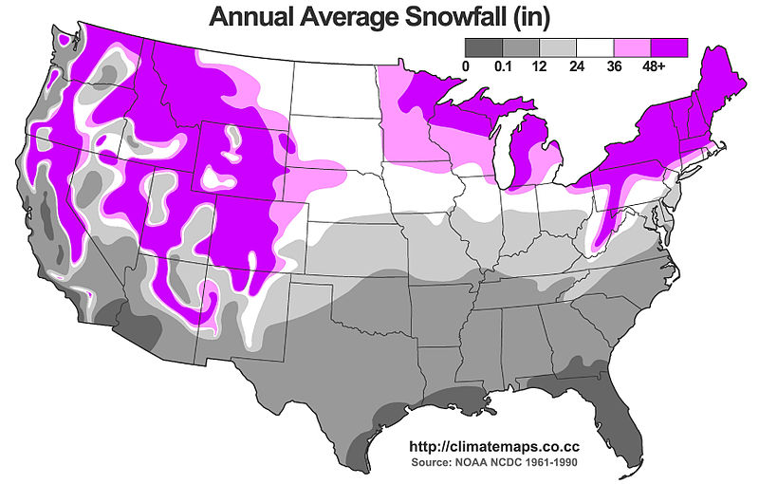
Example Weather Report Map
This map shows the average annual 1961-1990 snowfall in the U.S. (in inches)
A graphic like this helps you visualize, see patterns and understand lots of data at a glance!
How are maps like this created?
Notes:
GIS Presentation, A Closer Look at Natural Disasters Using GIS activity, TeachEngineering.org
///
Image source (also Figure 1 in activity write-up):
2011 Alex Matus, Wikimedia Commons CC BY-SA 3.0 http://climatemaps.co.cc https://commons.wikimedia.org/wiki/File:United_states_average_annual_snowfall.jpg

Slide 2
GIS
Notes:
GIS Presentation, A Closer Look at Natural Disasters Using GIS activity, TeachEngineering.org

Slide 3
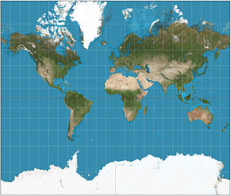
Maps
What map is commonly used today?
Mercator projection
Is the Mercator projection accurate?
Show 4-min video
Notes:
(To introduce and get students comfortable with GIS, start with maps.)
Q: What types of maps of the world do we have and use? What type is most commonly used? A: Most of the maps used today are Mercator projection.
Q: Why is this map the one most commonly used? A: Because it was used so much for nautical purposes (that is, sailing), the Mercator projection became the standard because it represents lines of constant course (rhumb lines or loxodromes) as straight segments that conserve the angles with the meridians.
Although this mapping approach was a major break-through for nautical cartography, it did not gain prominence until the mid-1700s because the technology to utilize the map was unavailable. For a long time it was not possible to determine longitude at sea with enough accuracy and magnetic directions, not geographic directions, were used in navigation. When the marine chronometer (a device to keep accurate time at sea) was invented and magnetic declination became known, then the Mercator projection was adopted.
Q: Do you think the Mercator projection is accurate?
Listen to student answers and BEFORE ANSWERING, show the 4-minute video clip to get students to question what might be the best way to map the world.
VIDEO: Why are we changing maps? (From the West Wing) https://www.youtube.com/watch?v=eLqC3FNNOaI
Magnetic declination = the angle on the horizontal plane between magnetic north and true north. https://en.wikipedia.org/wiki/Magnetic_declination
/// image source
(The world on Mercator projection between 82°S and 82°N. 15° graticule. Imagery is a derivative of NASA’s Blue Marble summer month composite with oceans lightened to enhance legibility and contrast. Created with Geocart map projection software)
2011 Strebe, Wikimedia Commons CC BY-SA 3.0 https://commons.wikimedia.org/wiki/File:Mercator_projection_SW.jpg
///
If students have a hard time understanding the size distortion created by the very common Mercator mapping approach, use Google’s interactive The True Size of… map to drag and drop the shapes of countries around the globe to compare their relative sizes. Surprising!

Slide 4
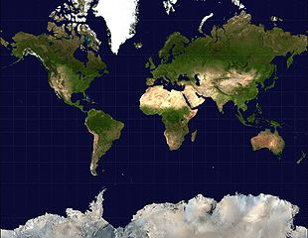
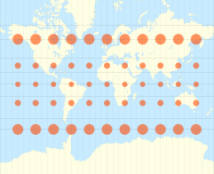
Mercator Projection
Notes:
(Now that students are questioning maps, show them the Mercator projection in detail and describe how it distorts the world.)
The Mercator projection enlarges the poles and shrinks the equator in its attempt to make a flat (2D) image of a round (3D) physical surface.
The linear scale is equal in all directions around any point, which preserves the angles and shapes of small objects (thus making the projection conformal). But, this approach distorts the size of objects at high latitudes.
In the diagram, each red dot has a radius of 500 km so you can see the size deformation that results from this mapping approach.
Mapping the planet this way is great for navigation across the oceans and is still used today for navigation. Because of the preserved 90° angles and straight lines of latitude and longitude, rhumb lines are also straight on the Mercator projection. This means that sailors using maps in this projection do not need to recalculate their bearings on long journeys. Instead, they can mark their starting and ending points and simply follow the line along the expedition route.
Rhumb line = an arc crossing all meridians of longitude at the same angle, that is, a path with constant bearing as measured relative to true or magnetic north.
If students have a hard time understanding the size distortion created by this mapping approach, use Google’s “The True Size of…” interactive map to drag and drop country shapes around the globe to compare their relative sizes. Surprising! See: https://www.google.com/url?sa=t&rct=j&q=&esrc=s&source=web&cd=1&cad=rja&uact=8&ved=0ahUKEwjMw7_Rh_nWAhVPz2MKHTvGB6sQFggoMAA&url=https%3A%2F%2Fthetruesize.com%2F&usg=AOvVaw0Zvz-UuR-3DV6HxEI2-3aL
/// image sources
(left; world map) 2008 mdf, Wikimedia Commons (public domain) https://commons.wikimedia.org/wiki/File:Mercator-projection.jpg
(right; dot diagram) 2008 Eric Gaba user Sting, Wikimedia Commons CC BY-SA 4.0 (using U.S. NGDC World Coast Line data) https://commons.wikimedia.org/wiki/File:Tissot_indicatrix_world_map_Mercator_proj.svg

Slide 5
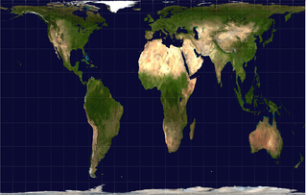
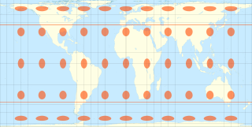
Gall-Peters Projection
Notes:
(Show students the Gall-Peters Projection, as mentioned in the video.)
This rectangular map projection elongates the equator and stretches the poles.
It maps all areas to the correct sizes relative to each other. In order to accomplish this, the shapes must be distorted. The Gall-Peters projection has no distortion at 45 degrees north and south. So, the areas with the highest accuracy are the US and Europe, while the tropics have poor accuracy.
James Gall created the projection in 1855 while Arno Peters brought the map to prominence in 1970s claiming this map to be the only “area correct” map. The discussion of how maps had social impacts were of importance during this time of social change and Peters became a champion of utilizing this map to accurately represent the world. This map is used in UK schools and it is clear that the continents have vastly different sizes when compared to the Mercator projection. North America is much smaller than Africa and South America. The UK and the rest of Europe are also much smaller.
/// image sources
(left; world map) 2008 Louis Waweru/2006 Mdf, Wikimedia Commons (public domain) https://commons.wikimedia.org/wiki/File:Gall-peters.png
(right; dot diagram) 2010 Eric Gaba user Sting, Wikimedia Commons CC BY-SA 4.0 (using U.S. NGDC World Coast Line data) https://commons.wikimedia.org/wiki/File:Tissot_indicatrix_world_map_Hobo-Dyer_equal-area_proj.svg

Slide 6
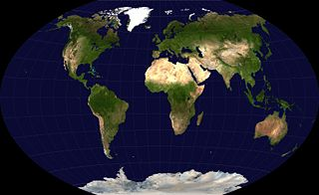
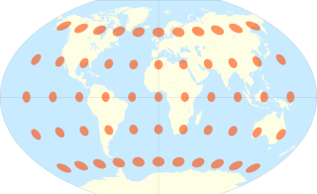
Winkel Tripel Projection
Notes:
As we move to the Windel tripel projection, we get closer to correct, but still have distortion.
Tripel is German for triple, in reference to the goal of minimizing three types of distortion (area, direction and distance).
In 1998, the Winkel tripel projection replaced the Robinson projection as the standard projection for world maps made by the National Geographic Society.
All maps will have some distortion. This projection produces small distance, area and skewness error.
To achieve the best visual representation of the Earth, a globe is the best depiction.
/// image sources
(left; world map) 2006 NASA, Wikimedia Commons (public domain) https://commons.wikimedia.org/wiki/File:Winkel-tripel-projection.jpg
(right; dot diagram) 2008 Eric Gaba user Sting, Wikimedia Commons CC BY-SA 4.0 (using U.S. NGDC World Coast Line data) https://commons.wikimedia.org/wiki/File:Tissot_indicatrix_world_map_Winkel_Tripel_proj.svg

Slide 7
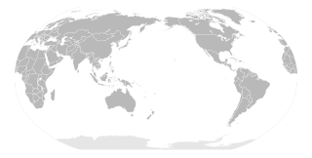
South-Oriented Map
Notes:
Q: After looking at all those maps and improving distance and area errors, who says that the maps we use are correct in orientation?
This map sets south as the top of the map and shifts western Europe from the middle.
Q: Now which countries are located in the middle (focal point) of the map?
Q: Does the orientation of a map affect the thoughts of people who live in the Southern Hemisphere?
(Expect students to say that Russian and Asia are now more central in the map, Australia becomes more prominent and all formerly-southern countries and continents seem to have more importance. )
Studies show that map orientation has psychological impacts.
North is associated with richer people, more expensive real estate and higher altitude, while south is associated with poorer people, cheaper prices and lower altitude—called the "north-south bias." When study subjects were presented with south-up oriented maps, this north-south bias disappeared.
///study info source: https://en.wikipedia.org/wiki/South-up_map_orientation
///image source: (map) 2008 Lokal_Profil, Wikimedia Commons (public domain) https://commons.wikimedia.org/wiki/File:BlankMap-World-180E.svg

Slide 8
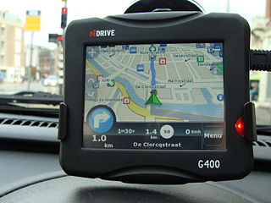
GPS
GPS = global positioning system
A satellite-based radio navigation system
Composed of 32 satellites that continuously orbit the Earth
The satellites broadcast time and position signals
GPS receivers on the ground (like this navigation device in a car) use the signal data from multiple satellites to calculate the exact receiver position (to tell you where you are!)
Location data is calculated by measuring the distance to the satellites based on the time it takes for the device to receive the signals
Notes:
Q: What does GPS stand for? A: Read the slide
Q: What does it do and does this differ from a map? A: Read the slide
GPS differs from maps because it is geographic location data overlaid onto a map.
///image source: (photo of an automotive navigation device)
2009 ines s., Flickr, Wikimedia Commons CC BY-SA 2.0 https://commons.wikimedia.org/wiki/File:NDrive_GPS.jpg

Slide 9
GIS
GIS = geographic information system
A software system that captures, stores, manipulates, analyzes, manages and presents spatial or geographic data—which is data related to physical locations on the Earth’s surface (like GPS data)
Countless GIS application tools enable us to examine and geographically represent location-based data for many purposes
GIS example: A U.S. map shows the distribution of Starbucks and Dunkin’ Donuts http://www.businessinsider.com/dunkin-donuts-vs-starbucks-map-2015-1
Notes:
Q: What does GIS stand for? A: Read the slide
Q: How does GIS differ from GPS?
A: GIS stores and makes use of GPS data or other types of geographical/spatial data. GIS takes these data and provides a geographical representation and interface.
(As a GIS example, show students the link to a U.S. map with dots marking all the Dunkin’ Donuts and Starbucks store locations: http://www.businessinsider.com/dunkin-donuts-vs-starbucks-map-2015-1.)
Look at this map. Green dots are Starbucks and purple dots are Dunkin’ Donuts. Looking at this map, is clear that Dunkin’ Donuts dominates in the East Coast while Starbucks dominates in the West Coast. Why? Dunkin’ Donuts originated in Massachusetts while Starbucks originated in Seattle.
In our community and as you traveled, you may have noticed both Starbucks and Dunkin’ Donuts, but not until you saw a great amount of location data through a GIS could we see this east/west predominance pattern. For many other things, using GIS reveals patterns that we wouldn’t otherwise notice.

Slide 10
More about GIS
GIS software is designed to use all kinds of data (such as GPS data) to accomplish many things. Examples:
A computerized tool for solving geographic problems
A spatial decision-support system
A method to examine lots of geographic information data so as to reveal patterns and processes
A way to extend and deepen the way that maps are used to explore geographic-based issues
What might you use GIS for?
…to map the spread of diseases, air quality, power consumption, temperature and weather data, invasive plant/animal species locations, genealogical migration, demographics + more…
Notes:
(Define GIS again [read the bullets] to expand students’ understanding of GIS.)
Simply said, geographical analysis is plotting points on a map and looking for relationships.

Slide 11
John Snow “Father of Modern Epidemiology”
GIS History
A physician in London in the 1950s
In 1849, published an essay stating that diseases such as the bubonic plague and cholera were not caused by bad air
After the 1854 cholera outbreak, he suggested a relationship between the cholera cases and a nearby water source
As a result, local council deactivated the pump that was the source of the cholera
Considered an early use of map-based geographical or spatial analysis—or GIS
Notes:
(Provide some GIS history and background.)
Let’s take a step back and learn about the origin of GIS.
In a severe outbreak of cholera in London in the mid-1800s, more than 600 people died.
But Londoners were unable to determine the cause or source of the disease.
Dr. Snow hypothesized that contaminated water, not air, was the source of the cholera.
He noticed where the cholera victims lived, which led him to suggest that one neighborhood water pump was contaminated.
His study of the PATTERN of the disease convinced the local council to disable the well pump by removing its handle and the outbreak subsided.
What he did was unique because he used mapping methods to depict and ANALYZE clusters of location-based data—a geographical or spatial analysis of disease data.
This is often cited as an early epidemiological analysis of disease and how it spreads.
epidemiology = the study and analysis of the patterns, causes and effects in defined populations as they pertain to health and disease conditions

Slide 12
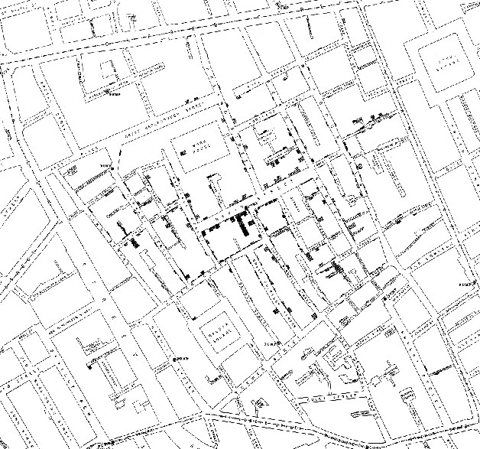
SOHO London Map by John Snow, 1854
After the 1854 cholera outbreak, he plotted points on a map where cholera victims lived and suggested a relationship between the cases and a nearby water source
Notes:
This is John Snow’s original 1854 map of cholera outbreak events in SOHO along with water pump locations.
(Now that you have set the stage for students, explain John Snow’s approach.)
John Snow plotted on a map of London the locational data of where the sick lived. He also noted the water pump locations. Water pumps were the public sources of water. People from each house brought buckets to the pump and hand pumped water that they carried back to their houses.
His dot map plotted where the cholera victims lived, which led him to suggest that one neighborhood water pump was contaminated.
His studies of the PATTERN of the disease convinced the local council to disable the well pump by removing its handle.
What he did was unique because he used mapping methods to depict and ANALYZE clusters of geographically dependent data.
This led to big changes in London’s water and waste systems that improved general pubic health.
///image source
(street map with dots) 1854 John Snow, published by C. F. Cheffins, Lith, Southhampton Buildings, London, England. On the Mode of Communication of Cholera, 2nd edition, John Churchill, New Burlington Street, London, England, 1855. (Figure 12.5) http://matrix.msu.edu/~johnsnow/book_images12.php
and http://matrix.msu.edu/~johnsnow/images/online_companion/chapter_images/fig12-5.jpg

Slide 13
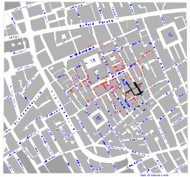
Cholera Cases
Noted in red on the map
Notes:
Here is the same map, but with the cholera cases in red so they stand out.
Using this basic map, we can see where cholera spread, but not much more.
To gain more knowledge, let’s change how we display the data—or alter the way we use GIS.
///image source
(gray map) 2014 Netcorredor, Wikimedia Commons CC BY-SA 1.0 (universal public domain) https://commons.wikimedia.org/wiki/File:Dr._John_Snow_Cholera_Map.svg

Slide 14
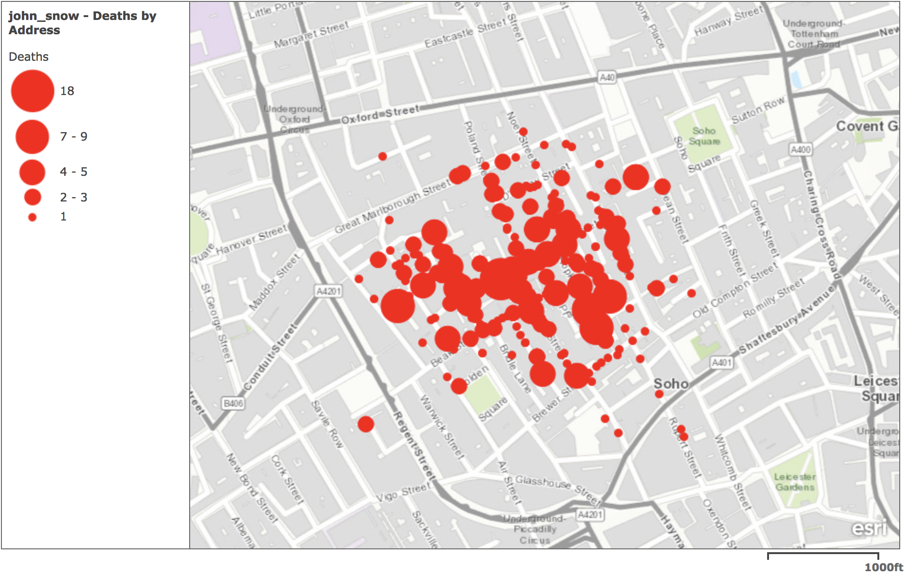
Circle size denotes number of infected
Notes:
Here, the data is displayed to show the NUMBER of affected people.
Larger dots show the presence of MORE infected people.
This method of mapping the data makes more obvious the location of large pockets of infected people.
Now we can overlay the water pump locations to see if any correlation exists.
///
map source: 2018 Kent Kurashima using ArcGIS online and open-source GIS data from the London cholera outbreak at http://www.arcgis.com/home/item.html?id=d4738a148fd149eab4d91918b937c194
///
More John Snow information and maps:
(street map with dots) 1854 John Snow, published by C. F. Cheffins, Lith, Southhampton Buildings, London, England. On the Mode of Communication of Cholera, 2nd edition, John Churchill, New Burlington Street, London, England, 1855. (Figure 12.5) http://matrix.msu.edu/~johnsnow/book_images12.php
AND http://matrix.msu.edu/~johnsnow/images/online_companion/chapter_images/fig12-5.jpg

Slide 15
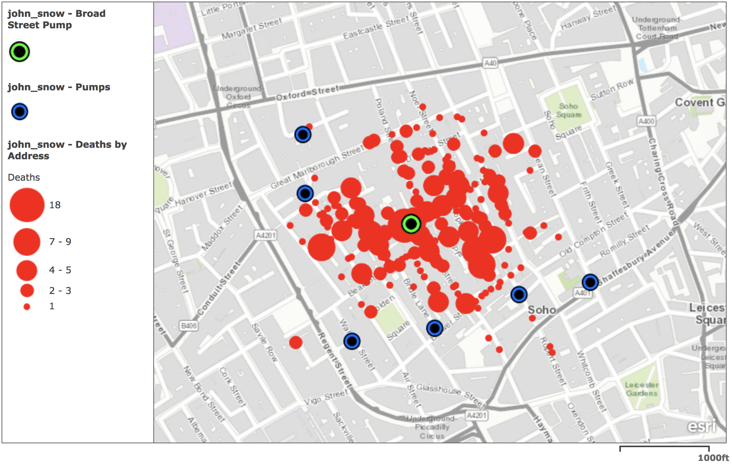
Blue and green dots denote water pumps
As a result, the local council shut down the pump that was the source of cholera
Notes:
Once the pump locations are overlaid (the blue dots), it is easier to see which pump is likely contaminated—the Broad Street pump (the green dot).
Without mapping the data like this, it would not be so obvious.
Some anomalies existed—some deaths that occurred in households that were located closer to other water sources—but Dr. Snow was able to confirm that these households drew their water from the Broad Street pump.
After the Broad Street pump handle was removed, the outbreak subsided, providing direct causal evidence in favour of his hypothesis.
His studies of the PATTERN of the disease convinced the local council to disable the well pump by removing its handle.
This led to big changes in London’s water and waste systems that improved general pubic health.
///
map source: 2018 Kent Kurashima using ArcGIS online and open-source GIS data from the London cholera outbreak at http://www.arcgis.com/home/item.html?id=d4738a148fd149eab4d91918b937c194
///
More John Snow information and maps:
(street map with dots) 1854 John Snow, published by C. F. Cheffins, Lith, Southhampton Buildings, London, England. On the Mode of Communication of Cholera, 2nd edition, John Churchill, New Burlington Street, London, England, 1855. (Figure 12.5) http://matrix.msu.edu/~johnsnow/book_images12.php
AND http://matrix.msu.edu/~johnsnow/images/online_companion/chapter_images/fig12-5.jpg
///
(map with red and blue dots) 2012 Robin Wilson, archive.is, John Snow’s famous cholera analysis data in modern GIS formats. http://blog.rtwilson.com/wp-content/uploads/2012/01/SnowMap_Points.png
https://archive.is/20130201020638/http://www.r-bloggers.com/john-snow%E2%80%99s-famous-cholera-analysis-data-in-modern-gis-formats/

