Slide 1
Physics of Sound
Notes:
Physics of Sound Presentation, Monitoring Noise Levels with a Smart Device activity, TeachEngineering.org

Slide 2
What is sound?
Vibrations that travel through the air (or another medium) that can be heard when they reach the ear
Sound may be classified as noise based on its magnitude, characteristics, duration and time of occurrence
Notes:
What is sound? We can’t see it, but if we look at a speaker we see the speaker moving and vibrating. (Read the bullets.)

Slide 3
Sound Waves
Transverse vs. longitudinal
Transverse wave: A wave vibrating at right angle to the direction of its propagation
Longitudinal wave: A wave vibrating parallel to the direction of its propagation
Transverse vs. longitudinal; 2011 Dan Russell [2]
Transverse vs. longitudinal wave; Physics007animations [1]
Notes:
Now that we know that sound is vibrations that travel through media, how do vibrations look?
Here are two types of waves: transverse and longitudinal. Do you see the difference?
(Read the bullets.)
Q: Which one of these wave motions is how sound travels?
A: The longitudinal wave is how sound travels. We know that vibration is how sound travels and if we think of these dots as molecules, we will see later how the collision of molecules moves the vibration along.

Slide 4
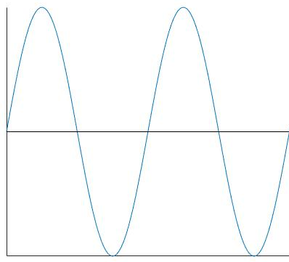
Wave Properties
Frequency (f)
The number of waves passing a point in a certain time A sound wave consists of a repeating pattern of high-pressure and low-pressure regions moving through a medium
Frequency units are hertz (Hz) 1 hertz = 1 wave per second
f = 1/T
OR f = v/λ
f = frequency
v = wave velocity
λ = wave length
T = time or period
T
Position (y)
Time
T
Notes:
Because waves are vital for sound travel, let’s focus on wave properties, starting with frequency. (Read the bullets.)
Frequency can be described as f=1/T or f=v/lambda
In order to calculate f, we must know time or wave velocity, and wave length. These variables can either be observed/measured or calculated. Notice the axis labels: position on the y-axis and time on the x-axis.
A higher frequency results in a higher pitch.

Slide 5
Frequency
Sound is classified according to its frequency and pressure
High and low hertz numbers characterize high and low tones, respectively
Humans are able to perceive sounds in the range of ~20 Hz to 20,000 Hz^{[3]}
Notes:
(A little more information about frequency; read the bullets.)

Slide 6
Wave Properties
Wavelength (λ)
Distance from a particular point on a wave to the next point that is at the same height, going in the same direction
Wavelength is measured in meters
Again f=v/λ
➔ λ=v/f
λ
Position (y)
Position (x)
λ
Notes:
Moving on from frequency, we again have f=v/lambda, which can be manipulated to solve for lambda=v/f.
Again we need to know the v or f variables in order to solve for lambda. These variables can be observed/measured or calculated.
This graph may look similar to the previous graph, but notice that the x-axis is now described by distance x instead of time.
Lambda is wavelength… length, which is a measure of distance. Hence the x-axis measuring distance.

Slide 7
Wave Properties
Amplitude (A)
The distance from the center line to the top of a crest or to the bottom of a trough
Measured in meters
A
Position (y)
Time
A
Notes:
Finally, amplitude shows the height a wave travels vertically.
Notice the y-axis is now position, so we can measure the amplitude.
A higher amplitude results in a louder sound.
Amplitude can be calculated by the distance a wave traveled divided by frequency.

Slide 8
Speed of Sound
Sound waves need to travel through a medium (for example, solids, liquids, gases)
Sound waves move through various mediums by vibrating the molecules in the matter
The speed of sound varies in different media (for example, solids, liquids, gases)
Temperature also dictates how fast sound waves travel
Notes:
Because sound must travel through a medium (no sounds exist in outer space because space is a vacuum!), sound has speed.
At an air temperature of 59 °F, the speed of sound in air is 340 meters/second, 761.2 miles/hour or 1225 km/h.
(Read the bullets.)
Now you know why I said the speed of sound in air at 59 °F; that’s because sound sound travels at different speeds in different media and temperature.

Slide 9
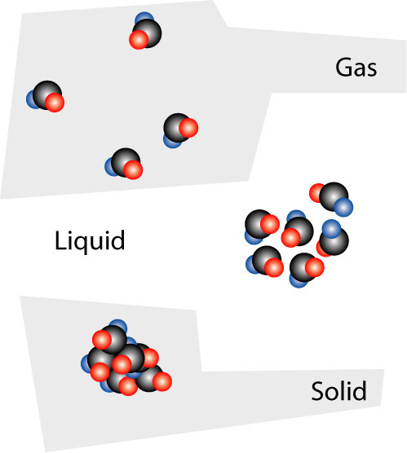
Sound Waves in Solids, Liquids and Gases
Molecules are:
tightly packed in rigid material
less tightly packed in liquid
loosely packed in gas
In close proximity, molecules collide with one another to propagate waves of vibrations
Graphic of molecules of solid, liquid and gas
2007 Yupi666 at English Wikipedia CC BY-SA 3.0
https://commons.wikimedia.org/wiki/File:Solid_liquid_gas.jpg
Notes:
Q: Through which media does sound travel the fastest?
A: Sound travels fastest in solids.
Q: Why is that?
A: Because the molecules are able to collide with each other faster and easier, compared to in liquids and gases.
As an illustration, conduct a demonstration with students: With students sitting at their desks close to each other, nudge one student who, in turn, bumps into the students sitting next to him/her and those students bump into the next ones and so on. That’s how it works for solids, but for liquids and gases, the molecules are spaced farther apart. So, for example, if one student was placed at each table around the classroom, it would take much longer for you to push the students into each other.

Slide 10
Sound Waves in Solids, Liquids and Gases
Sound travels faster in solids than in gases
For example, sound waves move ~13 times faster in wood than in air^{[4]}
Sound travels faster in liquids than in gases
Loosely packed molecules have further to travel and take longer to collide with one another
Graphic of molecules of solid, liquid and gas
2007 Yupi666 at English Wikipedia CC BY-SA 3.0
https://commons.wikimedia.org/wiki/File:Solid_liquid_gas.jpg
Notes:
(Read the bullets to reiterate this principle.)

Slide 11
Sound Waves in Media
Recall the longitudinal wave:
Transverse vs. longitudinal; 2011 Dan Russell [2]
Notes:
Looking at the longitudinal wave again, we see that the molecules are colliding with each, transferring vibrational energy/sound.
Sound waves propagate by moving molecules.

Slide 12
Sound Measurement
The scale for measurement of sound pressure is called decibels (dBs)
Decibels are measured on a logarithmic scale
A small change in the number of decibels results in a huge change in the amount of noise and the potential damage to a person's hearing^{[5]}
Notes:
Noise is measured in units of sound pressure levels called decibels (named after Alexander Graham Bell) using A-weighted sound levels (dBA)^{[5]}
Read the bullets

Slide 13
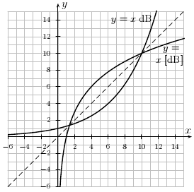
Decibel
When a sound increases by 10 units on the decibel scale, its loudness becomes 10 times more powerful
β represents sound intensity level measured in dB
Graph of the decibel function and its inverse
2010 Name, Wikimedia Commons CC BY-SA 3.0
https://commons.wikimedia.org/wiki/File:Plot_of_decibel_and_inverse.png
Notes:
I_{o} is the referenced sound intensity, which equals 10^-12 W/m2. This is the threshold of hearing.
I is the intensity that you measure or hear, such as the intensity of people talking
(Read the bullets.)

Slide 14
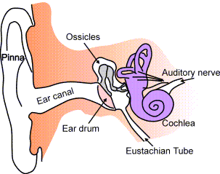
How do people hear?
The human ear translates the energy from sound waves into neurologic impulses that are heard as sound^{[5]}
Cutaway diagram of human ear anatomy
2003 Iain at English Wikipedia
https://commons.wikimedia.org/wiki/File:Ear-anatomy-text-small-en.png
Notes:
After sound pressure waves enter and pass through the ear canal, they cause the tympanic membrane (eardrum) to vibrate.
These vibrations are transferred to the ossicles, a series of bones (hammer, anvil and stirrup) in the middle ear.
The ossicles amplify the sounds, which moves the oval window of the cochlea.
In turn, this movement causes fluid in the cochlea to move and stimulate hairs, which next activates cells that send neurologic impulses along the cochlear nerve to the brain.
These impulses are perceived as sound.

Slide 15
Sound vs. Noise
Noise is unwanted or unpleasant sound
One person may hear something as sound, while another person considers it noise
Sound may be classified as noise based on its magnitude, characteristics, duration and time of occurrence^{[6]}
Notes:
The classification of sound as noise is subjective.
(Read the bullets.)

Slide 16
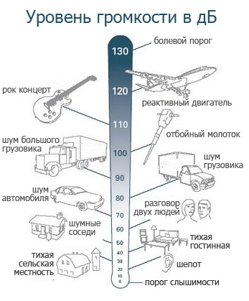
The A-weighted sound levels closely match the perception of loudness by the human ear
Decibel scale
2017 Department4,
Wikimedia Commons CC BY SA-4.0
https://commons.wikimedia.org/wiki/File:Decibel_scale.jpg
Notes:
Re: 20 uPa means relative to 20 micro Pascal's = 2x10^-5 Pa because that is approximately the quietest sound a human can hear.
The drawings indicate the dB levels of common noise sources.

Slide 17
Health Hazards/Impacts
Exposure to loud noises can cause a temporary threshold shift (TTS) in hearing sensitivity or a permanent threshold shift (PTS)^{[5]}
A noise-induced permanent threshold shift (NIPTS) is a permanent threshold shift that can be attributable to noise exposure
Notes:
Noise has an impact on health.
Certain requirements have been created to protect workers from hearing damage.
A TTS is a short-term loss in hearing sensitivity that lasts for several hours, such as 14 hours or longer for certain situation.
A PTS is any change in hearing sensitivity that is persistent.

Slide 18
Health Hazards/Impacts to Students
High noise levels may obstruct students’ recognition of teachers' speech
The extra effort required to identify and remember the words may result in fewer resources available for understanding^{[7]}
Notes:
Studies have shown that noise levels impact people’s ability to learn.
The extra effort results in an overall reduced level of learning.

Slide 19
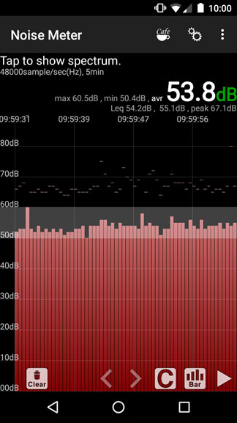
Sound Measurement
Sound level meter:
Commonly, a handheld instrument with a microphone
The microphone diaphragm responds to air pressure changes caused by sound waves^{[5]}
Smart phones now have sound monitor apps
Noise Meter app on smart phone
2016 Kent Kurashima and Jana B. Milford, College of Engineering and Applied Science, University of Colorado Boulder (authors)
Notes:
A sound level meter is used to make acoustic measurements.
Acoustic: sound that travels through air.
The image is a screen capature of a smart phone noise monitoring app.

Slide 20
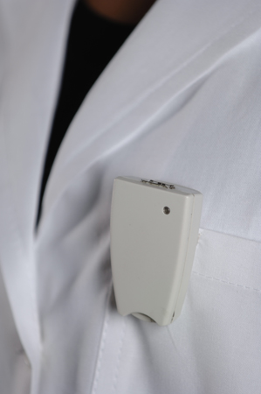
Sound Measurements
Dosimetry: The use of body-worn instruments to monitor people’s noise exposure^{[5]}
Engineering surveys: Noise exposure monitoring
Pocket dosimeter; a NMR monitoring device with three Hall-effect sensors
2010 Elia.braggio, Wikimedia Commons (public domain)
https://commons.wikimedia.org/wiki/File:Pocket_Dosimeter.jpg
Notes:
Dosimetry is used in industry to make sure people are not being exposed to excess noise levels, while enabling them to continue their work unimpeded.
Noise exposure monitoring is accomplished by using sophisticated acoustical equipment in addition to sound level meters.
(Read the bullets.)
Engineering surveys are similar to spot checks of noise levels as a way to make sure that works are not being exposed to excess levels.

Slide 21
References
[1] “Transverse wave and longitudinal Wave.” (6-second video) YouTube. Physics007animations, Sept. 2, 2011. https://www.youtube.com/watch?v=2Wlh3M2a10U
[2] Russell, Dan. “Acoustics and Vibration Animations.” Longitudinal and Transverse Wave Motion. Creative Commons Attribution-NonCommercial-NoDerivatives 4.0 International License
[3] Serway, Raymond A, and John W. Jewett, Jr. Physics for Scientists & Engineers with Modern Physics. 8th edition. Belmont: Brooks/Cole Cengage Learning, 2010. Print.
[4] Hall, Debra, and Crystal Patillo. “2.7 How does sound travel in different environments?” Kenan Fellows Program, BioMusic, Learn NC, School of Education, University of North Carolina. http://www.learnnc.org/lp/editions/biomusic/6517
[5] Friis, Robert H. Occupational Health and Safety for the 21st Century. Burlington, MA: Jones & Bartlett Learning, 2015. Web. library.books24x7.com.colorado.idm.oclc.org/toc.aspx?bookid=93068 (e-book access requires login)
[6] “Perception of Sound - Human Ear.” Sound and Noise - Perception of Sound - Human Ear. Web. http://www.epd.gov.hk/epd/noise_education/web/text/ENG_EPD_HTML/m1/intro_1.html
[7] Kjellberg, Anders, Robert Ljung, and David Hallman. “Recall of Words Heard in Noise.” Applied Cognitive Psychology, vol. 22, no. 8, 2008, pp. 1088-98. Web. http://onlinelibrary.wiley.com/doi/10.1002/acp.1422/abstract

