Slide 1
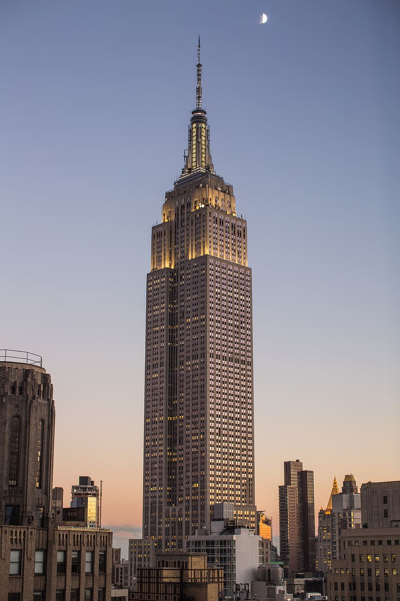
PAPER TOWER DESIGN CHALLENGE
Today, you will be working as civil engineering teams to take on a design challenge to construct a model tower using only a few sheets of paper, tape, and scissors. With only these supplies, your team will have one class period to complete this design challenge.
Image Source: Ben Dumond, 2015, https://unsplash.com/photos/VedK8_UlmkY

Slide 2
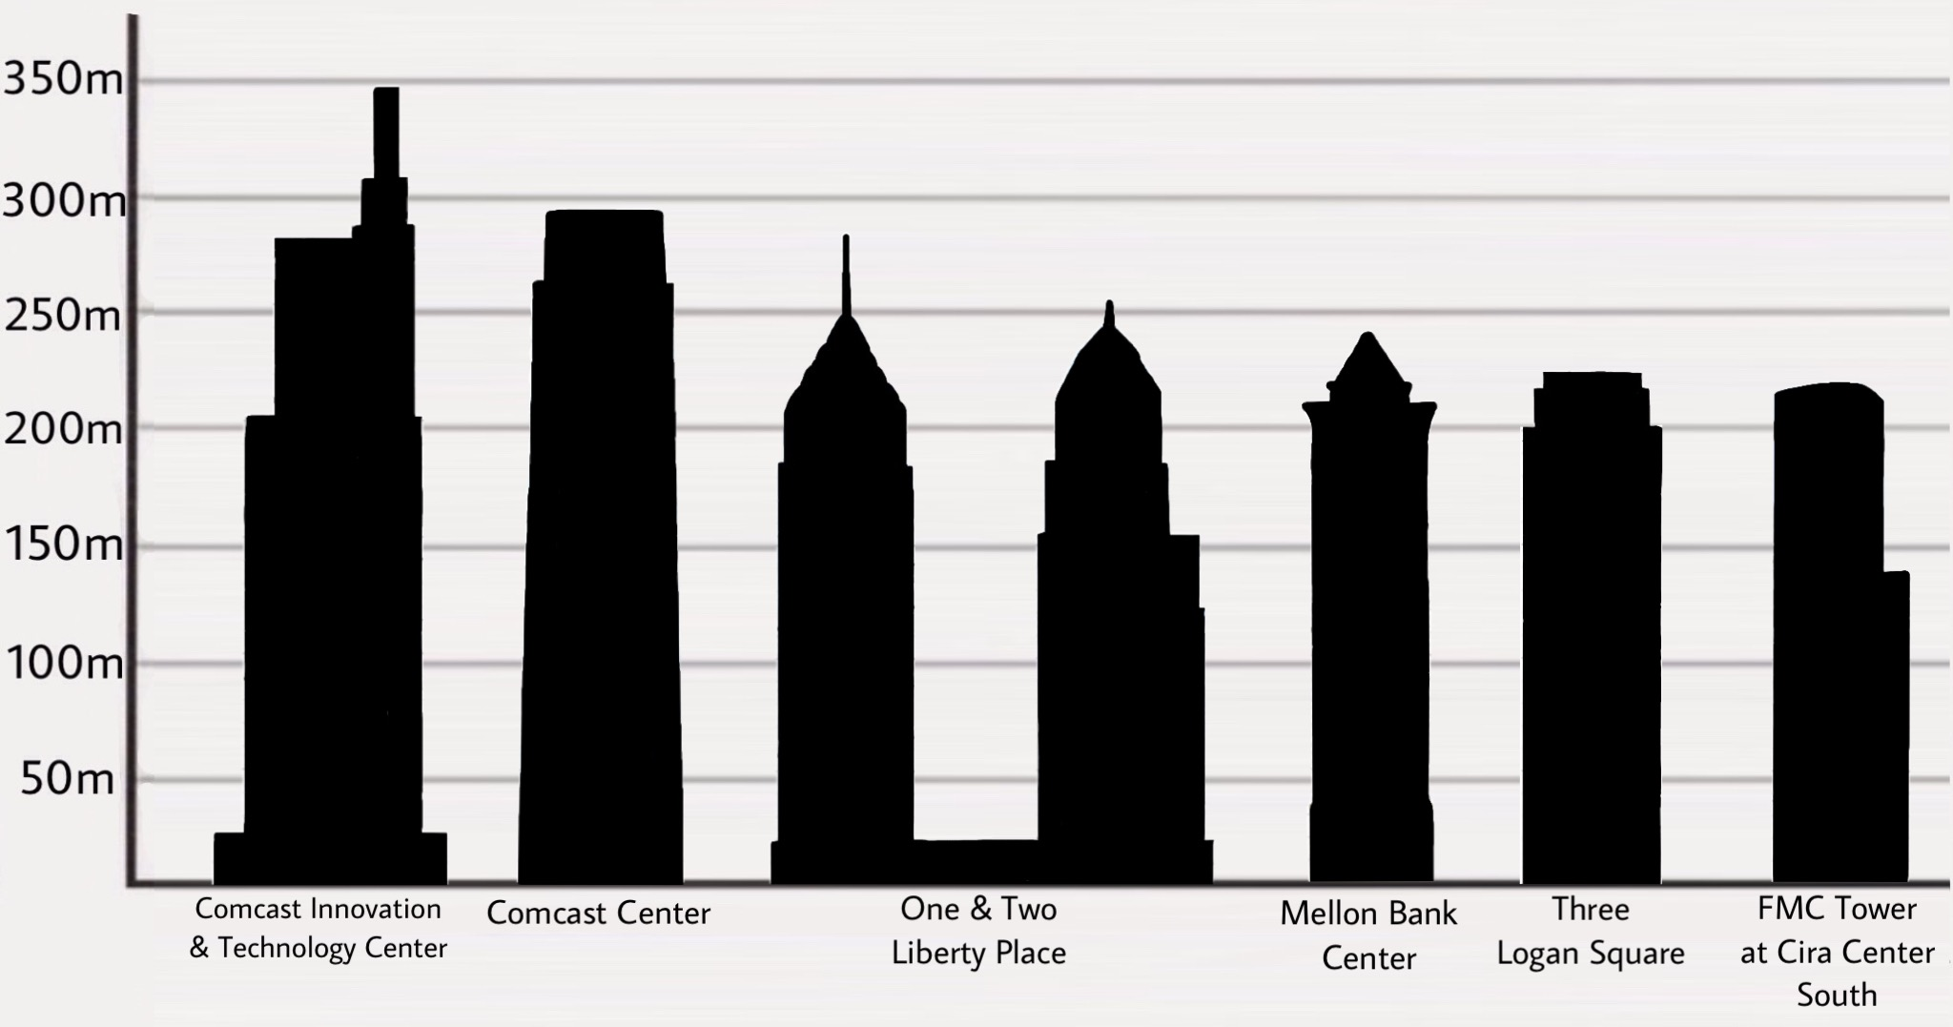
PAPER TOWER DESIGN CHALLENGE
Make sure to follow each step and answer each question in your Paper Tower Worksheet!
Your team’s tower must be:
Tall - as high as you can build it
Stable - to withstand a wind load in a hurricane-prone region
Freestanding - it cannot be attached or secured to a table, wall, floor, furniture, etc.
Materials per team:
3 sheets of construction paper
24 inches (60 cm) of tape
1 pair of scissors
Image Source: Saggittarius A, 2019, https://commons.wikimedia.org/wiki/File:Philadelphia_skyscrapers.jpg, CC BY-SA 4.0

