Slide 1
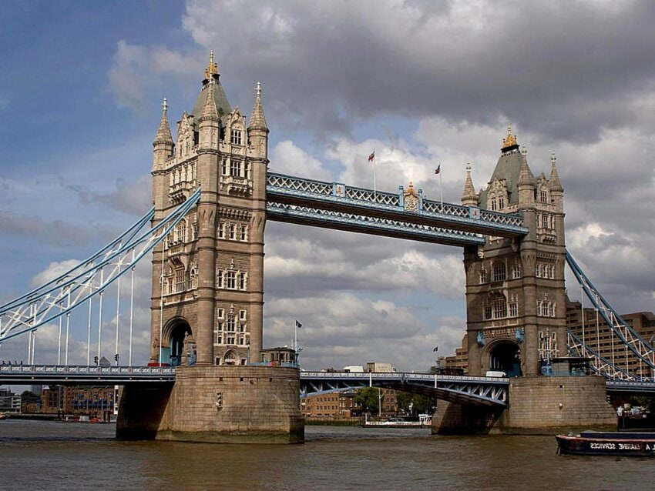
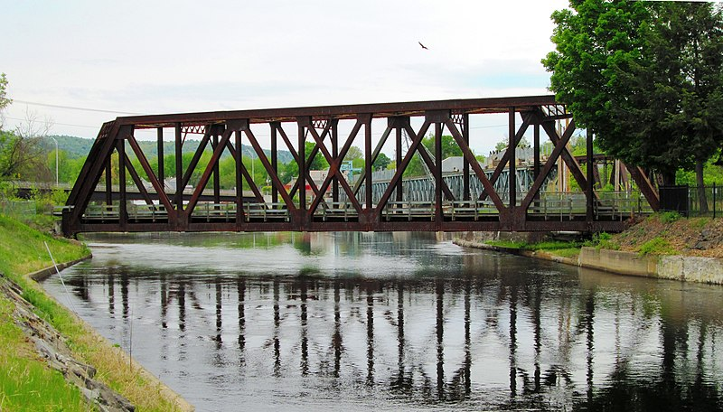
BRIDGE DESIGN CHALLENGE
Creative Engineering Design 2021-2022
Notes:
What impacts do bridges have on our communities and cities? Bridges provide essential links between places, providing us with access to resources, other places and other people. Bridges enable roadways to pass through varying terrain, over waterways and through mountains with minimal deviation, saving time in transport or commute or even connecting areas that would otherwise be inaccessible. Who designs these bridges? Civil engineers do. Think about bridges as a way that engineers help us bring worlds together.

Slide 2
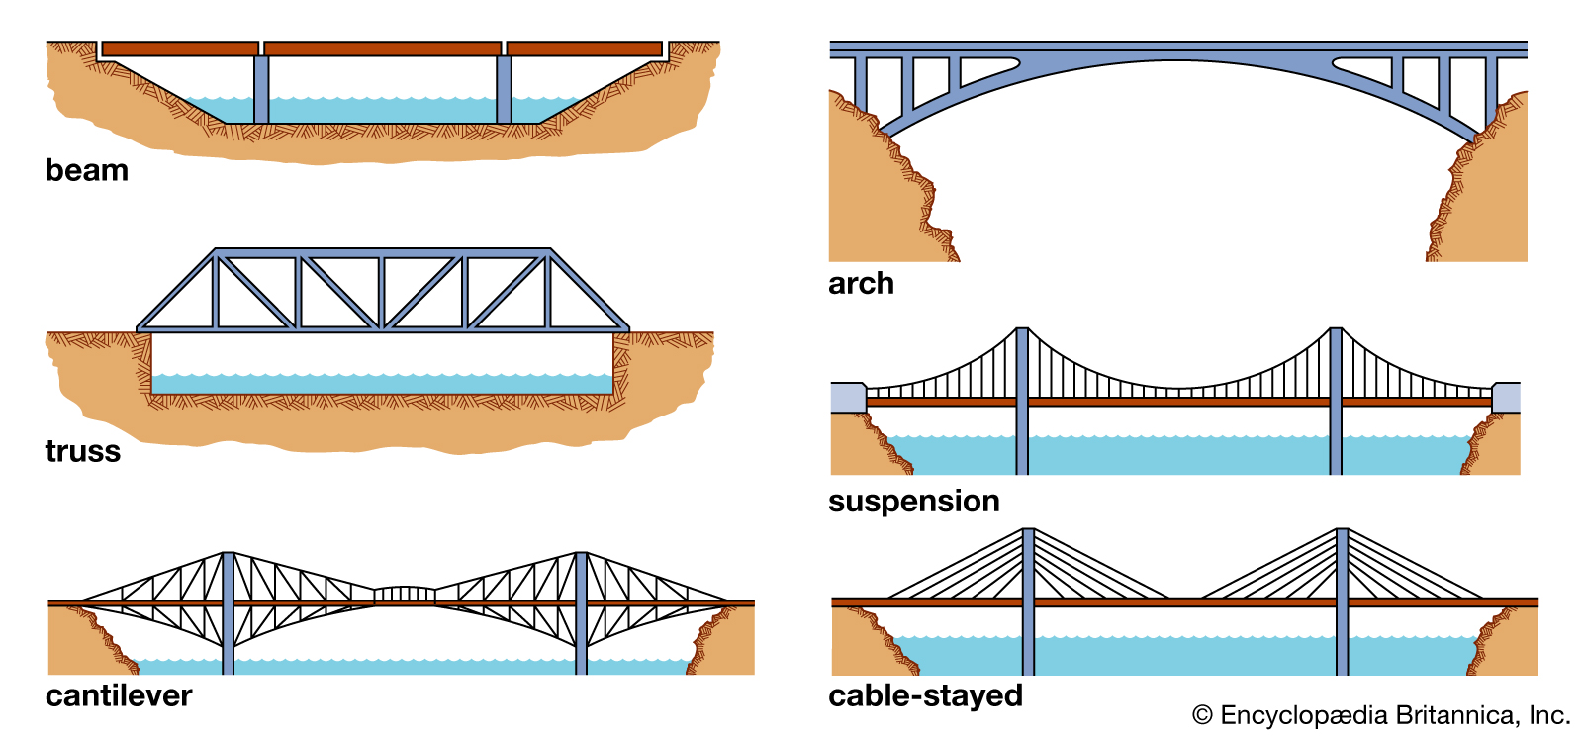
BRIDGE TYPES
Notes:
Three basic types of bridges used in transportation are: beam and truss bridges, arch bridges and suspension bridges. To understand how bridges work, we must understand the forces that act on every bridge. Two major forces act on a bridge at any given time: compression and tension. Compression, or compressive force, is a force that acts to compress or shorten the thing it is acting on. Tension, or tensile force, is a force that acts to expand or lengthen the thing it is acting on. As a simple example, think of a spring. If we push both ends of the spring towards each other, we are compressing the spring. Thus, a force of compression is acting on it to shorten the spring. If we pull both ends of the spring away from each other, we are stretching the spring. Thus, a force of tension is acting on it to lengthen the spring. It is the purpose of the bridge design to handle these forces without breaking or failing in some manner.

Slide 3
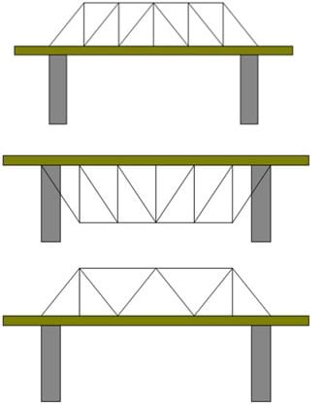
The most common type of bridge is a beam bridge—a structure made of horizontal, rigid beams whose ends rest on two columns.
The load of the bridge is supported by the columns. Load refers to the bridge’s own weight that needs to be supported, as well as any weight that is added to the bridge such as cars, trucks and people.
A truss bridge is a type of beam bridge that has triangular units to distribute the load and support the bridge.
Example truss bridge designs.
copyright
Notes:
Beam bridges are the simplest and least expensive type of bridge to build. The most simple beam bridges consist of a horizontal beam that is supported on each end by columns or piers. The weight of the beam and any additional load on the bridge is transferred directly to the piers. However, the beam itself must be able to support its own weight and loads between the piers. When a load pushes down on the beam, the top portion of the beam is pushed together by a compressive force while a tensile force stretches the lower portion. The farther apart the supports or piers, the weaker a beam bridge becomes. For larger beam bridges designed for heavy car and railroad traffic, the beams are substituted by simple trusses, or triangular units, which are more economical than solid beams. Engineers have used many different truss patterns in bridges. Therefore, most beam bridges rarely span more than 200 feet (61m), however, old truss bridges crossing major rivers are often as long as 500-600 feet (152-183m), not including end supports such as piers.

Slide 4
STRAW BRIDGES DESIGN CHALLENGE
Today, you will be working as structural engineering design teams to take on a design challenge to construct a model bridge. Your team will be given a set amount of supplies and a time limit of two class periods (constraints) to complete this design challenge.
Your team’s bridge must:
be at least 10 inches (25 cm) in length; able to span an 8-inch (20-cm) gap
be able to securely hold small cup to which weight may be added until the model bridge fails (begins to bend)
incorporate a truss design
be made of 20 (or fewer) straws
not be taped to the desk
Materials per team:
20 plastic drinking straws
scotch or masking tape
scissors
measuring stick or ruler
Make sure to follow each step and answer each question in your Straw Bridges Worksheet!
Creative Engineering Design 2021-2022

