Slide 1
AQ DATA COLLECTION AND MONITORING EMISSIONS

Slide 2
Learning Objectives
After this activity, you should be able to:
List the products of complete and incomplete combustion and explain what physical and chemical characteristics lead to the different outcomes
Provide examples of how changes made by engineers over time to vehicle designs and control technologies have reduced the emission of harmful pollutants
Interpret emissions data from a plot, using concepts from combustion chemistry and vehicle characteristics to support your explanation
Use the Pods (air quality monitors) to collect your own data

Slide 3
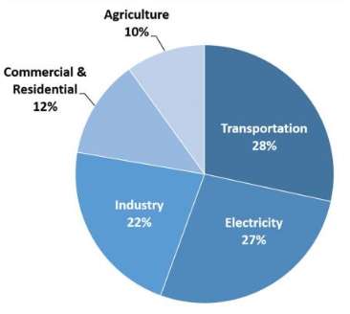
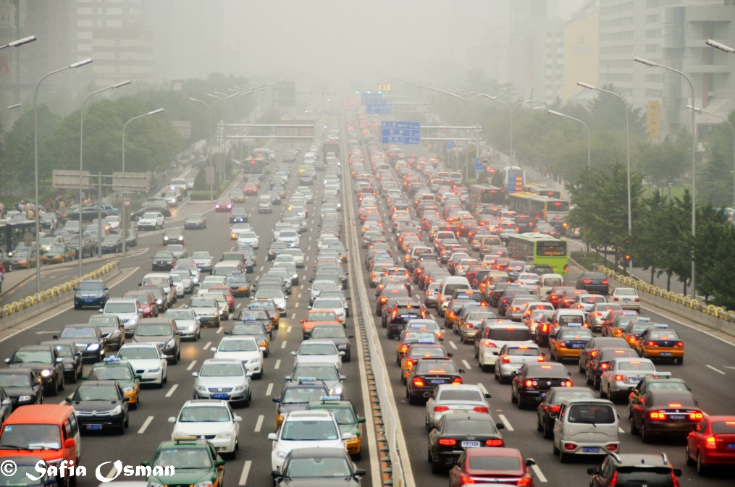
Emissions Monitoring
Total 2018 U.S. greenhouse gas emissions by economic sector
(estimates from Inventory of U.S. Greenhouse Gas Emissions & Sinks: 1990-2018)
Transportation = 28%
Today, we will compare the emissions from different vehicles
First, we need to learn about: 1) types of combustion and 2) internal combustion engines
Notes:
According to the Inventory of U.S. Greenhouse Gas Emissions and Sinks, in 2014, transportation accounted for 26% of greenhouse gas emissions, which is a substantial portion of the total greenhouse gas emissions!
For this reason, it is important that we monitor and study vehicle emissions (or mobile pollution sources).
These measurements are made in a variety of ways: 1) individual cars undergo testing, 2) monitors are placed on roadways (or interstate, which you may have seen), and 3) analysis of data from stationary monitors (which can sometimes provide an idea about how much of each pollutant comes from vehicles vs. industry, called source apportionment).
In today’s activity, you will conduct a low-tech emissions monitoring experiment, but first we need to learn a little background information about combustion chemistry and internal combustion engines.
Image sources:
(pie chart plus explanation of what included in each economic sector) U.S. EPA https://www.epa.gov/ghgemissions/sources-greenhouse-gas-emissions (Beijing traffic) 2012 Safla Osman, Flickr https://www.flickr.com/photos/so8/8161891893 CC BY-NC-ND 2.0 https://creativecommons.org/licenses/by-nc-nd/2.0/

Slide 4
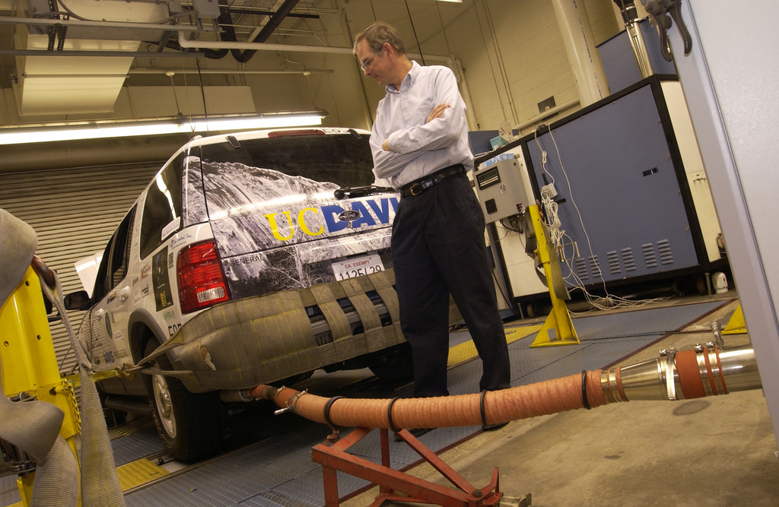
High-Tech Emissions Monitoring
Notes:
This photograph shows an example of what manufacturers and city governments do to evaluate vehicle emissions to make sure they comply with regulations.
Notice the measurement device connected directly to the vehicle’s tailpipe.
Image source: (emissions testing): 2002 Advanced Vehicle Technology Competitions/FutureTruck 2002, Flickr https://www.flickr.com/photos/doeavtc/8284998644 CC BY-ND 2.0 https://creativecommons.org/licenses/by-nd/2.0/

Slide 5
Combustion: Essentially 3 important reactions
CO, VOCs, water vapor, unburned fuel and energy
CO2, water vapor, and energy
NOx
NO and NO2
OUTPUTS:
FYI: typical fuels = C_{x}H_{y}
(average gasoline = C₈H₁₈ average diesel formula = C₁₂H₂₃)
INPUTS:
Air
O2 & N2
O2
Carbon-based fuel
CxHy
Notes:
Combustion in vehicles involves a carbon-based fuel burning in the presence of air (oxygen and nitrogen) and resulting in the production of energy and combustion by-products.
Fuel is represented by the formula CxHy, meaning we have x carbons and y hydrogens.
Next, we will go through the three different reactions individually.
For an introduction and more information on combustion, see: http://www.bbc.co.uk/schools/gcsebitesize/science/ocr_gateway/carbon_chemistry/carbon_fuelsrev1.shtml
Image source: (fire) Pexels free stock photos https://www.pexels.com/photo/night-fire-easter-heat-9334/

Slide 6
Combustion: Reaction 1
Reaction 1 is
Complete Combustion
Requires sufficient oxygen to provide every carbon with 2 oxygens, resulting in carbon dioxide (CO2)
CO, VOCs, water vapor, unburned fuel and energy
CO2, water vapor, and energy
NOx
NO and NO2
OUTPUTS:
C_{x}H_{y} + O₂ →
CO2 + H2O
INPUTS:
Air
O2 & N2
O2
Carbon-based fuel
CxHy
Notes:
Reaction 1: Complete Combustion
Complete combustion occurs when enough oxygen is present to fully combust each carbon in the fuel, or enough oxygen to provide 2 Os for each C.
The by-products of complete combustion are water vapor and carbon dioxide.
Since carbon dioxide is not a concern for human health, this is (generally) the combustion we prefer to happen.
Image source: (fire) Pexels free stock photos https://www.pexels.com/photo/night-fire-easter-heat-9334/

Slide 7
Combustion: Reaction 2
Reaction 2 is
Incomplete Combustion
Without sufficient oxygen, combustion is incomplete and results in carbon monoxide (CO) and volatile organic compounds (VOCs)
CO, VOCs, water vapor, unburned fuel and energy
CO2, water vapor, and energy
NOx
NO and NO2
OUTPUTS:
INPUTS:
C_{x}H_{y} + O₂ →
CO + VOCs + CO₂ + H₂O
Air
O2 & N2
O2
Carbon-based fuel
CxHy
Notes:
Reaction 2: Incomplete Combustion
Combustion is incomplete when not enough oxygen is present to completely combust the fuel.
In this situation, we end up with by-products like CO (carbon monoxide) and VOCs (volatile organic compounds).
CO is harmful to human health and VOCs have the potential to be harmful (it depends on the compound).
We may still end up with some CO2, but essentially the outcome is a mixture of different compounds.
Image source: (fire) Pexels free stock photos https://www.pexels.com/photo/night-fire-easter-heat-9334/

Slide 8
Combustion: Reaction 3
Reaction 3 is
Thermal NOx Formation
In the presence of high-temperature combustion, N2 in the atmosphere can be broken up and bonded with oxygen to form NO and NO2 (nitrogen oxides)
CO, VOCs, water vapor, unburned fuel and energy
CO2, water vapor, and energy
NOx
NO and NO2
OUTPUTS:
INPUTS:
Air
O2 & N2
O2
Carbon-based fuel
CxHy
N₂ + O₂ → NO/NO₂
Notes:
Reaction 3: Thermal NOx Formation
This reaction does not involve a direct interaction with the fuel; rather, it is the result of high-temperature combustion.
At high temperatures, the air’s oxygen (O2) and nitrogen (N2) can be broken up and bonded to each other, resulting in NOx (including both NO and NO2)., which are a concern for human health.
Image source: (fire) Pexels free stock photos https://www.pexels.com/photo/night-fire-easter-heat-9334/

Slide 9
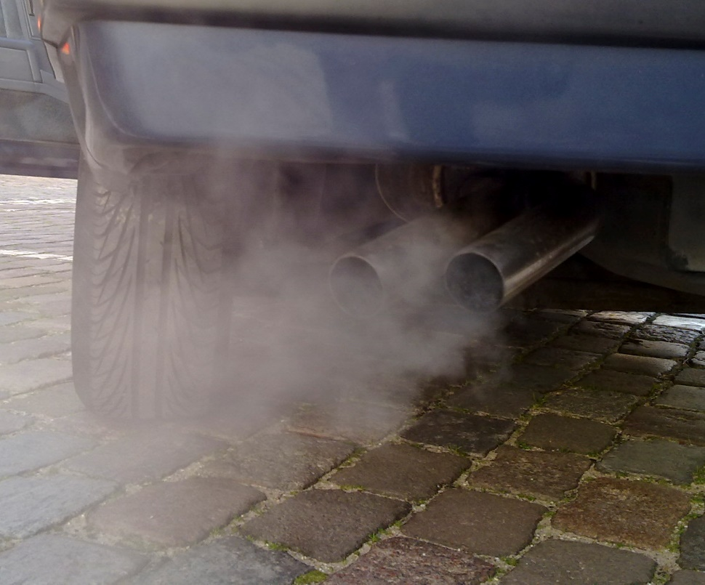
Review: Combustion Reactions
Typical fuels: C_{x}H_{y}
Average gasoline = C₈H₁₈
Average formula for diesel = C₁₂H₂₃
Fuel + O₂ → CO₂ + H₂O
(complete combustion)
CO₂
CO
Fuel + O₂ → CO + VOCs + CO₂ + H₂O
(incomplete combustion)
VOCs
N₂ + O₂ → NO/NO₂
(high-temperature combustion)
NO_{x}
Notes:
Review the important reactions of combustion that we may see during our activity.
Also, note the formulas for gasoline vs. diesel fuel.
A different fuel composition results in different physical properties.
For example, diesel fuel has a higher energy content than gasoline.
For comparison: gasoline energy content = 120,388-124,340 BTU/gal, vs. diesel energy content = 138,490 BTU/gal
Data source: http://www.afdc.energy.gov/fuels/fuel_comparison_chart.pdf
Image source: (automobile exhaust gas from tailpipe) 2009 Ruben de Rijcke, Wikimedia Commons https://commons.wikimedia.org/wiki/File:Automobile_exhaust_gas.jpg

Slide 10
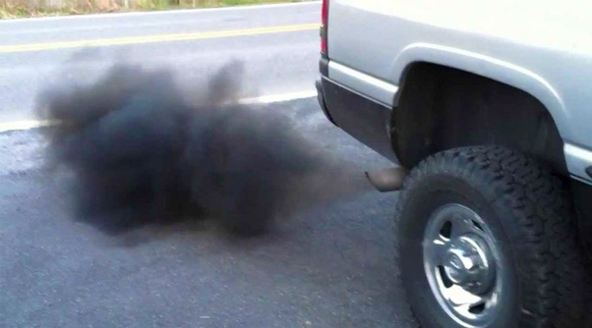
Vehicles and Particulate Matter
How do vehicles generate particulate matter (PM)?
Directly emitted from their tailpipes as a result of the combustion process of its fuel
Tire and brake wear can spew off small particles
Dust generation from driving on dirt roads and asphalt surfaces
What is black soot?
Dark exhaust seen emitted from diesel-powered vehicles
One of the most harmful emissions produced by diesel engines (for human health and community visibility)
Forms as a result of incomplete fuel combustion
Notes:
How do vehicles generate particulate matter (PM)?
Directly emitted from their tailpipes as a result of the combustion process of its fuel
Tire and brake wear can spew off small particles
Dust generation from driving on dirt roads and asphalt surfaces
What is black soot?
Dark exhaust seen emitted from diesel-powered vehicles
One of the most harmful emissions produced by diesel engines (for human health and community visibility)
Forms as a result of incomplete fuel combustion
Image source: (automobile exhaust gas from tailpipe) 2016 Quora Answers https://www.quora.com/Why-is-the-exhaust-from-my-diesel-engine-black-smoke

Slide 11
Why do these pollutants matter?
PM
CO₂
CO
VOCs
NO_{x}
Notes:
Review students the main reasons we are interested in these pollutants:
PM = small particles can irritate eyes/nose/throat and penetrate further into the body (into the lungs and bloodstream), contributes to smog production and thus poor visibility
CO2 = carbon dioxide is a greenhouse gas (changes the chemical composition of the Earth’s atmosphere; climate change)
CO = depending on the concentration, carbon monoxide can be a danger to human health
VOCs = potentially harmful to human health (depending on the concentration and the compound), VOCs also contribute to ozone and photochemical smog formation
NOx = harmful to human health (depending on the concentration) and contributes to ozone and photochemical smog formation
Image source: (automobile exhaust gas from tailpipe) 2009 Ruben de Rijcke, Wikimedia Commons https://commons.wikimedia.org/wiki/File:Automobile_exhaust_gas.jpg

Slide 12
Why do these pollutants matter?
Particulate Matter
Harmful to human health
Contributes to smog production
Carbon dioxide
Climate change
PM
CO₂
Carbon monoxide
Harmful to human health
CO
Volatile organic compounds
Harmful to human health
Contributes to ozone and photochemical smog production
VOCs
Nitrogen oxides
Harmful to human health
Contributes to ozone and photochemical smog production
NO_{x}
Notes:
Review with your students the main reasons we are interested in these pollutants:
PM – small particles can irritate eyes/nose/throat and penetrate further into the body (into the lungs and bloodstream), contributes to smog production and thus poor visibility
CO2 – greenhouse gas (climate change)
CO – depending on the concentration it can be a danger to human health
VOCs – potentially harmful to human health (depending on the concentration and the compound), also these contribute to ozone and photochemical smog formation
NOx - harmful to human health (depending on the concentration) and contributes to ozone and photochemical smog formation
Image source: (automobile exhaust gas from tailpipe) 2009 Ruben de Rijcke, Wikimedia Commons https://commons.wikimedia.org/wiki/File:Automobile_exhaust_gas.jpg

Slide 13
Vehicular Combustion: Air-Fuel Ratio
Air-Fuel Ratio
Fuel rich vs. fuel lean is controlled by how much fuel is sent to the engine
In some cars, drivers can adjust the air-to-fuel ratio themselves
 | Fuel Rich | Fuel Lean
What it means | More fuel, less oxygen | Less fuel, more oxygen
Advantages | More power available for vehicle | More complete combustion (fewer harmful pollutants)
Disadvantages | Less fuel-efficient and more harmful pollutants (CO, VOCs, unburned fuel) | Less power available, possibly more NOx produced (if high-temperature combustion)
Notes:
For vehicles that use internal combustion engines, their performance is partially governed by the air-to-fuel ratio, or the amount of air and fuel sent to the engine.
The air-fuel ratio affects how much energy is produced and what combustion by-products are released.
The chart lists the advantages and disadvantages of each scenario.
Basically,
FUEL RICH means more fuel and less air are present, which results in more power, but also more incomplete combustion by-products
FUEL LEAN means less fuel and more air is present, which results in more complete combustion, but less power

Slide 14
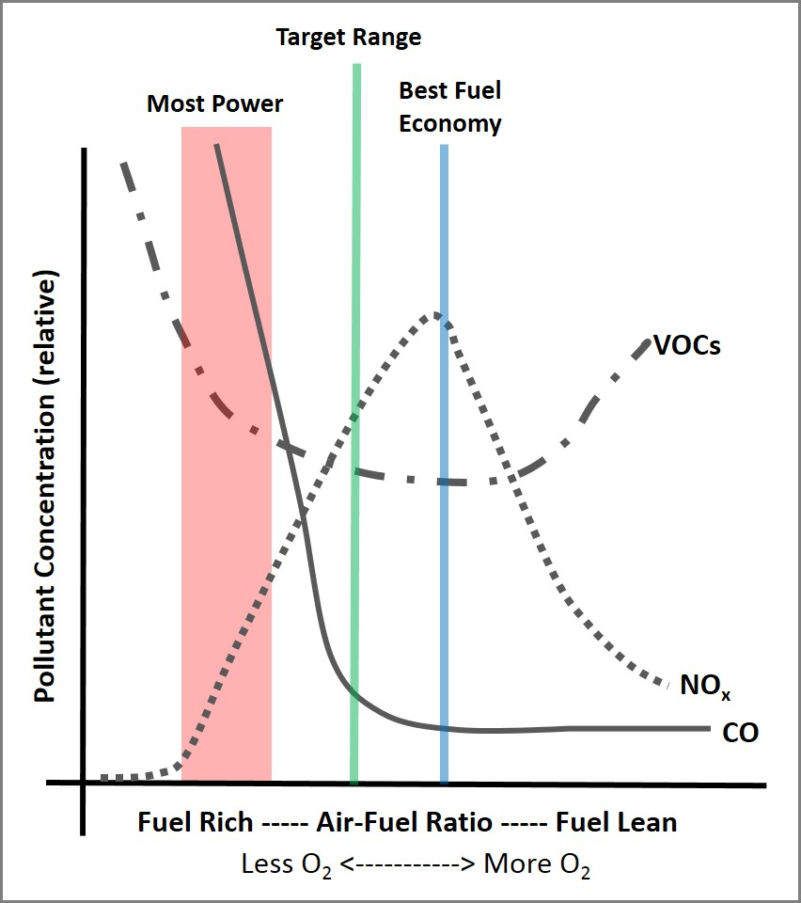
Vehicular Combustion: Air-Fuel Ratio
Notes:
This plot illustrates the effect of different air-to-fuel ratios.
Use the plot to discuss which pollutants are higher on the fuel-rich side and which are higher on the fuel-lean side.
This is also a good point to stop and review the worksheet questions as a class.
Observations to share with students:
On the fuel-rich side of the plot, notice the higher CO and HC (hydrocarbons, or VOCs)
On the fuel-lean side of the plot, CO drops to a minimum
The best economy range is on the fuel-lean side
The best power range is on the fuel-rich side of the plot
The target range is a compromise between fuel rich and fuel lean
CHALLENGE QUESTION: What would a line for CO2 look like?
Answer: It would rise as CO decreases, peak where NOx peaks, plateau, and then drop a little as HCs increase.
Image source: (plot) 2015 Hannigan Lab, College of Engineering, University of Colorado Boulder

Slide 15
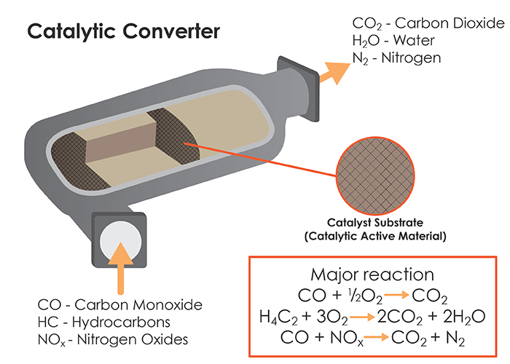
Control Technologies
The air-fuel ratio is also important to consider for the effective operation of control technologies
Three-way catalytic converters use oxidation and reduction reactions to minimize harmful pollutants leaving tailpipes
CO and hydrocarbons → CO₂
NO_{x} → N₂
Notes:
A catalytic converter is a device invented in 1975 to reduce the harmful emissions from vehicles.
Using metals that serve as catalysts (or substances that cause or facilitate chemical reactions, but do not “participate”), these devices reduce NO and NO2 back to N2 and O2, and oxidize CO and VOCs to CO2.
Different substances (or metals) are used for the different reactions.
Platinum and rhodium are used for the reduction reactions, and platinum and palladium are used for the oxidation reactions.
Other examples of controls that have improved air quality related to transportation include:
The removal of lead from gasoline
Adding filters to diesel engines to catch the particulates
More info on the technology: http://auto.howstuffworks.com/catalytic-converter.htm
Image source: (catalytic converter diagram) Science Media Group (permissible to use in classrooms) https://www.learner.org/courses/chemistry/text/text.html?dis=U&num=Ym5WdElURS9NeW89&sec=YzJWaklUQS9OU289

Slide 16
A Conceptual Model…
Outputs: power to run the car and emissions (combustion products)
Let’s start by thinking about our problem in the simplest terms.
The System:
Inputs:
Outputs:
Process:
Notes:
Move on to think about the upcoming activity…
Using a very simple conceptual model, ask students to suggest what should go in the blanks above.
Answers:
The system = a vehicle
Inputs = carbon-based fuel
Outputs = power and emissions
Process = idling the engine, internal combustion
Image source: (red car clipart) free-to-use image http://www.publicdomainpictures.net/pictures/90000/nahled/red-car-2.jpg

Slide 17
A Conceptual Model…
Outputs: power to run the car and emissions (combustion products)
The System: vehicle
Inputs:
fuel
Outputs:
power
emissions
Process: idling (internal combustion)
What independent variables (changes to the inputs or vehicle) will affect our outputs?
This is a simplification. What would make this activity more challenging in the real world?
Notes:
Discuss the two questions on the slide. Example answers:
Example answers to question 1: Independent variables affecting our outputs?
Vehicle age and type
Fuel type (diesel vs. gasoline)
Where the gas came from, how full the tank is
Engine size
Whether the vehicle was driven recently or not (is the engine warmed up?)
Example answers to question 2: What would make the activity more challenging in the real-world?
Mainly environmental conditions (for example, wind disperses the emissions and makes them more difficult to measure) since our setup is not very controlled and the environmental conditions can change from vehicle to vehicle
We might max out our monitor’s sensors because we do not have a way to collect, mix and dilute the emissions
Different vehicles require the monitor to be setup in different ways (for example, different tailpipe designs, angles and heights)
Image source: (red car clipart) free-to-use image http://www.publicdomainpictures.net/pictures/90000/nahled/red-car-2.jpg

Slide 18
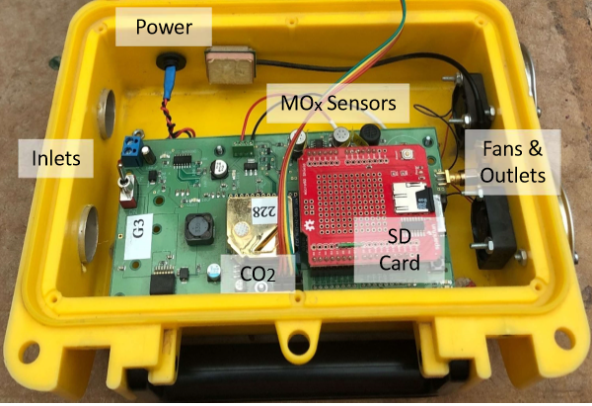
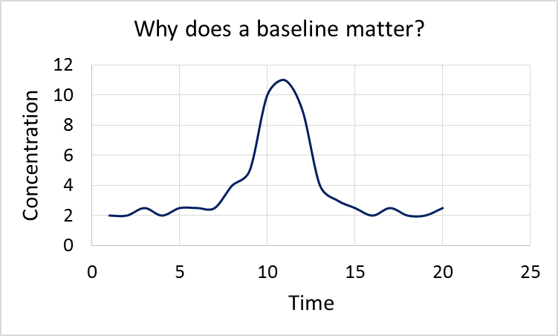
Experimental Procedure
Dependent variables
CO2, VOCs, temperature and relative humidity (RH)
Procedure
Run monitor outdoors to collect a baseline measurement
Place monitor behind tailpipe, slightly above and straight out
Idle vehicle #1
Repeat baseline measurement
Replicate setup and idle vehicle #2
Repeat entire series, or finish with baseline measurement
Record on the Activity Data Sheet
Monitor placement (distance from emission source)
Start and stop times for emission tests
Observations (environmental conditions, etc.)
Vehicle notes (for example, make, model, year, etc.)
sensors
(Example Data)
Notes:
Before going outside, quickly walk students through what will happen.
Explain how the activity will be conducted and what students should work on while it is running (for example, their hypotheses). As much as possible have students set up the monitors and run the tests.
The plot shows what the data may look like.
Use the plot to explain the different between baseline (what was already in the ambient air) and a measurement.
Image sources:
(photo of inside of air quality monitor) 2015 Hannigan Lab, College of Engineering, University of Colorado Boulder
(sample plot) 2015 Hannigan Lab, College of Engineering, University of Colorado Boulder

Slide 19
During the activity…
On the Activity Data Sheet
Predict how the pollutants will vary over time for each vehicle and why
Predict how the pollutant trends will vary from vehicle to vehicle and why
Comment on any experimental setup or environmental conditions you think might be affecting our data and why
Notes:
A reminder of what students should work on while the tests are running.

