Slide 1
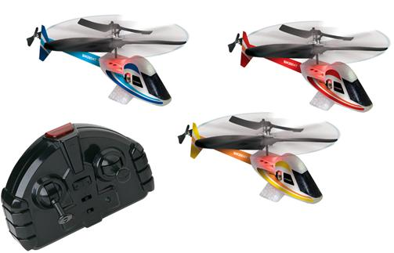
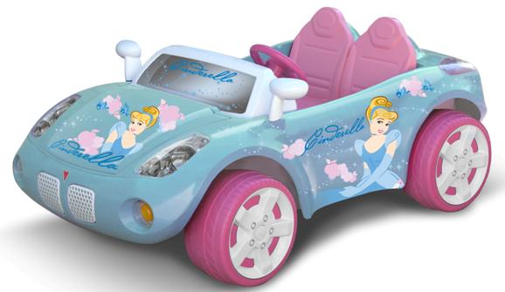
Toy Story: Build Your Own Toy!
Notes:
Left (helicopters with remote controller)
Source: http://www.cpsc.gov/cpscpub/prerel/prhtml08/08341.html
Right (Cindarella car)
Source: U.S. Consumer Product Safety Commission http://www.cpsc.gov/cpscpub/prerel/prhtml08/08195.jpg

Slide 2
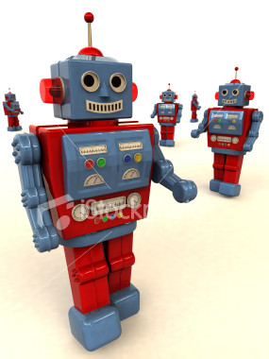
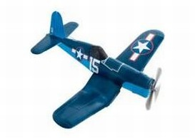
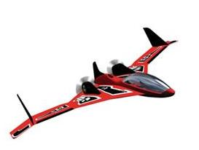
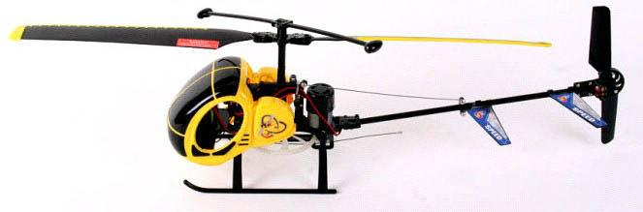
Some Electric Toys
Notes:
Top left (toy planes)
Source: http://www.cpsc.gov/cpscpub/prerel/prhtml07/07139.html
Top right (robot)
Source:http://www.personal.psu.edu/bjm5322/PersonalCAD.htm
Bottom (remote controlled helicopter)
Source:http://www.cpsc.gov/cpscpub/prerel/prhtml10/10228.html

Slide 3
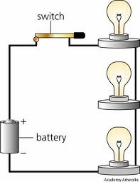
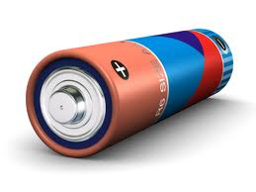
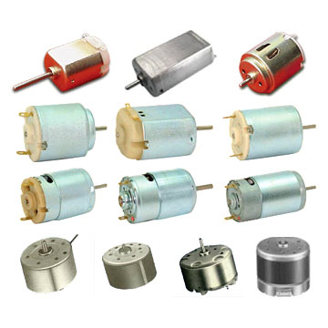
Circuits and Motors
Batteries are used to supply electricity
Electricity is used to run a motor
Notes:
Left (battery)
Source: http://www.uvm.edu/~seed/2007-8/drpower/charts.html
Middle: (examples of dc motors)
Source: http://www.dtic.upf.edu/~jlozano/interfaces/interfaces8.html
Right (example circuit)
Source: http://ed101.bu.edu/StudentDoc/current/ED101fa10/mariam45/circuits.html

Slide 4
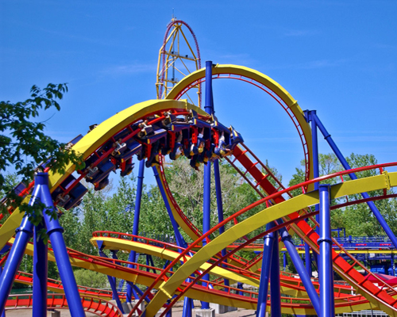
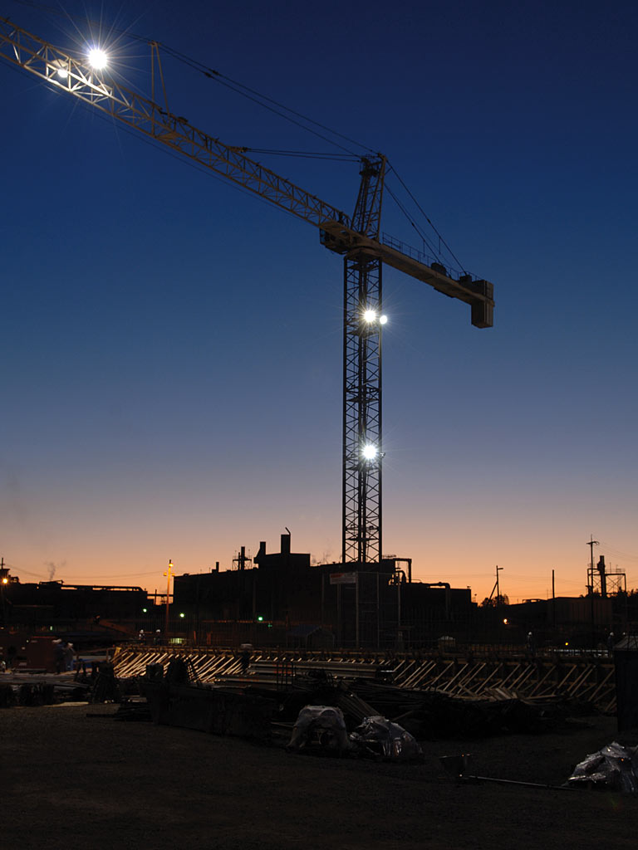
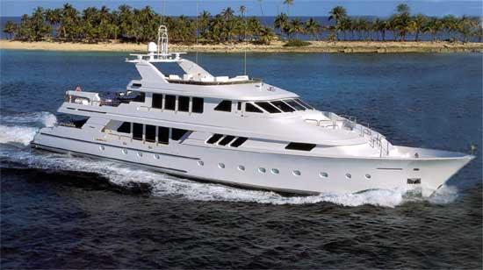
Motors are used for lots of things
From big…
Notes:
Left (construction crane)
Source: http://www.y12.doe.gov/news/report/toc.php?vn=2_3&xml=pm_1
Center (boat)
Source: http://astro.temple.edu/~tub84763/products.html
Right (ferris wheel)
Source: http://www.edb.utexas.edu/visionawards/petrosino/index.php?usr=ellenjoan&id=s:home_ellenjoan

Slide 5
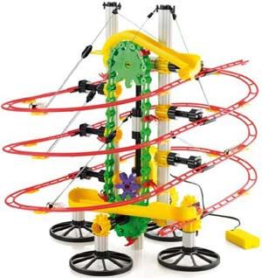
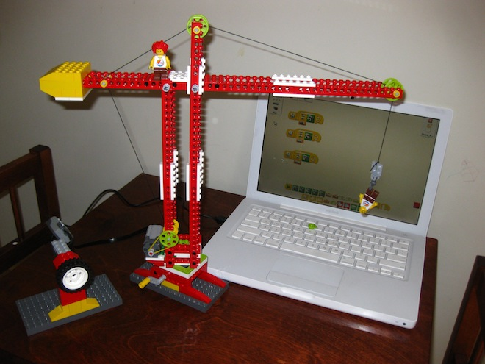
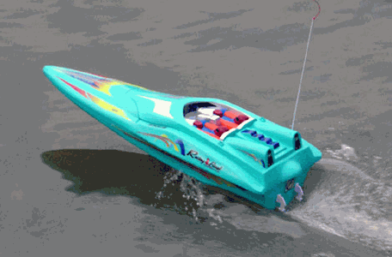
To small…
Notes:
Left (toy construction crane)
Source: http://scratched.media.mit.edu/stories/wedo-redo
Center (toy motor boat)
Source: http://www.pitt.edu/~bre19/teamwebpage/serviceinformation.html
Right (toy roller coaster)
Source: http://store.exploratorium.edu/browse.cfm/skyrail-morotized-marble-roller-coaster/4,6055.html

Slide 6
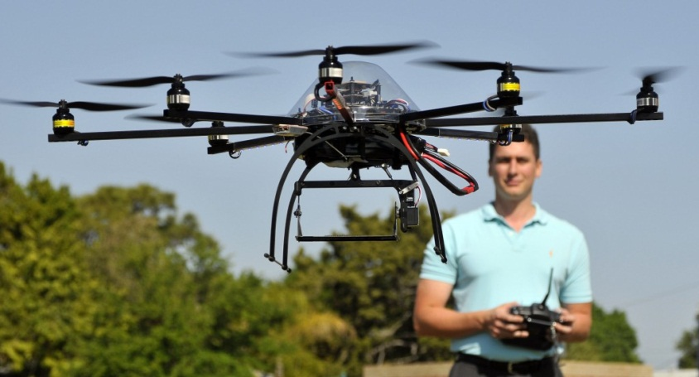
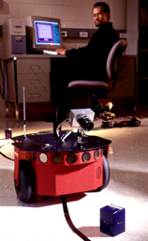
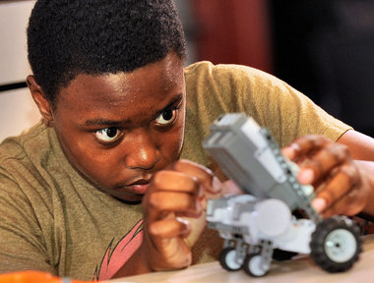
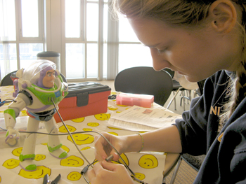
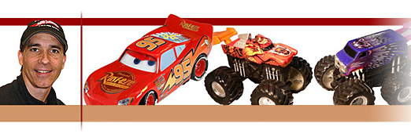
Toy Engineering
Engineers design, build, and test toys using motors
Notes:
Top left: RC helicopter test
Source: http://blogs.fit.edu/blog/student-stories/flying-high-with-master%E2%80%99s-project/#.T-38pbVtp5k
Bottom left: Engineer fixing buzz lightyear
Source: http://www.uakron.edu/im/online-newsroom/news_details.dot?newsId=2250225&pageTitle=UA%20News&crumbTitle=Engineering+students+bring+new+life+to+broken+toys
Bottom right: Hot wheels engineer
Source: http://soe-oldwebserver.stanford.edu/alumni/profiles/hippely.html
Center: Robot engineer
Source: http://www.jhu.edu/news_info/news/home99/mar99/vision.html
Upper right: engineer student working on electronic toy
Source: http://www.eng.buffalo.edu/modules/news/img/120601_nationa_grid_large_.png

Slide 7
Today’s Project
Goal: Design and build a new toy
Given: Motor, batteries, wires, popsicle sticks, straws, tape, note cards, gears, axles, wheels
Requirements: Toy must have moving parts and be fun to play with
(Optional) Presentation: Explain why your toy should be manufactured for the children (your clients) This should include how fun and creative your toy is!

