Slide 1
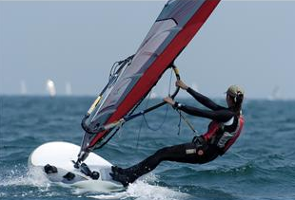
Renewable Energy: Sail Cars!
Notes:
Renewable Energy: Sail Cars! Presentation
Gone with the Wind – Sail Cars! activity > TeachEngineering.org
~
Image source (wind surfer) Microsoft clipart: http://office.microsoft.com/en-us/images/results.aspx?qu=sail&ex=1#ai:MP900448351|mt:2|

Slide 2
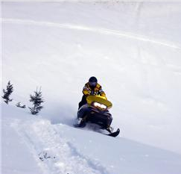
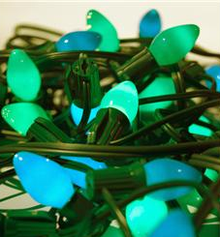
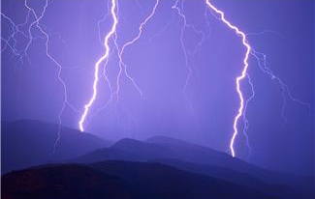
Question: What Is Energy?
Answer: Energy is the ability to do work.
Energy comes in many forms: chemical energy, electrical energy, heat energy, light energy, mechanical energy and nuclear energy.
Notes:
Image sources:
(snowmobile) Microsoft clipart: http://office.microsoft.com/en-us/images/results.aspx?qu=sports&ex=1#ai:MP900448662|mt:2|
(blue/green bulbs) Microsoft clipart: http://office.microsoft.com/en-us/images/results.aspx?qu=light&ex=1#ai:MP900382836|mt:2|
(lightning storm) Microsoft clipart: http://office.microsoft.com/en-us/images/results.aspx?qu=storm&ex=1#ai:MP900407566|mt:2|

Slide 3
Conservation of Energy
“Energy is neither created nor destroyed.”
The amount of energy in a system is conserved over time.

Slide 4
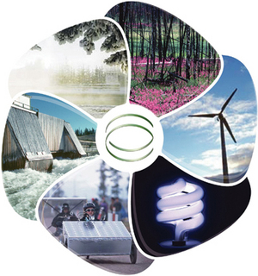
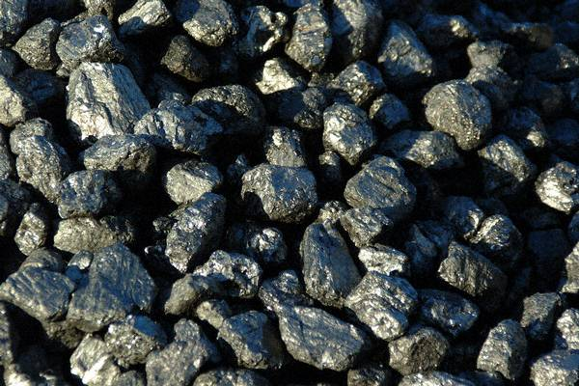
Renewable vs. Nonrenewable
Examples of renewable energy:
solar, biofuel, wind,
geothermal, hydropower
LIMITLESS
Examples of nonrenewable energy:
fossil fuels (coal, oil, natural gas)
LIMITED
Notes:
Image sources:
(wheel showing renewable energy types) U.S. Green Building Council, North Carolina Chapter
https://usgbccrc.site-ym.com/store/ViewProduct.aspx?id=836649
(coal chunks) Office of Surface Mining, Reclamation and Enforcement, U.S. Department of the Interior http://arri.osmre.gov/Partnerships/Coffee_Coal/Images/coal_chunks.jpg

Slide 5
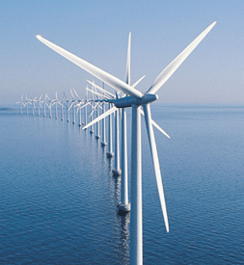
Wind Energy
A type of renewable energy provided by the wind.
Wind turbines ➔
Brainpop:
http://www.brainpop.com/technology/energytechnology/windenergy/
Notes:
Image source:
Bureau of Ocean Energy Management, Department of the Interior http://www.boem.gov/Renewable-Energy-Program/Renewable-Energy-Guide/index.aspx

Slide 6
Notes:
Image source:
Energy Quest, California Energy Commission
http://www.energyquest.ca.gov/story/images/chap01_convection.png

Slide 7
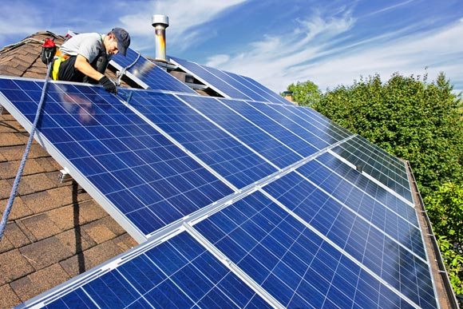
Solar Energy
PV Cells
Concentrated Solar
Notes:
Image sources:
(PV cells on roof) Lawrence Berkeley Lab, U.S. Department of Energy http://carboncycle2.lbl.gov/lib/img/articles/psc-installing-solar.jpg
(concentrated solar farm) U.S. Energy Information Administration http://www.eia.gov/todayinenergy/images/2011.03.16/concentrating_solar.png

Slide 8
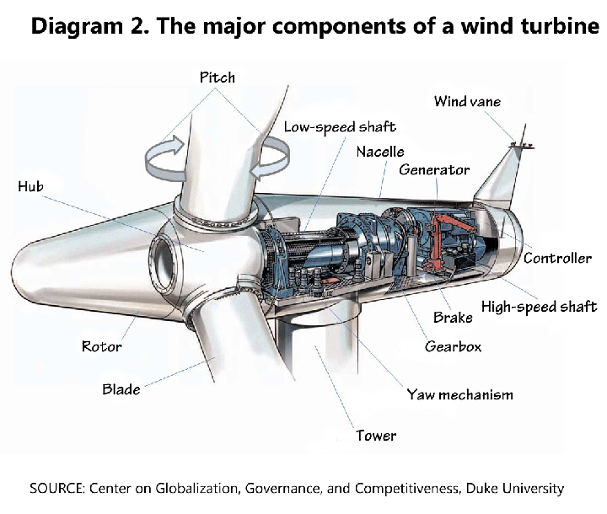
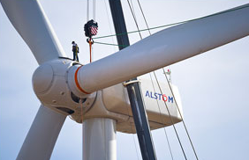
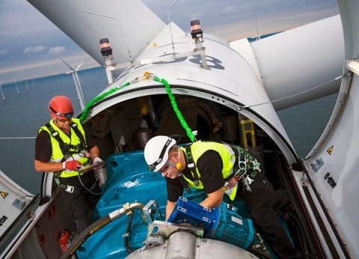
Wind Turbines
Notes:
Image sources:
(man stands on wind turbine as blades are attached) Dennis Schroeder, National Renewable Energy Laboratory http://www.nrel.gov/news/features/feature_detail.cfm/feature_id=1498
(two men work inside a wind turbine) Energy.gov http://energy.gov/eere/wind/career-map-wind-technician
(wind turbine components diagram) U.S. Bureau of Labor Statistics, U.S. Department of Labor, Center on Globalization, Governance and Competitiveness, Duke University http://www.bls.gov/green/wind_energy/diagram_2_resize.png

Slide 9
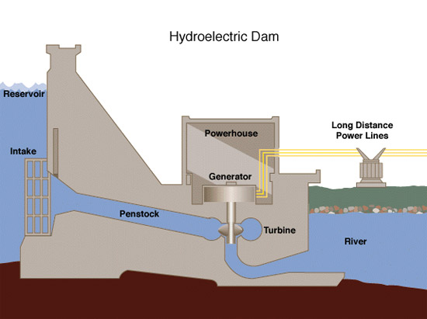
Hydropower
Notes:
Image sources:
(Hoover dam under construction) Bureau of Reclamation, U.S. Department of the Interior http://www.usbr.gov/lc/images/gallery/hoover/Wash-No-2857.jpg
(hydroelectric dam side view diagram) Tennessee Valley Authority http://www.tva.gov/power/images/hydro.gif

Slide 10
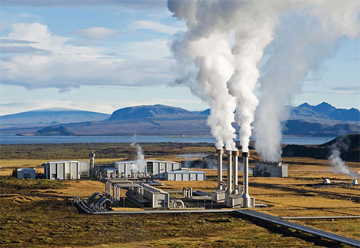
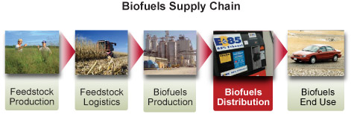
Other Types of Renewable Energy
geothermal
hydro/tidal
biofuels
Biofuels Supply Chain
Notes:
Image sources:
(tide coming in drawing) Climate Kids, NASA http://climatekids.nasa.gov/review/tidal-energy/Tidal-power-300.jpg
(geothermal power plant) Texas Office of Public Utilities http://www.opuc.texas.gov/images/geothermal_power_plant.jpg
(biofuels supply chain diagram) NIST http://www.nist.gov/mml/csd/images/biofuel1c_1.jpg

Slide 11
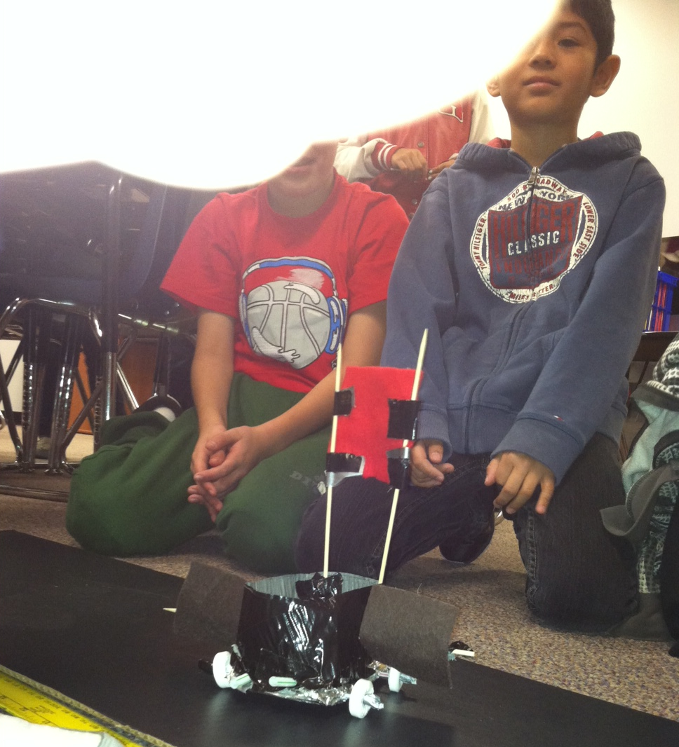
Sail Car Challenge
In groups of two, design a sail to propel your car forward using the wind from a box fan!
Each group receives a base with axles and wheels.
Use the given materials to design a mast and sail that propels your “sail car” forward.
Be creative and don’t give up!
Notes:
Image source: 2014 Wyatt Champion, College of Engineering and Applied Science, University of Colorado Boulder

Slide 12
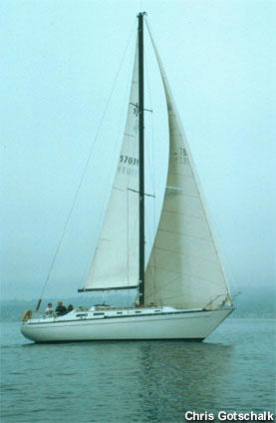
Sail Types
Notes:
Image sources:
(Oracle sailboat) U.S. National Park Service http://www.nps.gov/safr/images/ac_45_blog_post.jpg
(sailboat) Chris Cotschalk, NOAA http://sanctuaries.noaa.gov/pgallery/pgchannel/human/sailboat_100.jpg

Slide 13
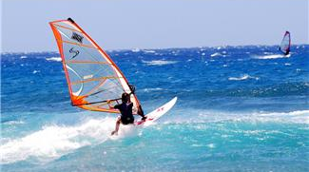
Scientific Method
What are our constants?
car base – cardboard rectangle of the same size and shape
axles – coffee stirrers
wheels – Lifesavers® mint candies
What are our variables?
sail material
sail design
mast material
mast design
Can you think of any other constants?
Can you think of any other variables?
Notes:
Image source: (woman wind surfing) Microsoft clipart http://office.microsoft.com/en-us/images/results.aspx?qu=wind&ex=1#ai:MP900448372|mt:2|

Slide 14
Notes:
Image source: (steps of the engineering design process) TeachEngineering https://www.teachengineering.org/engrdesignprocess.php

