Slide 1
Silly Putty Opening Question
Does it behave like an elastic solid or a viscous fluid? What was your prediction?
It actually has viscoelastic behavior! It has properties of an elastic solid and a viscous fluid.
Notes:
Viscoelasticity Presentation, Viscoelasticity lesson, TeachEnginering.org

Slide 2
Viscoelastic Materials

Slide 3
Viscoelasticity
Materials that exhibit both viscous and elastic characteristics when undergoing deformation
Results in time-dependent behavior: The rate that a force/displacement is applied matters as well as how long the force/displacement is applied
What type of materials are viscoelastic?
polymers
biological materials

Slide 4
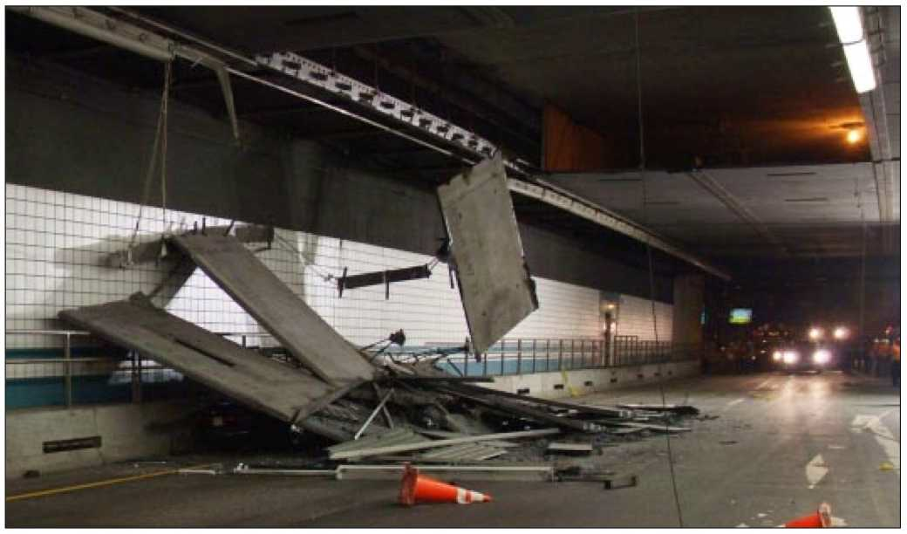
Viscoelasticity
Why is it important to understand viscoelasticity?
If using a viscoelastic material in your device/structure design
If your device must operate in an environment that contains viscoelastic materials
Real-life example: Fort Point Channel Tunnel in Boston
Ceiling panels secured with bolts embedded in epoxy (a polymer)
12 tons of concrete fell
242 unsafe bolts found
Notes:
Image source: Massachusetts State Police, National Transportation Safety Board http://www.ntsb.gov/doclib/reports/2007/HAR0702.pdf

Slide 5
Strain Rate Dependence
The faster the loading rate:
The more elastic the response
The smaller the curvature
The stiffer the material response
Notes:
Graph source: © 2011 Brandi N. Briggs, ITL Program, College of Engineering, University of Colorado Boulder

Slide 6
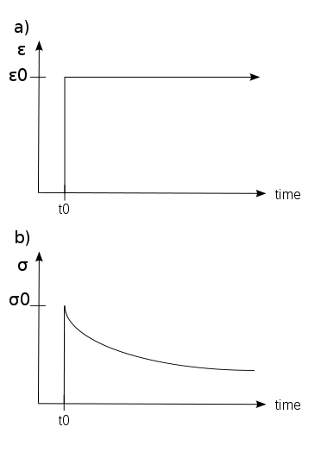
Stress Relaxation
If you apply a constant displacement then the force decreases as a function of time.
Example:
A rubber band around a newspaper for a long period of time will decrease the force that it applies
Notes:
Graphs source: Strafpeloton2, Wikipedia {PD} http://en.wikipedia.org/wiki/File:StressRelaxation.svg

Slide 7
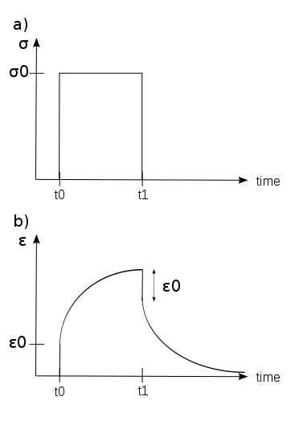
Creep
If you apply a constant force then the displacement will increase as a function of time.
Example:
Hang a bike from a bungee cord and the bungee cord will lengthen over time
Notes:
Image source: Strafpeloton2, Wikipedia http://en.wikipedia.org/wiki/File:Creep.svg

Slide 8
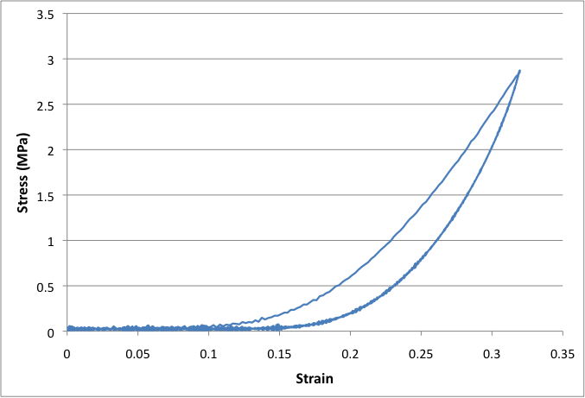
Hysteresis
Takes more energy to load the material than to unload. This energy is lost during the loading phase.
The area between the load and unloading curve represents the energy lost.
Notes:
Graph source: © 2011 Brandi N. Briggs, ITL Program, College of Engineering, University of Colorado Boulder

Slide 9
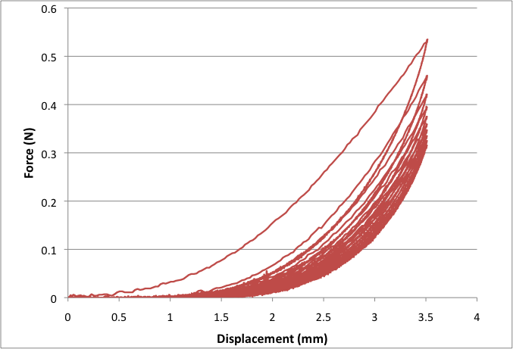
Preconditioning
As you continue to cycle the material, the amount of energy loss decreases until it reaches an equilibrium close to zero.
The amount of force it takes to displace the material decreases with more cycles. Eventually, equilibrium is reached.
Example: Stretching balloon material to make them easier to blow up/stretch.
Notes:
Graph source: © 2011 Brandi N. Briggs, ITL Program, College of Engineering, University of Colorado Boulder

Slide 10
Silly Putty Experimentation
Let’s demonstrate some of these properties with silly putty
strain rate dependence
creep
In your lab notebook, describe the differences that you observed in behavior between springs and silly putty.
Notes:
Conduct the In-Class assessment (see the Assessment section), which details how to demonstrate strain rate dependence and creep using silly putty.

