Slide 1
Appendix Slides
Notes:
Presentation Appendix Slides, An Introduction to Air Quality Research lesson, TeachEngineering.org
These slides provide more information about the Pod air quality monitor—how it works, the sensors, the measurements and data available, etc.
Image source: clouds in sky: © 2015 Hannigan Lab, College of Engineering, University of Colorado Boulder

Slide 2
Appendix 1: More Information on the Technology (Pods)
Operational Info: How the Pods work, how you can look at data
Sensors: How they work
Calibration: Raw vs. calibrated data

Slide 3
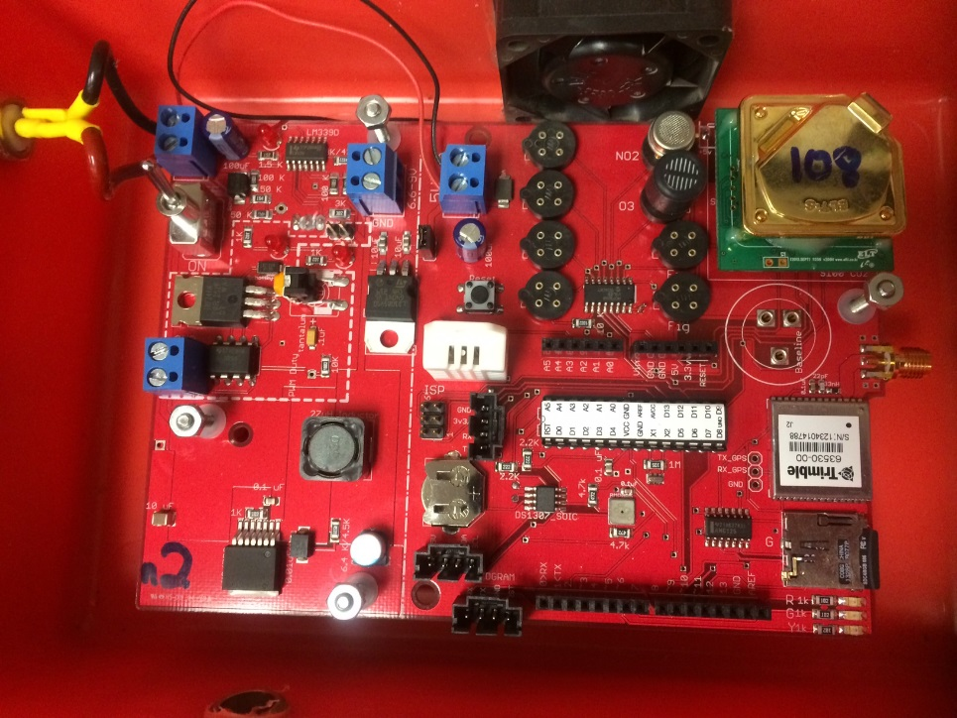
Operational Info
Pods record data every ~5-25 seconds, depending on the settings
Data is recorded to a mini–SD card on the board (bottom right corner of image)
Powered by using a power adapter OR a battery
Checks:
Is this light on?
Turn pod on
Is the fan running?
Are these lights flashing ~once every 5-10 seconds?
If so, then the pod is collecting data
FYI: plenty of space on the SD card
Notes:
Image source: inside a Pod air quality monitor; © 2015 Hannigan Lab, College of Engineering, University of Colorado Boulder

Slide 4
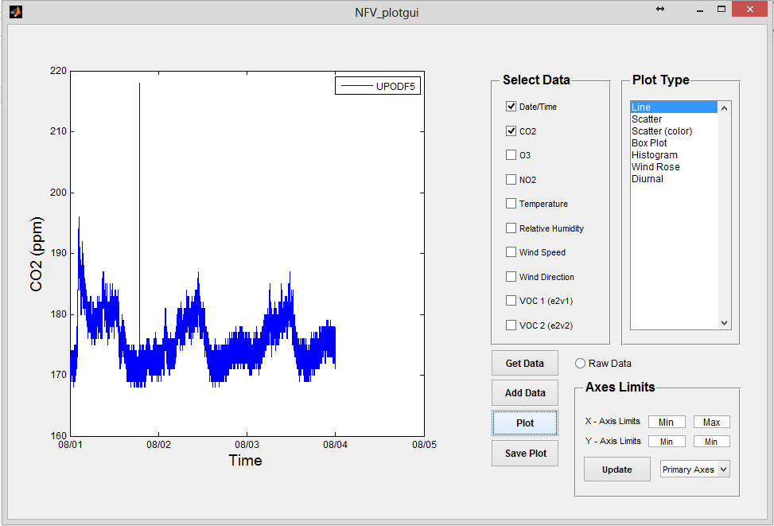
Operational Info
Data files can be viewed in Excel OR in “Plotter Tool”
Excel gives you:
More flexibility
More analysis tools (statistics)
Plotter Tool:
Reduces the time required to load data files into Excel
Able to plot large amounts of data
Problems: If the data file did not write perfectly, it will not load (for example, stray characters)
Downloadable for free from wiki site at: Citizenscienceairqualitymonitoring.pbworks.com
Notes:
Image source: screen capture; © 2015 Hannigan Lab, College of Engineering, University of Colorado Boulder

Slide 5
The Sensors
Metal Oxide Semi-Conductor
Pros: affordable (≈$5-10), easy to implement, easy to use, available for a variety of pollutants
Cons: temperature and humidity effects, cross-sensitivities, requires intensive sensor characterization and data processing
chemical reaction with gases changes the resistance across the sensor
constant voltage supplied
variable
voltage
output
convert to useable data
Notes:
Image source: sensor on circuit board; 2013 Nathan Chantrell, Flickr https://www.flickr.com/photos/nathanchantrell/8459183561; license CC BY-NC-ND 2.0; labeled for noncommercial reuse, https://creativecommons.org/licenses/by-nc-nd/2.0/

Slide 6
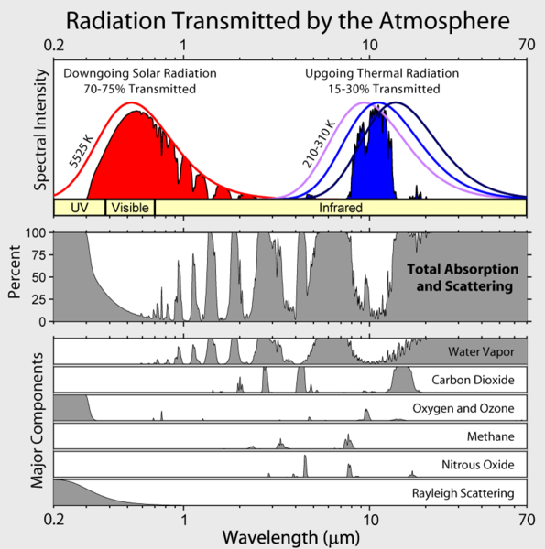
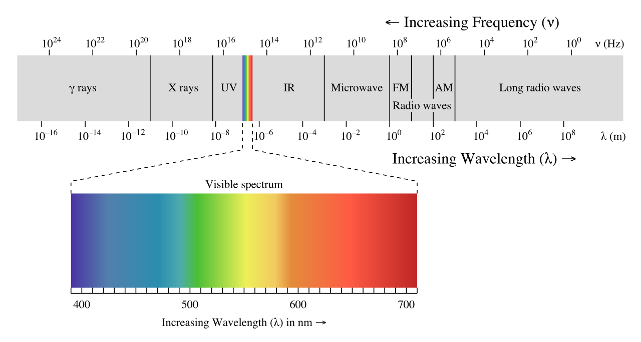
The Sensors
Non-Dispersive Infrared
Slightly more expensive ($40)
Less subject to temperature and humidity effects
Utilizes optical properties to measure gas concentration (light absorbance by a gas, at specific wavelengths)
Notes:
Image sources:
Electromagnetic spectrum diagram: 2007 Philip Ronan, Wikimedia Commons https://commons.wikimedia.org/wiki/File:EM_spectrum.svg
Transmittance of greenhouse gases diagram: 2007 Robert A Rohde, Global Warming Art project, Wikimedia Commons https://commons.wikimedia.org/wiki/File:Atmospheric_Transmission.png

Slide 7
An Important Note about Data Analysis and Calibration
Raw sensor data directly from the Pod is in the form of voltages
Calibration enables us to convert the voltages to concentration values
Analyzing raw signal is possible and useful, especially for:
short-term class activities/demos (it is immediately available)
indoor data
or when you are seeing substantial amounts of pollutants
Why is this? The change in pollutant is likely going to be more significant than the change in temperature or humidity, which means the data trends will be driven by pollutants and qualitative analysis is possible (or examining relative changes rather than numerical concentrations)

Slide 8
An Important Note about Data Analysis and Calibration
Calibrated data is in the form of concentration (such as ppm or ppb)
Analyzing calibrated data is necessary, especially:
If you are trying to quantitative analysis
If you are collecting data in an environment with large changes in temperature or humidity
If you wish to share your data beyond your project
Also, different levels of calibrated data exist; see the next slide ➔

Slide 9
Different Levels of Data Quality
Notes:
Image source: graph; © 2015 Hannigan Lab, College of Engineering, University of Colorado Boulder

Slide 10
Appendix 2: Data Examples
Calibration example
Carbon dioxide data example
Ozone data example

Slide 11
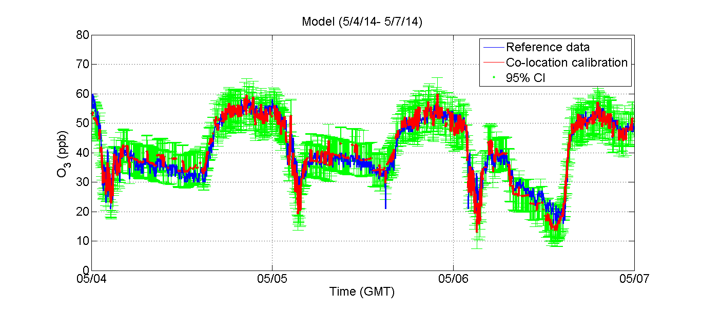
Data Examples
What a calibration looks like…
Similar to y = m*x +b
We use linear equations or models to convert our data
y (concentration) = m₁*voltage + m₂*temperature + m₃*humidity + b
Calibration Example
To calibrate our sensors we need both an independent variable and dependent variable
We get the dependent variable from a higher quality monitor that we want our data to match
Then we can solve for our coefficients (slopes and y-intercept)
Then we can use this model to predict the concentration or dependent variable for new data collected in the field
Reference Data
Matched Sensor Data
R² = .98, MSE = 2.5 ppb
Notes:
Y=mx+b
Image source: graph; © 2015 Hannigan Lab, College of Engineering, University of Colorado Boulder

Slide 12
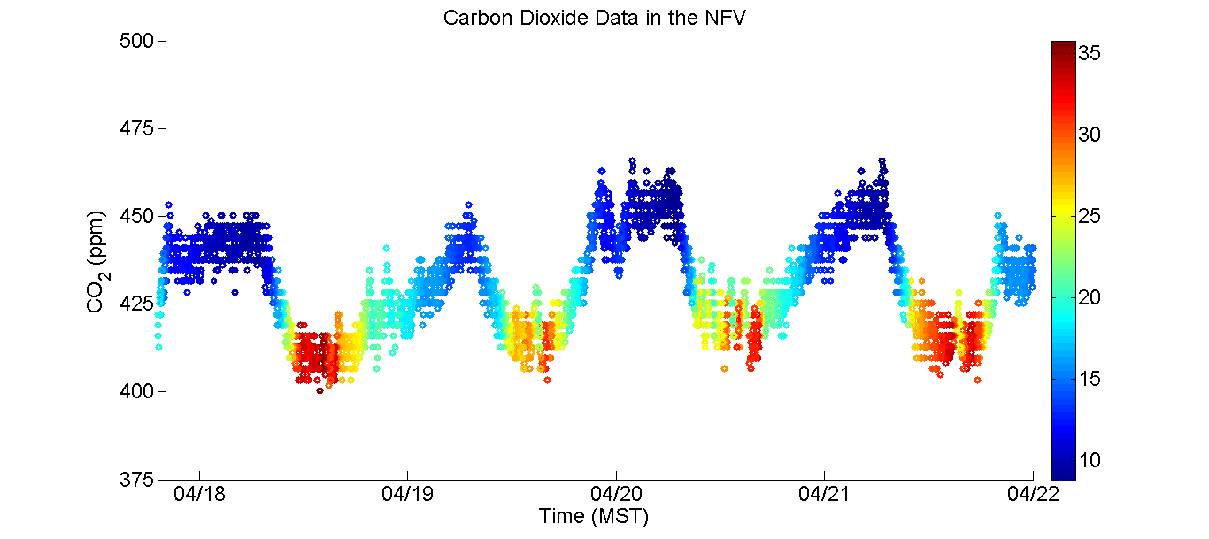
Data Examples
What can we learn from this data?
Do you see a daily pattern?
How does the pattern relate to temperature?
Carbon Dioxide Data from a small town in a valley
Temperature (^{O}C)
Notes:
Image source: graph; © 2015 Hannigan Lab, College of Engineering, University of Colorado Boulder

Slide 13
Data Examples
Observations
CO2 is highest when temperature is at its lowest
CO2 peaks at night
Following the warmest day, there is the lowest night time CO2
Possible Explanations
Boundary layer
Temperature inversions
Emissions from home heating
Temperature (^{O}C)
Notes:
Image source: graph; © 2015 Hannigan Lab, College of Engineering, University of Colorado Boulder

Slide 14
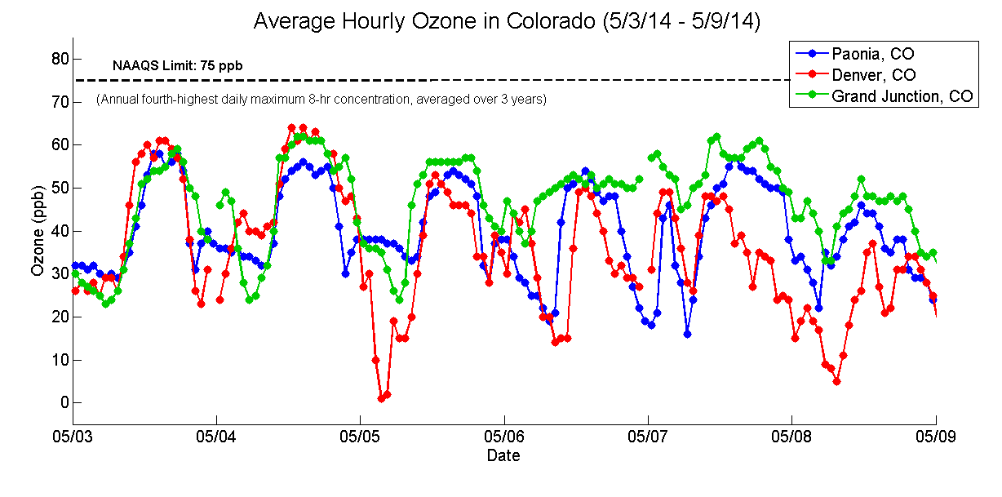
Data Examples
How can you explain the diurnal trend in the beginning of this data set? Any interesting observations?
midnight
noon
Notes:
Image source: graph; © 2015 Hannigan Lab, College of Engineering, University of Colorado Boulder

Slide 15
Data Examples
Diurnal Trend
The chemistry of ozone formation requires sunlight
Ozone is continually being formed and broken down
Sunlight – formation is favored
No sunlight – destruction is favored
Destruction of ozone requires NOx; if not enough NOx, ozone can “hang around”
Observations
Little variance between three locations
Ozone typically peaks in urban areas in the summer (thus, lack of sunlight might be limiting production in Denver)
Background ozone = 30-40 ppb, in uninhabited areas (naturally occurring VOCs can assist in its production)
Ozone is more of a regional issue than a local one because it takes more time to form and decay
Notes:
Image source: graph; © 2015 Hannigan Lab, College of Engineering, University of Colorado Boulder

