Slide 1
US Energy Graphs

Slide 2
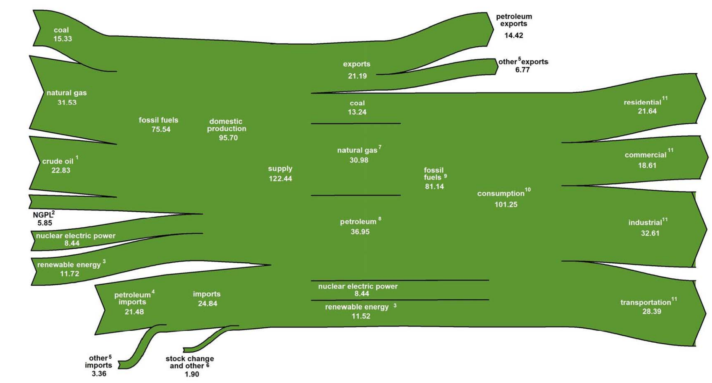
US Energy Flow 2018
Photos should be a
square like this.
#6091ba
#9fcc3b
#8d64a
#f8a81b

Slide 3
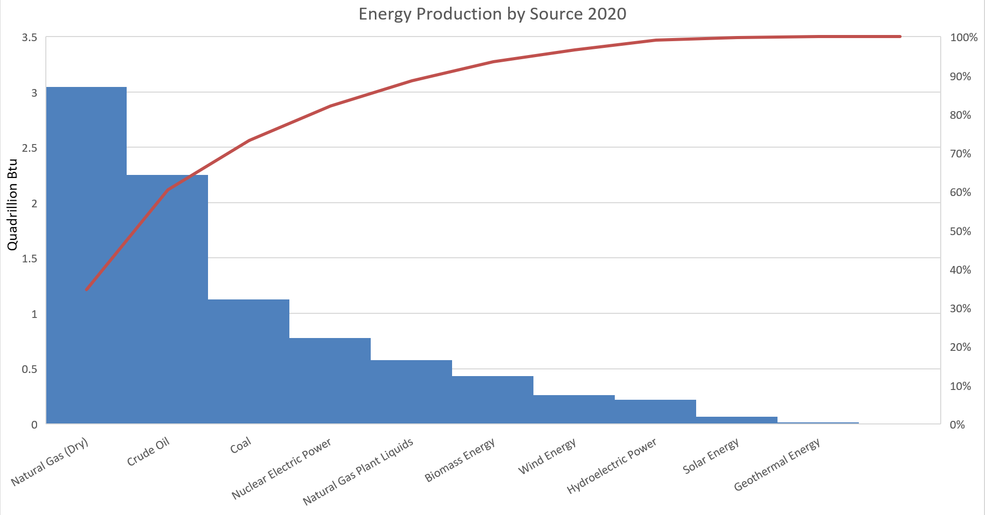
Photos should be a
square like this.
#6091ba
#9fcc3b
#8d64a
#f8a81b

Slide 4
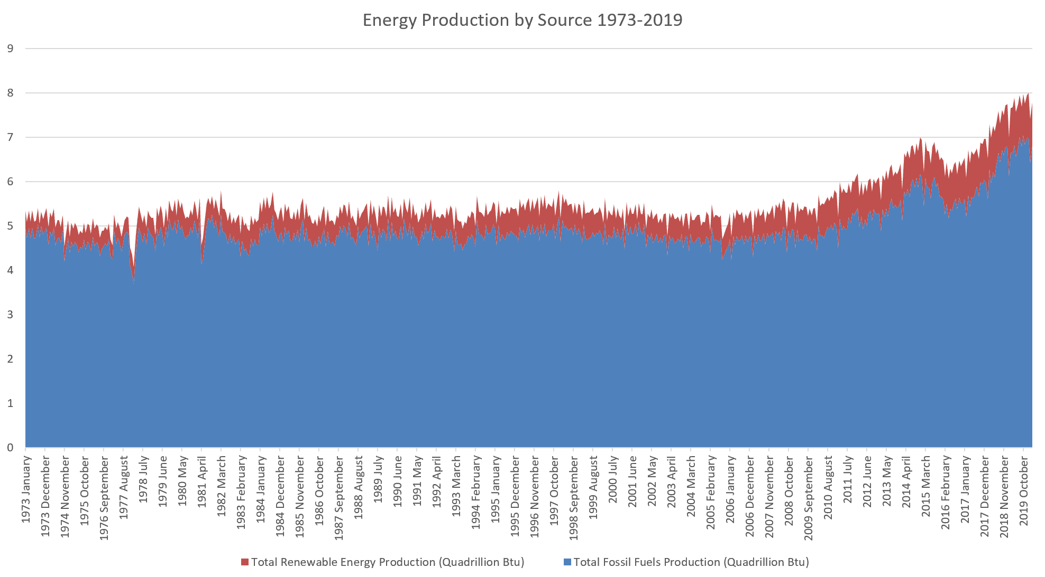
Photos should be a
square like this.
#6091ba
#9fcc3b
#8d64a
#f8a81b

Slide 5
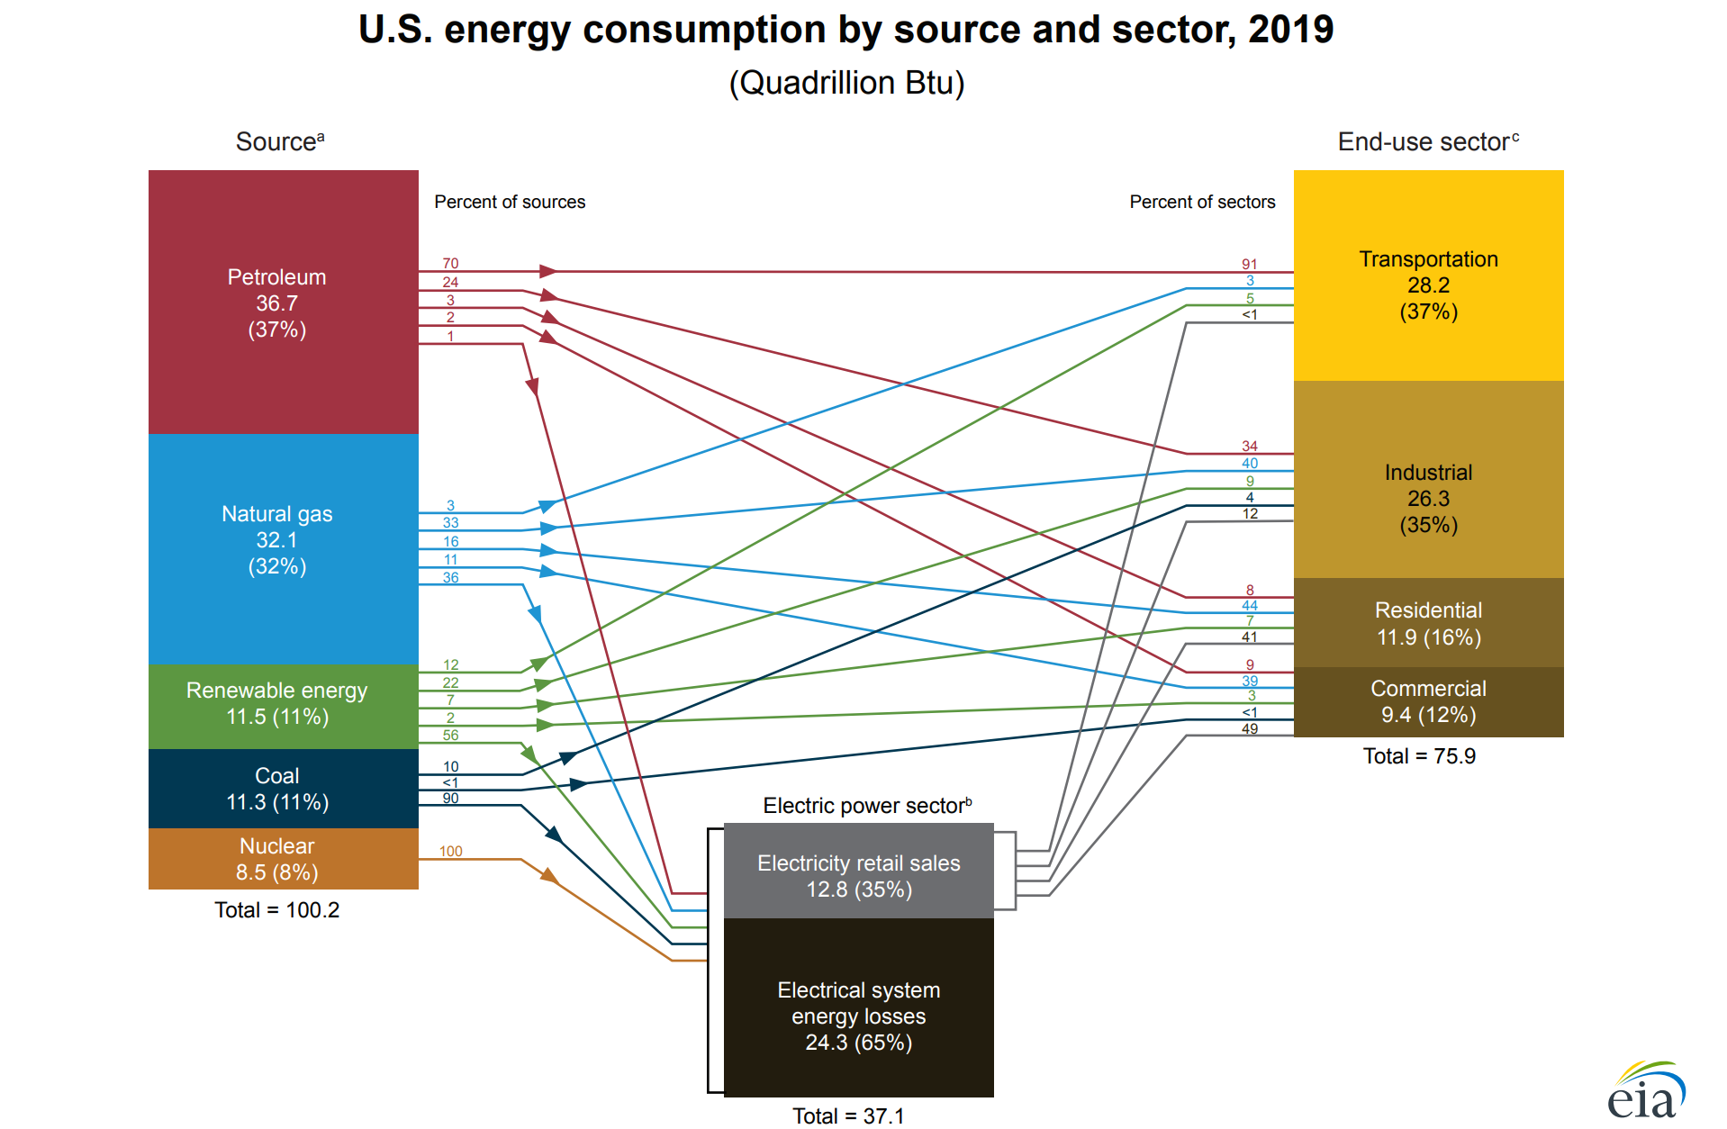
Photos should be a
square like this.
#6091ba
#9fcc3b
#8d64a
#f8a81b

Slide 6
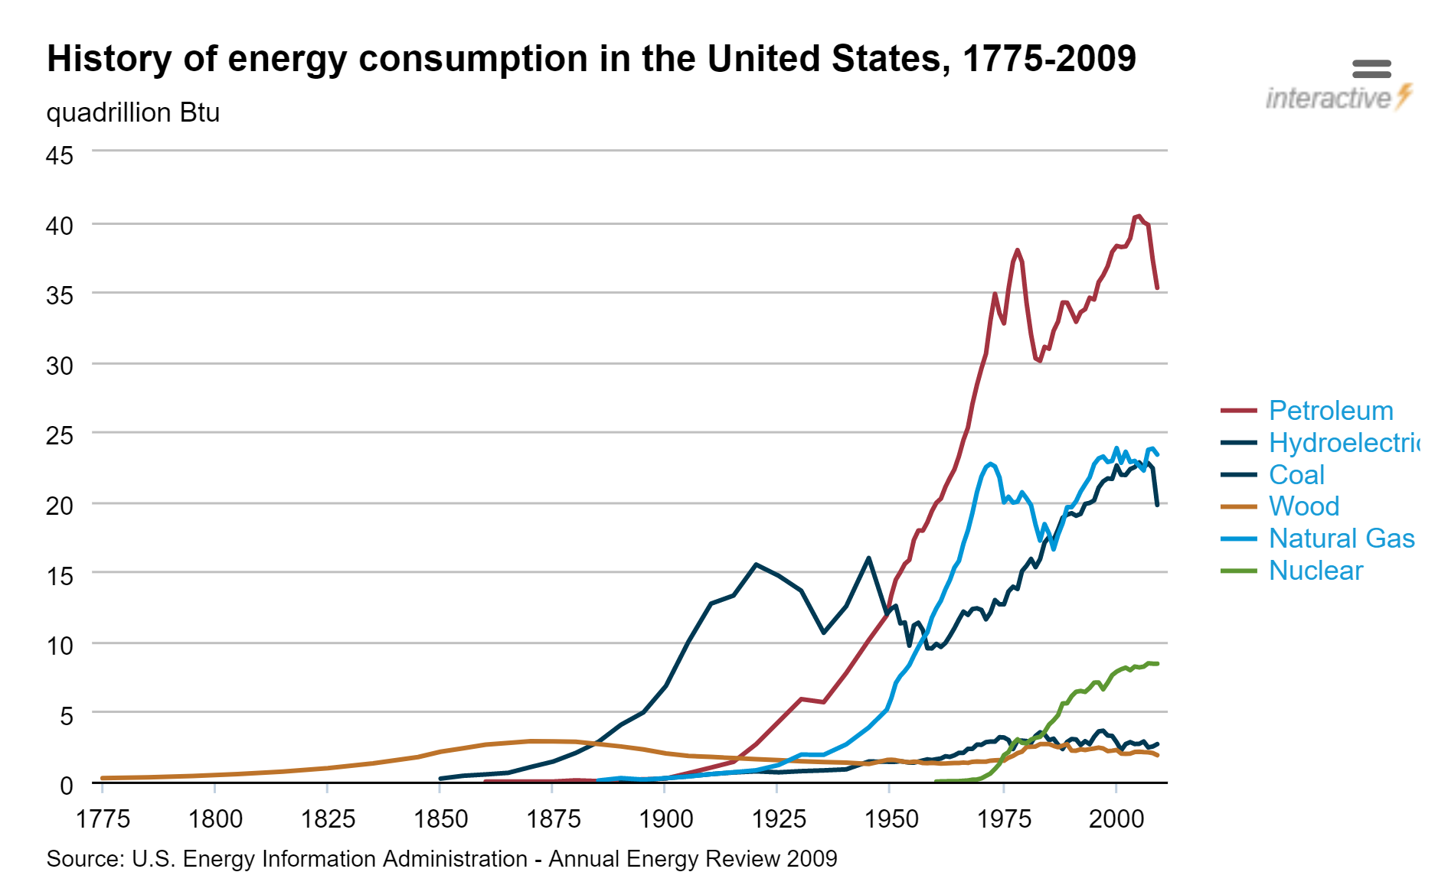
Photos should be a
square like this.
#6091ba
#9fcc3b
#8d64a
#f8a81b

Slide 7
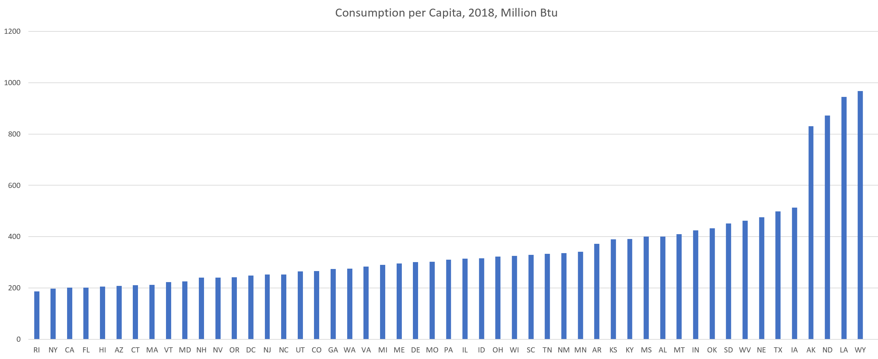
US Energy Consumption by State
Photos should be a
square like this.
#6091ba
#9fcc3b
#8d64a
#f8a81b

Slide 8
Sources
Energy Information Administration, U.S. Department of Energy,
https://www.eia.gov/totalenergy/data/annual/index.php and https://www.eia.gov/state/?sid=US
Accessed: July 25, 2020

