Slide 1
Lighting, Controls and Energy Savings
How Architectural Engineers Impact Building Energy Use

Slide 2
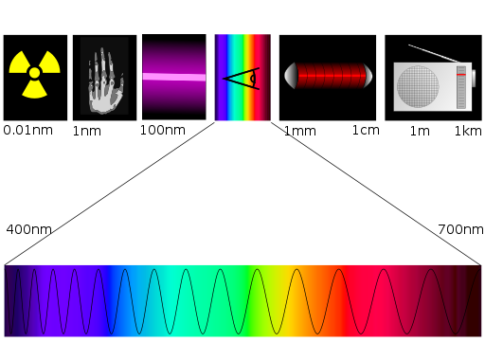
Visible Light
Notes:
Image from Wikimedia Commons

Slide 3
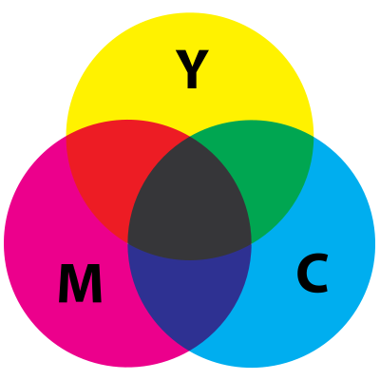
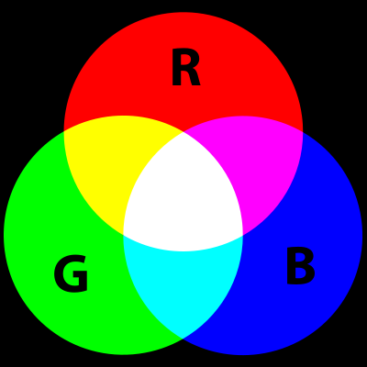
Visible Light
Subtractive color mixing
  Paint or Ink
Additive color mixing
  LIGHT!
Notes:
Images from Wikimedia Commons

Slide 4

Light Source Technology
Did you know? Sunlight has all colors of the rainbow and appears WHITE
Notes:
Image from Wikimedia Commons

Slide 5
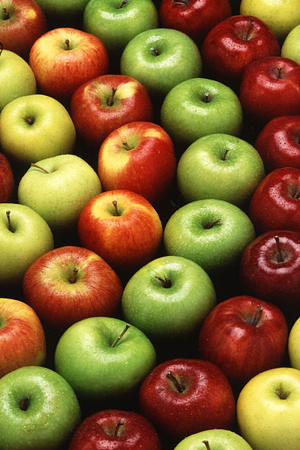
Visible Light
Reflected light is what we “SEE”
The RED apple is red because it absorbs all light except RED
The GREEN apple is green because it absorbs all light except GREEN
Notes:
Image from Wikimedia Commons

Slide 6
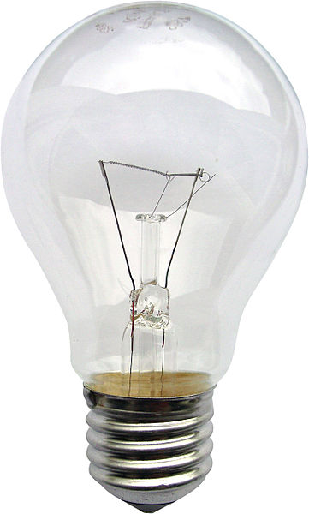
Light Source Technology
Electric Light
Bulb
LAMP
Filament
Socket
Notes:
Image from Wikimedia Commons

Slide 7
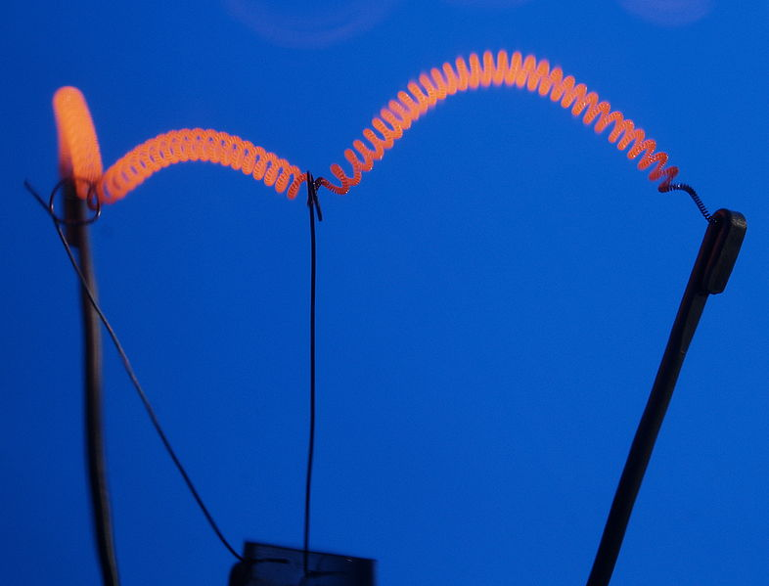
Light Source Technology
Incandescent Light
Notes:
Images from Wikimedia Commons

Slide 8
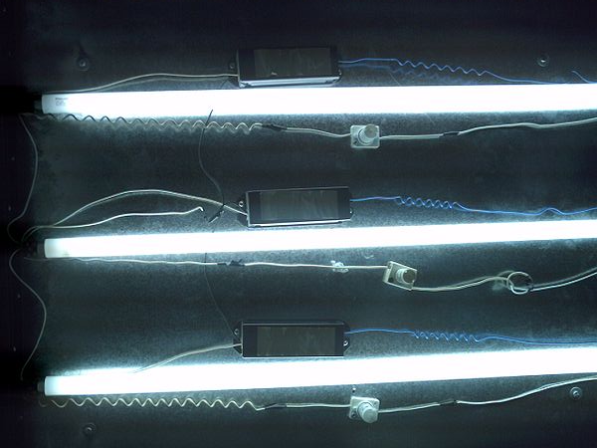
Light Source Technology
Fluorescent Light
Visible Light
Bulb Wall
Phosphor
UV
Mercury
Electricity
Notes:
Image on right from Wikimedia Commons. Image on left created from scratch.

Slide 9
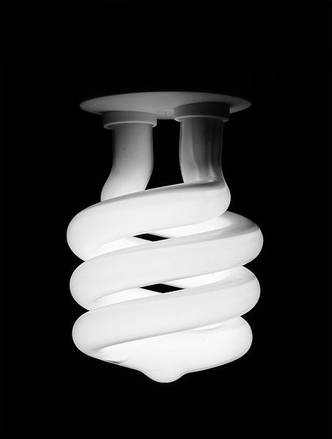
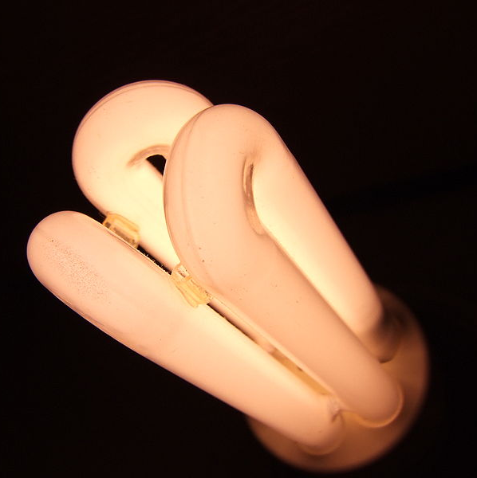
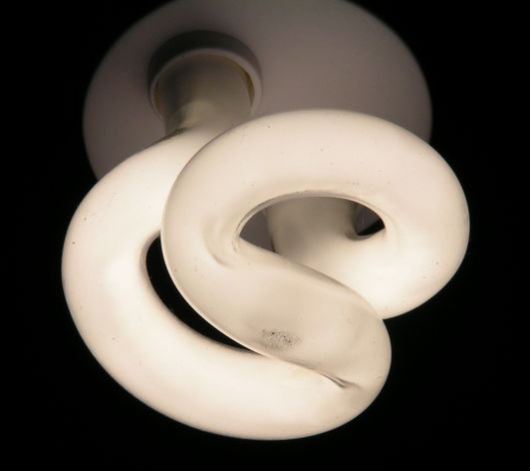
Light Source Technology
Compact Fluorescent Lamps (CFLs)
Notes:
Images from Wikimedia Commons

Slide 10
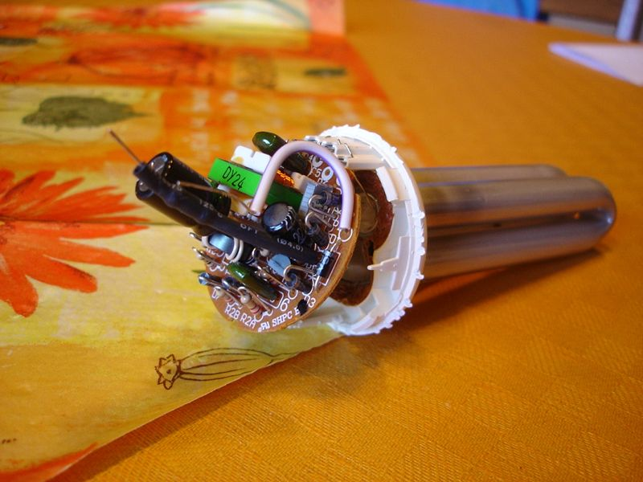
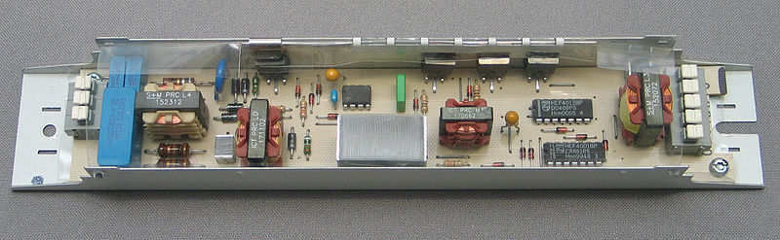
Light Source Technology
Fluorescent Ballast
Notes:
Images from Wikimedia Commons

Slide 11
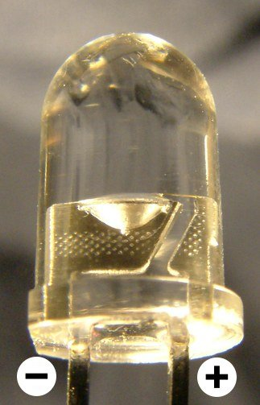
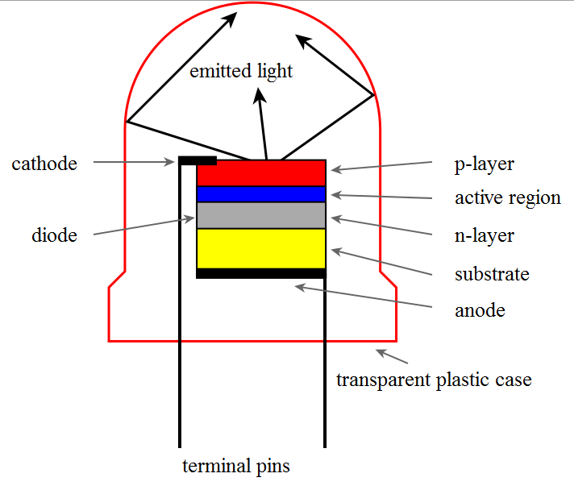
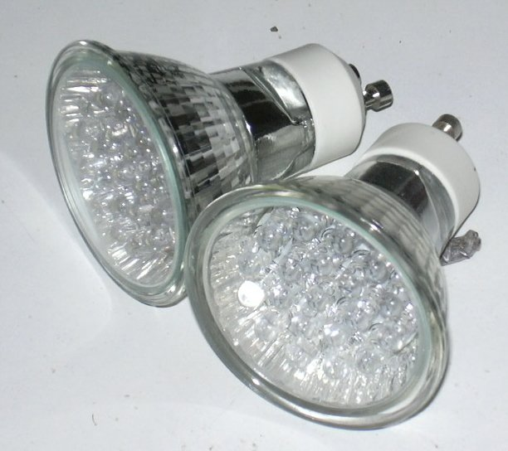
Light Source Technology
Light-Emitting Diodes (LEDs)
Notes:
Images from Wikimedia Commons

Slide 12
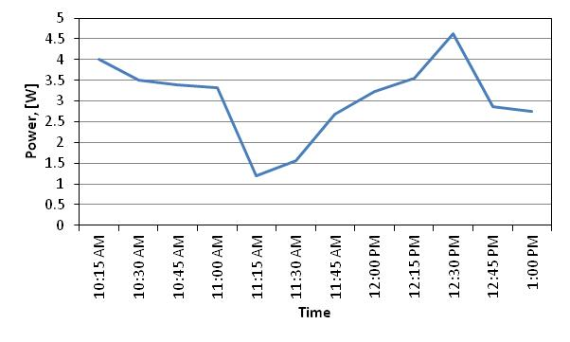
Lighting Controls
Power vs. Energy
Energy
Used
Notes:
Image created from scratch

Slide 13
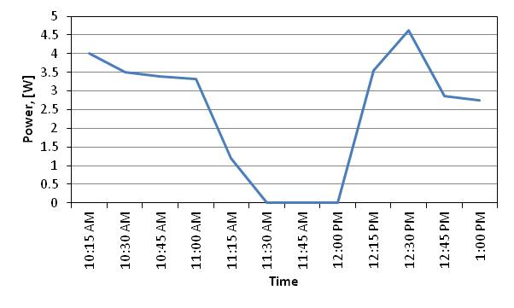
Lighting Controls
Saving Energy through Occupancy Controls
Energy
Saved
Energy
Used
Unoccupied
Notes:
Images created from scratch

Slide 14

Lighting Controls
Passive Infrared (PIR) Occupancy Sensors
Notes:
Image is a modified Microsoft Clipart graphic

Slide 15
Lighting Controls
Ultrasonic Occupancy Sensors
Notes:
Image is a modified Microsoft Clipart graphic

Slide 16
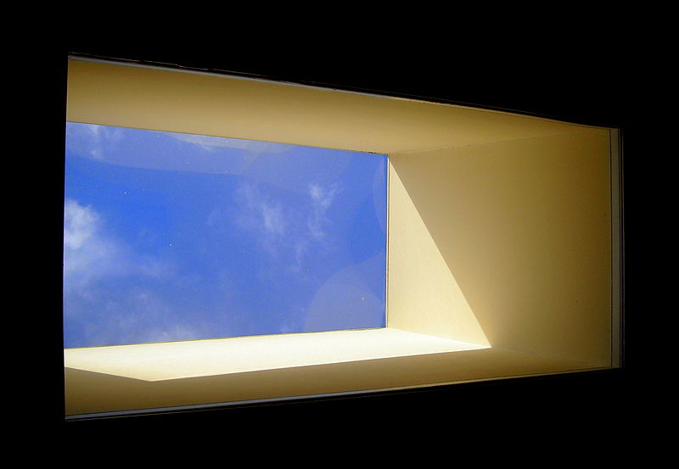
Lighting Controls
Daylighting
Notes:
Image from Wikimedia Commons

Slide 17
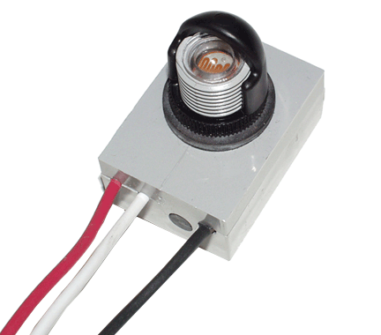
Lighting Controls
Photocell
Notes:
Image from Wikimedia Commons

