Slide 1
ECOLOGY IN ACTION: ROOFTOP GARDENS

Slide 2
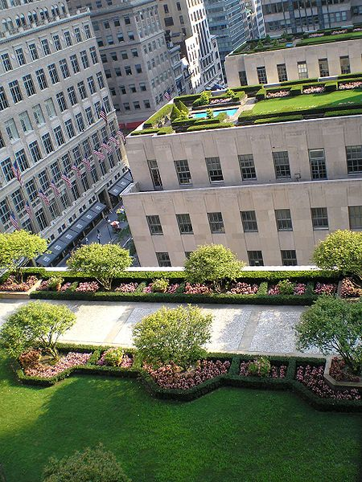
WHY A ROOFTOP GARDEN
Reduce the “urban heat island effect”
Reduce amount of greenhouse gas
Provide more space for agriculture
Reduce and clean storm water runoff
Reduce energy consumption
Increase the beauty of cities

Slide 3
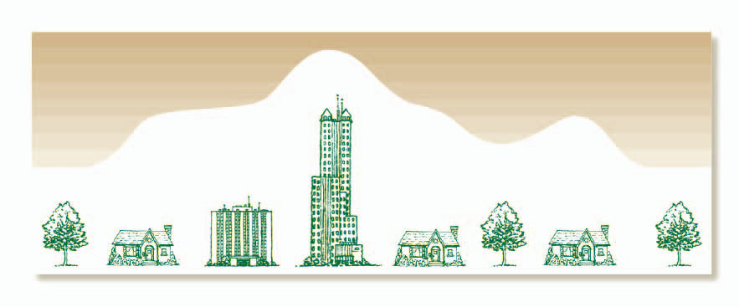
URBAN HEAT ISLAND EFFECT
A phenomenon in which the ambient air temperature in cities is higher than in its surrounding suburban and rural areas
Causes:
Materials (such as concrete and asphalt) absorb and radiate more heat than natural surfaces found in rural settings
Tall buildings - more surfaces that reflect and absorb light and block wind
Waste heat from energy usage – includes cars, air conditioning, industries
Creates higher energy demands to keep buildings cool
Affects weather and climate

Slide 4
HEAT TRANSFER BASICS

Slide 5
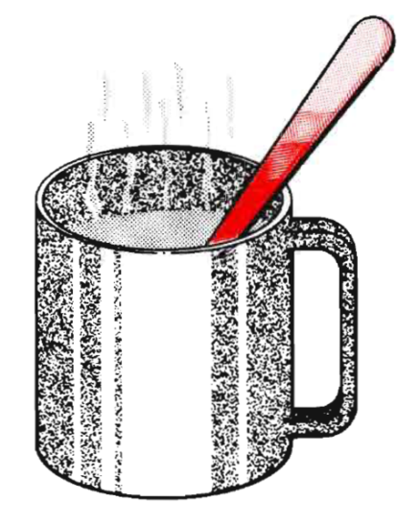
CONDUCTION
Transfer of heat by direct contact of particles in matter
In solids, close vibration of atoms next to each other

Slide 6
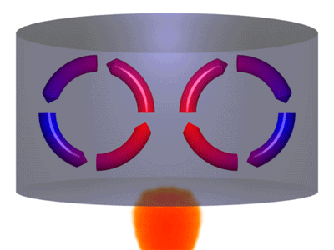
CONVECTION
Transfer of heat by fluid or gas moving across a boundary
Natural convection occurs by buoyancy forces

Slide 7
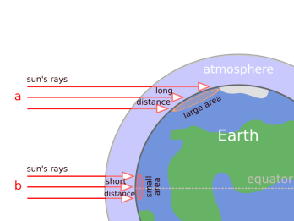
RADIATION
Transfer of thermal energy through space
This is how the sun heats the surface of the Earth!
Radiation can be transmitted, reflected and emitted from a surface

Slide 8
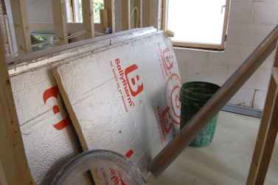
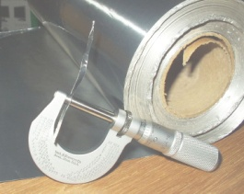
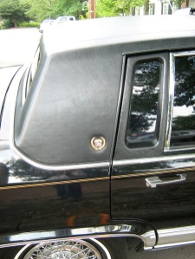
MATERIALS
Insulators – materials that reduce the rate of heat transfer
Absorbers – materials that take up the energy of light
Reflectors – materials that change the direction of light waves

Slide 9
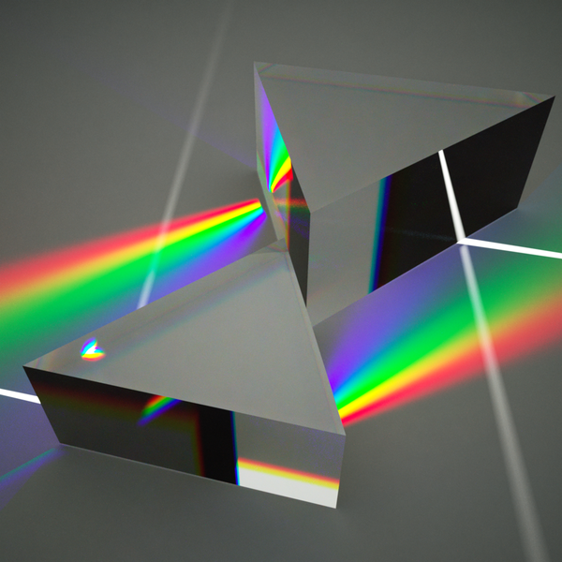
COLOR, LIGHT, AND HEAT
All colors absorb light and reflect only the wavelengths of their color
White reflects all wavelengths of light
Black absorbs all wavelengths of light
The energy of the absorbed light is transferred into heat energy…
➔ Black surfaces get hotter than other colors!

Slide 10
PLANTS TO THE RESCUE

Slide 11
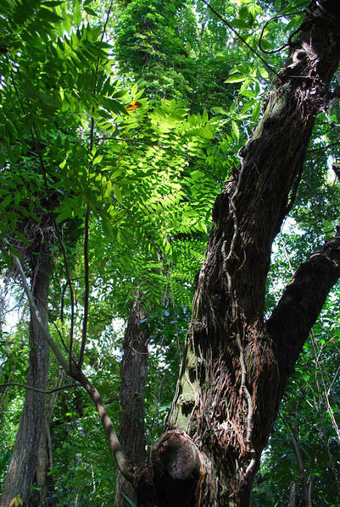
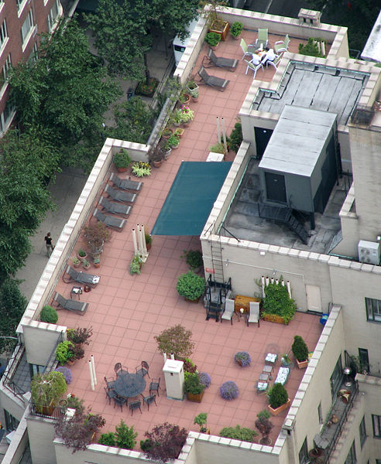
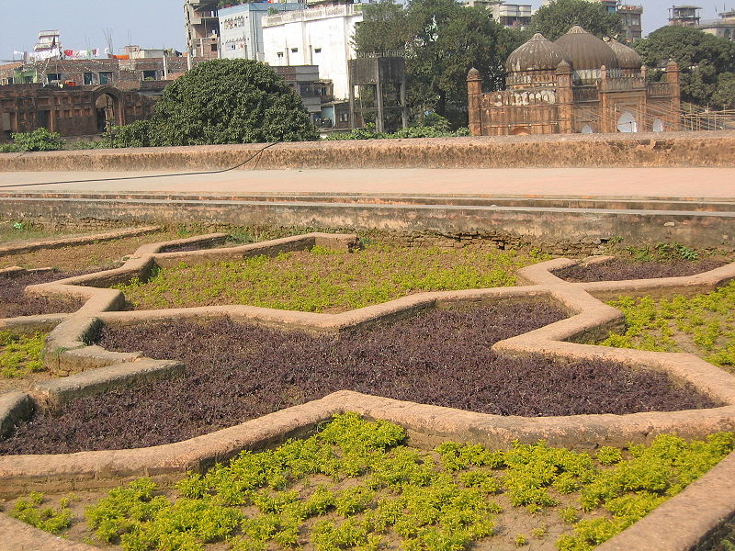
HOW DO PLANTS REDUCE TEMPERATURE?
Provide an alternative to common roof materials
Absorb CO₂ and sunlight during photosynthesis
Create shade

Slide 12
PHOTOSYNTHESIS
Photosynthesis: how plants feed themselves
Occurs in the leaves of plants
Represented by the equation:
Additional benefit: Photosynthesis helps reduce global warming by converting carbon dioxide molecules (a greenhouse gas)
Uses carbon dioxide and energy from the sun
Produces oxygen

Slide 13
CONSTRUCTING A ROOFTOP GARDEN

Slide 14
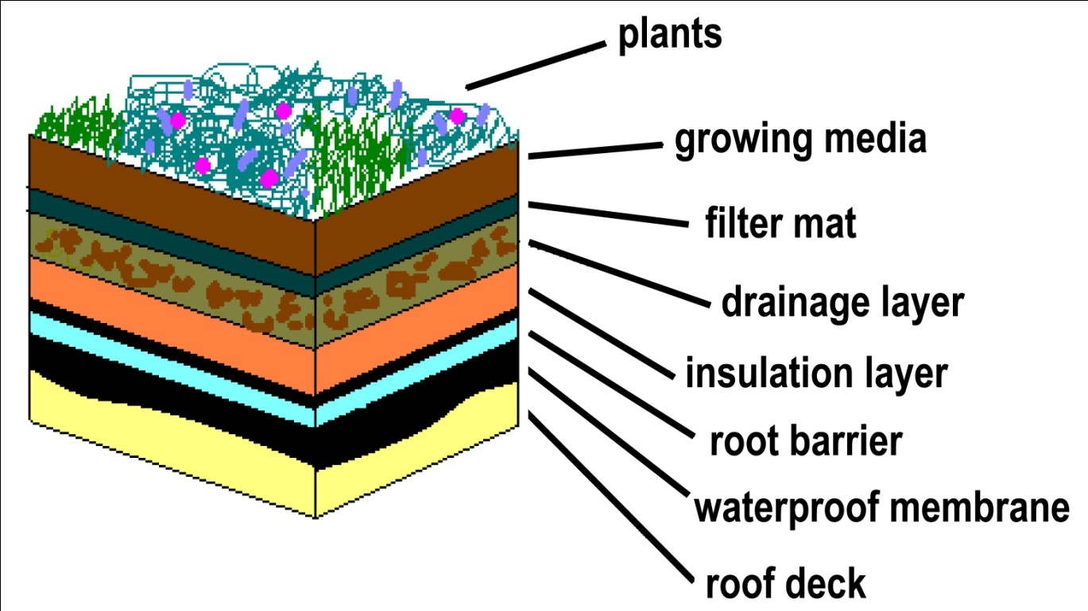
CONSTRAINTS OF A ROOFTOP GARDEN
Condition of the roof
Structural capacity of the roof
Access to the roof
Cost
Irrigation
Drainage

Slide 15
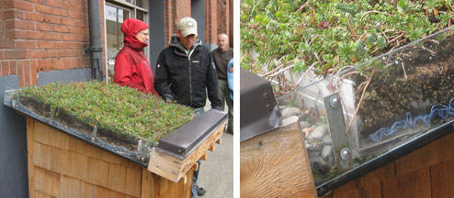
EXAMPLE
This demonstration plot on a sidewalk in Portland, OR, shows the exact composition of the “green roof” on the building above it.

Slide 16
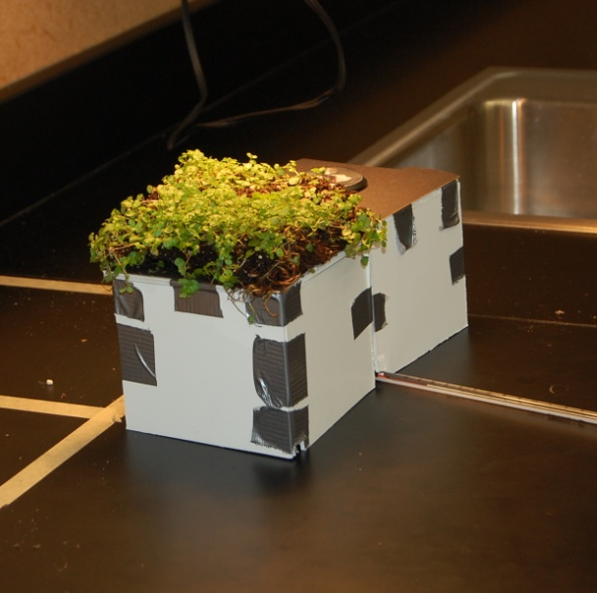
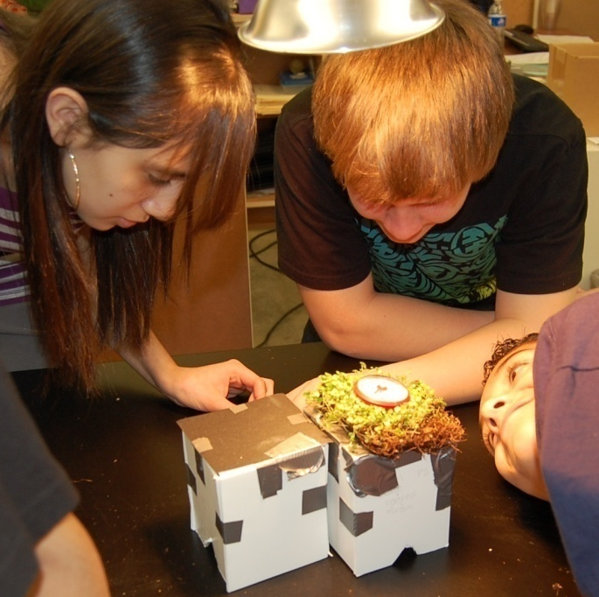
OUR ROOFTOP GARDEN PROJECT
TEAM OBJECTIVES:
Construct two identical model buildings
One with a black tar roof
One with a rooftop garden
Measure the temperatures inside and on the roof of the buildings while under a heat lamp (sun)
Graph the data

Slide 17
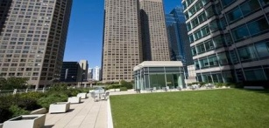
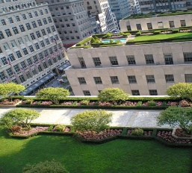
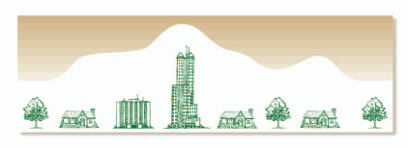
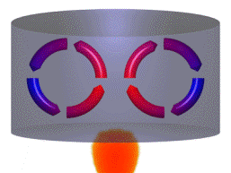
IMAGE SOURCES
Peter Halasz
http://commons.wikimedia.org/wiki/File:Oblique_rays_02_Pengo.svg
http://www.explorechicago.org/city/en/about_the_city/green_chicago/Green_Roofs_.html
Thingermejig
http://commons.wikimedia.org/wiki/File:Polyisocyanurate_insulation_boards.jpg
http://www.explorechicago.org/city/en/things_see_do/attractions/tourism/pepsico_rooftop_garden.html
http://commons.wikimedia.org/wiki/File:Rockefeller_Center_Rooftop_Gardens_by_David_Shankbone.JPG
Julo
http://commons.wikimedia.org/wiki/File:Lupa.na.encyklopedii.jpg
http://www.cityofchicago.org/content/dam/city/depts/doe/general/GreenBldsRoofsHomes/GuidetoRooftopGardening_v2.pdf
Sparkla
http://commons.wikimedia.org/wiki/File:Aluminium_foil_micrometer.jpg
http://commons.wikimedia.org/wiki/File:Cup_for_Heat_Conduction_2010-08-17.png public domain image)
CZ Martin
http://commons.wikimedia.org/wiki/File:1991_Cadillac_Fleetwood_gold-edition_black_vr.jpg
http://commons.wikimedia.org/wiki/File:Convection.gif

Slide 18
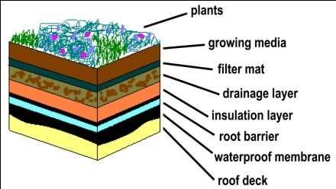
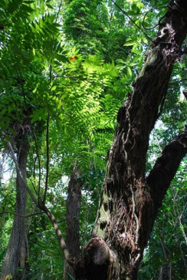
IMAGE SOURCES
http://commons.wikimedia.org/wiki/File:Prism.png
http://commons.wikimedia.org/wiki/File:Photosynthesis.jpg
Original uploader was Joeriee at nl.wikipedia. Original uploader was Rmstock at en.wikipedia
http://commons.wikimedia.org/wiki/File:Rooftop_Garden_in_Lalbagh_Fort.jpg
Carleigh Samson, ITL Program, College of Engineering and Applied science
http://commons.wikimedia.org/wiki/File:Rooftop_garden_NYC.jpg
Denise W. Carlson, ITL Program, College of Engineering and Applied science
http://commons.wikimedia.org/wiki/File:LEAVE_24_0314.jpg

