Slide 1
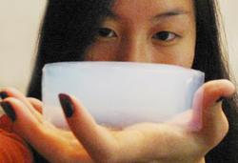
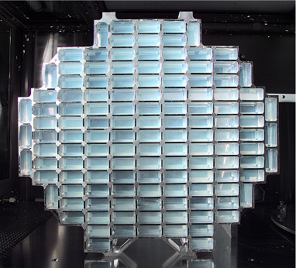
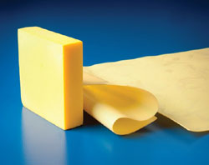
Welcome to the wonderful world of wonder materials: Aerogel
The lightest solid known to humans!
Notes:
Introduce aerogels to the class, as outlined in the Introduction/Motivation section.
Aerogel Presentation > The Amazing Aerogel lesson > TeachEngineering.org
Image sources:
(left) NASA https://solarsystem.nasa.gov/scitech/display.cfm?ST_ID=2
(middle, Stardust Collector): 2005 NASA via Wikimedia Commons http://commons.wikimedia.org/wiki/Aerogel#mediaviewer/File:Stardust_Dust_Collector_with_aerogel.jpg
(right) Glenn Research Center, NASA https://technology.grc.nasa.gov/featured-tech/aerogels.shtm

Slide 2
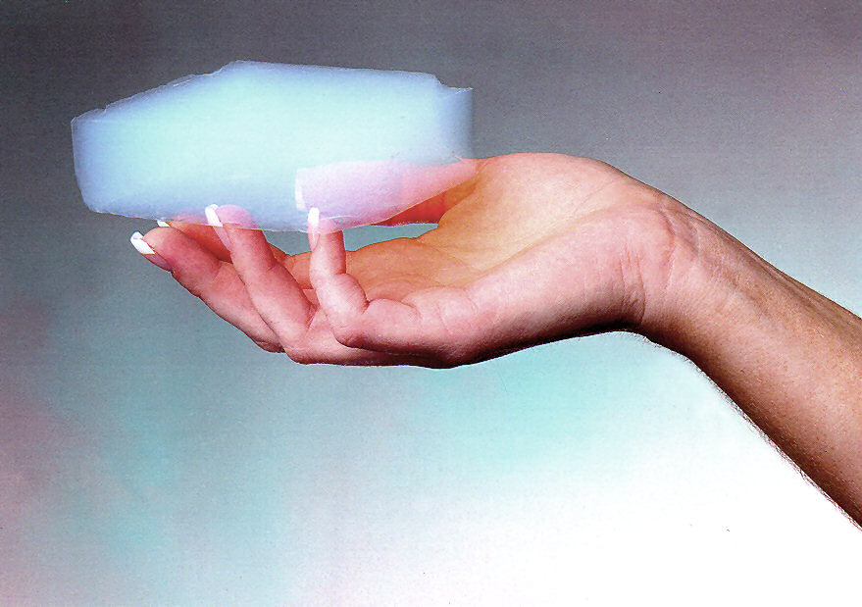
What is an aerogel?
aerogel: air solid
“aero” = air
“gel” = part solid and part liquid
Aerogels are created by removing moisture from a gel while maintaining the gel structure.
Though ghostly in appearance, aerogel is very solid and feels like hard Styrofoam to the touch.
Notes:
Aerogels are created by removing moisture from a gel while maintaining the gel structure. (For more advanced students: Aerogels are synthesized by removing moisture from a highly porous gel structure [commonly silica] and replacing the liquid with air or carbon dioxide.) So aerogel is a porous solid that is mostly air—more than 99% air. Aerogel is commonly a silica-based solid, often with the chemical formula, SiO₂ Do you know any other silica-based solids? (One common silica-based solid is sand, such as common beach sand.) In addition to those made of silica, other types of aerogels have been created, such as graphene and polyimide aerogels, and increasingly polymer-composite aerogels, which are aerogels mixed with a polymer. Though ghostly in appearance, aerogel is very solid and feels like hard Styrofoam to the touch.
Image source: NASA http://www.nasa.gov/multimedia/imagegallery/image_feature_449.html

Slide 3
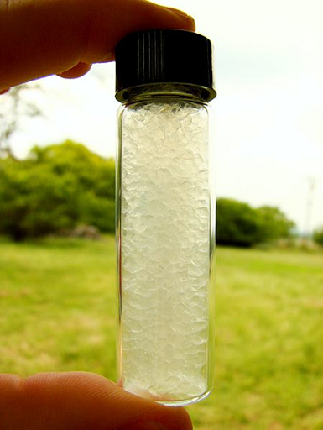
One of the highest surface area solids
Aerogel Properties
Notes:
Aerogels have very high surface areas. Surface area is the total area of the surface of a three-dimensional object. How would you calculate the surface area of a cube with two-inch edge-length sides? (The surface area of a cube is 6 × [edge length]².)
Image source: 2009 Zach from Gamboa, Panama, Wikimedia Commons http://commons.wikimedia.org/wiki/File:Aerogel_Vial.jpg

Slide 4
Has a density lower than any other known solid
Lightest solid in the world
Aerogel Properties
Notes:
Aerogels are known for their extreme low densities, which range from 0.0011 to ~0.5 g cm⁻³. What is density? Density is mass divided by volume. What are some examples of high- and low-density objects? The lowest density solid materials that have ever been produced are all aerogels!
Image source: JPL, NASA http://stardust.jpl.nasa.gov/images/guinnesscert.jpg

Slide 5
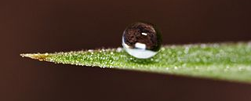
Hydrophobicity
Aerogel Properties
Notes:
Aerogels are often very hydrophobic. What do we mean by hydrophobic and hydrophilic? Tip: Consider the root words hydro- and phobic/phillic. Hydrophobic is a property of a substance to repel water, while hydrophilic is having a strong affinity for water. What are some examples? The photograph on the slide shows a drop of dew on a leaf; the surfaces of many leaves are hydrophobic.
Image source (dew drop on leaf): 2005 Michael Apel, Wikimedia Commons http://commons.wikimedia.org/wiki/File:Dew_2.jpg

Slide 6
Transparency
Aerogel is sometimes called “solid smoke” or “frozen smoke”
Aerogel Properties
Notes:
What do we mean by transparency? Transparency is “the property of transmitting light through a substance so the objects situated beyond or behind can be distinctly seen.” What are some examples of other materials and objects that are transparent? (Examples: Eyeglass lenses, drinking glasses, window glass, microscope lenses, thin films, etc.)
Before moving to the next slide (about translucency), ask students: What is the material characteristic that permits light to pass through, but diffuses the light? (See if anyone answers correctly: translucency.)
Image source: NASA http://spinoff.nasa.gov/spinoff2001/ch5.html

Slide 7
Translucency
NASA developed ways to create aerogels that are polymer-reinforced.
These aerogels are stronger and can be translucent.
Aerogel Properties
Notes:
Like transparency, light is able to pass through the surface. Unlike transparency, the light is diffused. The aerogel shown is translucent. Other examples are stained glass and foggy bathroom windows.
What do we mean by opaque? Opaque surfaces are not transparent or translucent, meaning all the light waves are either absorbed or reflected, and no light waves are transmitted. So you cannot see through opaque materials.
Image source: NASA http://www.nasa.gov/topics/technology/features/aerogels.html#.U7rR7BbMns8

Slide 8
Composite Aerogels
Plain slide aerogels (left) are so fragile that they break by a light finger press, whereas a cross-linked aerogel supports a load (middle). The mesoporous structure is maintained after cross-linking (right).
Notes:
Basic silica aerogels are often brittle and easily broken, so aerogel composites are often created to improve their characteristics to be more desirable.
Image source: NASA https://technology.grc.nasa.gov/documents/auto/Polyimide-Aerogels.pdf

Slide 9
Composite Aerogels
500 x stronger!
⬇
Aerogel Properties
Notes:
Notice in this photograph a piece of polyimide aerogel under the front wheel; it can withstand the weight of a car without being crushed. The new polyimide aerogels are designed to be much stronger—500 times stronger than conventional (more brittle) silica aerogels. This type of aerogel composite—a mixture of an aerogel and another compound—is strong, flexible and foldable.
Image source: Glenn Research Center, NASA https://technology.grc.nasa.gov/documents/auto/Polyimide-Aerogels.pdf

Slide 10
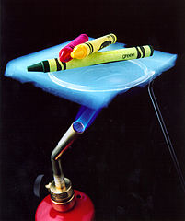
Lowest thermal conductivity
←Crayons on aerogel over a hot flame. The crayons are protected from the flame (no melting!)
Aerogels resist temperature change
Aerogel Properties
Notes:
This photo illustrates the excellent insulating properties of aerogel. An aerogel blanket held over a blue flame remains cool to the touch and keeps the crayons from melting. This is because aerogels have a very low thermal conductivity. That means they resist temperature change. For this reason, aerogels are often used as insulators. What are your ideas about where aerogels could be used for insulation purposes? (Possible answers: Beverage thermos, winter jacket, pipe insulation, etc.) Aerogel provides 39 times more insulation than the best fiberglass insulation.
Image source: NASA http://stardust.jpl.nasa.gov/photo/aerogel.html

Slide 11
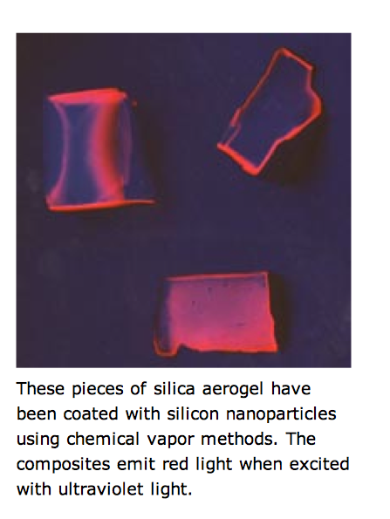
Composite Aerogels
Though aerogels are often made of silicon dioxide, SiO_{2,} many hybrid aerogels have been created.
Notes:
Aerogels are often mixed with various compounds to create composite aerogels, which may help to strengthen the aerogel or emit light, as in the photograph. These pieces of silica aerogel have been coated with nanoparticles using chemical vapor methods. The composites emit red light when excited with ultraviolet light.
Image source: Lawrence Berkeley National Laboratory, U.S. Department of Energy http://energy.lbl.gov/ecs/aerogels/sa-nano.html

Slide 12
Why are some aerogels blue?
Rayleigh scattering is the elastic scattering of light by particles much smaller than the wavelength of light.
Notes:
Aerogels have little particles or bubbles in them that scatter light. The term for this is “Rayleigh scattering,” which is defined as the elastic scattering of light by particles much smaller than the wavelength of light. As you can see in the graph on the screen, the highest percentage of scattering due to sunlight is in the blue range.
Image source: 2007 Robert A. Rohde, Wikimedia Commons http://commons.wikimedia.org/wiki/File:Rayleigh_sunlight_scattering.png

Slide 13
Why are some aerogels blue?
The sky, glaciers and some aerogels have tiny particles or bubbles that scatter light.
Blue scatters the most, so they all look blue.
Notes:
The sky, glaciers and some aerogels all have tiny particles or bubbles in them that scatter light; blue scatters the most, making them appear bluish.
Image source: JPL-NASA http://stardust.jpl.nasa.gov/photo/aerogel.html

Slide 14
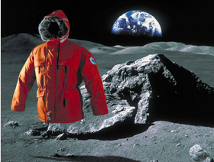
Great insulators
⬅Used as jacket insulation for wear in extremely harsh conditions
Provides thermal & acoustic insulation
 The NASA-developed aerogel material was incorporated into this jacket, which was tested during an Antarctic expedition
Aerogel material also used to insulate shuttles and aircraft
Aerogel Applications
Notes:
From all the remarkable materials properties exhibited by different types of aerogels, you can imagine that aerogels have been used and imagined for all sorts of applications. For example, since aerogels have very good insulation properties, it is used for thermal insulation in jackets, space suits, the Mars Rover and many other home and automotive applications.
Image sources: (both) NASA http://spinoff.nasa.gov/spinoff2001/ch5.html

Slide 15
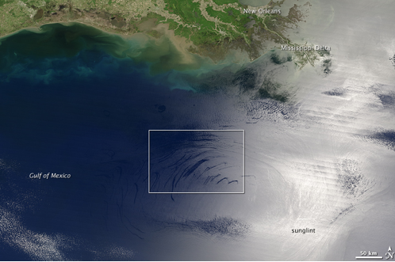
Chemical adsorber
For cleaning up oil and chemical spills
←An oil spill area in the Gulf of Mexico
Aerogel Applications
Notes:
Aerogels are also used to clean up chemical and oil spills.
Image source: NASA https://newsline.llnl.gov/_rev02/articles/2010/jul/07.23.10-gulf.php

Slide 16
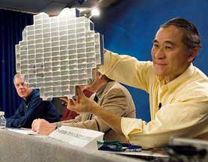
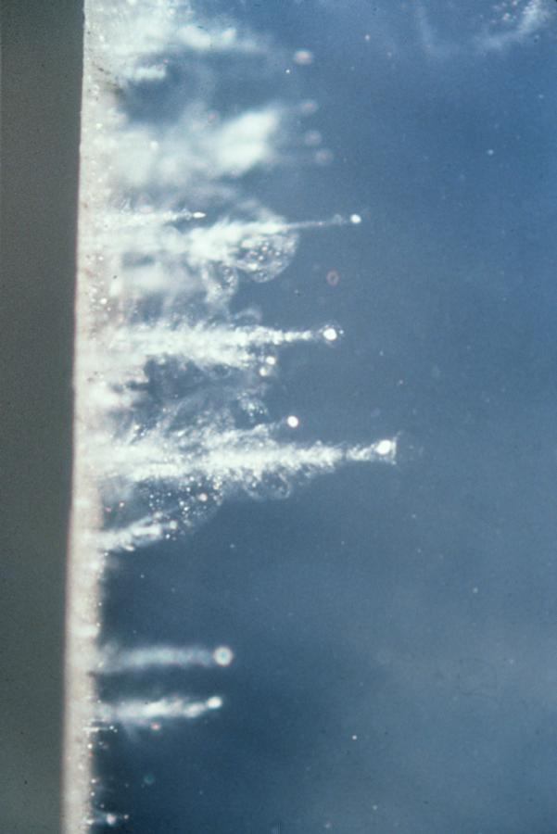
Stardust collector
NASA used aerogels in a device that collects dust samples (including ancient stardust and comet particles) in space
 ⬅
 ⬅
 ⬅
 ⬅
 
Trapped particles!
Aerogel Applications
Notes:
Stardust are the grains of dust formed around stars that pre-date our sun. Stardust travels more than 10,000 mph, explodes on impact with solids and zips through gases. So to collect these flying particles, NASA designed a stardust collector (left image) composed of aerogel blocks held in a device placed on a spacecraft; the aerogel traps the streams of interstellar dust encountered in space. When a particle hits the aerogel block, it buries itself in the material, creating a carrot-shaped track up to 200 times its own length (right image). The aerogel material slows down the sample and brings it to a gradual stop without damaging it. Since the aerogel used is mostly transparent—with a distinctive smoky blue cast—researchers can follow the little paths to find the tiny particles. Examination of the dust helps researchers investigate the origin of our Solar system.
Ask students to start thinking of their own ideas for good purposes to use aerogels. Hand out the worksheets and direct students to individually complete them.
Image sources:
(left) 2006 NASA http://www.nasa.gov/mission_pages/stardust/multimedia/jsc2006e01800.html
(right) NASA http://www.nasa.gov/images/content/3794main_aerogeltracks_browse.jpg

