Slide 1


Exploring Light & Health

Slide 2
Day One
Exploring Light & Health
Photos should preferably be a square - although horizontal or vertical are accepted

Slide 3
HEADER TYPE
Body copy goes here….
Use only Open Sans for the typeface.
Use only these colors: Black, White and...
How would you describe the function of the heart?
Before we dive in, let’s do a quick pre-assessment of what we know about the heart and its functions. Please jot down what you know about the heart on a sticky note.

Slide 4

Jobs of the Heart

Slide 5
Monitoring Our Hearts
Many adults in your life will visit the doctor every year. At these appointments, their blood will be tested. The blood tested can give many clues about heart health.
For one, high levels of “bad” cholesterol in the blood can be a sign of higher risk of having a heart attack. And other substances in the blood can point to heart failure or the risk of getting fatty deposits, called plaques, in the arteries.
But what if adults can’t always visit the doctors? Is there a way to monitor heart health at home?

Slide 6
HEADER TYPE
Body copy goes here….
Use only Open Sans for the typeface.
Use only these colors: Black, White and...
Jot & Post!
Your job right now:
Grab a sticky note.
Jot down any possible answers to how someone can monitor their hearth health at home.
Post it on the chart paper.

Slide 7
Let’s explore how biomedical engineers help keep people healthy by developing point-of-care devices.

Slide 8
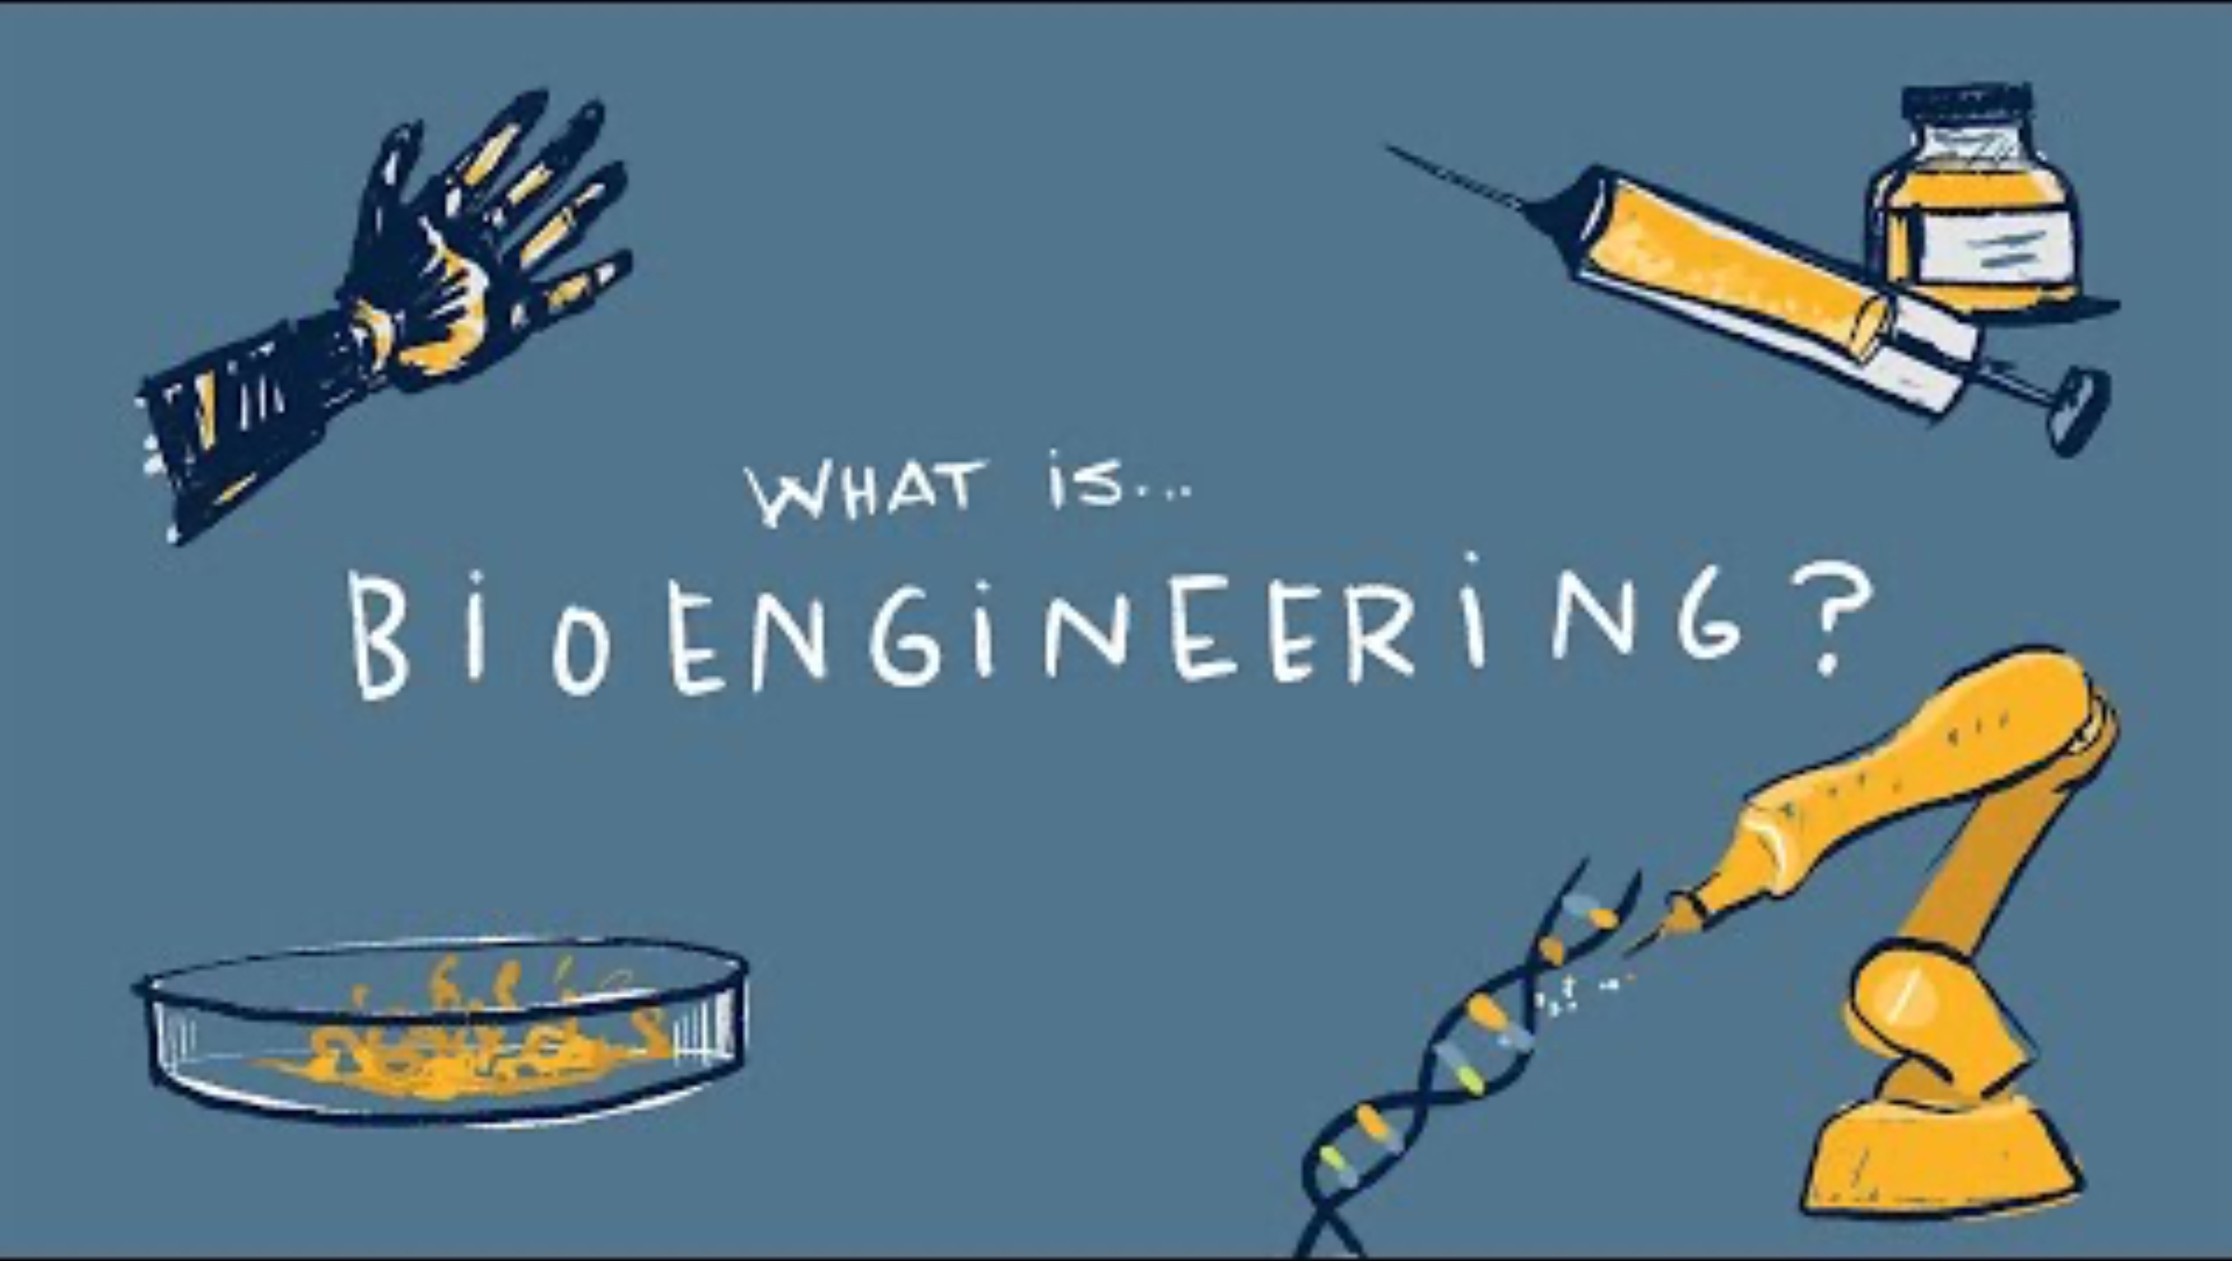
What Is a Biomedical Engineer?

Slide 9
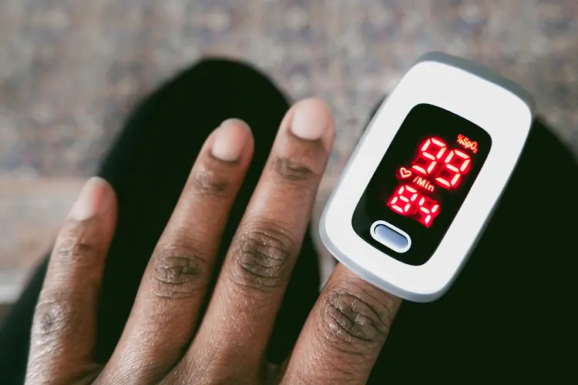
Point-of-Care Devices
A point-of-care device is a medical tool that allows people to get important health information right where they are, instead of needing to go to a hospital or lab.
These devices give fast results, often at home, in a clinic, or even out in the streets!!

Slide 10
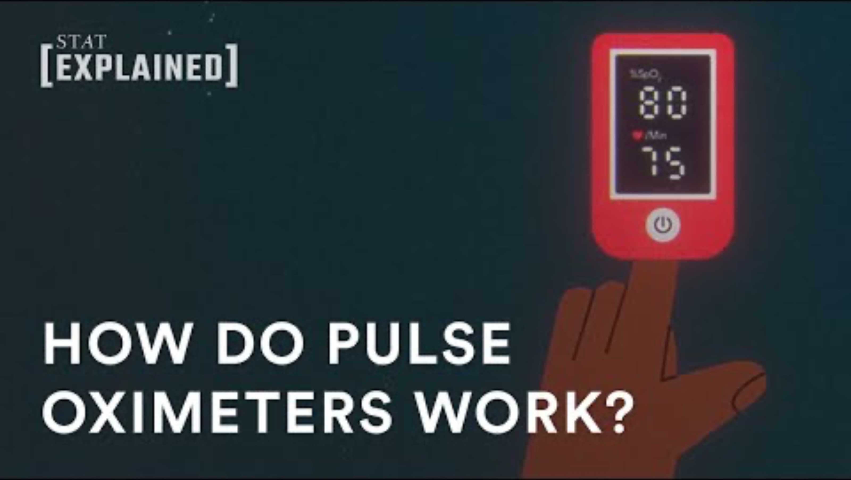
Let’s Learn How Light Is Used

Slide 11
HEADER TYPE
Body copy goes here….
Use only Open Sans for the typeface.
Use only these colors: Black, White and...
Let’s Try It!
The pulse oximeter clips onto your finger and shines light through your skin to measure how much oxygen is in your blood.
Why would this be important? Well, your blood carries oxygen from your lungs to your body. If your heart or lungs aren’t working properly, the oxygen level in your blood might drop, which could be dangerous.
The amazing part? This device uses just light! No needles, no blood, and it gives results in seconds!

Slide 12
HEADER TYPE
Body copy goes here….
Use only Open Sans for the typeface.
Use only these colors: Black, White and...
Now that we understand what point-of-care devices do and how engineers design tools like the pulse oximeter, we’re going to dig deeper.
We’ll look at how light and sensors work together to measure what’s happening in our bodies.

Slide 13
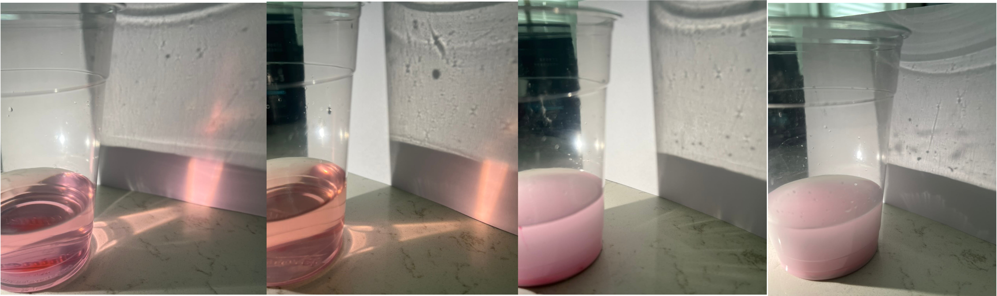
HEADER TYPE
Body copy goes here….
Use only Open Sans for the typeface.
Use only these colors: Black, White and...
When light hits something, like your skin or blood, it might go through it, bounce off, or get absorbed.
Engineers use these patterns to figure out what’s happening inside your body.

Slide 14
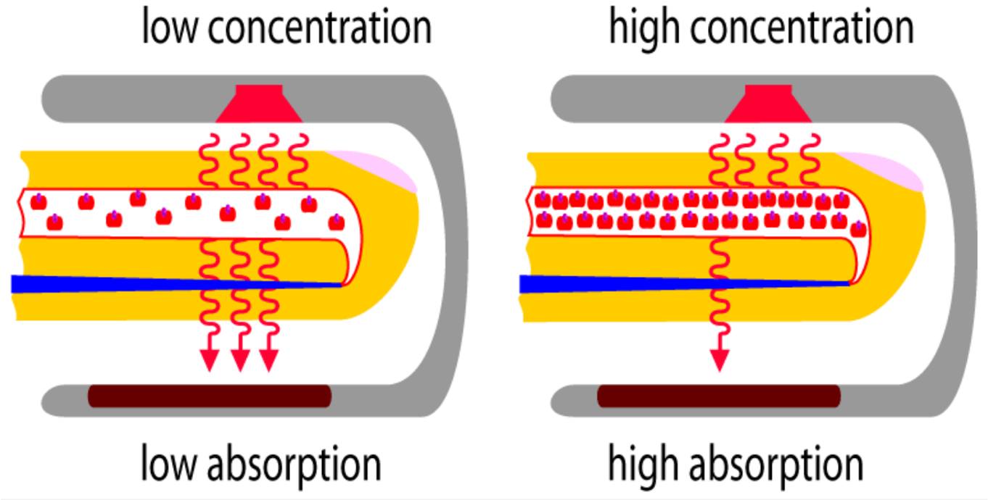
HEADER TYPE
Body copy goes here….
Use only Open Sans for the typeface.
Use only these colors: Black, White and...
Oxygen-rich blood absorbs red light differently than blood without much oxygen.
By comparing how much light gets through, a device can figure out how much oxygen is in your blood.

Slide 15
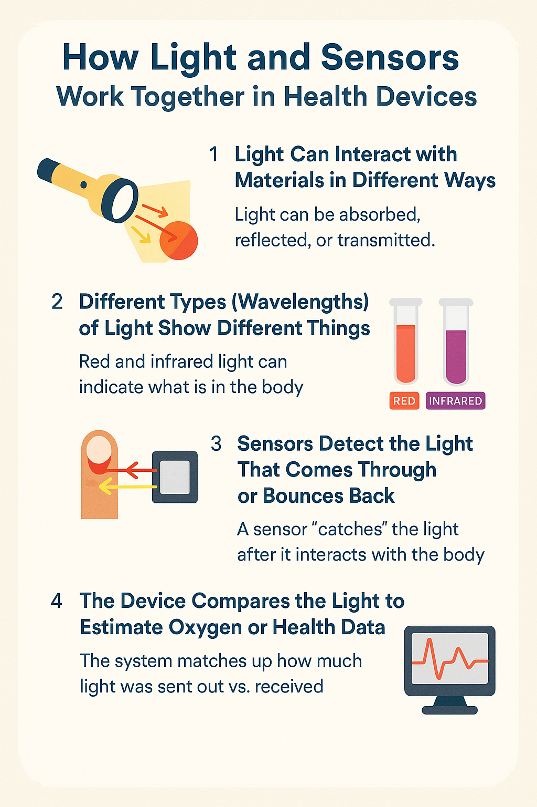
HEADER TYPE
Body copy goes here….
Use only Open Sans for the typeface.
Use only these colors: Black, White and...
Instead of needles or big machines, engineers use light and sensors to make health tools you can use at home or on the go.
Next, you’ll get to be the engineer and design a tool that works the same way!

Slide 16
Day Two
Exploring Light & Health
Photos should preferably be a square - although horizontal or vertical are accepted

Slide 17

Let’s Review!

Slide 18
HEADER TYPE
Body copy goes here….
Use only Open Sans for the typeface.
Use only these colors: Black, White and...
Engineering Challenge!
Your task is to design a light-based diagnostic tool that can distinguish between at least two different mixtures that simulate blood. These mixtures will vary in color or opacity to represent different oxygen levels; for example, bright red could mean oxygen-rich blood, and dark red or purple could mean oxygen-poor blood.
You’ll use materials such as flashlights, clear containers, colored liquids, and paper or cardboard to build a system that shines light through the sample and detects how much light gets through.
You’ll work in teams and follow the engineering design process to plan, build, test, and improve your device.

Slide 19
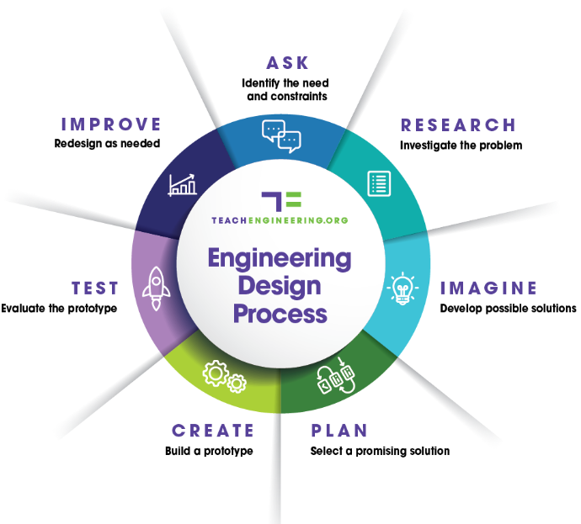
HEADER TYPE
Body copy goes here….
Use only Open Sans for the typeface.
Use only these colors: Black, White and...
Engineering Design Process

Slide 20
HEADER TYPE
Body copy goes here….
Use only Open Sans for the typeface.
Use only these colors: Black, White and...
Challenge Parameters:
1. Use a light source (flashlight).
2. Your device must allow light to pass through the sample container.
3. Include a detection method (e.g., a sensor area, a marked screen, or even your own eyes) to observe differences in light intensity.
4. You must test at least two “blood” samples and record your results.
5. Your design must be safe, non-invasive, and reusable for multiple tests.

Slide 21
HEADER TYPE
Body copy goes here….
Use only Open Sans for the typeface.
Use only these colors: Black, White and...
Success Criteria:
Effectiveness: It can clearly show a difference between at least two sample types based on how light passes through.
Accuracy: The way you measure or observe the light must be consistent and repeatable.
Creativity & Design: Your system is thoughtfully constructed, easy to use, and safely handles the samples.

Slide 22
HEADER TYPE
Body copy goes here….
Use only Open Sans for the typeface.
Use only these colors: Black, White and...
Engineering Design Process: Imagine
Brainstorm possible designs:
What are we trying to detect or measure?
How will our device shine light through the sample?
Can we measure how much light gets through, or how much is blocked?
How will we hold the sample and the light in place?

Slide 23
HEADER TYPE
Body copy goes here….
Use only Open Sans for the typeface.
Use only these colors: Black, White and...
Engineering Design Process: Plan
Your group should now sketch your design and create a plan, identifying:
What materials you will need.
How you will keep everything safe and secure.
What role each person in the group will take on.
How you will know if your design works.

Slide 24
HEADER TYPE
Body copy goes here….
Use only Open Sans for the typeface.
Use only these colors: Black, White and...
Engineering Design Process: Create
Once your group has a plan, build your device according to your plan.

Slide 25
HEADER TYPE
Body copy goes here….
Use only Open Sans for the typeface.
Use only these colors: Black, White and...
Engineering Design Process: Test & Improve
Test your device with the blood samples.
How did your device work?
What improvements would you make?
Make improvements to your device and retest.
Did your improvements help?

