Slide 1
Sedimentation and the ESR Test
A Simple and Useful Separation Technique
Notes:
Sedimentation and the ESR Test Presentation, Diseases Exposed: ESR Test in the Classroom activity, TeachEngineering.org

Slide 2
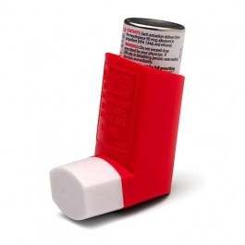
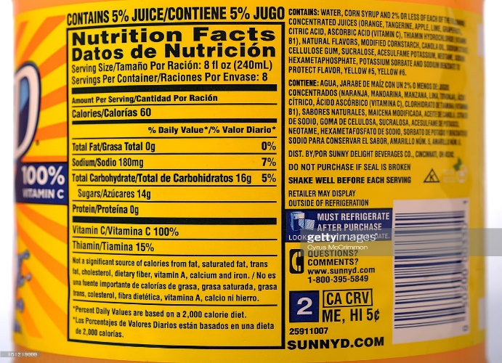
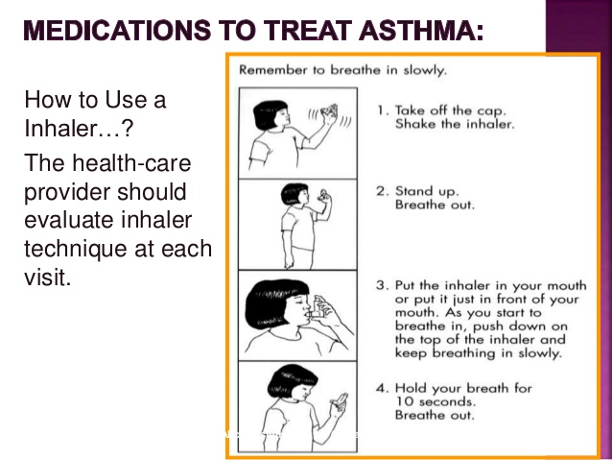

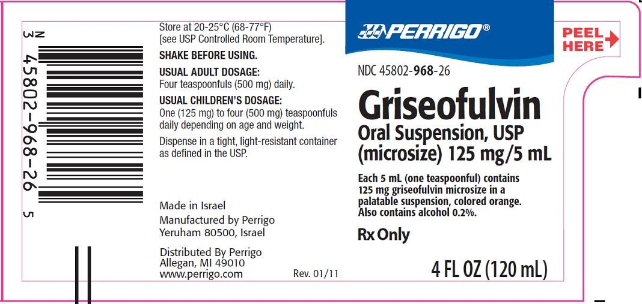

Why do we need to shake well before serving or using?
We are always told to shake juice bottles before serving.
This is printed as label instructions.
Shake it up!
“Natural juice products settle.
Shake well before serving.“
“Shake it up!” instructions for soymilk, inhalers and oral suspensions.
Notes:
Image sources: Reproduced with permission for educational purposes only.
Orange juice label: http://www.gettyimages.in/detail/news-photo/smart-money-story-on-comparing-nutritional-labels-on-two-news-photo/161219999 and http://www.gettyimages.in/license/161219999
Carrot juice label: http://www.coroflot.com/shellyjmlarson/Tobys-Family-Foods
Inhaler: Pharma Products
Soymilk: Tesco products http://www.tesco.com/groceries/product/details/?id=256438810
Oral Suspension: Perrigo New York Inc. https://dailymed.nlm.nih.gov/dailymed/fda/fdaDrugXsl.cfm?setid=b394ee74-53e5-493a-8ed9-95d3e8a10e88&type=display

Slide 3
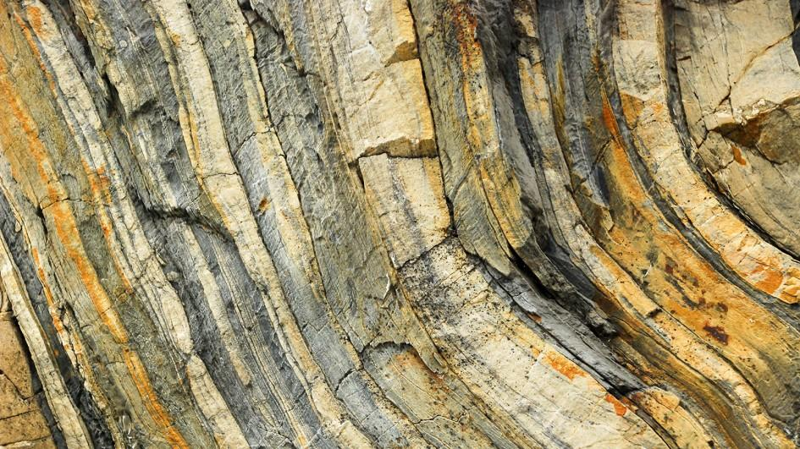

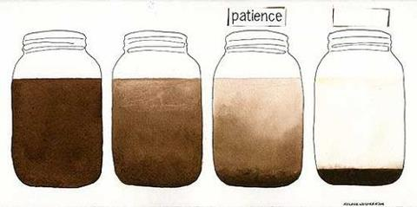
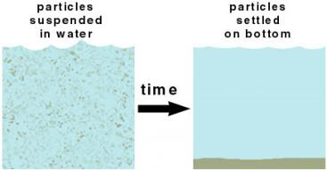

What is sedimentation?
Look at sedimentary rocks and deposits:
What is suspension?
Define suspension using these words:
mixture, standing, gravity, settle, one or more, heterogeneous, solvent, solutes, down, liquid
Check your answer
A suspension is a solution-based heterogeneous mixture that includes a liquid solvent and one or more solutes; upon standing, some or all of the solutes in the suspension separate from the liquid and settle down due to gravity.
What is settling?
Figure 2. Sedimentary rocks. Reproduced with permission from National Geographic.
The sedimentation process is very important in the industrial world for processing related to food, beverages, pharmaceuticals, paper and pulp, and clean water industries.
Sedimentation is a separation technique in which insoluble solute particles settle out of a heterogeneous solution upon standing due to the influence of gravity. The settled-out particles deposit at the bottom of the container as sediment.
Sediment
Figure 1. Sedimentation of muddy water.
As turbid water is left to stand, the mud settles out due to sedimentation and water clarifies on its own due to the Earth’s gravitational force.
Sedimentation Technique Advantages
Simple
Low-cost separation method
Does not involve any energy supply
No complex skill required
The deposit particles move closer together.
More liquid leaves the deposit.
The deposit thickens (packing).
Figure 3. Sedimentation Process. Source: Rachel Casiday, et al. (1999) Reproduced with permission.
Figure 4. Decantation.
Source: Oresom Resources Reproduced with permission.
Notes:
Image sources: Reproduced with permission for educational purposes only.
Figure 1: Muddy water settling: https://cleardone.files.wordpress.com/2014/01/muddy-water-is-best-cleared-by-leaving-it-alone.jpg
The Tad Principle, MeditationShift. http://www.thetadprinciple.com/daily-musings/muddy-water-mental-noise-and-alan-watts and https://cleardone.files.wordpress.com/2014/01/muddy-water-is-best-cleared-by-leaving-it-alone.jpg
Figure 2: Sedimentary rocks: National Geographic http://kids.nationalgeographic.com/explore/science/geology-101/#geology-sedimentary.jpg
Figure 3: Sedimentation process graphic: Reproduced with permission. Rachel Casiday, et al. (1999) http://www.sswm.info/glossary/2/letters and http://www.slideshare.net/bharathpharmacist/bo-dand-sewage-39685820 [see slide 54]
Figure 4: Decantation graphic: Oresom Resources. Reproduced with permission. http://www.oresomeresources.com/resources_view/resource/experiment_decantation_experiment

Slide 4
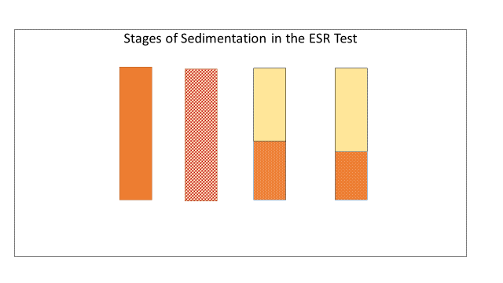
From macro-sedimentation to micro-sedimentation
Diseases causing low ESR
Polycythemia
Abnormal proteins
Sickle-cell anemia
Leukocytosis
The sedimentation process can also occur at a small scale. For instance, a micro-level sedimentation process is used in the medical world as a clinical blood test. In hospitals around the world, 3 to 4 billion blood sedimentation tests are done every day. How does it work?
Diseases causing high ESR
Inflammation
Infection
Cancer
Anemia
Autoimmune disorders such as:
  Temporal arteritis
  Polymyalgia
  Rheumatoid arthritis
Blood sedimentation in an important clinical test, called the ESR test
Table 1. Diseases that cause high or low ESR. Source: Macolm Brigden, 1999.
Blood Sedimentation
Blood is a heterogeneous solution mixture and red blood cells (aka erythrocytes) are a major insoluble solute in blood. So red blood cells sediment, which is called erythrocyte sedimentation. The time that it takes the red blood cells to sediment is called the erythrocyte sedimentation rate (ESR).
The ESR value is of great clinical significance because its numerical value is affected by blood composition changes. Since diseases generally alter blood’s composition, the ESR value of blood from a sick person is different from that person’s normal ESR value.
What do you think the ESR value would be for different diseases and illnesses?
Will it be the same or different?
3 Stages of Erythrocyte Sedimentation:
In the first 10 minutes, red blood cells stack over each other, called aggregation—a slow step. In the next 40 minutes, the aggregated erythrocytes settle down rapidly. In the third and final stage, lasting about 10 minutes, packing occurs—a very slow step. The 4 tubes in Figure 5 show ESR at different time intervals.
To understand blood sedimentation better, watch https://www.youtube.com/watch?v=gwsNcC4ZFHw
What difference do you notice between the sedimentation in the two glitter bottles?
The sedimentation rate can be different for different solutions.
In hospitals, the ESR test is done using Wintrobe and Westerngren tubes. The tubes are similar and give equally precise results. However, Westerngren tubes are more widely used than Wintrobe tubes, which seems to be more of a manufacturing choice. See details on slide 9.
Figure 5. ESR stages (l to r) t (min) = 0; t = 10; t= 40; t = 60
Notes:
Show the Hush Video (glitter bottles; 1:55 minutes) to illustrate the sedimentation of a solution composed of fine glitter, clear gel glue and water in a bottle. (Note: the video was made for the purpose of calming down young children in time outs.)
Video at YouTube at https://www.youtube.com/watch?v=gwsNcC4ZFHw
Glitter settles slowly in the bottle containing more glue.
The fall rate is different for different solutions and that is why the ESR value is different for different disease conditions.
Glitter bottle instructions at http://www.inlieuofpreschool.com/hush-bottles-the-calm-down-solution/
Data and image sources:
Table 1 data: Diseases that cause high or low ESR from Brigden, 1999, Clinical Utility of the Erythrocyte Sedimentation Rate (paper).
http://www.aafp.org/afp/1999/1001/p1443.html
Figure 5: ESR stages © 2016 Renuka Rajasekaran, Georgia Institute of Technology

Slide 5
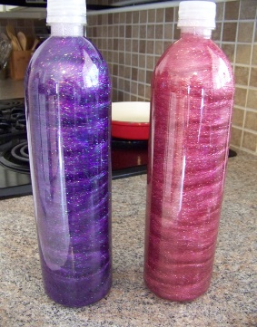
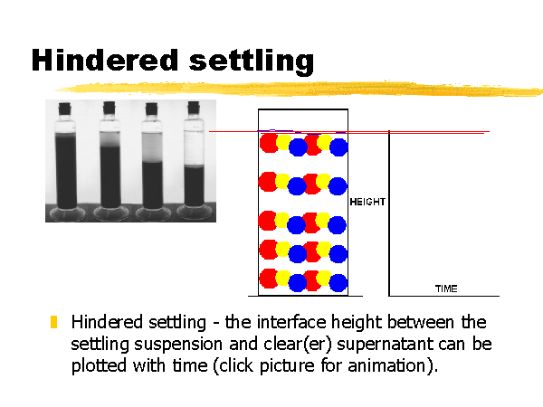
Resistance to settling: Plasma and erythrocyte factors
Watch the glitter bottle video again to take a closer look at the sedimentation process of the glitter.
Next, watch a sedimentation animation video to see the influence of the quantity of particles on the rate of sedimentation in more detail (watch up to 1:21 seconds only) https://www.youtube.com/watch?v=E9rHSLUr3PU
What materials could you use in place of glue? Consider the following:
Glycerin
Xanthan gum
Starch solution
Corn syrup
Honey or maple syrup
Vinegar
Lemon juice
Two kinds of settling:
Unhindered settling takes place when the particle
concentration is low. It is slower.
Hindered settling
when the particle
concentration is high.
It is faster.
Clues to help you answer the question:
Glycerin is thicker than water. It increases density and viscosity.
Xanthan gum is a glue. It increases density and viscosity.
Starch solution forms a colloidal solution. It increases density and viscosity.
Corn syrup, honey and maple syrup are soluble in water, so they increase the water density; whether they will considerably increase the viscosity of water to simulate glue in water depends on the concentration. At higher concentration, they could simulate glue.
Vinegar and lemon juice will not simulate glue because they are ionized, quickly dissolving materials that do not form colloidal solutions.
Hindered Settling
Figure 6. Hindered settling. The interface height between the settling suspension and the clear supernatant can be plotted over time. Reproduced with permission from
https://www.youtube.com/watch?v=E9rHSLUr3PU
Now, let’s revisit the question:
Glycerin: Yes
Xanthan gum: Yes
Starch solution: Yes
Corn syrup: Yes and no
Honey or maple syrup: Yes and no
Vinegar: No
Lemon juice: No
Notes:
By watching the glitter bottles video again and more closely for 25 to 30 seconds, students affirm that the solvent in the right bottle is resisting the fall of glitter, compared to the solvent in the left bottle. Glitter settles slowly in the bottle containing more glue.
If students ask, explain that xanthan gum is fermented corn sugar by a bacterium called xanthomonas campestris.
Image sources:
Two glitter bottles: Nlieu Opreschool, “Hush Bottles.” Used with permission. https://www.youtube.com/watch?v=gwsNcC4ZFHw
Sedimentation animation video: Sedimentation by Richard Holdich https://www.youtube.com/watch?v=E9rHSLUr3PU
Figure 6: Hindered settling graphic: Richard Holdich. Reproduced with permission. https://www.youtube.com/watch?v=E9rHSLUr3PU

Slide 6
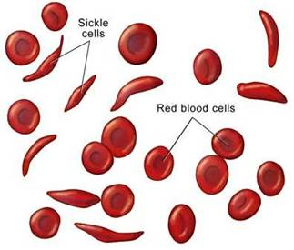
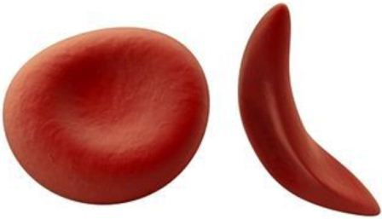
The influence of particle size and shape
Sickle-cell anemia is an inherited disease in which a person’s red blood cells are disc-shaped—like donuts with no holes. We expect the ESR of sickle-cell anemia blood to be lower than the normal value because the sickle cells will not settle quickly and tend to stay in the plasma.
Watch this video to learn more about sickle-cell anemia:
http://vikaspedia.in/health/diseases/genetic-disorders/sickle-cell-disease
Explore which would settle faster:
Normal erythrocytes or sickle cells?
A clue is given in Figure 10 (on slide 9).
The fastest settling particles are larger, heaver, spherical molecules because the sphericity of sedimenting particles is an important condition for good sedimentation. (Wadell, 1935)
The slowest settling particles, which sometimes cannot be settled accurately or properly, are tinier, lighter, and/or irregularly shaped molecules.
For everything in between, a general guide to characteristics that increase sedimentation rate:
Question: In the glitter bottles, what could you have done differently with the glitter (not the solutions) to speed up the fall?
Consider the following scenarios:
Figure 7. General distortions seen in the shape of erythrocytes forming sickle cells. Source: California Baptist University. Reproduced with permission.
Spherical or near-spherical particles
Heavy particles
Dilute slurries
Particles whose diameter does not rival that of the container
Flocculation or "clumping" of particles into spherical shapes
Auto coagulation due to chemical traits inherent in the particle
Increase the glitter particle size.
Decrease the glitter particle size
Use a mix of bigger and smaller glitter particles
Use sequins of moon shape mixed with the glitter.
Add some starch powder to the solution
Figure 8. Blood cell shape distortion is accompanied by reduced mass (less hemoglobin) and lesser density of the erythrocyte.
Source: Vikaspedia. Reproduced with permission.
Notes:
Teacher notes:
1) Reinforce the influence of gravity on larger vs. smaller and heavier vs. lighter particles and correlate it to the rate of fall and sedimentation.
2) Play the video and stop it at precisely 1 minute and 20 seconds: http://vikaspedia.in/health/diseases/genetic-disorders/sickle-cell-disease
3) If necessary, explain that a slurry is a slimy semi-liquid mixture of fine insoluble particles suspended in water. For example, a corn starch slurry is used to thicken gravy and a cement slurry is used to pave roads. The main point: in a slurry, the solute particles like to stay with water and do not like to settle out.
4) If needed, use/discuss the diagrams for sphericity from the following source: Wadell, Hakon (1935) "Volume, Shape and Roundness of Quartz Particles." Journal of Geology, vol. 43, no. 3, pp. 250–280. doi:10.1086/624298
5) As needed, discuss density and viscosity in adequate details.
Image sources:
Figure 7: Shapes of red blood cells and sickle cells: The Pulse, California Baptist University. Reproduced with permission. http://blogs.calbaptist.edu/alliedhealth/tag/sickle-cell-disease/
Figure 8: Two blood cells, different shapes: Vikaspedia. Reproduced with permission. http://vikaspedia.in/health/diseases/genetic-disorders/sickle-cell-disease
Text reference: Wadell, Hakon. (1935) “Volume, Shape and Roundness of Quartz Particles." The Journal of Geology, Vol. 43, No. 3: pp. 250–280. DOI:10.1086/624298. https://www.jstor.org/stable/30056250?seq=1#page_scan_tab_contents

Slide 7
Exploring cause and effects
In the glitter experiment, what could you have done with the glitter (not the solutions) to speed up the fall? Consider the following scenarios:
Yes. I could have done this! Hindered settling is promoted.
No! This would not work! Smaller particles do not settle out.
This would work, but the sedimentation rate would not be high! Although hindered settling is promoted.
No! This would not work! Lack of sphericity.
No! This would not work! Starch would mix with water, increasing the solution’s density and viscosity; however, if too much starch is added, all glitter will settle because the starch would pull them all down.
Increase the size of the glitter particles
Decrease the size of the glitter particles
Have a mix of bigger and smaller glitter particles
Have sequins of moon shape mixed with the glitter
Add some starch powder to the solution
Another reason for particles not settling is the charge on particles: Generally, in water medium, particles are negatively charged. Because of the repulsion of charge on the particles, the particles stay dispersed.
Outcomes of the circumstances:
Sedimentation is not effective if vibrated, so avoid vibrations.
Sedimentation is not effective in a slanted position, so keep vessels upright at 90 degrees.
Sediment will get hardened soon and will alter the rate of sedimentation, so avoid high temperatures
Let’s explore these circumstances:
You constantly vibrate the desk on which you placed the bottle for sedimentation:
Will the sedimentation be effective or not?
You keep the tube/bottle in a slanted position:
Will the sedimentation be effective or not?
You keep the bottom of the tube immersed in warm water: Will the sediment harden or not?
Summary: Three factors that affect sedimentation:
1) fluid factors, 2) particle factors, and 3) mechanical factors
To investigate sedimentation, we avoid interference of mechanical factors and carry out the sedimentation in vibration-free upright containers and do not increase the temperature.
Notes:
Reinforce that vibration, inclination and heating need to be avoided during ESR tests.

Slide 8

The laboratory investigation: ESR test in the classroom
In the ESR test:
Fluid factors = plasma factors
Particle factors = erythrocyte factors
Use the handout as a guide for doing the lab. It includes instructions on how to prepare the blood models that corresponding to normal blood and four diseased blood models for rheumatoid arthritis, anemia, leukocytosis and sickle-cell anemia.
All the solutions and apparatus needed to do the lab are at the lab bench at each lab station.
Prepare the model blood samples by mixing the different specific ingredients.
As soon as you have prepared a blood model that corresponds to a disease, conduct its ESR test by leaving it undisturbed for 60 minutes in a test tube stand.
At the 60th minute, be ready to measure the ESR!
Working in groups of five, prepare five blood sample models:
1 represents normal blood
2 have low ESR disease condition
2 have high ESR disease conditions
During the 60 minutes when the ESR sedimentation is taking place, work on the following assessment activities:
Post-Lab Quiz
Answer the post-lab inquiry questions. Feel free to use the slide notes printout and web searches.
Homework
Answer the two free-response questions about clinical engineering careers. You are strongly encouraged to do Internet research to answer the questions.
Your lab station tray includes the following materials used to represent different blood components :
Fibrous tomato drink/V8
Olive oil
Butter
Petroleum jelly
Beet extract
Starch solution
Beet shaving
Plus: 5 graduated test tubes with screw caps, droppers, tweezer and test tube stand
  Simulation Protocol:
  Erythrocytes = fibrous tomato (V8 drink)
Plasma = olive oil
Globulins = butter
Fibrinogen = petroleum jelly
Reduced protein condition = beet extract
White blood cells = starch solution
Sickle cell = beet shavings
Notes:
Image source: (clock) 2006 FreeImages.com/Toni Mihailov http://images.freeimages.com/images/previews/b28/clock-1196246.jpg

Slide 9
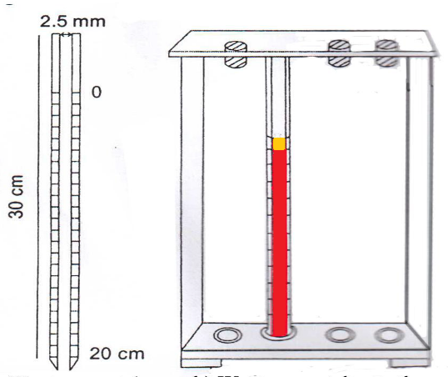
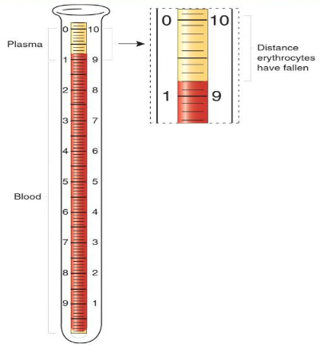
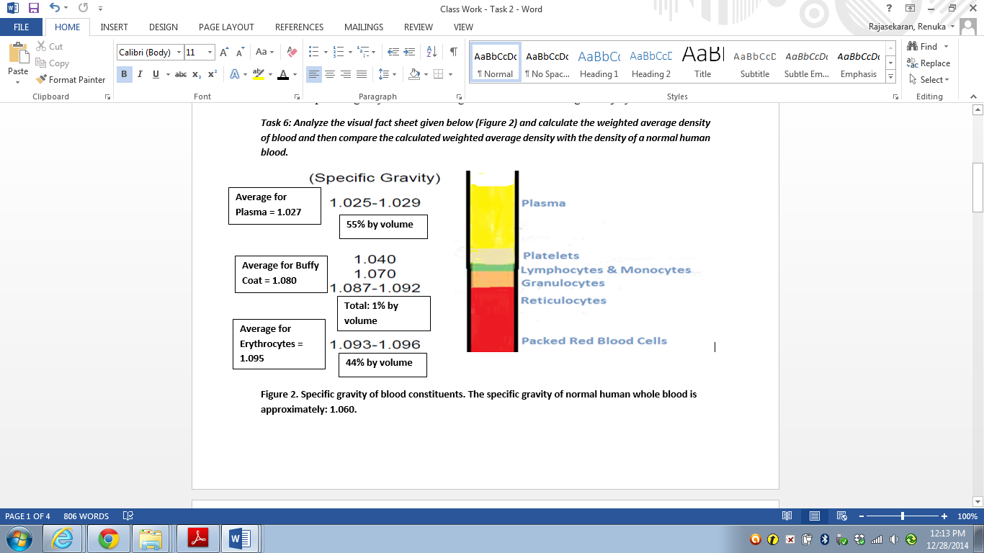
Real-world, relevant work
In a typical ESR test, a small sample of blood is placed in a very thin and long test tube, called an ESR tube. Before placing the blood in the tube, the tube is internally coated with an anticoagulant that prevents blood clotting. This is done because blood clotting interferes with sedimentation. In your lab, it is not necessary for you to add any anti-coagulant because we’re not using real blood.
Then the tube with the blood is left to stand in a rack/stand on a vibration-free flat surface. After 60 minutes, the plasma height, which has clarified over the erythrocyte sediment, is measured in millimeters (mm).
Two kinds of tubes are used for ESR tests (see Figure 9). The tubes are the same except for the dimensions. The Wintrobe tube is smaller in diameter than the Westergren tube. Both tubes can be used with or without stoppers. As shown in Figure 10, the specific gravity of erythrocytes causes them to settle out of solution (fall down) due to gravity.
An ESR tube is 250–350 mm long with an internal diameter of 2.5–3.5 mm. The tube is graduated with marks from zero to 200 mm (or 20 cm) so researchers can measure the height of the plasma that clarifies from the sediment. The small diameter and length require only a very small amount of blood. The tube dimensions also help the sedimentation to be completed within one hour.
The ESR test is so convenient and easy to perform and needs only small amounts of blood that doctors use the test as a baseline and follow-up monitoring tool to determine the success of medications and other treatments.
Figure 9. Westerngren (left) and Wintrobe (right) ESR tubes.
Source: 2016 Giri Dhurba. Reproduced with permission.
Figure 10. Percent composition and specific gravity of separated layers of blood. The average specific gravity of normal human blood is 1.060.
Source: Theresa Stec. Reproduced with permission.
Notes:
Image sources:
Figure 9 Westerngren tubes (left) and Wintrobe tubes (right): 2016 Giri Dhurba. Reproduced with permission. http:/laboratoryinfo.com/esr/
Figure 10: Percent composition and specific gravity of separated blood layers. The average specific gravity of normal human blood is 1.060. This fact sheet was adapted with permission from Stec, Theresa C. "What is in the Bag?" Accessed December 2014. (34-slide PDF file; an overview of blood and blood products) http://c.ymcdn.com/sites/www.apheresis.org/resource/collection/387FC8D3-D586-4DC2-A60D-EA1A83285A68/Fri_1515._2_ES_V_Stec_Seacliff_A_&_B_update.pdf, page 19.

Slide 10
Lab materials and instructions for ESR tests
Materials List: Your lab tray contains:
Containers of the following prepared solutions, each with a graduated plastic dropper:
  Tomato juice drink (such as V8)
  1% solution of petroleum jelly in olive oil
  1% solution of unsalted butter in olive oil
  0.5% solution of unsalted butter in olive oil
  5% rice starch solution
  Beet extract containing salt
A cup containing beet shavings and a tweezer
5 clean, dry, graduated 20- or 25-ml test tubes with screw caps
Test tube stand (not needed if using measuring cylinders)
Normal blood model
In a graduated test tube with screw cap, mix 4.5 ml of V8 drink, 5.5 ml of olive oil containing 1% petroleum jelly.
Rheumatoid arthritis blood model
In a graduated test tube with screw cap, mix 4.5 ml of V8 drink, 5.0 ml of olive oil containing 1% petroleum jelly and 0.5 ml of olive oil containing 0.5% butter.
Anemia blood model
In a graduated test tube with screw cap, mix 3.0 ml of V8 drink, 6.0 ml of olive oil containing 1% petroleum jelly, and 1.0 ml of olive oil containing 1.0% butter.
Leukocytosis blood model
In a graduated test tube with screw cap, mix 4.0 ml V8 drink, 5.5 ml of olive oil containing 1% petroleum jelly, and 0.5 ml of 5% starch solution.
Sickle-cell anemia blood model
In a graduated test tube with screw cap, mix 2.0 ml V8 drink, 2.0 ml beet extract, and, using very small tweezers, a very small amount of beet shaving. Shake well and add 5.5 ml of olive oil containing 1% petroleum jelly.
Instructions: Mix each blood model solution according to the instructions (➔). Then, cap its test tube, shake the sample well and place it in the test tube stand for 60 minutes on a flat surface with no vibrations or disturbances nearby. At the 60th minute, note the height in cm of the clear liquid above the top of the sediment. Clues to check your ESR results:
The normal ESR value is 18 ± 3 mm
Normal blood < rheumatoid arthritis < anemia
Normal blood > leukocytosis > sickle-cell anemia

Slide 11
Why is the ESR value altered depending on blood conditions?
ESR test background information
Some references to help in answering the post-lab quiz questions:
What is an ESR test? (2:08-min video) https://www.youtube.com/watch?v=wwW1sZ4utag
How is an ESR test done? (4:23-min video) https://www.youtube.com/watch?v=h7lmji5vx6Q
Erythrocyte sedimentation rate (scroll down) http://vjahnavi57.blogspot.com/2011_02_01_archive.html
How age and sex affect the erythrocyte sedimentation rate and C-reactive protein in early rheumatoid arthritis http://bmcmusculoskeletdisord.biomedcentral.com/articles/10.1186/1471-2474-15-368
Blood test results explained http://www.bloodtestsresults.com/high-esr-blood-test-results-elevated-rbc-sed-rate-levels/
Diseases and conditions http://my.clevelandclinic.org/health/diseases_conditions/benign-hematology-overview
Sedimentation levels of red blood cells (ESR) and its effect on viscosity of blood cells (PVC) and glucose in elderly people (research paper) http://jnus.org/pdf/1/2014/1/975.pdf
Bochen, Krzysztof, et al. (2011) “Erythrocyte Sedimentation Rate—An Old Marker with New Applications,” Journal of Pre-Clinical and Clinical Research, Vol. 5, No. 2, pp 50–55. https://www.infona.pl/resource/bwmeta1.element.agro-8f2cf24c-baa5-4817-9d30-50873bbb6c11
Brigden, Malcom, L. (1999) Clinical Utility of the Erythrocyte Sedimentation Rate, American Family Physician, Vol. 60, No. 5, pp 1443–1450. http://www.aafp.org/afp/1999/1001/p1443.html
High ESR-low hemoglobin. (2005) Health24.com. http://www.health24.com/Experts/Question/high-esr-low-haemoglobin-20051010
Siemons, Liseth, et al. (2014) “How age and sex affect the erythrocyte sedimentation rate and C-reactive protein in early rheumatoid arthritis.” BMC Musculoskeletal Disorder, Vol. 15: pp. 368; November 6, 2014. DOI: 10.1186/1471-2474-15-368. http://bmcmusculoskeletdisord.biomedcentral.com/articles/10.1186/1471-2474-15-368
van der Bom, Johanna, G., et al. (1998) “Elevated plasma fibrinogen: cause or consequence of cardiovascular disease?” Arteriosclerosis, Thrombosis, and Vascular Biology, Vol. 18, No. 4: pp 621-625. http://www.ncbi.nlm.nih.gov/pubmed/9555868
Wilson Deborah A. “Chapter 167: Immunologic Tests.” In: Walker HK, Hall WD, Hurst JW, editors. Clinical Methods: The History, Physical, and Laboratory Examinations. Third edition. Boston, MA: Butterworths, 1990. http://www.ncbi.nlm.nih.gov/books/NBK275/
Overview: Since infection, inflammation and other diseases/illnesses change blood characteristics (in the plasma constituents and the erythrocytes), the resulting ESR test values vary from the normal values, and the ESR values are different for different illnesses and diseases. (Refer to Table 1 on slide 4.)
Normal ESR values are age and gender dependent (Table 2). Generally, children have lower ESR values prior to puberty and men have lower ESR than women. For females, further ESR value elevation occurs during menstruation and pregnancy. (Shearn & Kang, 1986) Post-menopausal women have much elevated ESR values. (Rafnsson & Bengtsson, 1981) The quantity of fibrinogen increases with age and more so for females compared to males.
Doctors use the normal ESR values as a baseline to compare the ESR test values. Thus, the ESR test is used as a general (non-specific) screening test to identify illness type. Non-specific means the test does not identify the source of the problem or illness that is causing the inflammation, infection or other conditions. Knowing the ESR test values, doctors can conduct more specific tests to confirm causes. In pediatrics, the ESR test is used to diagnose and monitor children with rheumatoid arthritis and Kawasaki disease.
Age and Gender | ESR Value, mm | Age and Gender | ESR Value, mm
Newborn | 0-2 | 6 months to puberty | 5 to 13
Men < 50 years old | 15 | Women < 50 years | 20 or less
Men > 50 years old | 20 or less | Women > 50 years | 30 or less
Table 2. Normal ESR values. Sources: Bochen et al., 2001; Siemons et al., 2014.
Notes:
Table 2 data sources:
Bochen, Krzysztof, Anna Krasowska, Sylwia Milaniuk, Monika Kulczyńska, Andrzej Prystupa, & Grzegorz Dzida. (2011) Erythrocyte Sedimentation Rate—An Old Marker with New Applications, Journal of Pre-Clinical and Clinical Research, vol. 5, no. 2, pp 50–55. https://www.infona.pl/resource/bwmeta1.element.agro-8f2cf24c-baa5-4817-9d30-50873bbb6c11 OR pccr.eu/fulltxt.php?ICID=978359
Brigden, Malcom, L. (1999) Clinical Utility of the Erythrocyte Sedimentation Rate, American Family Physician, Vol. 60, No. 5, pp 1443–1450. http://www.aafp.org/afp/1999/1001/p1443.html
Text references:
Shearn & Kang, 1986: Shearn, M.A. and Kang, I.Y. (1986) “Effect of age and sex on the erythrocyte sedimentation rate.” Journal of Rheumatology, vol. 13, no. 2: pp. 297–298. http://www.ncbi.nlm.nih.gov/pubmed/3723495
Rafnsson & Bengtsson, 1981: Rafnsson V. and Bengtsson C. (1981) “Female sex hormones and the erythrocyte sedimentation rate results from a population study of women in Göteberg, Sweden.” Scandinavian Journal of Clinical and Laboratory Investigation, vol. 41, issue 8: pp. 729–733. http://www.tandfonline.com/doi/abs/10.3109/00365518109090522

Slide 12
Explanations as to why ESR values are altered depending on blood conditions
Table 3. Reasons why diseases alter the ESR value.
(Sources: Bridgen, 1999; van der Bom, et al., 1998; health24.com, 2015; Wilson, 1990)
High ESR Diseases
Rheumatoid arthritis: Plasma factors: Hyperfibrinogenemia and hyperglobulinemia; high concentration of fibrinogen and globulins act like glue and make the erythrocytes stick together and fall quickly
Multiple myeloma: Plasma factor: Plasma cell, which is a type of white cell, multiplies at a high rate due to cancer, which results in aggregation of erythrocytes
Anemia: Particle factor: Low hemoglobin causes fewer red blood cells > less the concentration of particles > less the rate of sedimentation
Waldenstrom's macroglobulinemia: Plasma factor: Cancer of the B cell (a type of white cell) results in the production of macroglobulins, which accelerate aggregation of erythrocytes
Low ESR Diseases
Polycythemia: Erythrocyte factor as well as plasma factor: Very high concentration of hemoglobin, in turn reducing the quantity of plasma
Sickle-cell anemia: Erythrocyte factor: Erythrocyte is deformed from discoid to sickle-shaped, which is angular; in addition, the mass and density of the erythrocyte are decreased; thus, erythrocytes show poor sedimentation
Abnormal proteins: Plasma factors: Hypofibrinogenemia and hypoglobulinima; low concentration of fibrinogen and globulins; thus, erythrocytes do not get closer to aggregate and then fall
Leukocytosis: Plasma factor: Due to high concentration of the white blood cells, the charge on erythrocytes is altered; erythrocytes prefer to stay dispersed rather than coming closer to aggregate and falling down
Notes:
Table 3 information sources:
Brigden, Malcom, L. (1999) “Clinical Utility of the Erythrocyte Sedimentation Rate,” American Family Physician, Vol. 60, No. 5, pp. 1443-1450. http://www.aafp.org/afp/1999/1001/p1443.html
van der Bom, Johanna, G., de Maat MP, Bots ML, Haverkate F, de Jong PT, Hofman A, Kluft C, and Grobbee DE. (1998) “Elevated plasma fibrinogen: cause or consequence of cardiovascular disease?” Arteriosclerosis, Thrombosis, and Vascular Biology, Vol. 18, No. 4: pp. 621-625. http://www.ncbi.nlm.nih.gov/pubmed/9555868
High ESR, Low Hemoglobin. Posted October 10, 2010. Expert Questions/Answers, Health24.com. http://www.health24.com/Experts/Question/high-esr-low-haemoglobin-20051010
Wilson Deborah A. “Chapter 167: Immunologic Tests.” In: Walker HK, Hall WD, Hurst JW, editors. Clinical Methods: The History, Physical, and Laboratory Examinations. Third edition. Boston, MA: Butterworths, 1990. http://www.ncbi.nlm.nih.gov/books/NBK275/

Slide 13
Homework Help
The homework is focused on careers in clinical testing labs. Answer these two questions:
Question 1: Evaluate the importance of clinical lab tests. Analyze the career options available in the industry as a clinical technician. List the pre-requisite educational qualifications, skills, attitude, and personality required for this job.
Question 2: Carry out a comparative evaluation of the following jobs in terms of pre-requisite educational qualifications, salary, skills, attitude and personality required for these jobs:
clinical engineer
field clinical engineer
human factor engineer
References for Internet Research
Clinical technician
http://study.com/articles/Clinical_Technicians_Job_Description_and_Requirements_for_a_Career_as_a_Clinical_Tech.html
Clinical engineering
https://nationalcareersservice.direct.gov.uk/advice/planning/jobprofiles/Pages/clinicalengineer.aspx
https://www.healthcareers.nhs.uk/explore-roles/physical-sciences-and-biomechanical-engineering/clinical-engineer
http://www.nslhd.health.nsw.gov.au/Careers/Documents/Fact%20Sheets/ClinicalEngineerNSLHD.pdf
Human factors engineering
http://www.britannica.com/topic/human-factors-engineering
Human engineering
http://www.the-scientist.com/?articles.view/articleNo/44686/title/Let-s-Talk-Human-Engineering/
Senior field clinical engineer
https://sjm.taleo.net/careersection/sjm_1/jobdetail.ftl?job=16000132

