Slide 1
Continuous Line
Robots and Art
Notes:
Continuous Line Robots and Art Presentation, Continuous Line Robots and Art Activity, TeachEngineering.org

Slide 2
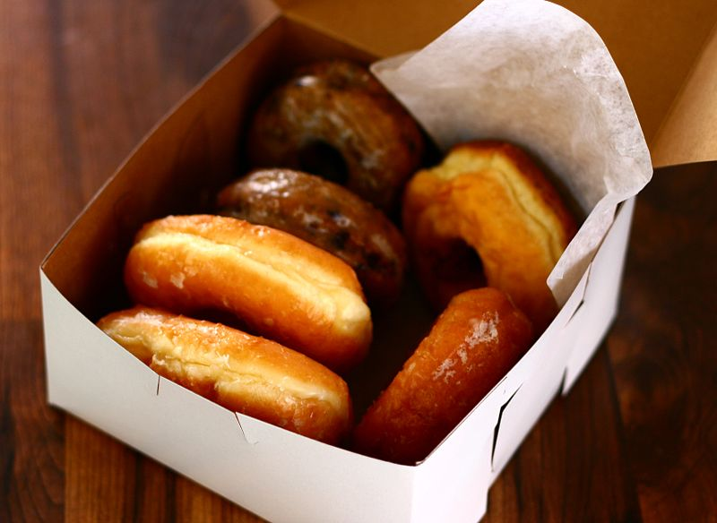
D
O
N
U
T
Make an acrostic!
2007 lucianvenutian, Wikimedia Commons https://commons.wikimedia.org/wiki/File:Donuts.jpg
Notes:
Photo source (box of donuts): 2007 lucianvenutian, Wikimedia Commons https://commons.wikimedia.org/wiki/File:Donuts.jpg

Slide 3
D electable
go O d
N om nom
delicio U s
T asty
Make an acrostic!
2007 lucianvenutian, Wikimedia Commons https://commons.wikimedia.org/wiki/File:Donuts.jpg
Notes:
Photo source (box of donuts): 2007 lucianvenutian, Wikimedia Commons https://commons.wikimedia.org/wiki/File:Donuts.jpg

Slide 4
frie D
d O ugh
rou N d
s U gar
pas T ry
Make an acrostic!
2007 lucianvenutian, Wikimedia Commons https://commons.wikimedia.org/wiki/File:Donuts.jpg
Notes:
Photo source (box of donuts): 2007 lucianvenutian, Wikimedia Commons https://commons.wikimedia.org/wiki/File:Donuts.jpg

Slide 5
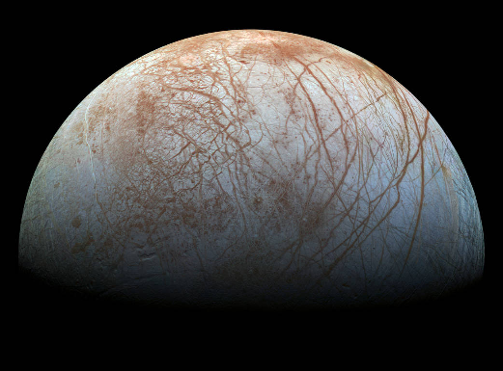
E
U
R
O
P
A
Make an acrostic!
Image source: NASA/JPL-Caltech/SETI Institute
Notes:
The fascinating surface of Jupiter’s icy moon Europa looms large in this newly-reprocessed color view, made from images taken by NASA's Galileo spacecraft in the late 1990s. This is the color view of Europa from Galileo that shows the largest portion of the moon's surface at the highest resolution.
Image source: NASA/JPL-Caltech/SETI Institute https://www.nasa.gov/europa/overview/index.html

Slide 6
ic E
j U piter
c R acks
O cean
telesco P e
NAS A
Make an acrostic!
Image source: NASA/JPL-Caltech/SETI Institute
Notes:
The fascinating surface of Jupiter’s icy moon Europa looms large in this newly-reprocessed color view, made from images taken by NASA's Galileo spacecraft in the late 1990s. This is the color view of Europa from Galileo that shows the largest portion of the moon's surface at the highest resolution.
Image source: NASA/JPL-Caltech/SETI Institute https://www.nasa.gov/europa/overview/index.html

Slide 7
How do we know all of this information about Europa?
What else do we want to know about Europa?
Do you think we will find life?

Slide 8
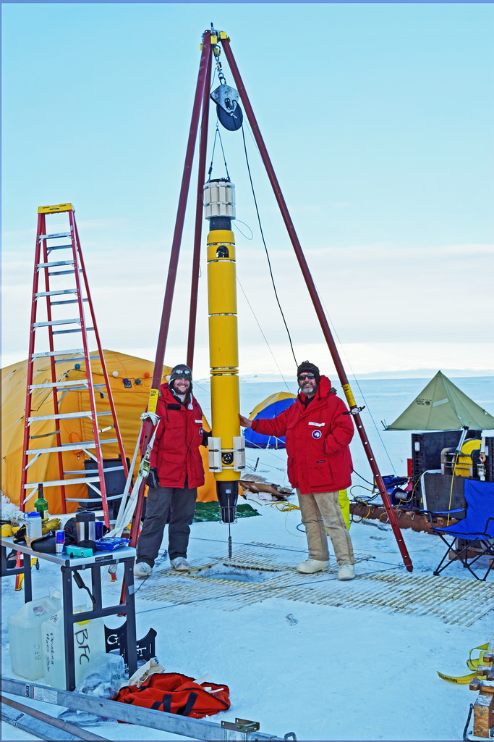
What did we do during the robot activity?
Why did we do the robot activity?
Notes:
Image source: 201_ Georgia Tech Research Institute

Slide 9
Our little robots are little artists!

Slide 10
The Mars Curiosity Rover is a little artist!
← Look at the path it has taken so far!
Notes:
Screenshot from a website that is regularly updated with data from the Curiosity Rover. http://curiosityrover.com/rovermap1.html

Slide 11
The technique used is called a continuous line drawing.
What does it mean to be continuous?
What is a line?

Slide 12
In math, a line is the connection of two points.
In art, a line is a point moving through space.
The robot created a continuous line as it traversed the maze.

Slide 13
Is this a line?
Notes:
Answer: yes

Slide 14
Is this a line?
Notes:
Answer: yes

Slide 15
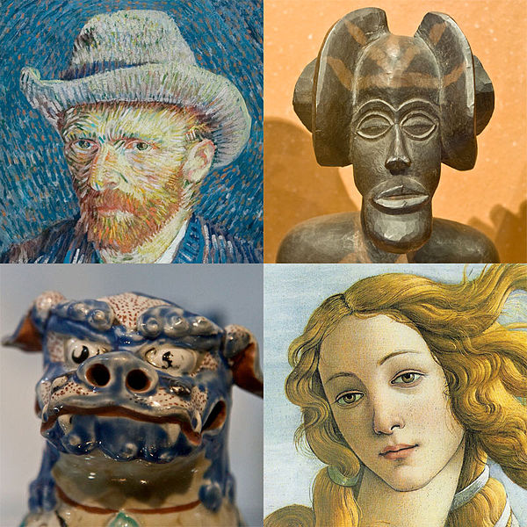
Examples of lines in art
Watch this video:
KQED Art School’s Elements of Art: Line
http://viewpure.com/BDePyEFT1gQ
Notes:
Play for students a 3:25-minute video that is a great introduction to line as one of the seven elements of art.
Images source (a montage of faces from four different works of art): 2009 User:Husky and h3m3ls, Mischa de Muynck and Niels, Wikimedia Commons https://commons.wikimedia.org/wiki/File:Art-portrait-collage_2.jpg Creative Commons Attribution-Share Alike 3.0 Unported license

Slide 16
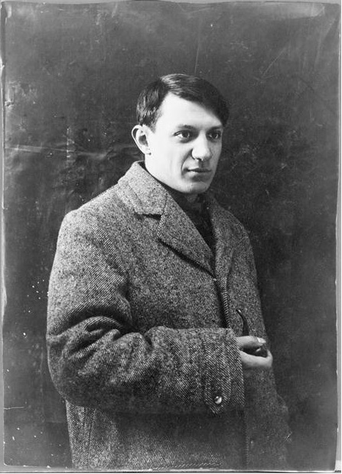
Pablo Picasso!
One famous collection of art is Picasso’s continuous line drawings.
Pablo Picasso was a famous Spanish artist who lived from 1881-1973.
He was talented in many forms of art, including painting, sculpture and writing.
He created 20,000+ works of art in his life!
Pablo Picasso in 1908
© RMN-Grand Palais (Musée Picasso de Paris)
Notes:
Image source (Portrait photograph of Picasso in 1908) [PD] Photo © RMN-Grand Palais (Musée Picasso de Paris), Wikimedia Commons https://commons.wikimedia.org/wiki/File:Portrait_de_Picasso,_1908.jpg

Slide 17
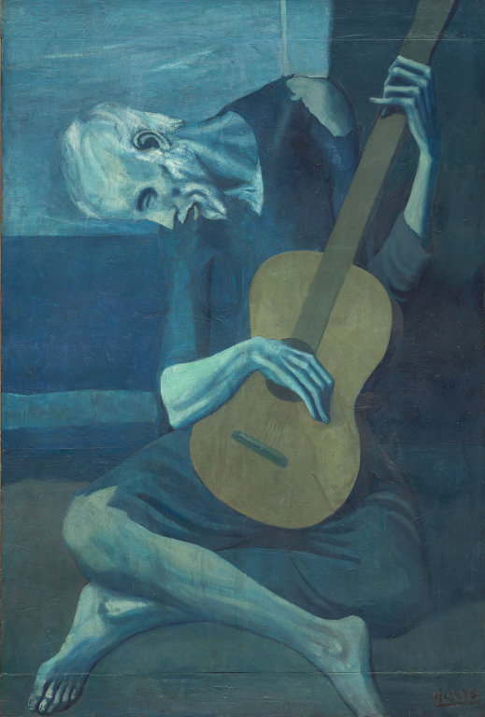
Pablo Picasso!
The Old Guitarist
by Pablo Picasso, 1903
Notes:
Image source (The Old Guitarist by Pablo Picasso, 1903): The Art Institute of Chicago, Wikimedia Commons https://en.wikipedia.org/wiki/File:Old_guitarist_chicago.jpg

Slide 18
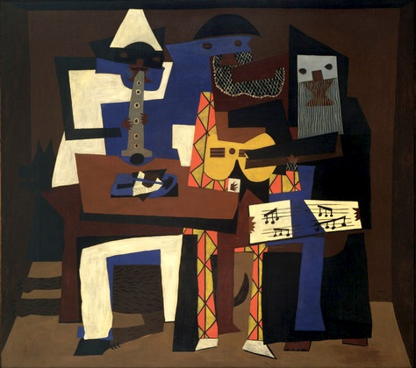
Pablo Picasso!
Three Musicians
by Pablo Picasso, 1921
Notes:
Image source (Three Musicians by Pablo Picasso, 1921): MoMa, Wikimedia Commons https://en.wikipedia.org/wiki/File:Picasso_three_musicians_moma_2006.jpg

Slide 19
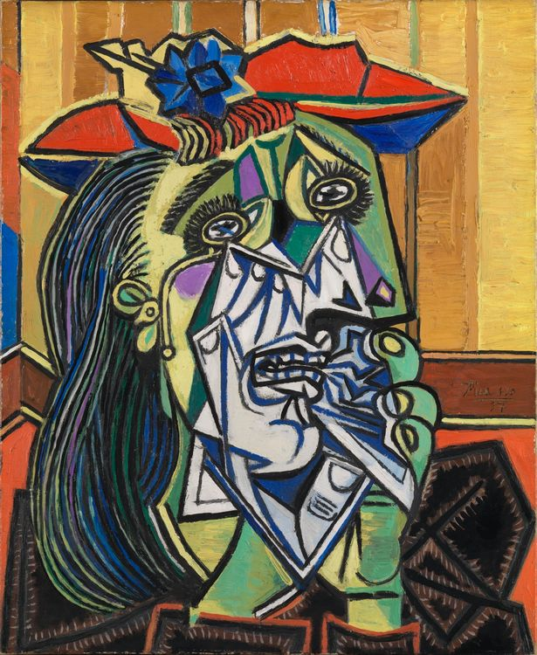
Pablo Picasso!
The Weeping Woman
by Pablo Picasso, 1937
Notes:
Image source (The Weeping Woman by Pablo Picasso, 1937): © Tate London, Wikimedia Commons https://en.wikipedia.org/wiki/File:Picasso_The_Weeping_Woman_Tate_identifier_T05010_10.jpg

Slide 20
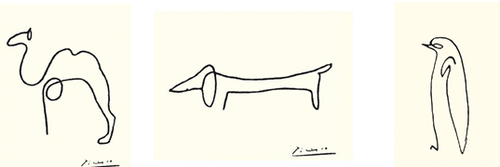
Picasso’s Continuous Line Drawings
Pablo Picasso, 1907 public domain
Notes:
Image sources: Pablo Picasso [public domain] https://www.pinterest.com/pin/135600638750826602/

Slide 21
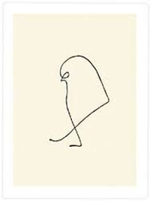
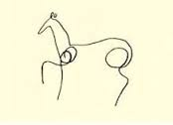
Picasso’s Continuous Line Drawings
Pablo Picasso, 1907 public domain
Notes:
Image sources: Pablo Picasso [public domain] https://www.pinterest.com/pin/135600638750826602/

Slide 22
Try it on your paper!
Pablo Picasso, 1907 public domain
Notes:
Image sources: Pablo Picasso [public domain] https://www.pinterest.com/pin/135600638750826602/

Slide 23
Try it with your opposite hand!
Pablo Picasso, 1907 public domain
Notes:
Image sources: Pablo Picasso [public domain] https://www.pinterest.com/pin/135600638750826602/

Slide 24
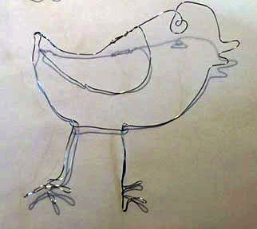
Make an original!
Create your own continuous line drawing on your paper.
When you are happy with it, use the
flexible wire to make a sculpture of it.
Tape one end of the wire to the starting point of your drawing.
Using your drawing as a guide, trace the drawing by bending the wire along with the direction of the line.
Please do not use the wire as a poking device. Even though the wire is
coated in plastic and is not sharp, please use it only for its intended purpose.
Remember, to make it continuous, do not break the line!
Notes:
Photograph source: © 2015 Carrie Beth Rykowski, Georgia Tech Research Institute

Slide 25
Let’s reflect!
Define a line.
Who was Pablo Picasso?
Do you think this art lesson connected to the robot activity? Why or why not?
How does engineering relate to art and aesthetics?
In what other earth science topic do you think we could connect the idea of continuous line drawings?
What stuck with you today, or made you think?
Did you like today’s activity? Why or why not?

