Slide 1
Using Visual Art to Communicate
Notes:
Using Visual Art to Communicate Presentation
Visual Art and Writing in Science and Engineering lesson > TeachEngineering.org

Slide 2
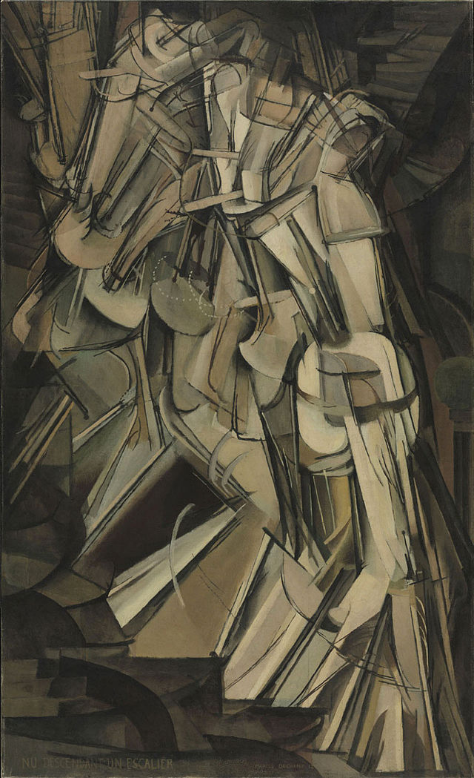
List 10 things you notice about this image
What stands out to you?
What other terms can you use to describe it?
Is there a foreground? A background?
Does it mean anything?
If so what?
Nude Descending a Staircase by Marcel Duchamp
Notes:
Nude Descending a Staircase, No. 2 by Marcel Duchamp, 1912, Paris, France, oil on canvas, Philadelphia Museum of Art
Image source: 2015 Coldcreation, Wikipedia http://en.wikipedia.org/wiki/File:Duchamp_-_Nude_Descending_a_Staircase.jpg

Slide 3
List 5 things you notice about this image
Is there a theme?
Are any particular art styles being used? Pattern? Rhythm?
Could it be used to represent anything?
Notes:
Image source: Pixabay (public domain; free download) http://pixabay.com/p-686254/?no_redirect

Slide 4
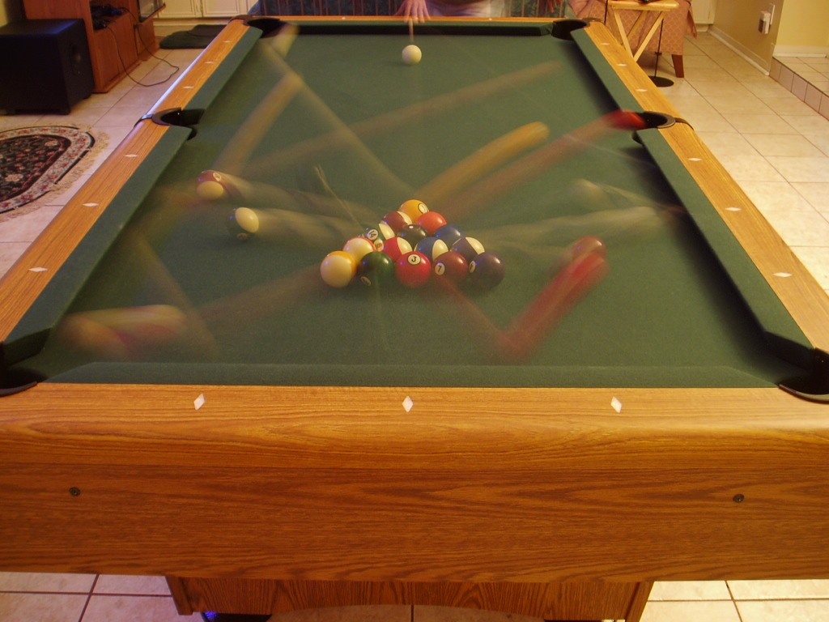
List 5 things you notice about this image
What is happening in the image?
How can you tell?
Are there any inconsistences?
Notes:
Ball break time lapse photograph
Image source: 2006 Jollytime (Austin), Wikimedia Commons http://commons.wikimedia.org/wiki/File:8_ball_break_time_lapse.jpg

Slide 5
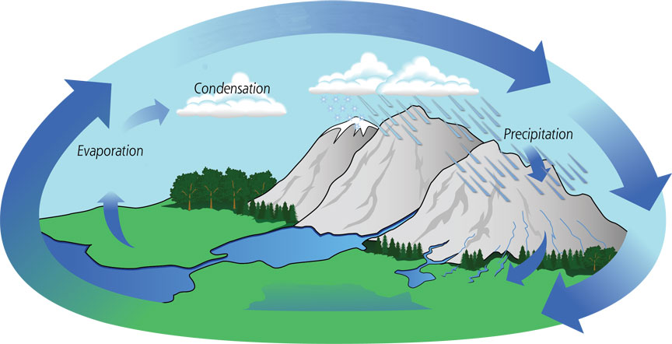
What is being shown?
How does this picture show how that process happens?
Why do you think that?
Do you need the text?
List 5 things you notice about this image
Notes:
Image source: NASA http://pmm.nasa.gov/education/water-cycle

Slide 6
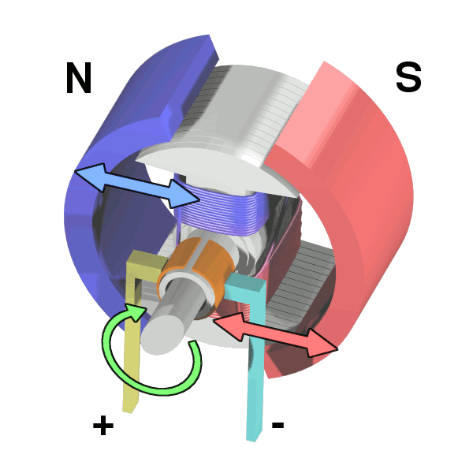
List 5 things you notice about this image
What does this look like it represents?
If this were a movie clip instead, what would happen?
Why do you think that?
Notes:
Illustration of simple electric motor
Image source: 2006 Wapcaplet in Blender, Wikimedia Commons http://commons.wikimedia.org/wiki/File:Electric_motor_cycle_2.png

Slide 8
Notes:
Image source (free) Paper Leaf Design http://paper-leaf.com/blog/2012/10/principles-of-design-quick-reference-poster/

Slide 9
Notes:
Image source (free): Paper Leaf Design: http://paper-leaf.com/blog/2011/02/elements-of-design-quick-reference-sheet/

