Slide 1
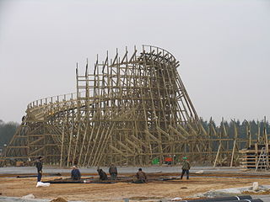
A Frictional Roller Coaster
Constructing from Design
Troy Roller Coaster, Toverland, Netherlands | height = 104 ft | speed = 54 mph | Cost = ????
Notes:
A Frictional Roller Coaster Presentation, Mathematically Designing a Frictional Roller Coaster Activity, TeachEngineering.org
///
Image source:
(Troy roller coaster, Toverland, Netherlands; construction site) 2007 Stefan Scheer, Wikimedia Commons CC BY-SA 3.0 https://commons.wikimedia.org/wiki/File:Toverland_Troy_Costr.jpg

Slide 2
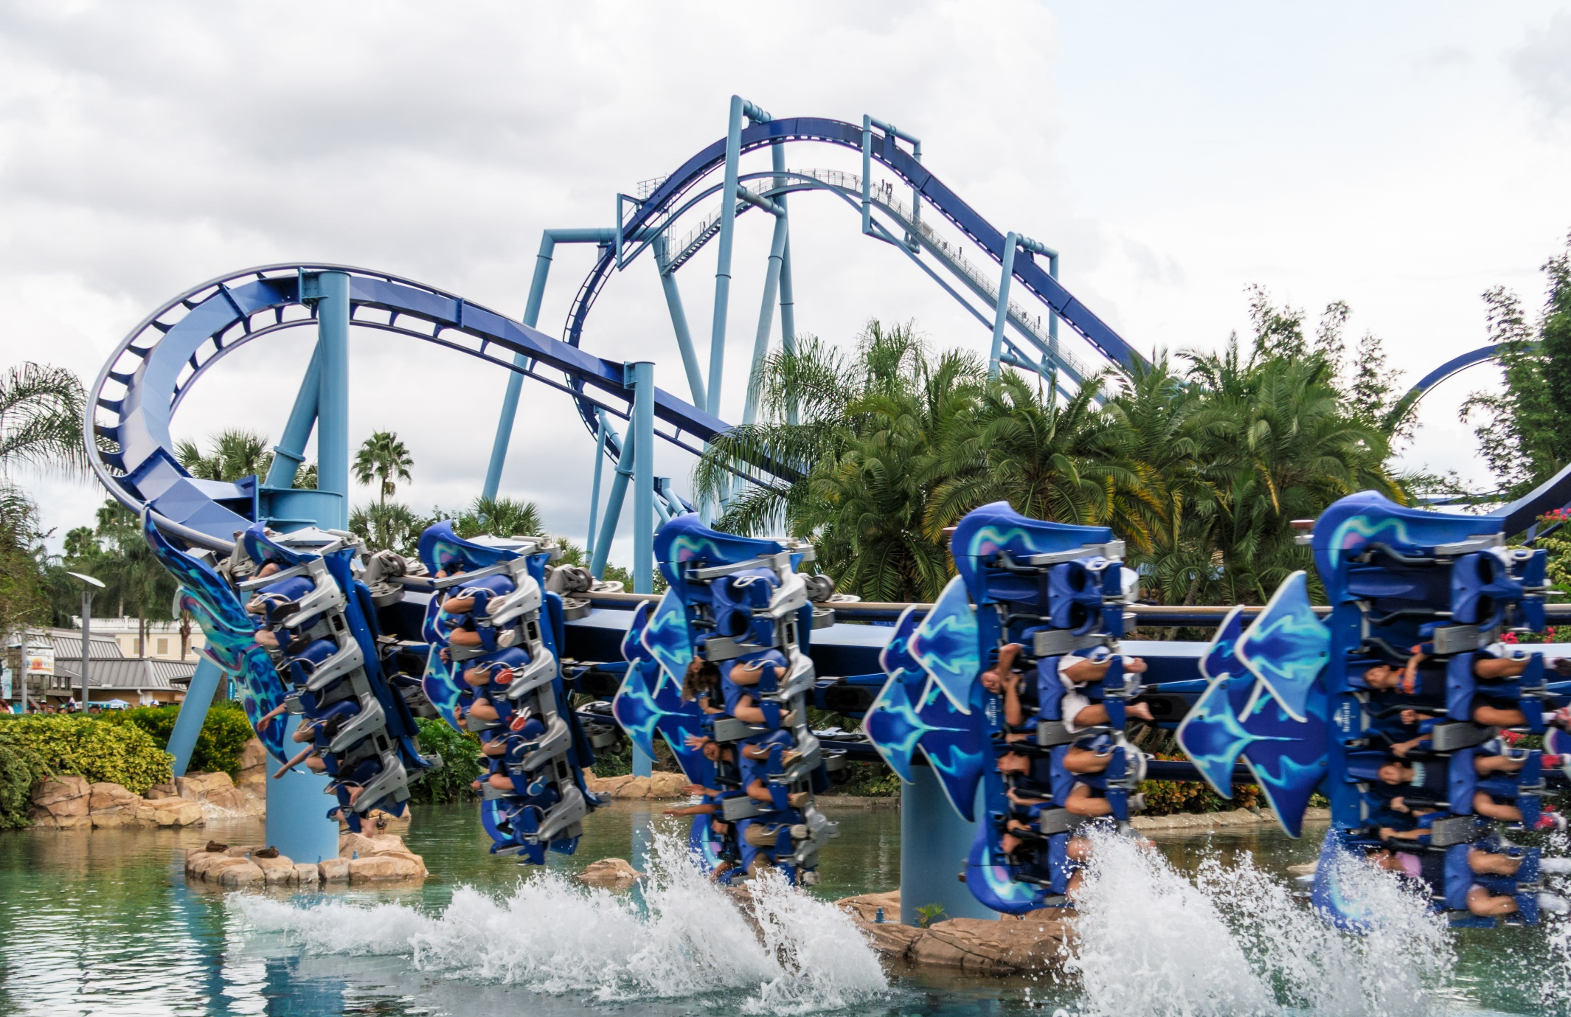
Do you have any idea of the cost of roller coaster projects?
Notes:
Click on the “Play” buttons to show videos of roller coaster construction and computer models.
Videos (left to right)
Video 1 (2:59 min): Timelapse Millennium Force Roller Coaster Construction, Cedar Point:
https://www.youtube.com/watch?v=vMg39-Ao734
Video 2 (3:51 min): Iron Rattler Construction Montage- Six Flags Fiesta Texas's new Hybrid Roller Coaster: https://www.youtube.com/watch?v=_MljfFw8E9U
Video 3 (3 min): Animation SFMM Twisted Colossus ride: https://www.youtube.com/watch?v=lFWnSA33UOo
Image source
(photo; Manta roller coaster at SeaWorld Orlando, FL): 2015 Stefan Scheer, Wikimedia Commons CC BY-SA 3.0, https://commons.wikimedia.org/wiki/File:Manta-SWO-Water.jpg

Slide 3
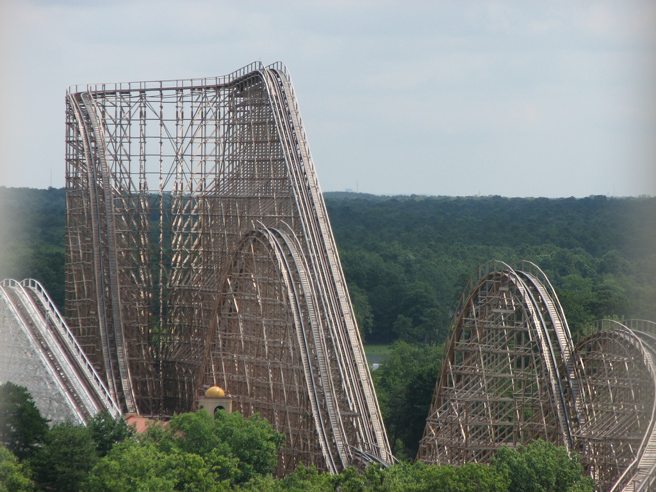
El Toro
Six Flags Great Adventure, Jackson, NJ
Height: 181 ft
Speed: 70 mph
Length: 4,400 ft
Guess the cost…
Notes:
Image source:
(photo; El Toro roller coaster) 2007 tenioman, flikr CC BY-SA 2.0
https://www.flickr.com/photos/tenioman/2074550533

Slide 4
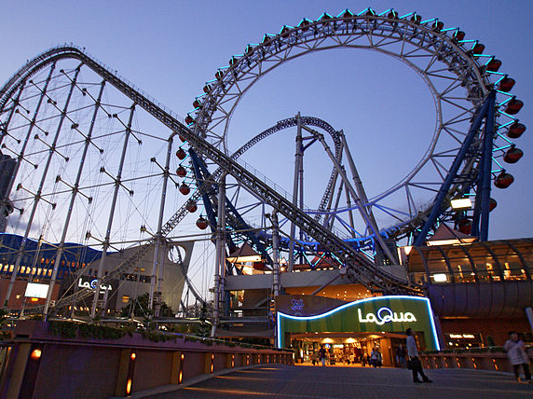
Thunder Dolphin
Tokyo Dome City Attractions, Tokyo, Japan
Height: 260 ft
Speed: 81 mph
Length: 3,497 ft
Guess the cost…
Notes:
Image source:
(photo; LaQua in Bunkyo-ku, Tokyo, Japan) 2007 66highland, Wikimedia Commons CC BY-SA 3.0

Slide 5
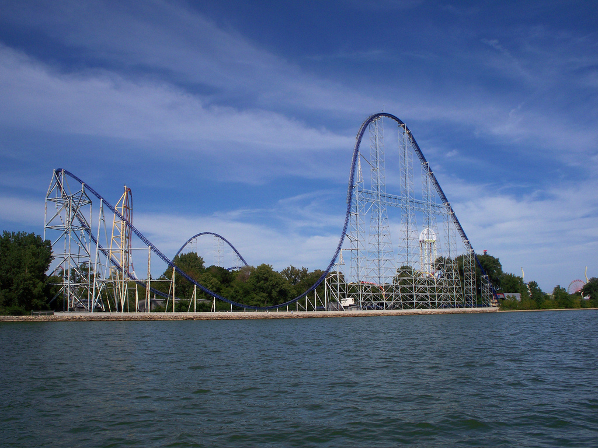
Millennium Force
Cedar Point Park, Sandusky, OH
Height: 310 ft
Speed: 93 mph
Length: 6,995 ft
Guess the cost…
Notes:
Image source:
(photo; Millennium Force, Cedar Point) 2011 Andrew Borgen, flickr CC BY-ND 2.0
https://www.flickr.com/photos/andrewb94/6148339795

Slide 6
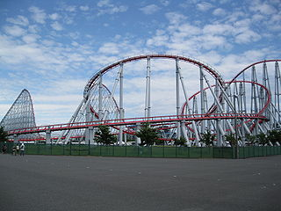
Roller coasters are expensive and complex projects…
Have you ever worked a school roller coaster project?
Steel Dragon 2000, Mie Prefecture, Japan | Height = 318 ft | Speed = 95 mph | Cost = $52M
Notes:
Cost answers to last three slides:
El Toro cost ~$25M, Thunder Dolphin cost ~$37M, and Millennium Force cost ~$25M
Disney’s Expedition Everest ride at Walt Disney World in Florida is the most expensive roller coaster, costing $100 million and took more than six years to create.
///
Image source:
(photo: Nagashima Spa Land 01) 2009 Janma, Wikimedia Commons CC BY-SA 3.0 https://commons.wikimedia.org/wiki/File:SteelDragon2000.jpg

Slide 7
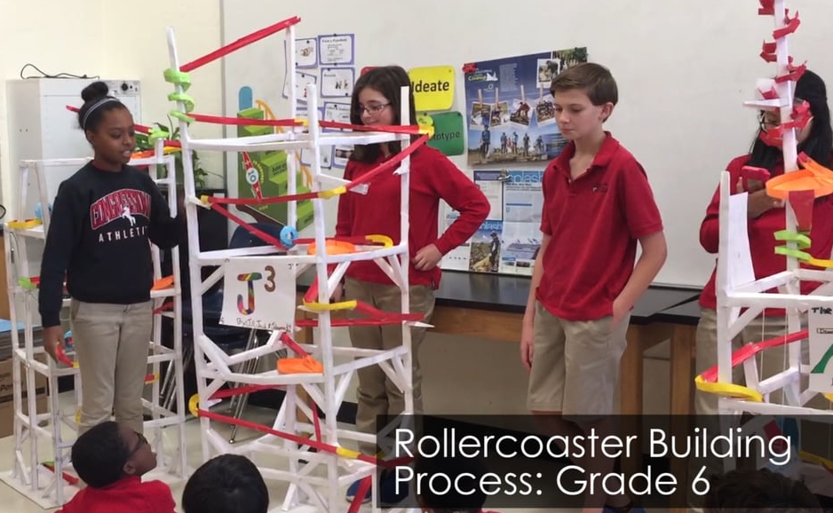
Notes:
Click on the “Play” buttons to show videos of students’ roller coaster school projects.
Video links (left to right)
Video 1 (1:53 min): 8th Grade Roller Coaster Project https://www.youtube.com/watch?v=Vdv0bjJgj5Q
Video 2 (2:52 min): Roller Coaster Loops Physical Science Project https://www.youtube.com/watch?v=pc2CyUBIgKA
Video 3 (4:27 min): 8th Grade Science Project: Rollercoaster with Marble. Riley, Yousuf and Nick
https://www.youtube.com/watch?v=e2JbR57JeAo
Video 4 (1:14 min): Pipe Insulation Roller Coasters https://www.youtube.com/watch?v=HLyC6tDQrkM
Video 5 (2:25 min): Making A Foam Pipe Roller Coaster https://www.youtube.com/watch?v=-_zfaO7_uog
Video 6 (12:56 min): 8th Grade Roller Coaster Example https://www.youtube.com/watch?v=wjhDOCWp_1k
Video 7 (2:22 min): Roller coaster project 8th grade https://www.youtube.com/watch?v=YAIJM5Xz8hA
Video 8 (2:33 min): How to Make a Homemade Roller Coaster Model -Home School Science Day 227 | ActOutGames https://www.youtube.com/watch?v=VDXOsaF_xr8
Video 9 (48 sec): Makers Class - Marble Roller Coasters https://www.youtube.com/watch?v=8CaI_q8Sqlk
Image source
Design Thinking and Interdisciplinary Learning video by Congressional School https://i.vimeocdn.com/video/615942868_1280x720.jpg AND https://vimeo.com/202023091
2017 Congressional School, vimeo CC BY-ND 3.0

Slide 8
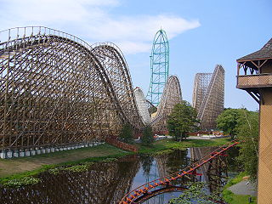
Are you ready for a school roller coaster project?
…and to have a lot of fun?
Notes:
Image source:
(photo; El Toro and Kingda Ka) 2007 Paulm27, Wikimedia Commons CC BY-SA 3.0 https://commons.wikimedia.org/wiki/File:KingdaEltoro.JPG

Slide 9
Your Engineering Challenge
Project requirements and constraints:
Work as real-world professional engineers do —from design to final product
Use the physics you learned in the previous lesson, A Tale of Friction
Define your roller coaster’s path as a differentiable function
Do the necessary calculations to prove that your coaster is going to work, before building it
Are you ready for all this fun?

Slide 10
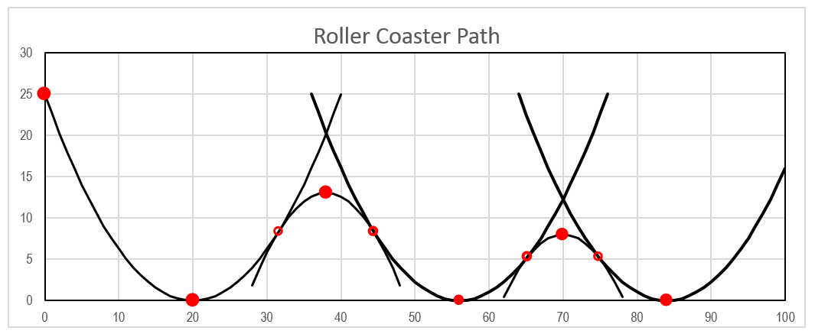
Project Guidelines
Work in teams of 3 or 4 members
Design your coaster’s path using at least 5 differentiable functions; to simplify the calculations, use parabolas
The piecewise function produced must be differentiable
Notes:
Image source:
(roller coaster path graph) 2017 Miguel R. Ramirez (author)

Slide 11
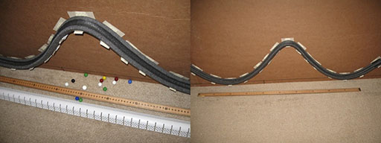
Project Guidelines
Your design dimensions must be appropriate to the flexibility of the material you use to build the model: foam pipe insulation
1.5-in external diameter pipe insulation material is suggested
That means, no very sharp curves or loops
Mount the roller coaster on a big enough flat surface; a 3 x 4-ft cardboard sheet is recommended
Notes:
Recommended material is polyethylene pipe insulation, which can be cut, glued, taped and curved
Image source:
(2 student project photos) 2017 Miguel R. Ramirez (author)

Slide 12
Project Guidelines
Use this formula
$$v_{f}=\sqrt{v_{i}^{2}−2g∙(f\left(x_{f}\right)−f\left(x_{i}\right))−\frac{4}{7}∙g∙\left|f\left(x_{f}\right)−f(x_{i})\right|}$$
to determine the maximum height the marble will reach after rolling from a high point on the upward-opening parabolas
(The velocity of the marble at this maximum height is zero)

Slide 13
Project Guidelines
Use the height the marble reaches at the end of an upward-opening parabola to determine the height of the vertex for the next downward-opening parabola
At path beginning, the initial marble velocity must be zero
At path end, the final velocity must also be zero (or almost)

Slide 14
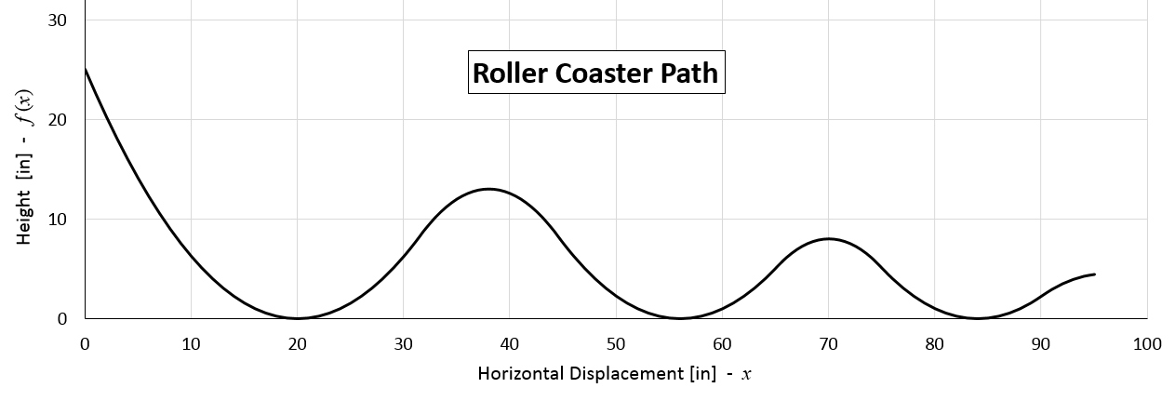
Project Guidelines
Use Excel to make the required computations and produce a graph of the designed path
Use the velocity formula to test the functionality of the entire designed path; the velocity must be greater than zero at every point on the path, except at the ends

Slide 15
Project Guidelines
Find the piecewise function for the designed path
Use points from this function to build your model

Slide 16
Project Guidelines
Test your model. Then make conclusions about your design and your model:
Is it behaving as expected? If not, why?
What were the failures?
What problems did you have during construction?
How did you solve them?
Make a class presentation of your model, design process, computations, construction process, and conclusions
Support your presentation with a slide show or video.
A standalone presentation earns extra points.
See details in rubric handout

Slide 17
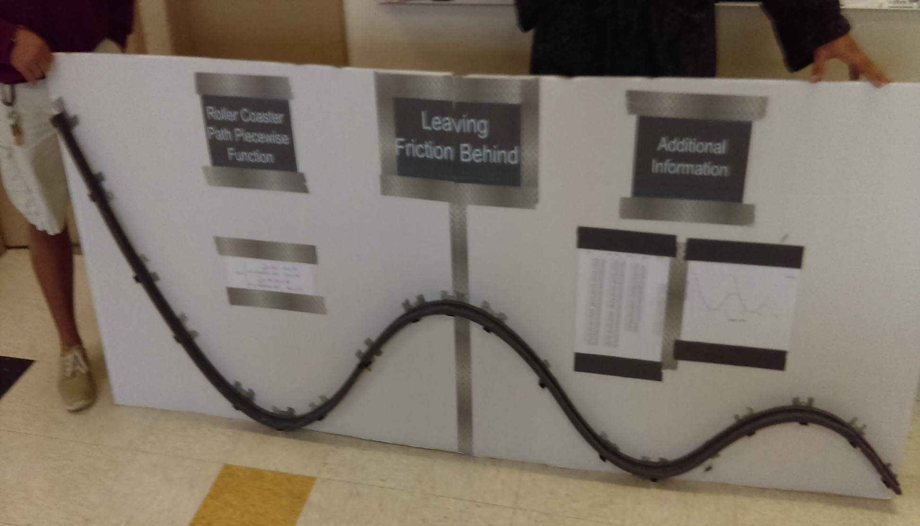
Have fun with this real-world engineering challenge project!
Notes:
Image source:
(photo; final student team poster) 2017 Miguel R. Ramirez (author)

