Slide 1
Chasing the Sun

Slide 2
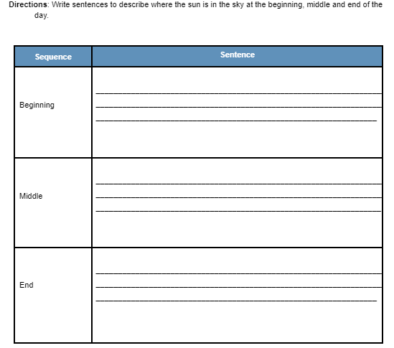
Pre-assesment Word Bank: Sunset West East Sunrise Noon High in the sky
Photos should be a
square like this.
#f8a81b
Suns Path Across the Sky

Slide 3
Review: Solar Patterns
The sun moves across the sky throughout the day because earth is spinning. In the morning the sun rises in the east. Then, in the middle of the day the sun is high in the sky. At the end of the day the sun sets in the west.
Photos should be a
square like this.
#f8a81b
Suns Path Across the Sky

Slide 4
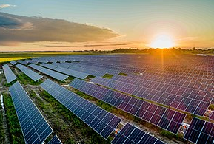
Review: Solar Energy
A combination of heat and light energy from the sun.
Photos should be a
square like this.
#f8a81b
Notes:
https://en.wikipedia.org/wiki/Solar_energy

Slide 5
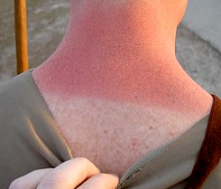
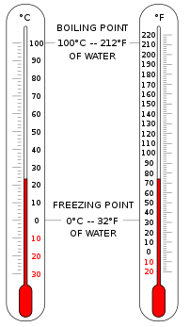
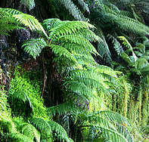
Review: How Does Solar Energy Affect You?
- Sun burns - Shadows - Helps plants grow - Changes the temperature -The sun can make electricity!
#f8a81b
Notes:
https://en.wikipedia.org/wiki/Plant
https://en.wikipedia.org/wiki/Shadow
https://en.wikipedia.org/wiki/Temperature
https://en.wikipedia.org/wiki/Sunburn

Slide 6
Review: What is Electricity
Let’s Review. Matter is anything that takes up space. All matter is made of tiny particles you can not see with your naked eye, called atoms. All atoms have even smaller particles called an electron. When Electrons move the give off energy called electricity.
Photos should be a
square like this.
#f8a81b

Slide 7
Phenomena
What do you think this is a picture of?
What properties of matter do you see?
What do you think it has to do with the sun?
Photos should be a
square like this.
#f8a81b
Notes:
https://en.wikipedia.org/wiki/Solar_energy

Slide 8
How does the sun make electricity?
Solar Panels use the sun’s solar energy to create electricity. They do this with solar panels. How do solar panels work?
Photos should be a
square like this.
#f8a81b
Notes:
https://en.wikipedia.org/wiki/Solar_energy

Slide 9
Engineers are trying to solve a problem
Engineers want their solar panels to be able to collect as much solar energy as possible . This means they want the sun to shine on the panel a lot. But the sun moves across the sky during the day. Why would this be a problem?
Photos should be a
square like this.
#f8a81b

Slide 10
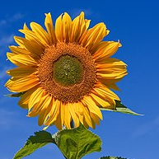
What could we do to the solar panel to solve the problem?
Your ideas: Research: A good engineer will do research to see if something already exists in the world to fix a similar problem. Can you think of another thing in the world that needs a lot of sunlight? Sunflower Solution
Photos should be a
square like this.
#f8a81b
Notes:
https://en.wikipedia.org/wiki/Common_sunflower

Slide 11
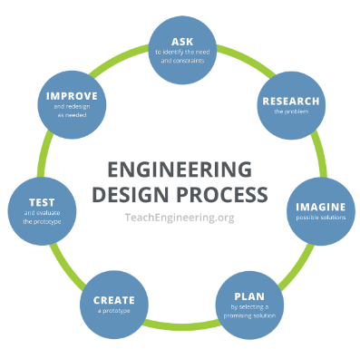
Engineering Design Process
Problem: The stationary solar panel is not getting enough sun exposure. Research: The Sun moves across the sky throughout the day. Sunflowers will bend and turn to follow the sun. Imagine: How could a solar panel follow the sun?
Photos should be a
square like this.
#f8a81b
Notes:
https://en.wikipedia.org/wiki/Solar_energy

Slide 12
Engineering Design Process
Plan Your materials are: - solar panel - pipe cleaners Your goal is: Create a stand for the solar panel that will allow it to follow the sun across the sky. Remember: The sun goes from East to West Your Solar panel needs to be securely held in the stand. Draw your designs and Discuss with your team!
Photos should be a
square like this.
#f8a81b
Notes:
https://en.wikipedia.org/wiki/Solar_energy

Slide 13
Engineering Design Process Create: You have 10 minutes to build with your group. Remember to record your data. Test: Let’s walk around and test out everyone's designs. Reiterate: What worked? What did not? Why? What could you do to improve it? Redesign: You have 5 minutes to redesign. Remember to record your data. Retest: Let’s walk around and test out everyone's designs.
#f8a81b
Notes:
https://en.wikipedia.org/wiki/Solar_energy

Slide 14
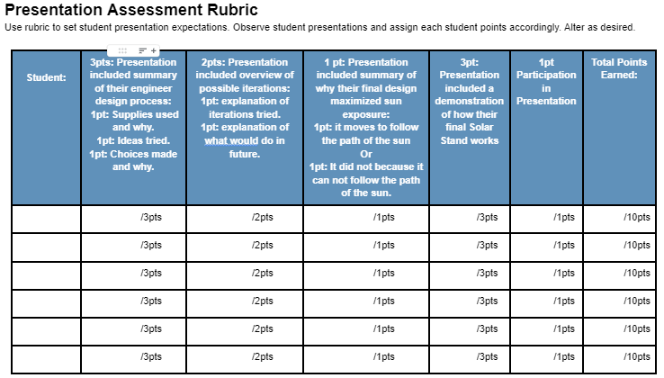
Engineering Design Process Prepare to Present Let’s look at the rubric
#f8a81b
Notes:
https://en.wikipedia.org/wiki/Solar_energy

Slide 15
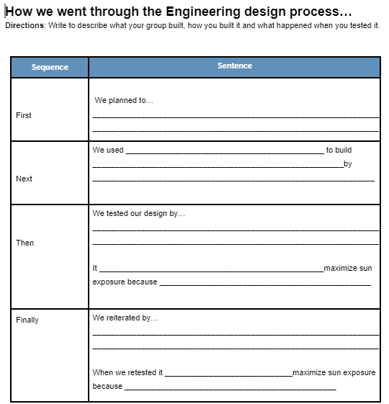
Engineering Design Process Prepare to present: Finalize your notes and drawings. Discuss who will do what part of the presentation. If desired… The teacher will call each team in small group to make their prestation script. Present!
#f8a81b
Notes:
https://en.wikipedia.org/wiki/Solar_energy

