Slide 1
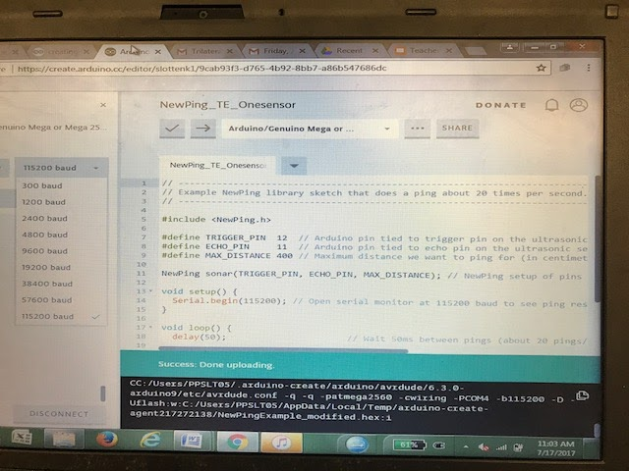
Teacher’s Note (do not include in student packet/slide show)
Open each work station to a Arduino Create account.
Open the sketch “NewPing_TE_OneSensor” in the window.
Make sure all devices are set to 115,200 baud.
Students will interface with this in Slide 7

Slide 2
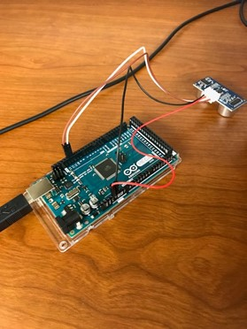
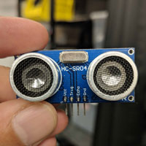
Setting Up Arduino Mega 2560 Microcontroller & Sunfounder HCSRO4 Ultrasonic Sensor

Slide 3
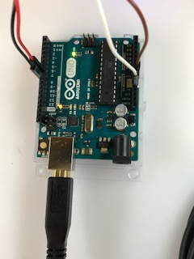
Step 1: Connect the Microcontroller to a Computer
Connect a USB to the computer and the Arduino Microcontroller.
If done correctly, two LED lights on board should light up.

Slide 4
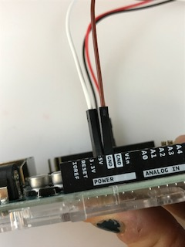
Step 2: Connect the Power Connection
Use the wires that are on the Sunfounder Ultrasonic Sensor:
Find the wire that is labeled GND (this is your ground) connect it to the pin labeled GND on the breadboard.
Find the wire labeled VCC and connect that to the 5V pin next to the ground pin.

Slide 5
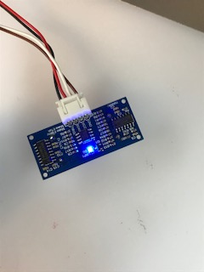
Step 3: Check the Power Connection
If the power was connected correctly, a blue LED light should appear on the back of the sensor.

Slide 6
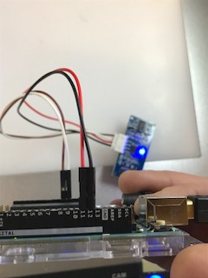
Step 4: Connect the Trigger and Echo Pins
Use the wires that are on the Sunfounder Ultrasonic Sensor
Find the wire that is labeled ECHO and connect it to the pin 11 on the breadboard.
Find the wire that is labeled trigger and connect it to the pin 12 on the breadboard.
Notes:
Image Source/Rights: 2017 Kendra Randolph, Michigan State University Department of Engineering

Slide 7
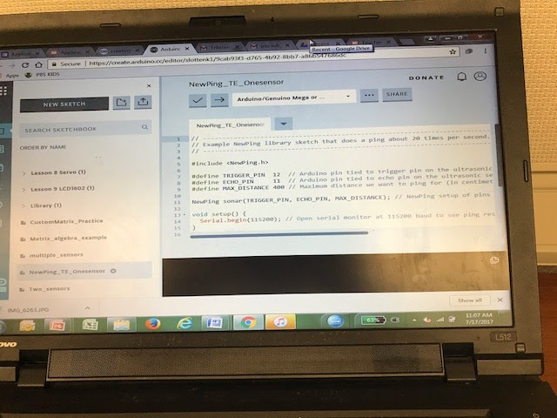
Step 5: Connect to Arduino Create
Using Google Chrome, please make sure you are logged into Arduino Create, and that your screen looks exactly like the photo example at the right, if not raise your hand to ask for teacher support.
Notes:
You will want to make sure you have followed slides 6

Slide 8
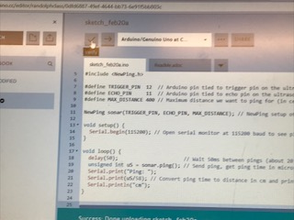
Step 6: Verify the Code
When you are working in a program that involves coding, it is always a good practice to verify a code before you upload it into the program. If you get an error, it will be explained in the black window at the bottom of the screen.
Notes:
You will want to make sure you have followed slides 6

Slide 9
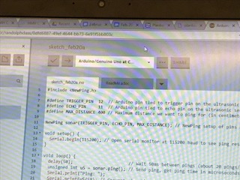
Step 7: Upload Code
1.Once you have verified the code and there are no errors, select upload.
2. Next to the upload button it should read, “Arduino/Genuino Mega or Mega 2560” or “Arduino/Genuino Uno”.

Slide 10
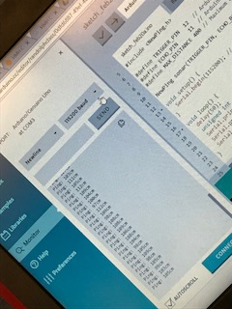
Step 8: Share Code with the Microcontroller
1. Select Serial Monitor.
2. Make sure it is set to 112500 baud. This will give you measurement values in the window.

Slide 11
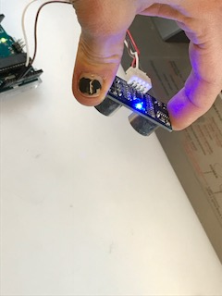
Step 9: Measuring Distance Practice
Hold the Ultrasonic Sensor above the tabletop with the trigger and echo sensors facing down. This means the LED should be facing upwards.
Allow each group member the opportunity to move and adjust sensor before moving on to Part 3 of the activity.
The receiver should point in the direction of the object

Slide 12
Step 10: Reading Distance with Ultrasonic Sensor
As one person moves the sensor from the table, the other group members should observe the distance measurements in the serial monitor in Arduino Create
Before moving onto Part 3, activity, record a short video that shows the readings from the serial monitor.
.

