Slide 1
How Can We Prevent the Corrosion Crisis?

Slide 2
Warm-Up
Go to the table with the nail samples and observe each nail. DO NOT touch the test tubes or nails!
Get a printout of today’s notes (next to the nails) and head back to your seat.
Individually (yes, without talking)... Write your observations, explanations, and any questions that you have at the top of your notes.
Notes:
As students come into class, they should be following the directions on the board. Monitor students to make sure that they are on task and are not crowding the nail table. I plan on having the nails in one line so that there can be a group of students on each side of the table.
The goal is for students to write their notes when they get back to the desk. The printout should be at the end of the table that contains the nail samples so that students pick it up as they go to their seats.

Slide 3
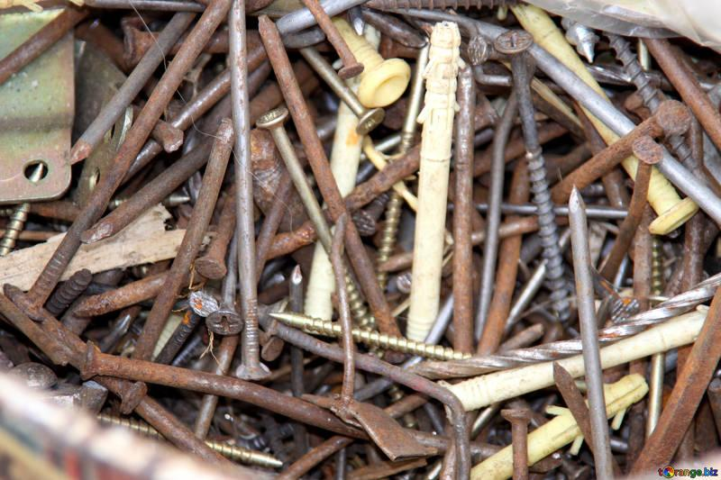
Turn, Talk, & Share
In small teams (2-4), take turns discussing what you wrote about the nail samples.
After a few minutes of discussing, we will share out as a class! Students will be called on randomly… be ready to share one of your notes!
Picture Credit: https://torange.biz/nails-screw-fasteners-2909#
Notes:
Things for the students to consider and/or the class to discuss: 1) Were the trials setup the same? If not, how were they different? (use of water, salt water, exposure to air, type of nail, time) 2) What did the students notice about the nails? (differences in amount of rust) 3) Based on the amount of rust, what are some factors that may have slowed down or prevented rust from occurring?
Picture Credit: https://torange.biz/nails-screw-fasteners-2909#

Slide 4
What do you already KNOW about Corrosion?
K
W
L
S
Notes:
“You’ve seen some examples of nails, some that have corroded and some that have not. Before we start the lesson, you are going to record what you already know about corrosion.”

Slide 5
K
What do you WANT to know about Corrosion?
W
L
S
Notes:
“Now, think about what you want to know about corrosion. Record one or two thoughts or questions in your W bubble.”

Slide 6
How Can We Prevent the Corrosion Crisis?
Notes:
“During this lesson, we are going to discuss what corrosion is and why it occurs. We will briefly discuss examples of corrosion in everyday life and how different industries and individuals are trying to prevent corrosion.”

Slide 7
I will be able to...
explain corrosion in my own words.
explain why some metals rust or oxidize.
provide examples of corrosion in everyday life.
Notes:
Teacher should read the “I Can” statements to students, outlining the goals of this lesson.

Slide 8
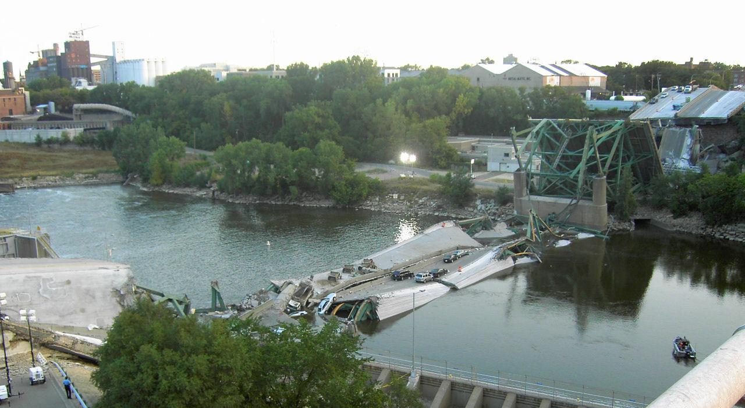
The Cost of Corrosion
Public Health & Safety
Infrastructure
bridges
roadways
Buildings
Water pipes and tanks
Flint Water Crisis
Picture Credit: https://upload.wikimedia.org/wikipedia/commons/6/6b/I35_Bridge_Collapse_4crop.jpg
Notes:
Pose question: “Have you ever seen or heard of structures collapsing without warning?”
“Infrastructure, such as bridges and roadways, can crumble or collapse if the metal materials supporting these structures are not monitored.”
Pose question: “What can happen to water pipes and tanks overtime?”
“Pipes and tanks can corrode over time, contaminating drinking water.”
Flint Water Crisis (see reference page for full link)
To save cost, a decision was made to not use corrosion inhibitors.
The high amount of chlorine in the Flint River caused pipes to start corroding immediately.
Corrosion of these pipes released lead into the water.
Picture Credit: https://upload.wikimedia.org/wikipedia/commons/6/6b/I35_Bridge_Collapse_4crop.jpg
Note: Teachers can choose to link videos or other infographics to help students visualize the impact that corrosion has on society.

Slide 9
The Cost of Corrosion
Corrosion Costs Money
In 2013, the total cost of corrosion in the U.S. was $451.3 billion.
Agriculture
Industry
Services
It’s estimated that corrosion costs about 3.1% of the country’s total GDP.
Video Credit: Transhield
Notes:
Video Link: https://www.youtube.com/watch?v=-zW-Y2CZM74
Specific Data from: economic-impact.aspx
“Corrosion is a problem that negatively impacts society and many different industries. There is a constant need to monitor and maintain structures, pipelines, and much more. Because of this, industries, companies, and individuals are trying to find ways to prevent and control corrosion.”
Note: Teachers can choose to link videos or other infographics to help students visualize the impact that corrosion has on society.

Slide 10
Time to Read!
Read the article from CK12.org
Highlight or underline key ideas
Look for vocabulary
Write comments or questions
We will refer to this later!
Notes:
Assign students a short article called “Corrosion” found on ck12.org. This article can be printed or viewed online. With both methods, students can highlight and make notes as they read. However, CK12 has provided additional videos that are optional for students to watch.
Optional: Other articles could be selected to replace the CK12 article.
“You are going to be given a short article about corrosion. By the end of this article, you should be able to explain corrosion in your own words and be able to provide examples of corrosion processes. As you read this article, write comments and questions that you have. You may also annotate or highlight key information. We will refer to this article later.”

Slide 11
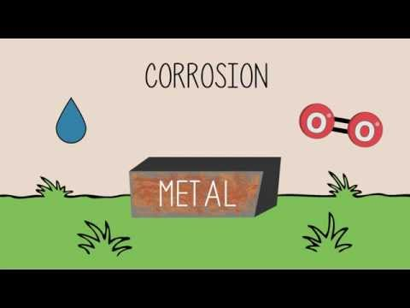
Video Credit: The Fuse School
Notes:
Link to video: https://www.youtube.com/watch?v=jQoE_9x37mQ
Found on youtube: Rust: Prevention and treatment; Chemistry for All; The Fuse School
“Do you know what causes rust? Why do only metals rust and not other materials? How can we prevent rust? These are all questions that will be answered with this video.”

Slide 12
K
W
What did you LEARN about Corrosion?
L
S
Notes:
“Now that we’ve watched a couple of videos, read an article, and have been given some background about corrosion, what is something new that you’ve learned about corrosion? Write two or three comments in your L bubble.”

Slide 13
What is a metal?
What types of properties do they have?
TURN
AND
TALK
Notes:
“Depending on what you’re referring to, corrosion can be used to describe the gradual breakdown of many materials. For the purpose of this lesson and the activity that follows, we are going to focus on the corrosion of metals. In your own words, what are metals? What types of properties do they have?”
Have students share some of their ideas with the class (at random) before moving to the next slide.

Slide 14
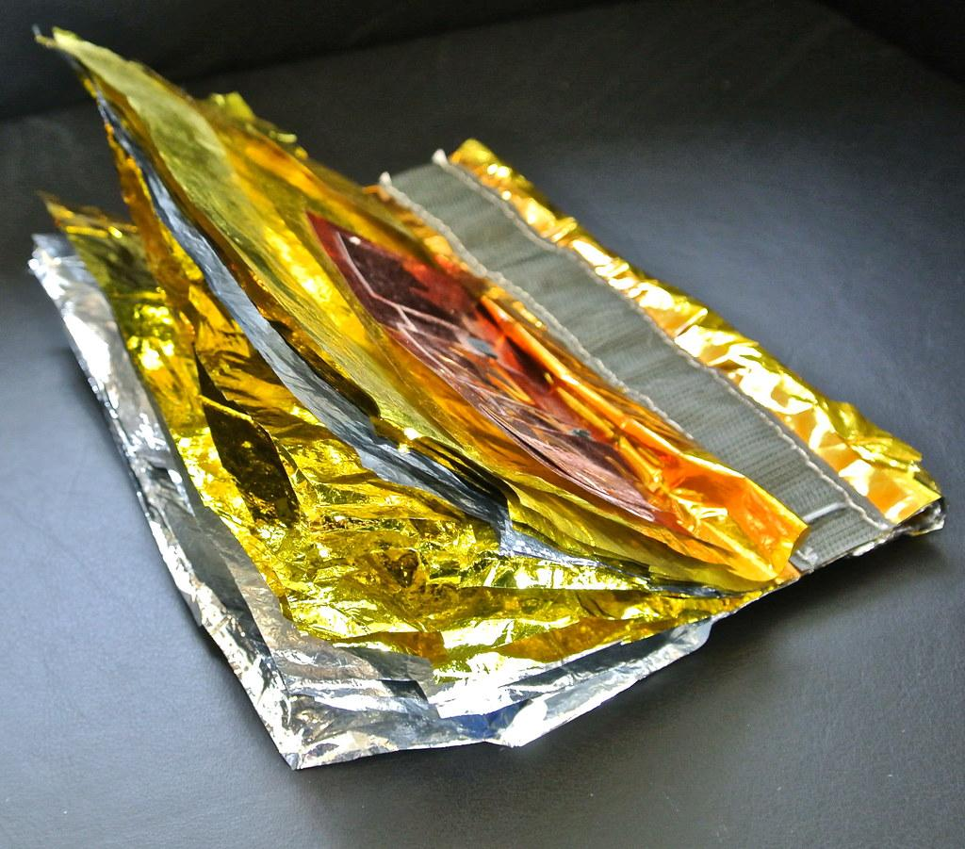
What is a Metal?
A type of matter that is a good conductor of heat and electricity.
Typically hard
Lustrous
Ductile
Malleable
Fusible
Notes:
“Whether or not you realize it, we rely on metals on a daily basis. Without their properties, we would not have cellphones and other electronic devices that we have come to depend on. While not all metals have all of the same properties, these are common properties found with metals.”
This definition should be added to the student notes. Students have the option of adding additional notes/examples at the bottom.
Lustrous: Having luster/shine
Ductile: Ability to be drawn into a thin wire
Malleable: able to be hammered or pressed permanently out of shape without breaking or cracking.
Fusible: ability to be fused or melted easily
Photo link: https://www.flickr.com/photos/jurvetson/6861117148

Slide 15
What is corrosion of a metal and why does it occur?
Is corrosion the same as rust?
TURN
AND
TALK
Notes:
“Now that you’ve been given some background information, it’s time to review what you’ve learned. As we discuss these questions, you may refer back to the notes you’ve taken up to this point.”
Have students share some of their ideas with the class (at random) before moving to the next slide.

Slide 16
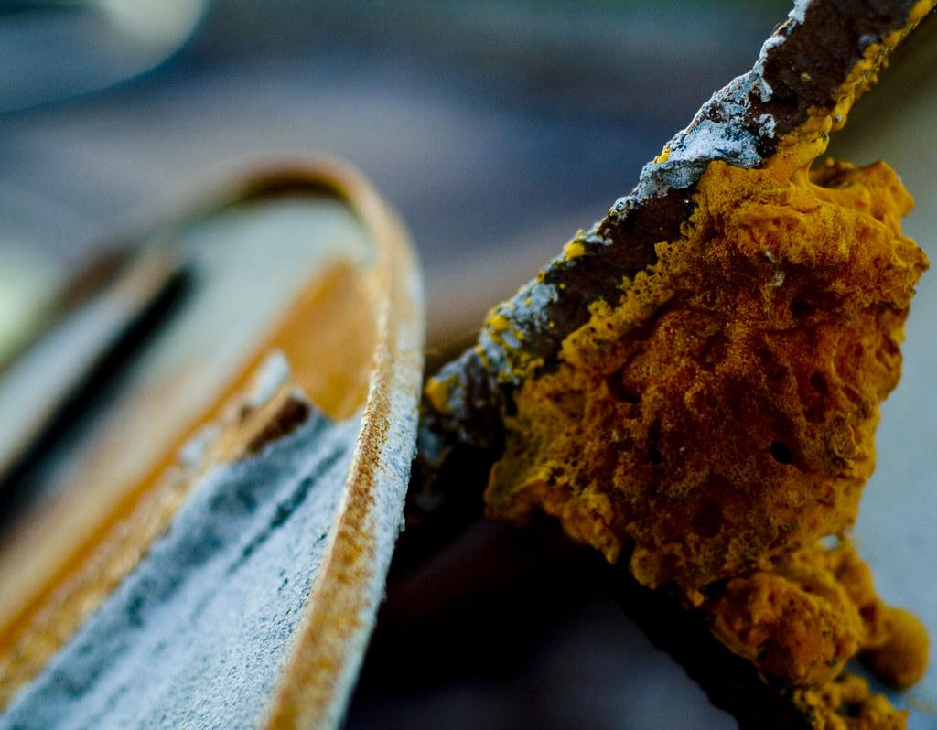
Corrosion
Rust
Chemical change of a metal surface when it’s exposed to oxygen in the environment.
Form of corrosion, specifically for iron and its alloys.
A reddish- or yellowish-brown flaky coating of iron oxide.
Picture Credit: Creative Commons
Notes:
“Today, we’ve looked at examples of both rust and corrosion. Are we talking about the same thing or are there differences between these two terms?”
Describe how rust is only one of many examples of corrosion. Not all corrosion reactions involve rust, but rust is a corrosion reaction.
These definitions should be added to the student notes. Students have the option of adding additional notes/examples at the bottom.
Picture link: https://search.creativecommons.org/photos/c65b520e-3d53-4743-9e5e-49126624e654

Slide 17
What are some examples of corrosion that you’ve seen in your everyday life?
TURN
AND
TALK
Notes:
“Now that we know what corrosion is and why it occurs, I want you to think about where you’ve encountered it before. With your neighbor, take turns discussing examples of corrosion in your everyday life.”
Have students share some of their ideas with the class (at random) before moving to the next slide.

Slide 18
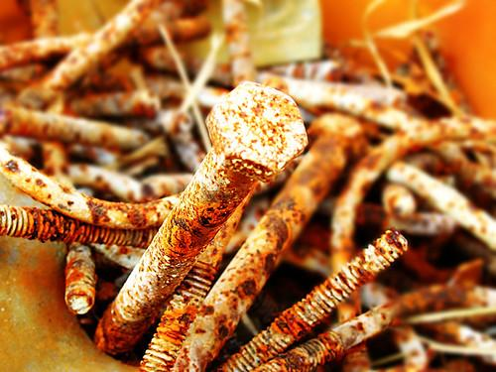
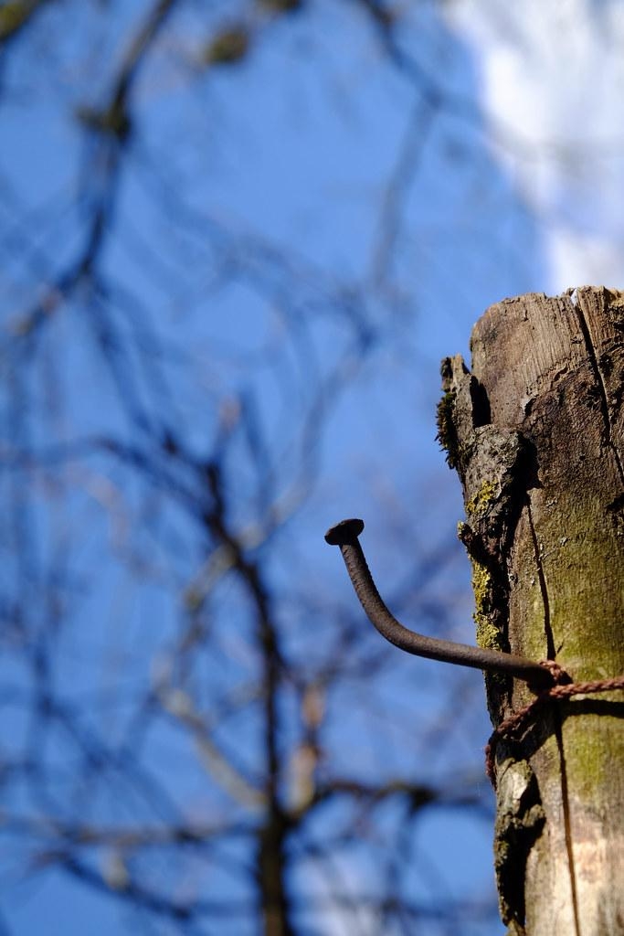
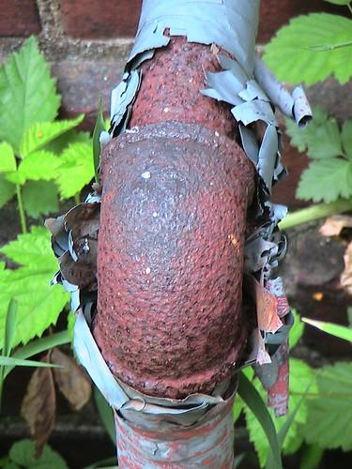
Notes:
“Here are just a few examples of corrosion that you may enounter.”
Picture credit:
"STATUE OF LIBERTY" by airlines470 is licensed under CC BY-SA 2.0
"American Rust on Route 66" by Davoud OHADI is licensed under CC BY-NC-ND 4.0
"Nail" by Jerzy Durczak is licensed under CC BY-NC 2.0
"knee" by be OH be is licensed under CC BY-NC 2.0
"Bolt Corrosion I" by scottwills is licensed under CC BY-NC-ND 2.0

Slide 19
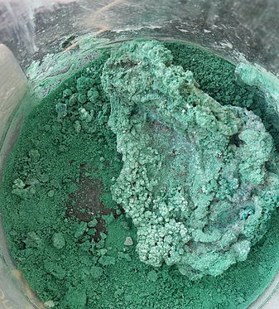
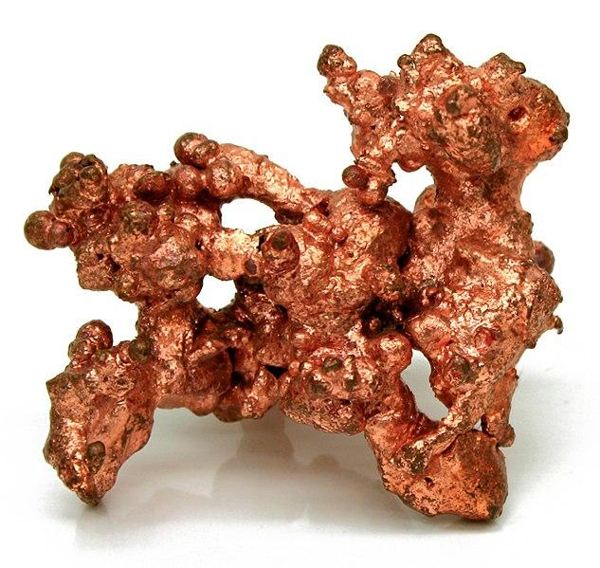
Are all Metals Equal?
Some metals do not corrode easily due to their low reactivity.
Gold, Platinum, Silver
When oxidized, other metals form a coating on the surface. This protects the metal from further corrosion.
Aluminum
Copper
Complete corrosion of metal
iron
Notes:
“Before discussing ways to prevent corrosion, let’s talk about how different metals respond to oxidation. Do all metals corrode? Do they all corrode the same?”
Noble or precious metals are metals that have a low reactivity and therefore do not oxidize or corrode easily. The examples listed in this slide are gold, platinum and silver, but there are more that chemists agree upon.
When you see a roll of aluminum foil, you may notice that one side is shiny and the other one is dull. This is because the aluminum metal reacts with oxygen and forms a layer aluminum oxide on its surface.
The Statue of Liberty has not always been green. When copper corrodes, patina (the green compound), prevents the copper from further corrosion.
Rust (iron oxide) is flaky and does not stay close to the surface. This allows the iron to continue corroding until the object is destroyed.
Picture link:
https://commons.wikimedia.org/wiki/File:NatCopper.jpg
https://commons.wikimedia.org/wiki/File:Copper_Carbonate.jpg

Slide 20
How can corrosion be prevented?
TURN
AND
TALK
Notes:
“Based on your reading and what we’ve talked about before, how can we prevent or slow down the rate of corrosion? You may refer back to the notes you’ve taken up to this point.”
Have students share some of their ideas with the class (at random) before moving to the next slide.

Slide 21
Preventing Corrosion
The rate of reaction is how fast a chemical reaction takes place.
In other words, how fast a product is formed or a reactant is used up.
One of the factors that determines the speed of a reaction is the surface area.
In this case, surface area is the amount of reactant that is exposed to other reactants in a chemical reaction.
The greater the surface area of a solid reactant, the faster its rate of reaction.
reactants
products
Notes:
“When we talk about preventing corrosion, we are talking about the rate at which the metals are corroding due to their exposure to the environment. There are different factors that can affect the rate at which a reaction occurs. For the purpose of this lesson and activity, we are going to focus on surface area.”
Example of surface area: “Is it faster to dissolve a sugar cube or the same amount of sugar in granulated form?”
Dissolving granulated sugar is faster than dissolving a sugar cube.
These definitions should be added to the student notes. Students have the option of adding additional notes/examples at the bottom.

Slide 22
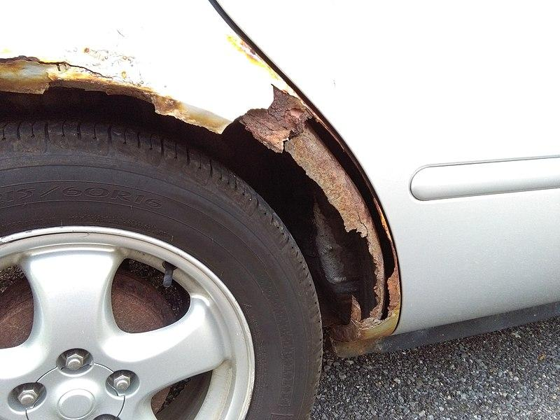
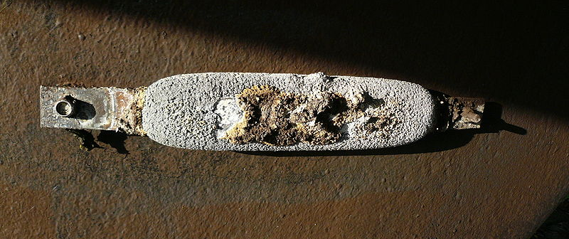
Preventing Corrosion
Create a physical barrier
Paint, enamel, oil
Issues?
Coat with another metal
“Tin cans”
Galvanizing
Cathodic protection
Prevent hulls of steel ships from rusting
Notes:
Students should list one or two examples of corrosion prevention on their notes, although they do not need to know the exact details on how each of these works or is accomplished.
“As we’ve learned today, corrosion has an adverse impact on society and the environment. A lot of time, effort, and money is spent trying to prevent or limit corrosion. We are going to discuss a few techniques that are currently being used to increase the shelf life of metal objects.”
To create a physical barrier, you can coat a metal surface with paint, enamel, or oil. This barrier doesn’t allow the metal to come in contact with moisture and oxygen.
“What are some issues that you can see with this?”
(paint chipping, coating wearing away, etc.)
Metal surfaces can be coated with another metal with the goal of protecting one of the metals. Tin cans are actually made with iron, but coated with tin. The tin is less reactive than iron and forms a protective barrier for the iron.
Galvanizing: Steel (an iron alloy) is prone to corrosion. During the process of galvanizing, steel is coated with zinc, which is more active than steel. The zinc is “sacrificed” and becomes corroded. This inhibits the steel to corrode.
Cathodic protection is similar to what we discussed with galvanizing. A metal object, which we want to protect, is connected to another metal object. In the case of the steel ship, a zinc block is attached to the underside of the hull. Because the zinc is more reactive, it corrodes, keeping the hull in tact. “Do we see any issues with this?”
(the zinc blocks need to be replaced periodically in order to protect the steel ship from corrosion)- see bottom picture
Picture links:
https://commons.wikimedia.org/wiki/File:Sacrificial_anode.jpg
https://commons.wikimedia.org/w/index.php?sort=relevance&search=rust&title=Special%3ASearch&profile=advanced&fulltext=1&advancedSearch-current=%7B%7D&ns0=1&ns6=1&ns12=1&ns14=1&ns100=1&ns106=1#/media/File:Ford_Taurus_Rust.jpg

Slide 23
K
W
L
What do you STILL
want to know about Corrosion?
S
Notes:
“Now that we’re at the end of the lesson, I want you to write down one or two things that you still want to know about corrosion. This should be done individually on your notes.”

Slide 24
Parking Lot
2-3 students per group
1-2 sticky notes
Each sticky note should only have ONE comment or question from the “S” category of your KWLS chart
When you’re done, bring your sticky notes to the board.
Notes:
“Throughout the unit and our next activity, we are going to refer back to this lesson. Take a few minutes to share what you wrote in your S bubble with a partner or in small groups (no more than three). Each group will be given 1-2 sticky notes. Here, you will choose the comments that you wish to discuss further. Only list one idea per sticky note.

Slide 25
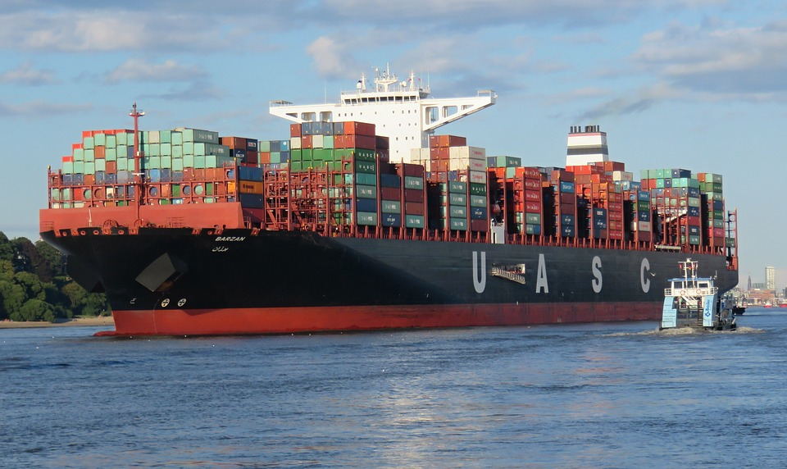
Corrosion Classroom Challenge!
How can you design a ship that holds cargo and holds up against the elements?
Notes:
Give students a sneak peek into the “Keep Your Boat Afloat” activity. Without giving too many details, give students a brief idea of what they’ll be asked to do during this activity.
“Industries that rely on cargo ships to transfer goods don’t want to spend extra money (or time) repairing or replacing their ships. In the next activity, you will be asked to engineer a cargo ship that is resistant to corrosion.”
Picture link: https://cdn.pixabay.com/photo/2017/09/25/21/25/container-2786842_960_720.jpg

