Slide 1
3D Printed Strain Sensors

Slide 2
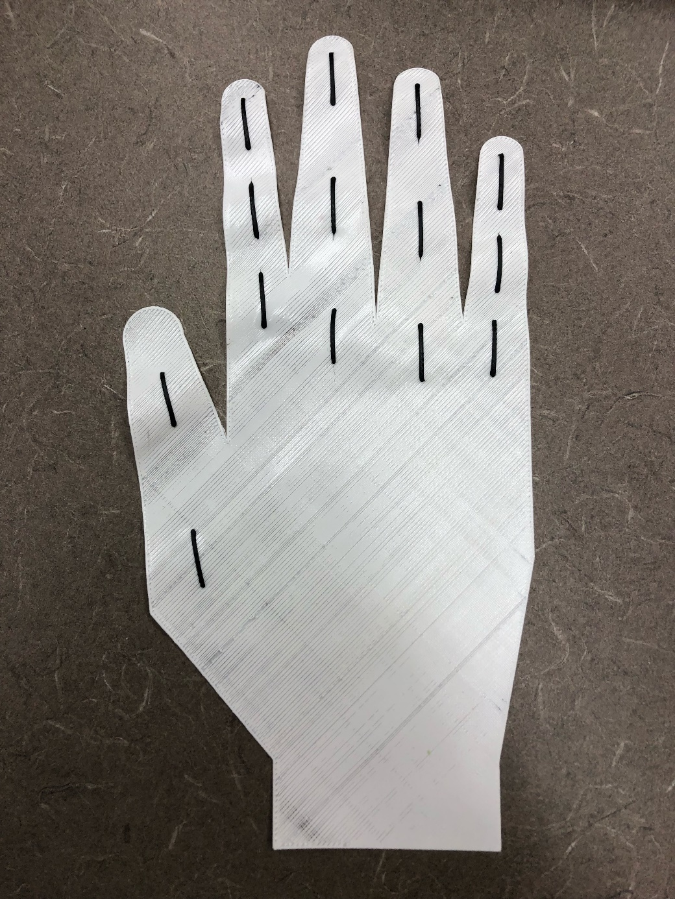
3D Printed Strain Sensors
What are they, how do they work, and how can they be useful to us

Slide 3
What are 3d Strain printed sensors?
3D printed strain sensors are sensors that are printed by a 3D printer.
The material they are printed from must be able to conduct electricity.
They can come in all shapes and sizes because they are custom made.
The quality of a sensor can vary widely because more expensive printers print with higher resolution and quality.
Resolution is the level of detail in a print. It corresponds to how thin the layers are and how refined the print is within a set area.

Slide 4
Strain Sensors conduct electricity
Strain sensors only work as sensors if they can conduct electricity.
Sensors will be plugged into a main computer of some kind that will measure the electrical resistance flowing through the sensor.
As environmental changes occur then the electrical resistance through the sensor changes. The main computer reads these changes and translates them into data about the environmental change that has been made.

Slide 5
Electrical Resistance
Electrical resistance is the measurement of how well electrons flow through a substance.
There are three variables that effect the electrical resistance: length, cross sectional area, and material used.
An increase in the length of the sensor would increase the resistance, an increase in the width of the sensor would decrease the resistance, and certain substances will increase the resistance while other substances will decrease the resistance.
Electrical resistance can be compared to water in a pipe. If a pipe is lengthened then the flow of water is slowed, if a pipe is widened then the flow of water is quickened, and if the material of a pipe is changed then the water may quicken or slow down depending on the material.

Slide 6
What are the Advantages of 3D Printed Sensors
They are much cheaper than other sensors.
They can be custom fitted very easily because of how fast 3D printing is in relation to other manufacturing methods.
It is easy to create a file in Computer Aided Design software and scale it for printing.
Users can also use a 3D Scanner to create exact specifications or exact model to 3D print to.
The material that is used to print (filament) can be custom made. There are machines that are commercially sold that can be used to create filament from scratch or from other filaments.

Slide 7
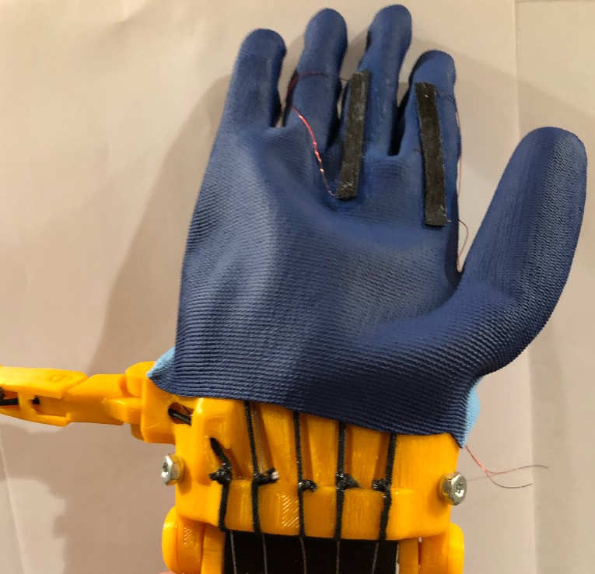
How Can 3D Printed Strain Sensors Be Used
They can be easily integrated into wearable technology.
They can be used to create electrodes that can be put on the body or integrated into bio circuits.
They can be printed directly onto other materials such as cloth, rubber, wood, or any material that will allow adhesion.

