Slide 1
Cooler Design Challenge
Middle School Engineering Adventures!

Slide 2
Keeping things cool is a huge industry!
Insulation is needed in everything from the walls of your house, to the coffee mugs everyone carries around.
Yeti alone sells over half a billion dollars worth of coolers a year. That’s not counting other big names like Igloo or Coleman!
Notes:
Teacher can find images on the web to show students what insulation in a house looks like before the sheetrock goes on the walls.

Slide 3
That’s a pretty big deal!
To keep up with competition, these companies employ engineers and scientists in order to help create and test new insulating technologies.
Let’s see how other projects have applied the engineering design process to create a cooler made out of hemp and flax!

Slide 4
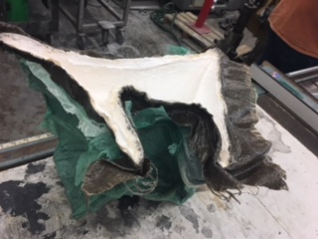
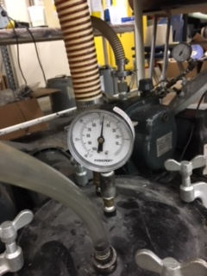
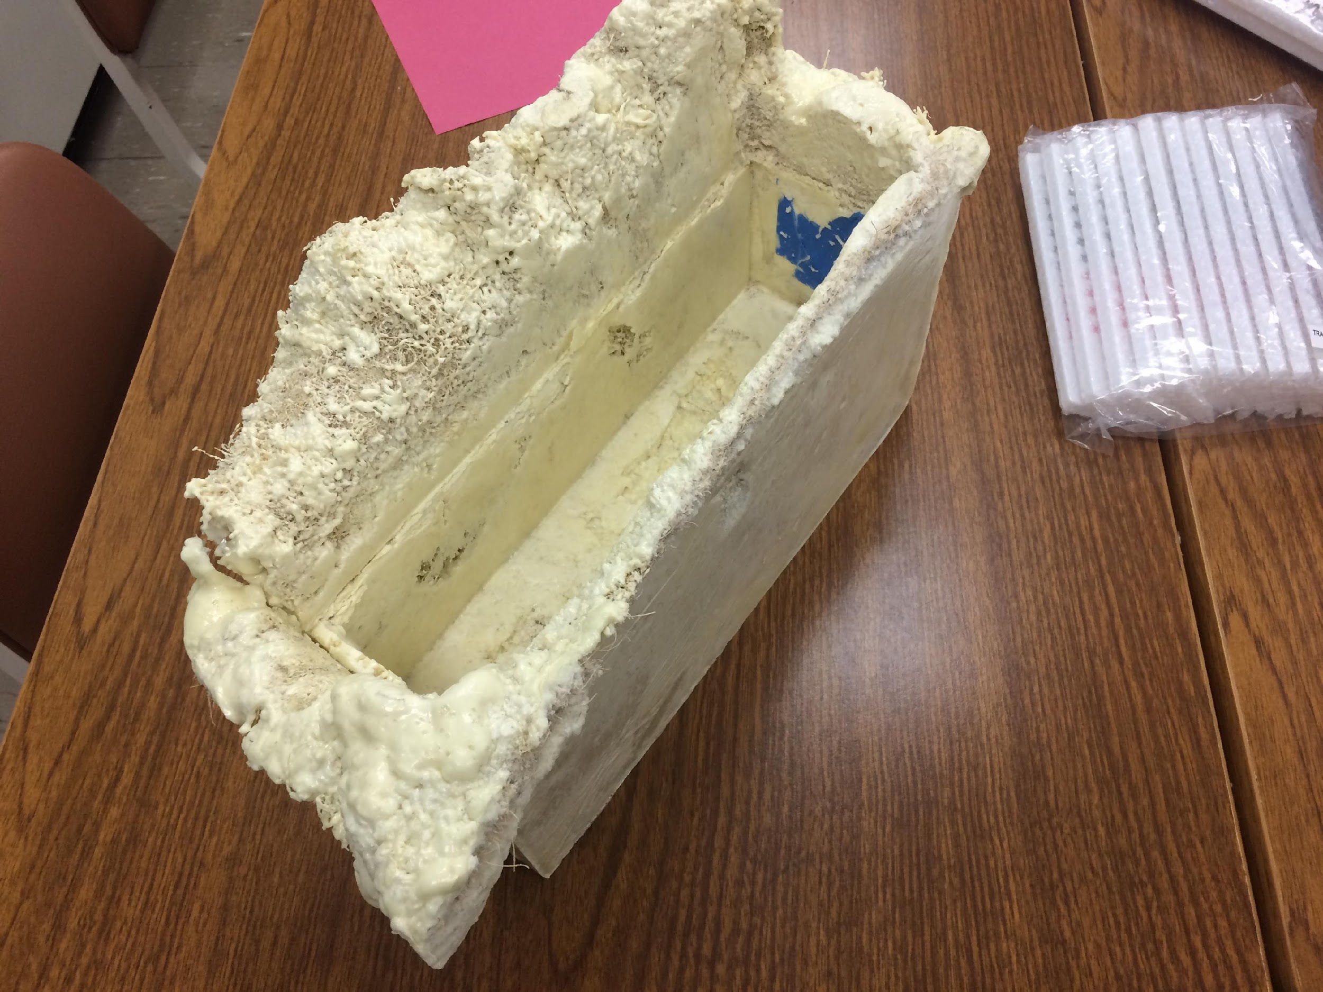
Initial failures
First attempt the class used a Styrofoam cooler as a mold but due to the pressure needed to create a compression for curing, the cooler collapsed.
In the second attempt, they used wooden blocks to form a cooler along with a foam mixture. We were able to get a solid shape but it was hard to remove the wooden forms without breaking the mold.

Slide 5
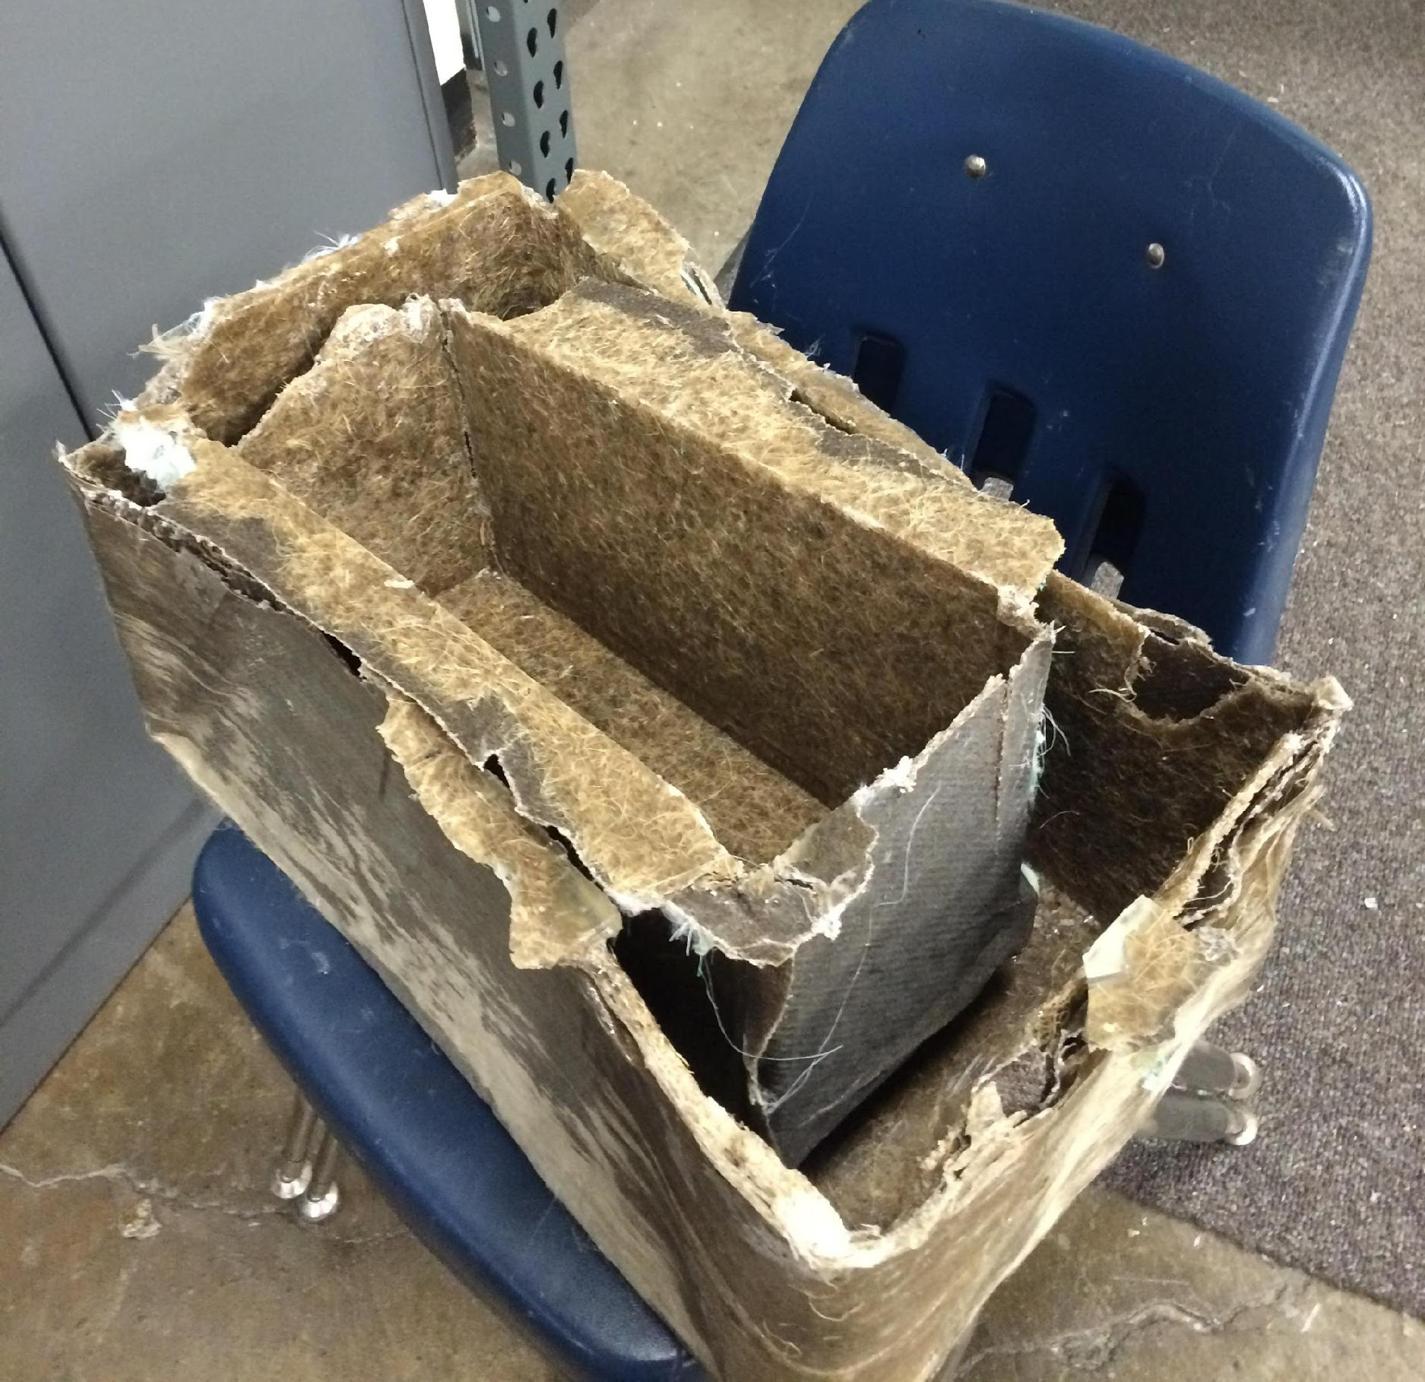
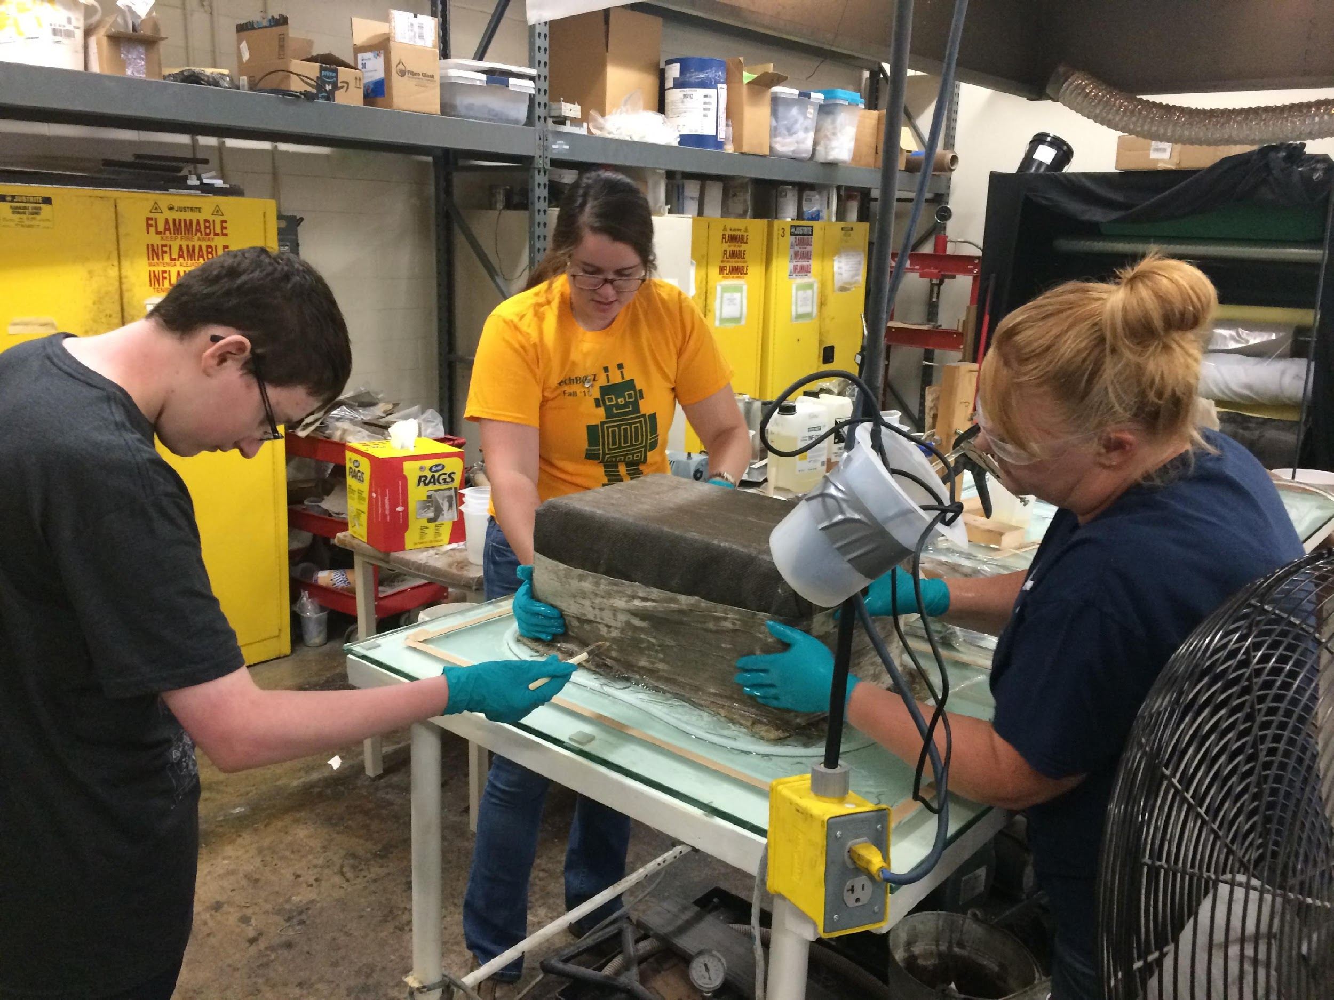
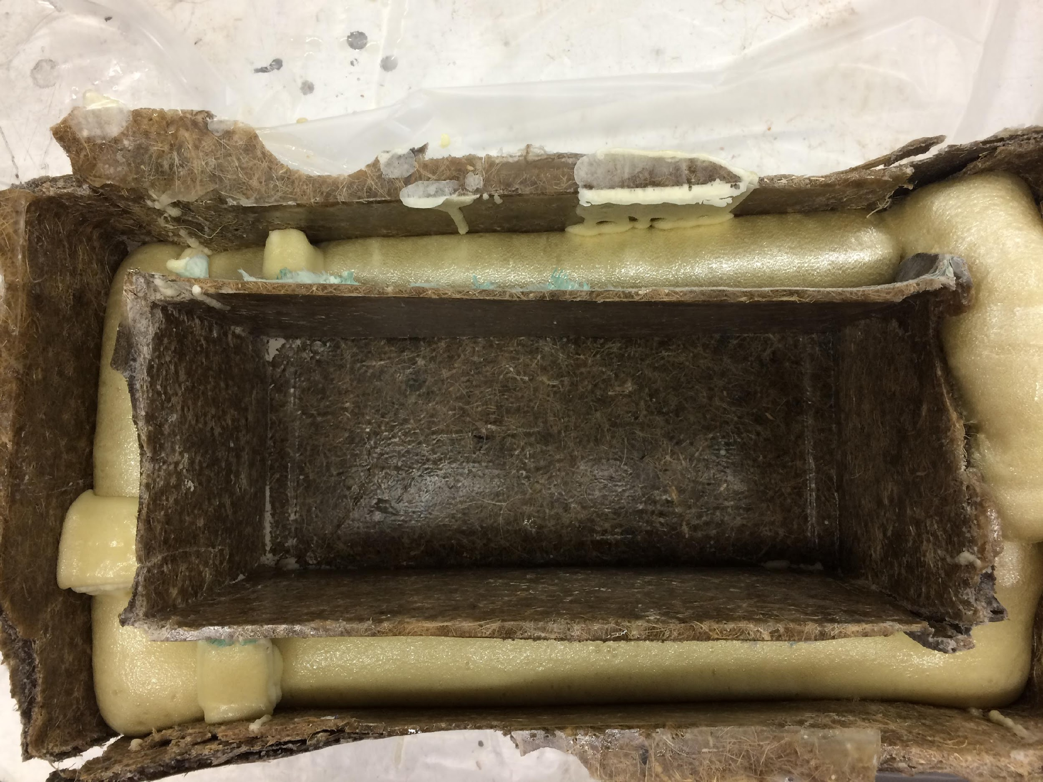
Final cooler

Slide 7
Cooler Challenge!
Today you are going to apply the engineering design process to create a cooler to keep your Popsicle and ice cube nice and cold while we learn more about wind energy—because no one wants warm popsicles!
But before we can start any of that we need to learn more about heat and insulation….

Slide 8
What makes good insulation?
First, we have to know the difference between insulators and conductors.
Second, we have to know how heat actually moves.

Slide 9
Conductors vs. Insulators
Conductors
Insulators
Material which allows energy to pass through easily
Weak covalent bonds
Freely moving electrons
Material which does not easily allow energy to pass through
Strong covalent bonds
Electrons do not move freely

Slide 10
How does heat move?
Radiation - a method of heat transfer that does not rely upon any contact between the heat source and the heated object, opposed to conduction and convection.
Convection - transfer of heat from one place to another by the movement of heated fluids, such as air or water, that carry thermal energy away from the source.
Conduction - the movement of heat from one solid to another one, which have different temperatures when they are touching each other.

Slide 11
Bill Nye discusses heat
https://www.youtube.com/watch?v=WMYb5684Kp0

Slide 12
Cooler Challenge!
Now that you have some background on the conductors and insulators, your challenge is to design a cooler using the supplies provided to keep your popsicle and ice cube cold.
Grab your supplies and start on your design!

