Slide 1
PING-PONG!
Designing Biocomposite Ping-Pong Paddles

Slide 2
Objectives
Research paddle designs
1
Brainstorm paddle design
2
Build ping-pong paddles
3

Slide 3
Notes:
Link to video: https://www.youtube.com/watch?v=EgI_hyPTrtA
Teachers can show this video for an introduction to the lesson.

Slide 4
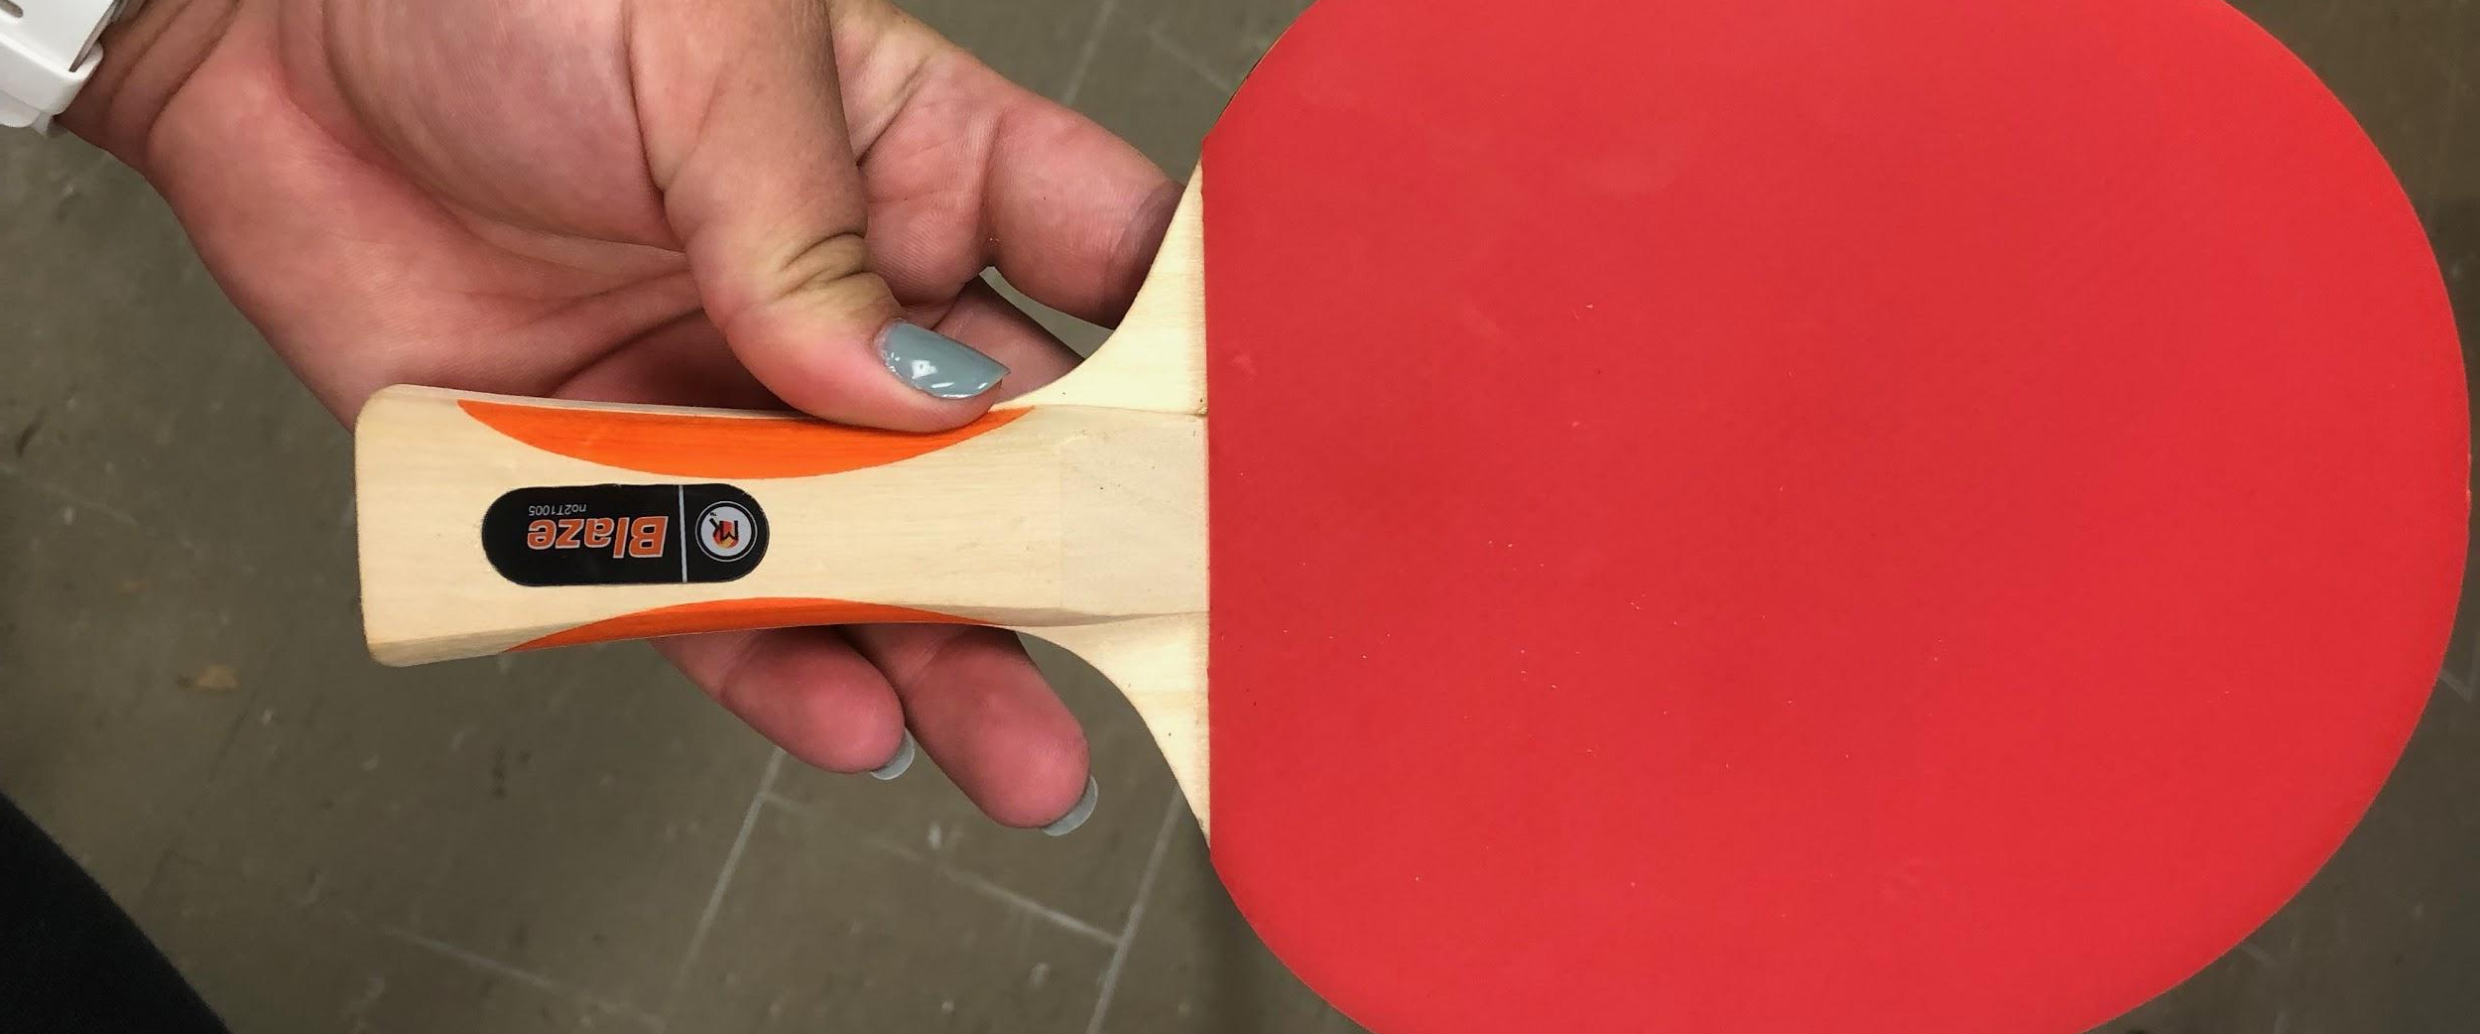
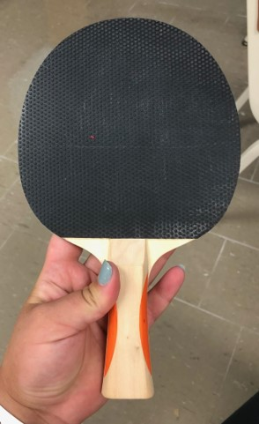
Make Observations
Notes:
These photos show a store bought paddle. These paddles were deconstructed to learn how paddles are currently designed.

Slide 5
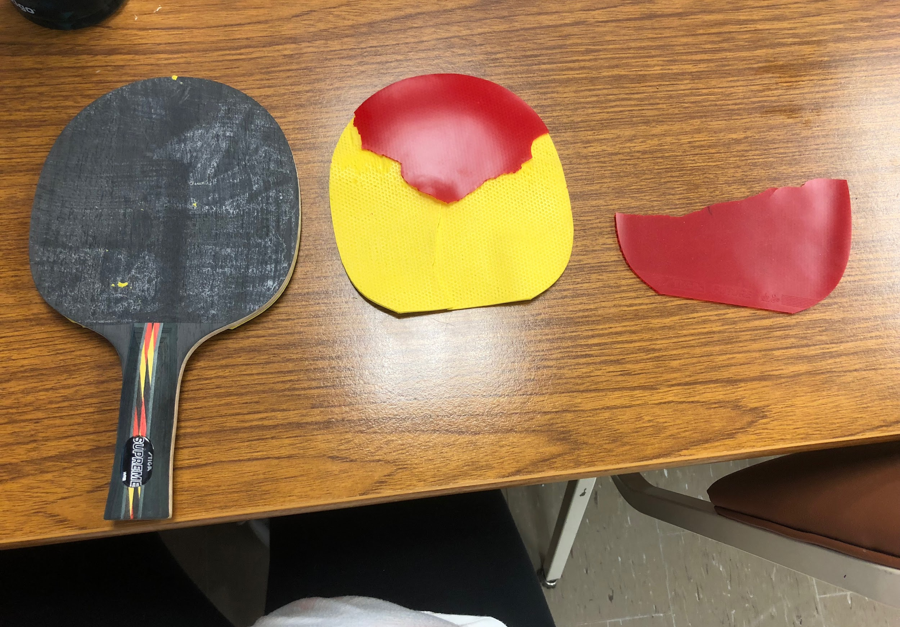
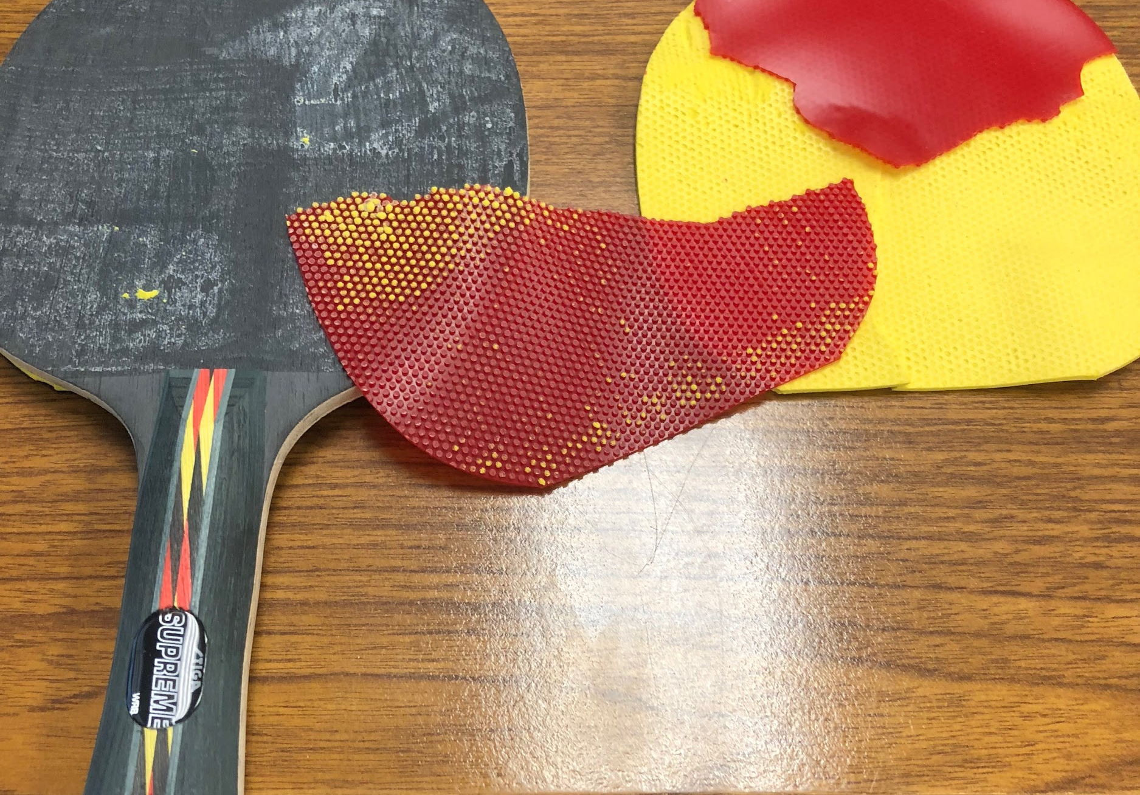
Deconstructing a Store-Bought Model
Notes:
These photos show a deconstructed paddle. The materials used in the paddle offer different benefits, such as spin control and ball speed when hit. To engage students and promote inquiry, this deconstruction activity would be great for students.

Slide 6
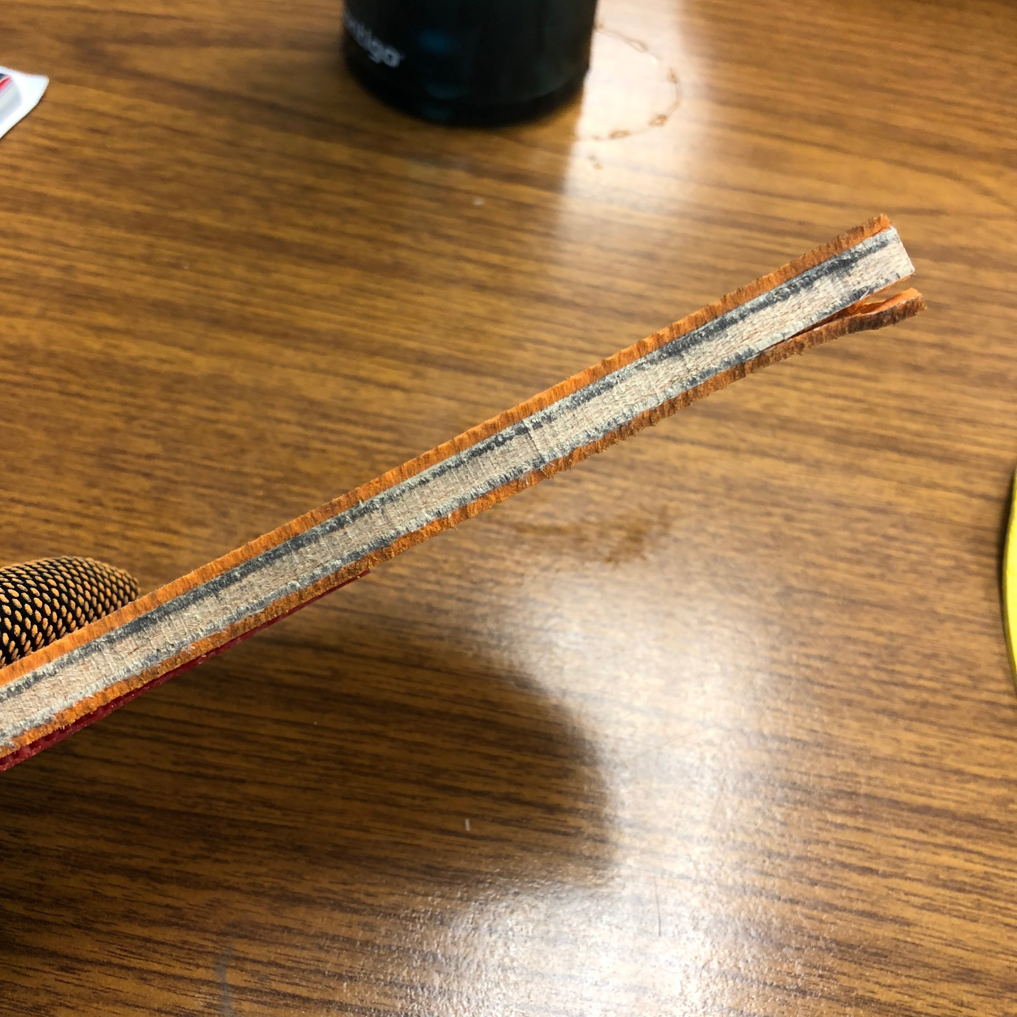
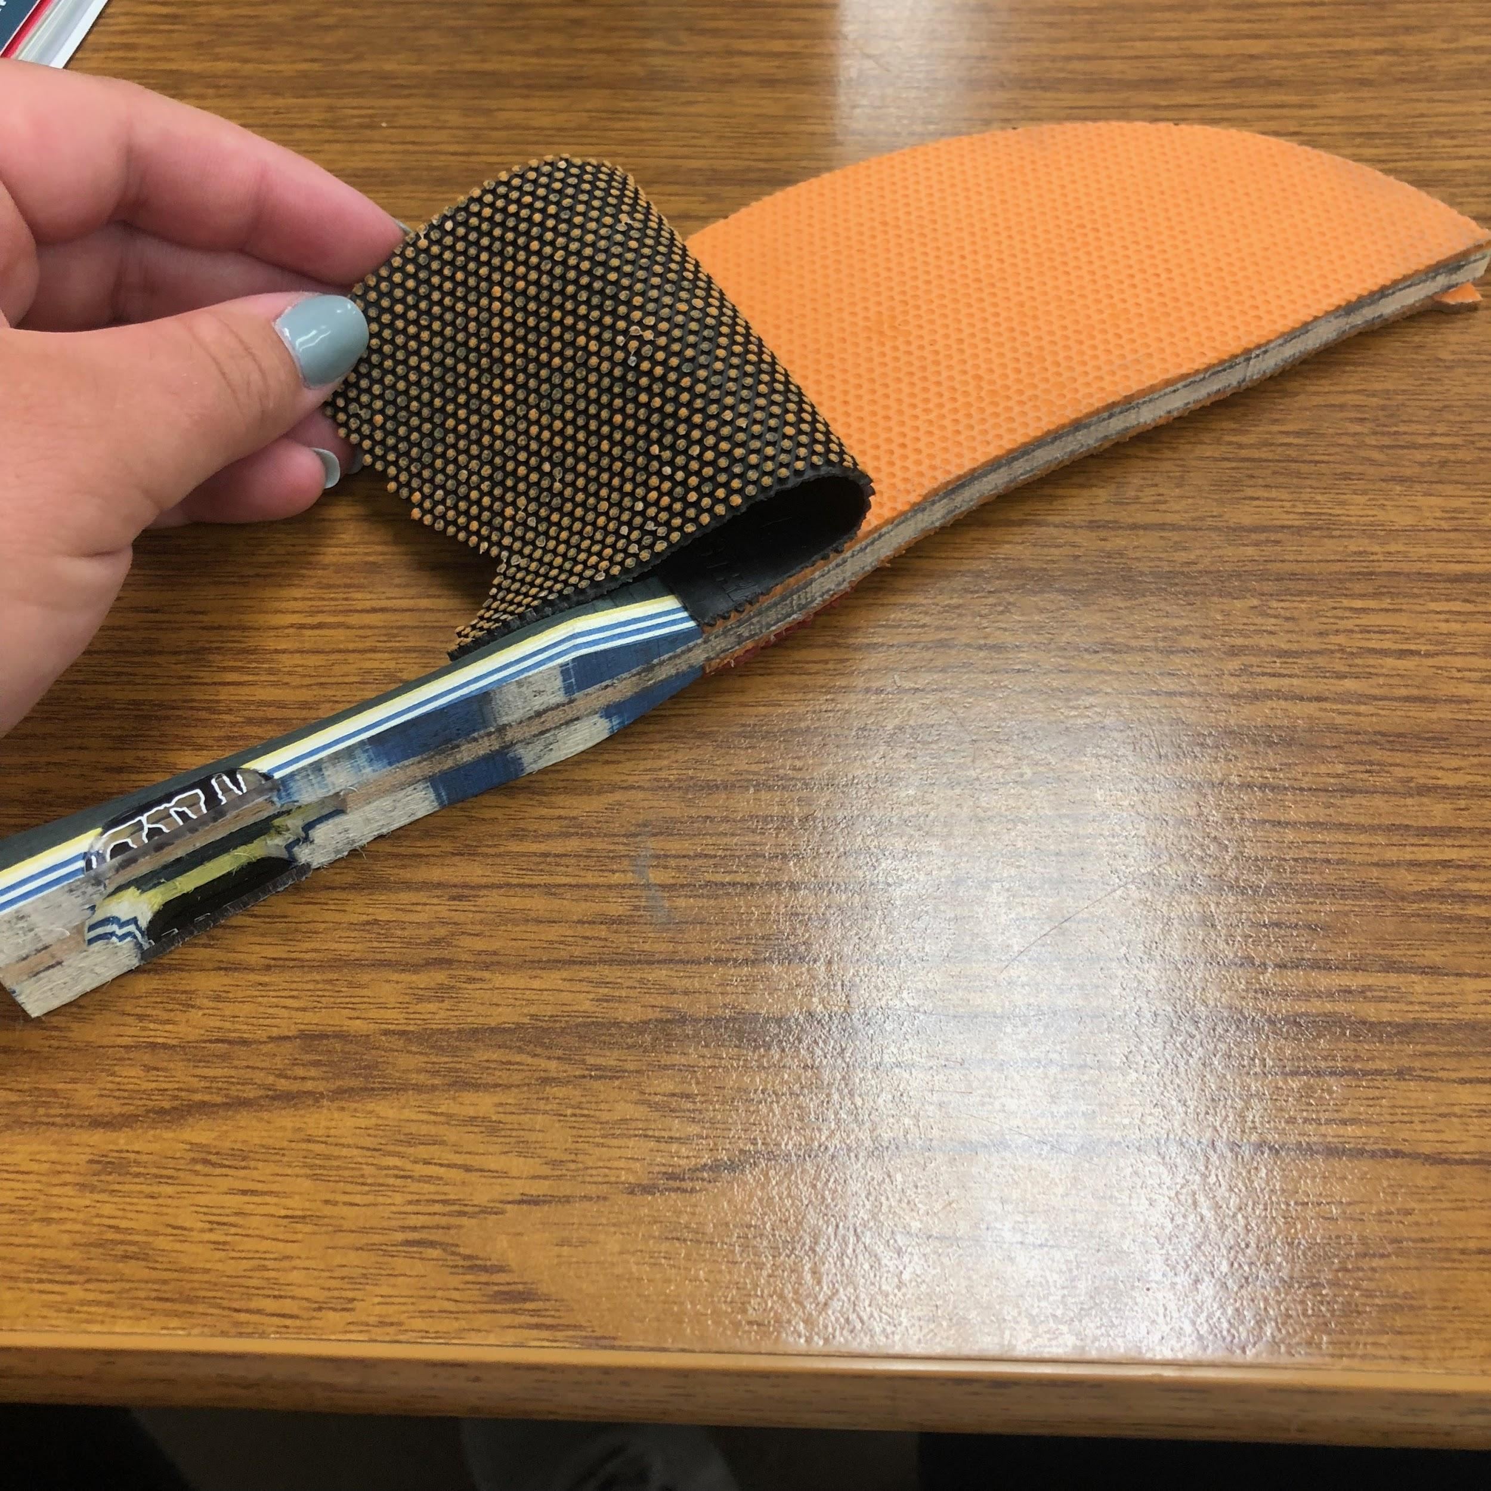
Notes:
These photos show another deconstructed paddle; this shows the many layers that make up the core of the paddle.

Slide 7
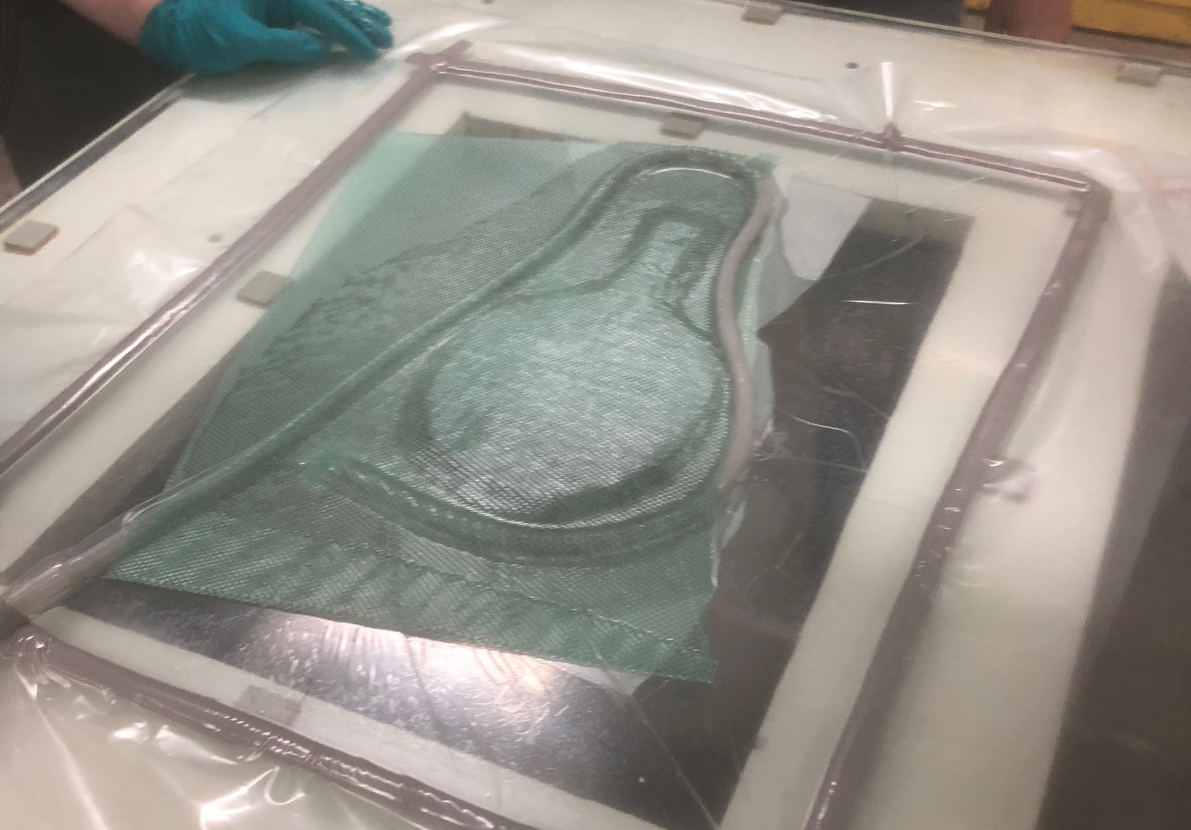
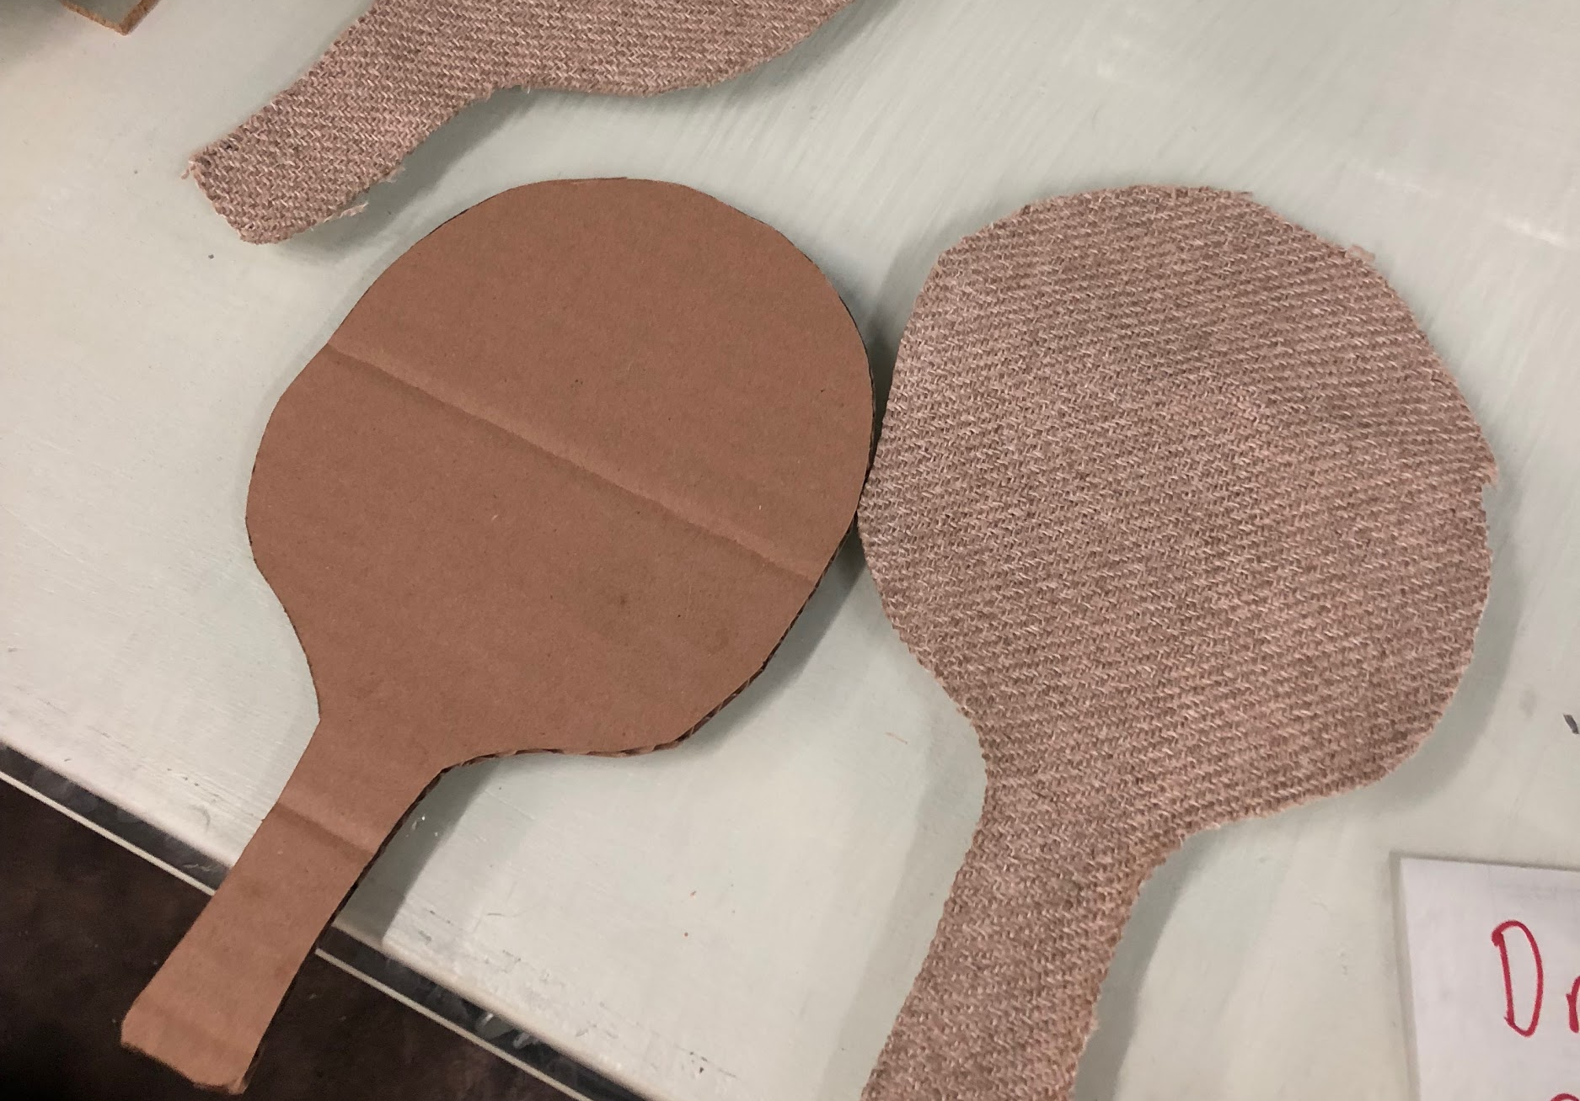
First Trials Examples
Notes:
When designing new paddles we used cardboard and flax fibers to create a core. The flax fibers were saturated in an epoxy resin and cured under a vacuum for 24 hours.

Slide 8
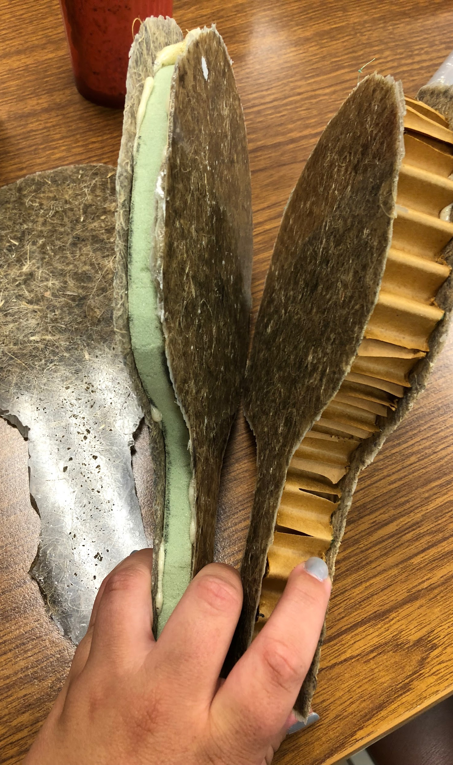
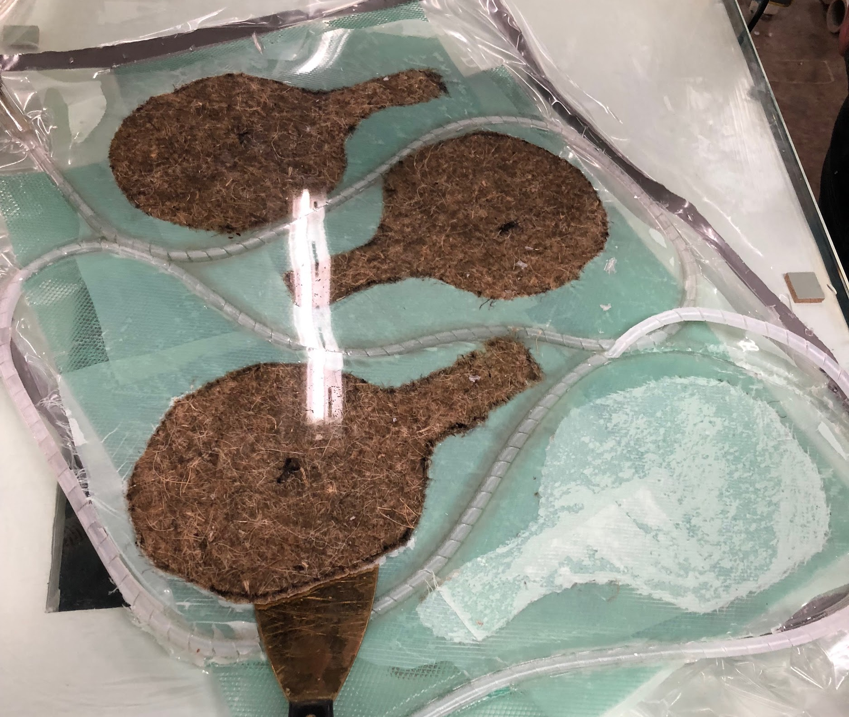
Other Trial Examples
Notes:
Picture 1 shows paddle blades made from hemp fiber and an epoxy resin after curing for 24 hours.
Pictures 2 shows 3 assembled paddles with hemp blades and cores made from foam (left) and cardboard (right).

Slide 9
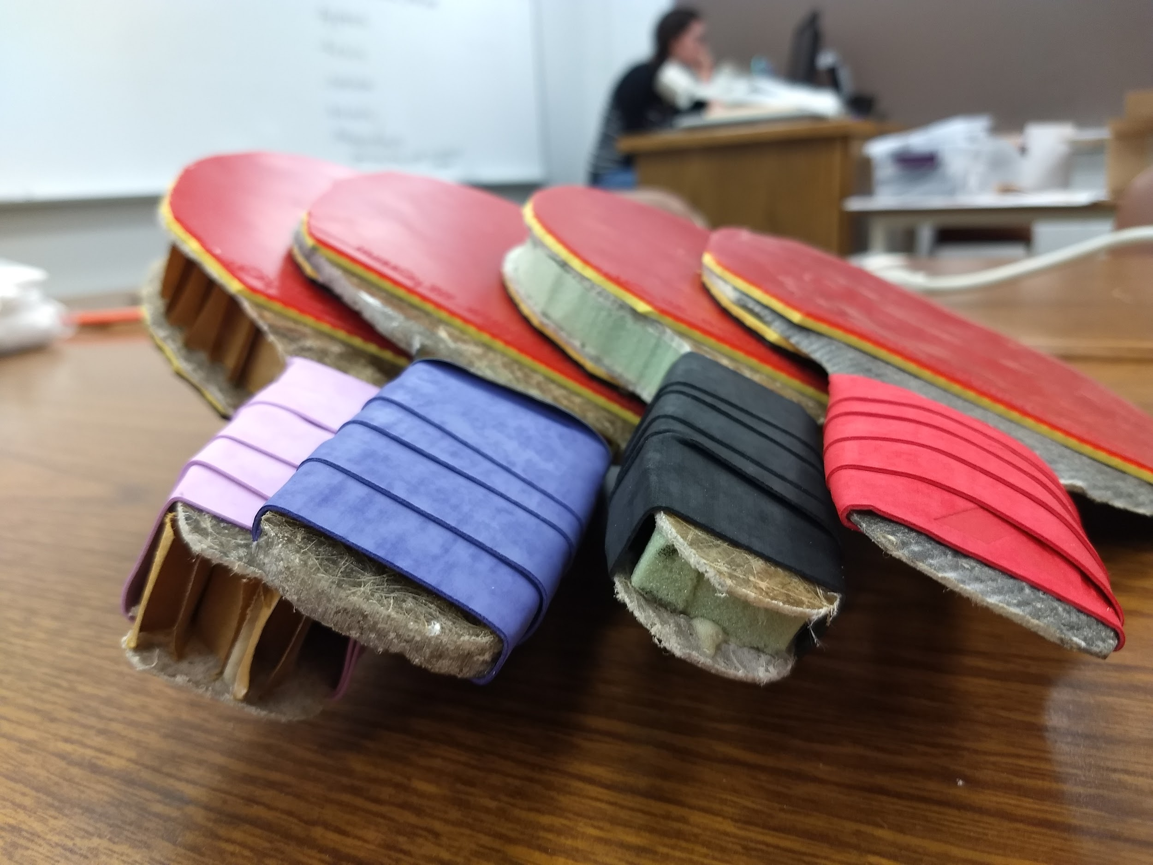
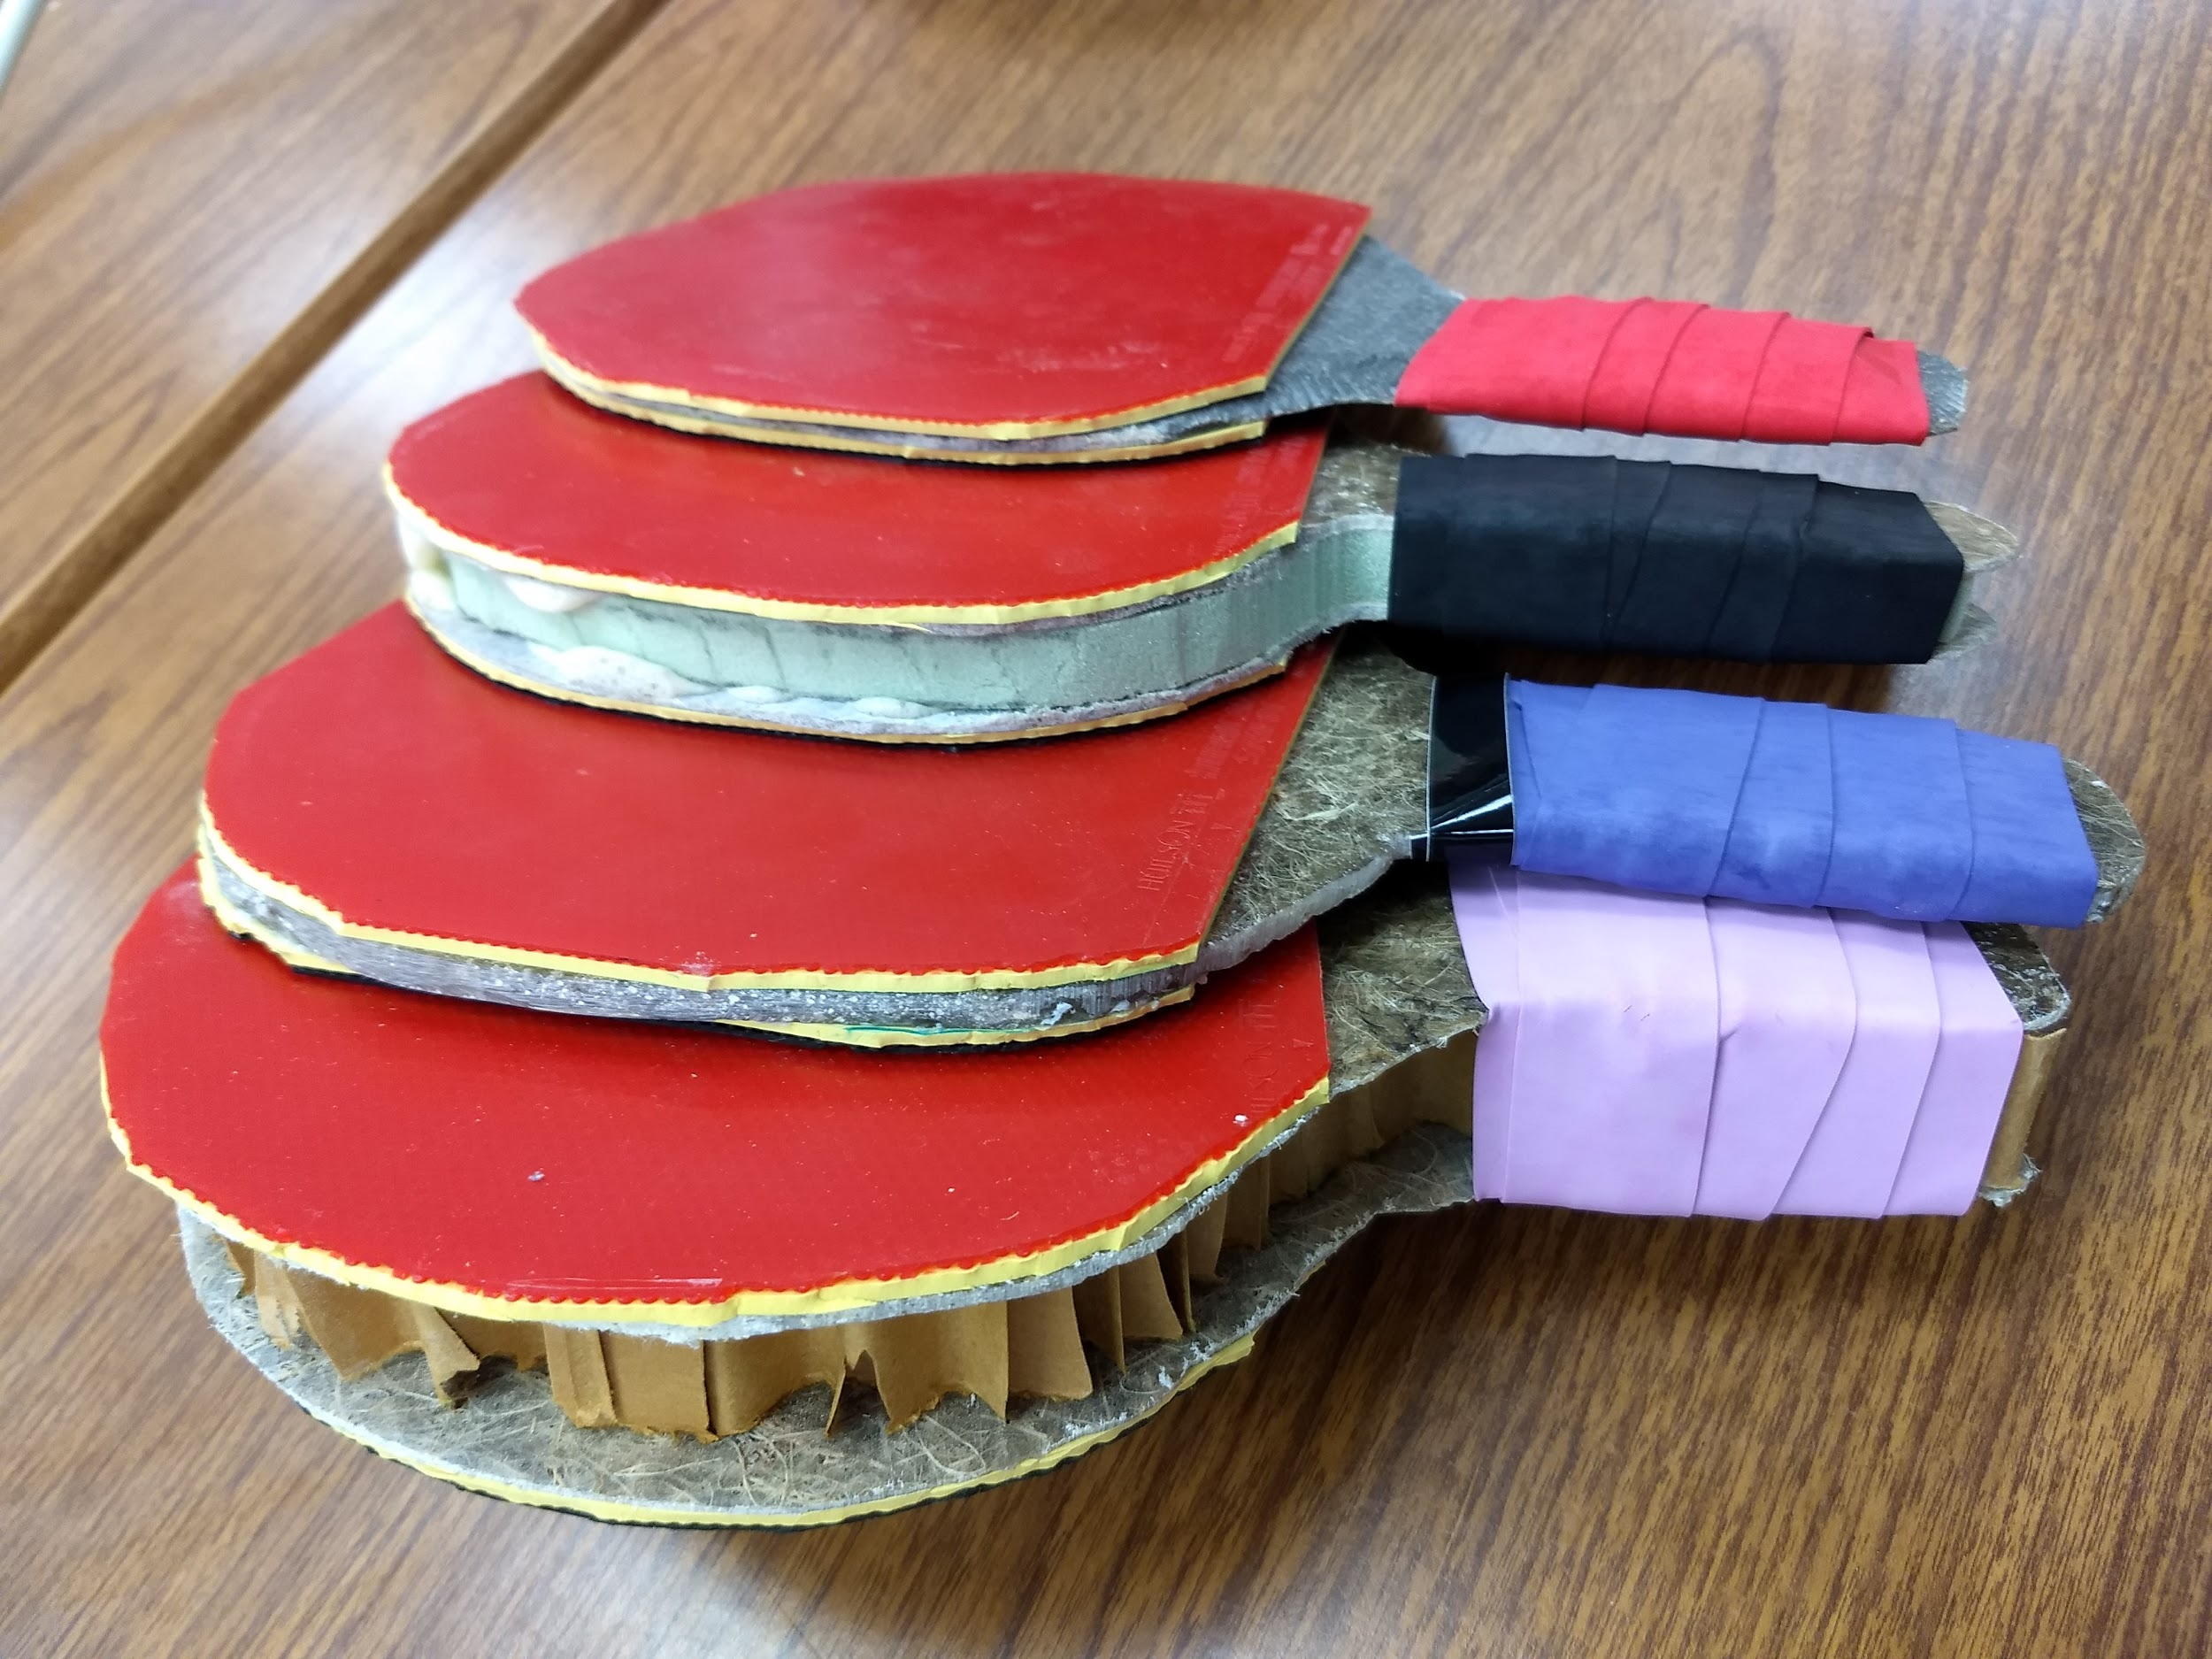
Finished Products
Notes:
Completed paddles have a lightweight core material, biocomposite blades, foam/rubber covering on the blades, and a cushioned handle grip.

Slide 10
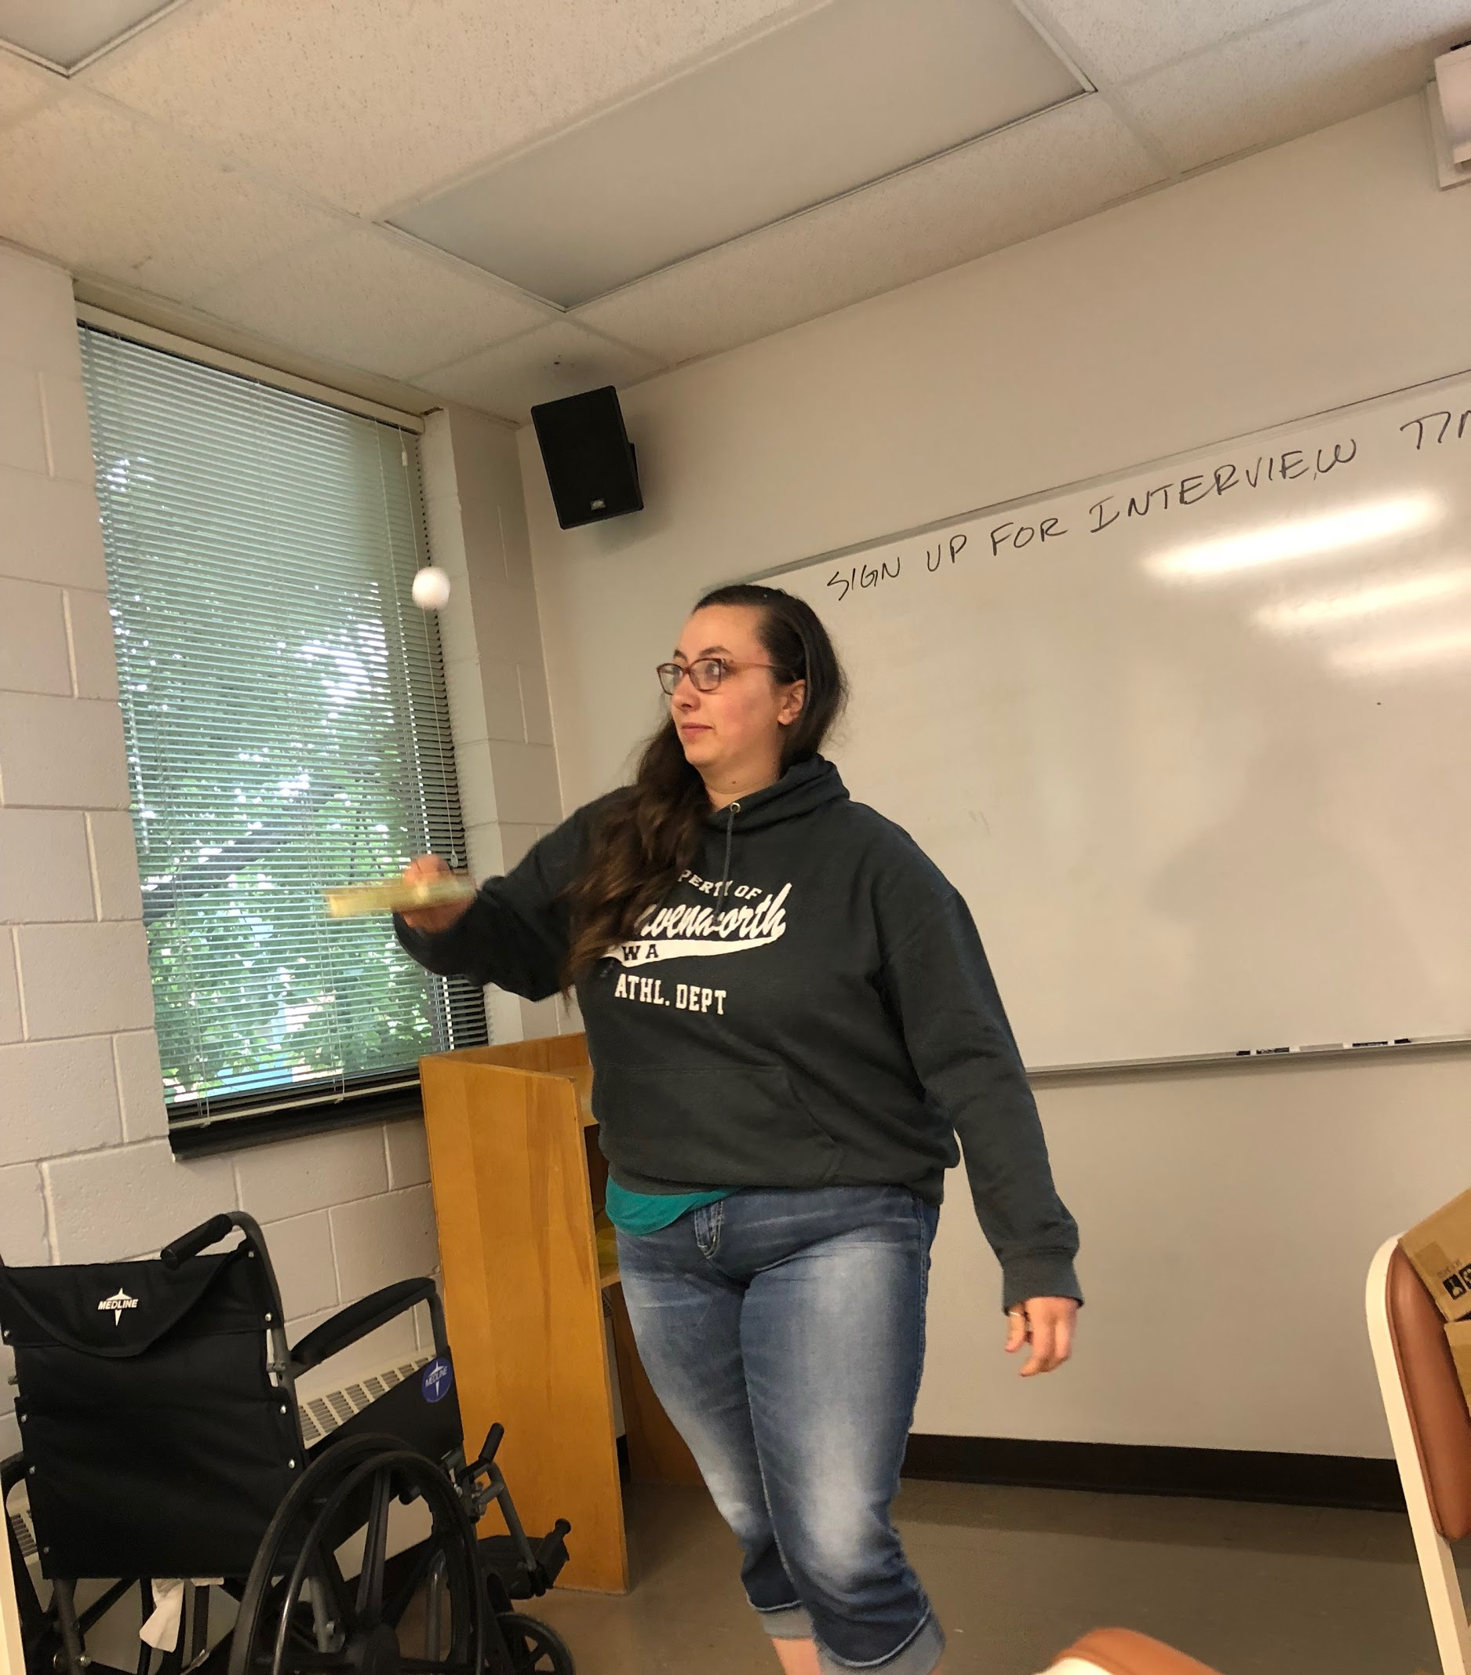
Testing
Notes:
This photo shows a paddle being tested. This is the juggle for control test. The tester juggled the ping pong ball for 30 seconds and counted how many times she could hit the ball.

Slide 11
Your Job
Design, build, and test your own ping-pong paddles. With your group, choose one item from each column that you feel will make the best paddle.
Materials for core
balsa wood
cardboard
Materials for coating
shellac
polyurethane
glue
flour-water paste
Materials for covering
foam & rubber
shelf liner
foam
neoprene rubber
You will be test your design for ball control, paddle wear, and player comfort. Keep these factors in mind when choosing your materials.
Notes:
Give the students time to become familiar the materials provided, and brainstorm possible designs. For instance, have them touch, feel, and document how the neoprene rubber could be used in their paddle design. Have them use the Design Challenge Handout to record. Students can then gather their materials and begin assembling their paddles.

Slide 12
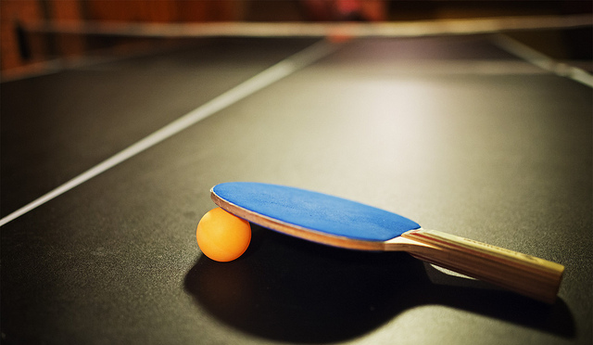
Evaluation
Finish assembling your design
Test your design vs. a store bought example
Compare and contrast your design
Redesign (or iterate) if needed!
Notes:
Allow students time to finish assembling their paddle. Distribute the Paddle Testing Handout. Allow students time to test their designs and analyze their results. If desired, teachers can offer time to redesign paddles.

