Slide 1
Flood: Causes and Mitigation Strategies for Civil Engineers

Slide 2
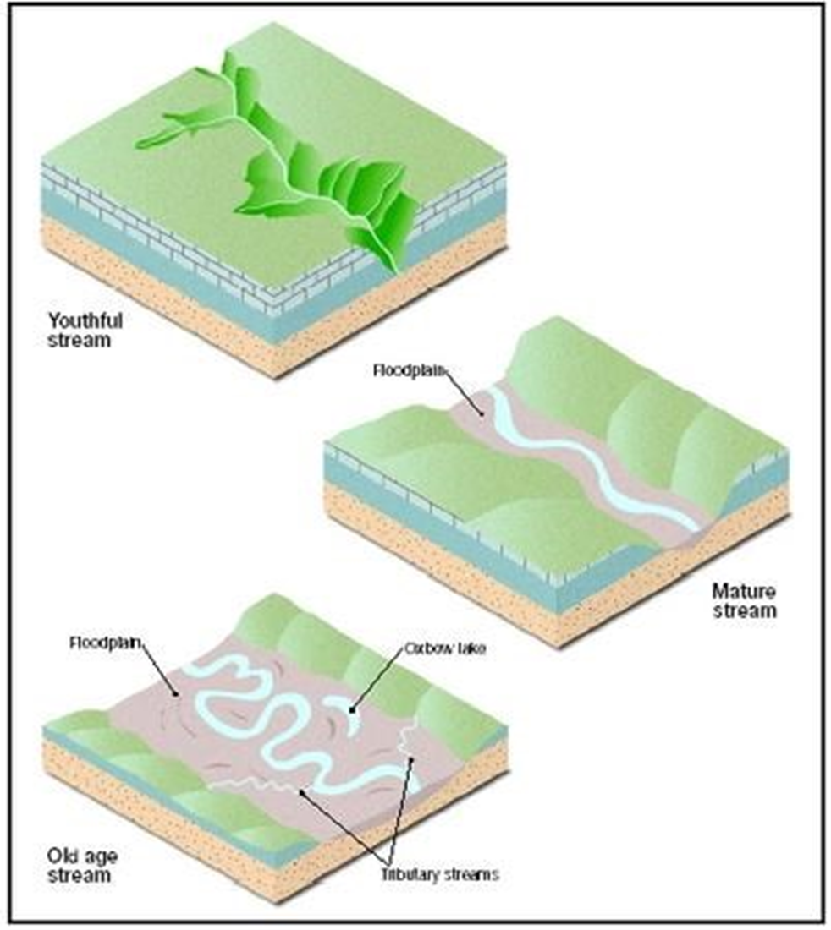
Age of Rivers
I can discuss how a river changes over time.

Slide 3
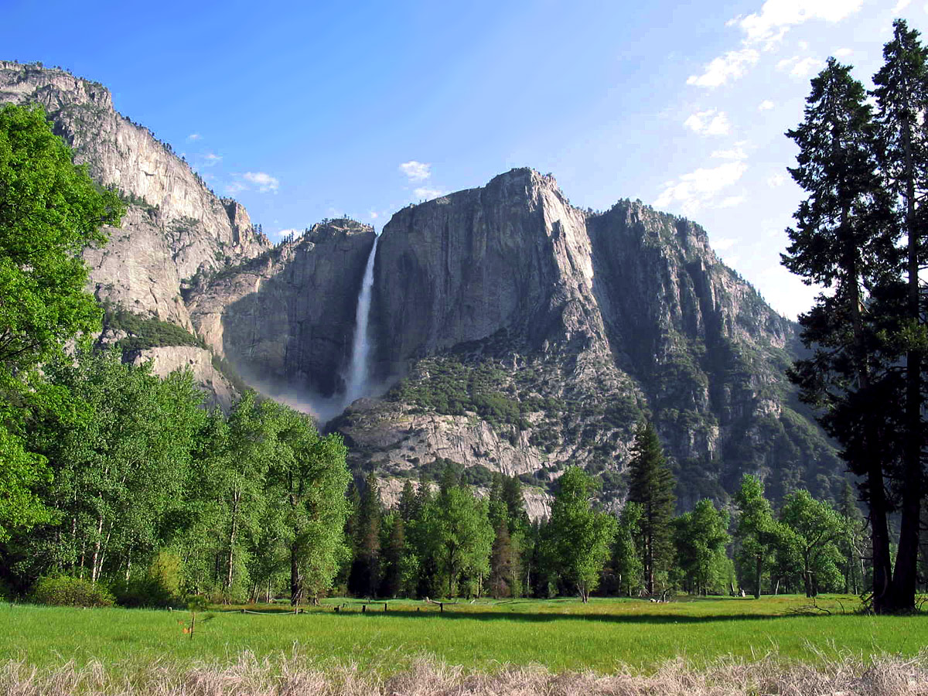
Young Stream
Steep gradient
Very few tributaries
Flows quickly – white water rapids, waterfalls
Channels erode deeper rather than wider
Example: Rivers in mountainous regions

Slide 4
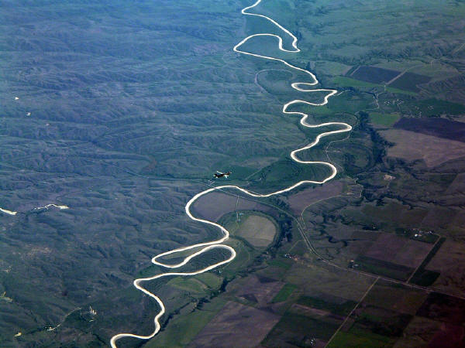
Mature Stream
Gradient is less steep
Flows more slowly
Fed by many tributaries
More discharge than a youthful stream
Channels erode wider rather than deeper
Well-developed floodplain
Example: Mississippi River

Slide 5
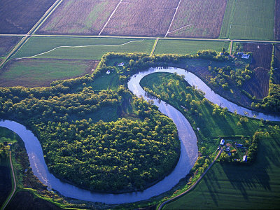
Old Age Stream
River with a low gradient (1-2 ft/mile)
Low erosive energy
Very wide valley
Floodplains with levees
Lots of deposition of sediment
Oxbows
Example: Red River

