Slide 1
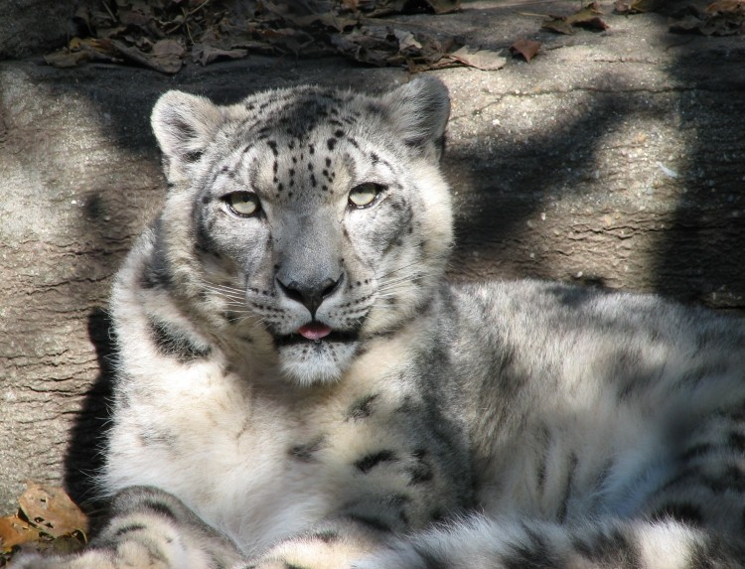
Adaptations Design with Robots
Notes:
Image source: http://commons.wikimedia.org/wiki/File:Snow_Leopard_at_Louisville_Zoo.jpg

Slide 2
WHAT ARE YOUR BASIC NEEDS?
FOOD
WATER
SHELTER
OXYGEN

Slide 3
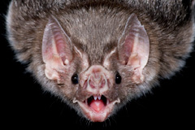
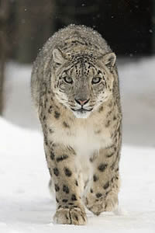
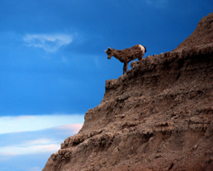
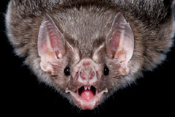
Animals have specialized body parts
( ADAPTATIONS! )
that help them get their basic needs
http://www.fws.gov/pacific/highlights_archive/Feature.cfm?id=13682
http://www.nps.gov/badl/naturescience/animals.htm
http://www.kpl.gov/events/animal-adaptations.aspx/

Slide 4
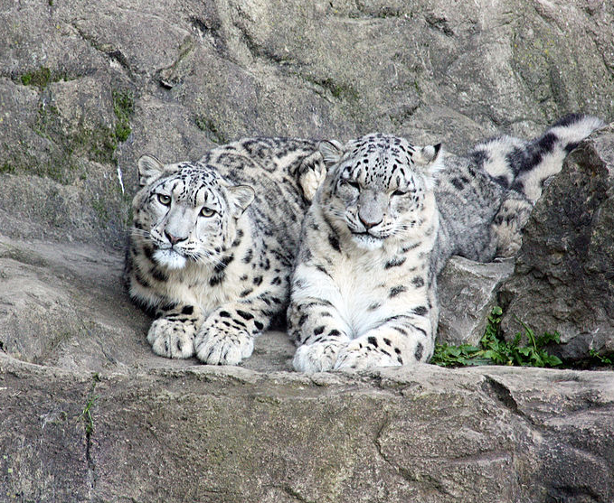
HEREDITY
Adaptations are passed down
from parents to offspring
Notes:
Image source: http://commons.wikimedia.org/wiki/File:Schneeleoparden_Kailash_und_Dshamilja_frontal.jpg

Slide 5
Adaptations come in many forms
Today we will learn about one way adaptations help:
LOCOMOTION

Slide 6
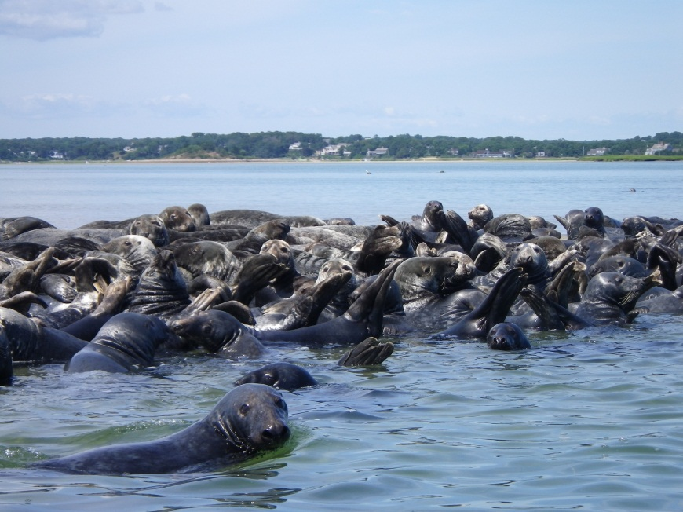
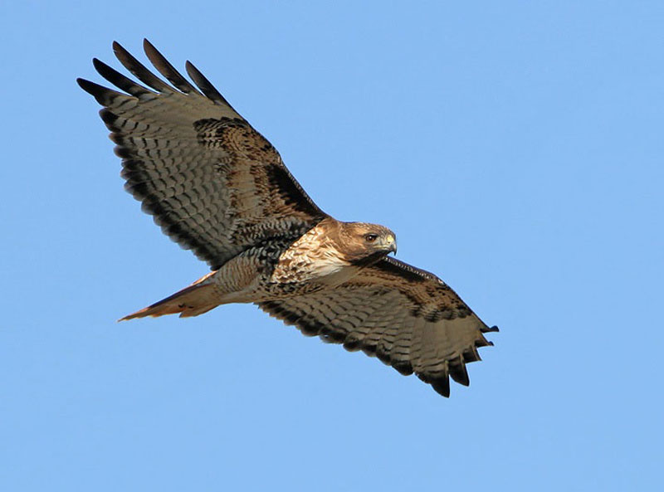
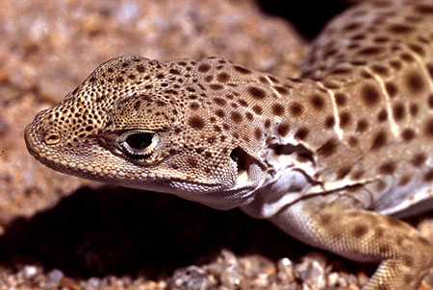
LOCOMOTION
Notes:
Image source:
Top center: http://www.nps.gov/caco/naturescience/animals.htm
Bottom left: http://fishandgame.idaho.gov/ifwis/ibt/site.aspx?id=68
Bottom right: http://www.werc.usgs.gov/OLDsitedata/fieldguide/gawi.htm

Slide 7
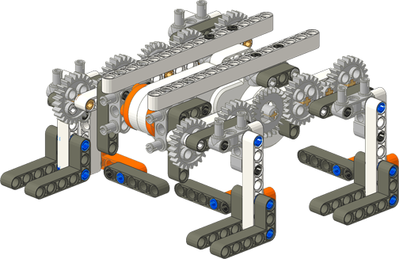
Four Legged Walker Bot
Source: www.nxtzoo.com

Slide 8
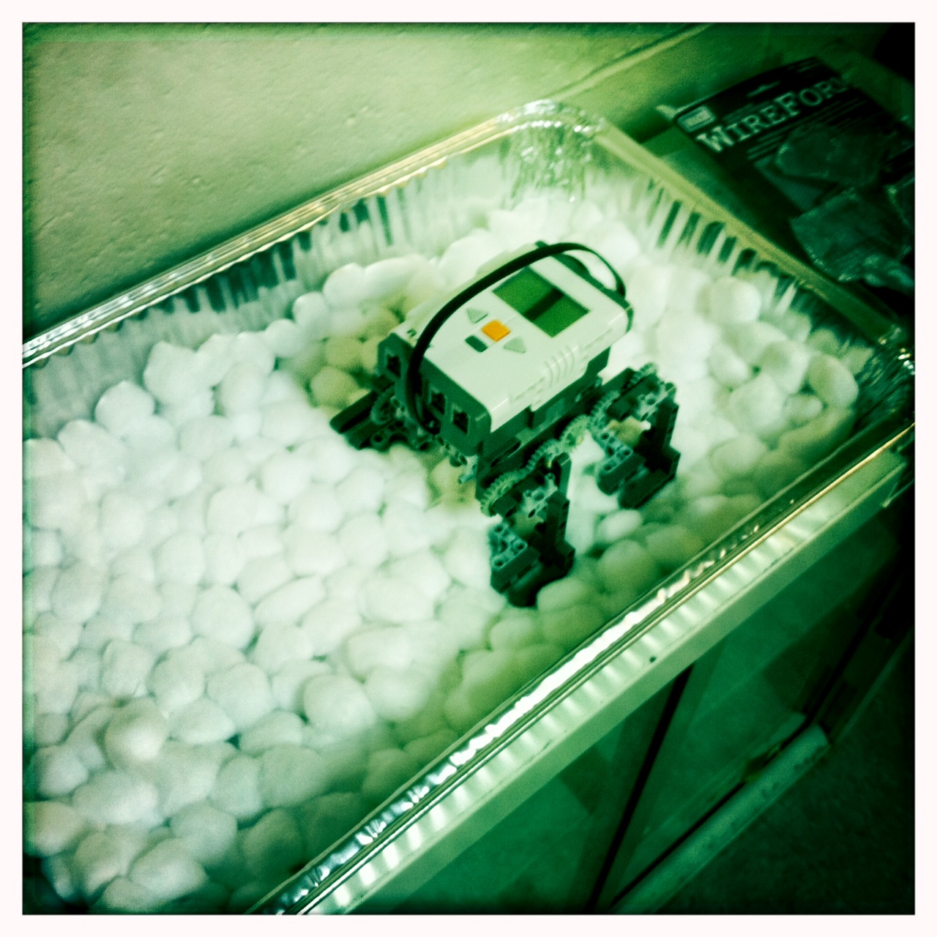
SnowBot

Slide 9
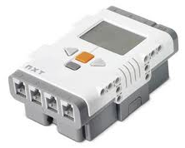
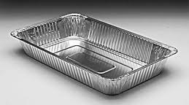
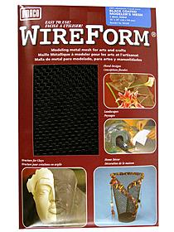
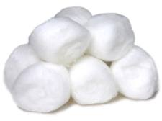
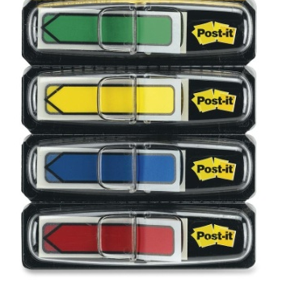
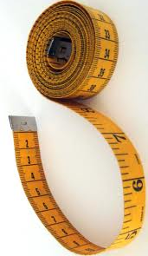
MATERIALS

Slide 10
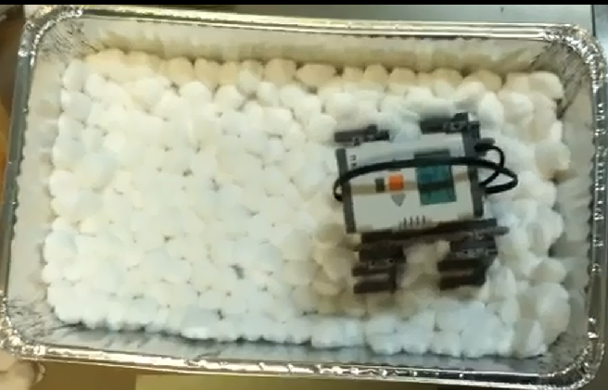
1
Notes:
Image source: Drew Cave, NYU Polytechnic, Used with permission

Slide 11
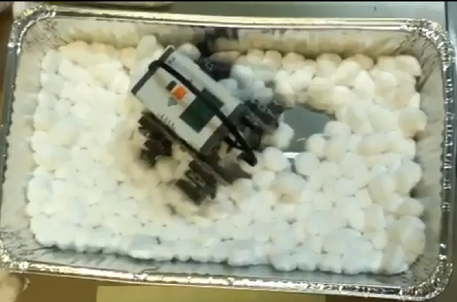
2
1
Notes:
Image source: Drew Cave, NYU Polytechnic, Used with permission

Slide 12
2
1
cm
Notes:
Image source: Drew Cave, NYU Polytechnic, Used with permission

Slide 13
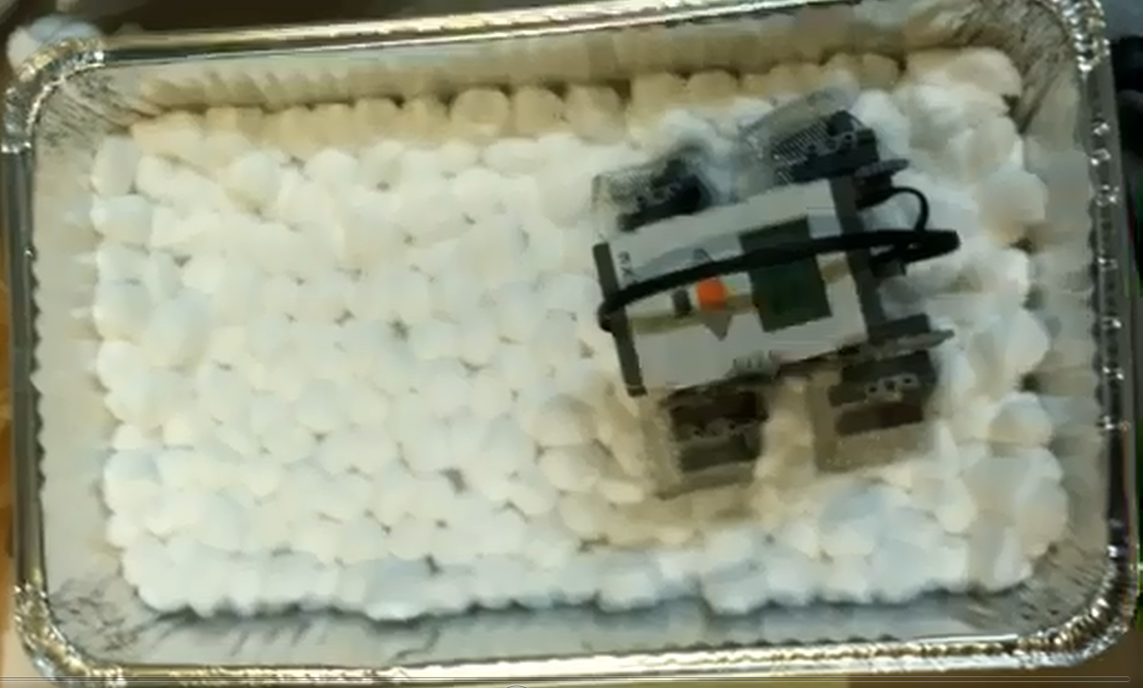
1
Notes:
Image source: Drew Cave, NYU Polytechnic, Used with permission

Slide 14
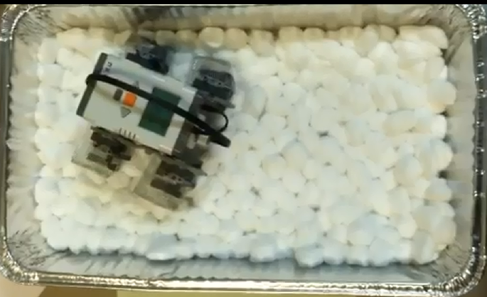
2
1
Notes:
Image source: Drew Cave, NYU Polytechnic, Used with permission

Slide 15
2
1
cm
Notes:
Image source: Drew Cave, NYU Polytechnic, Used with permission

Slide 16
What The Activity Demonstrates
Animals have specialized body parts that help them survive in the wild
Locomotion
Measuring in centimeters
Biomimicry
Pressure ( Weight / Area )
Engineering Desing Process

Slide 17
Questions?

