Slide 1
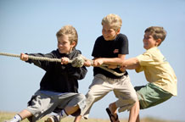
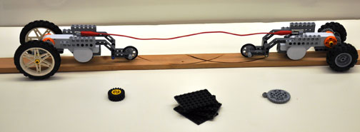
Tug of War Battle Bots
Notes:
A tug of war game designed to demonstrate engineering and physics concepts in grades 6-12

Slide 2
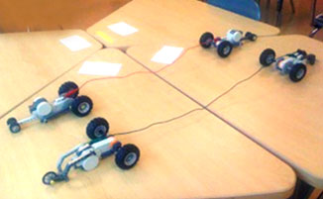
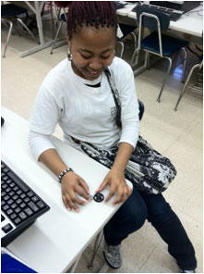
The Challenge
To design a vehicle with maximum puling power, in order to pull an opponent’s robot over the middle line.
To understand the concepts of friction, torque and gear ratio while playing games.

Slide 3
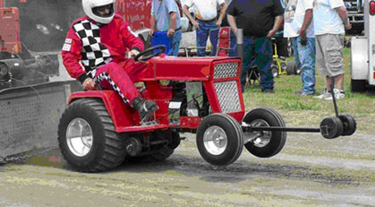
Battle Bots: The Tug of War Game
Each team is given an identical robot to modify
Modifications: amount of power provided to motor, robot weight, gear ratio, wheel size
Each team receives the same amount of points to spend on modifications; every modification costs some points
After design modifications, tug of war begins
Winner: The robot that wins the game and costs the least

Slide 4
Lego Mechanisms gears — motors — physics concepts
gear ratio
speed
force of friction
weight
normal force
applied force
torque
Notes:
What we’re going to learn about so we can play the Battle Bots tug of war game…

Slide 5
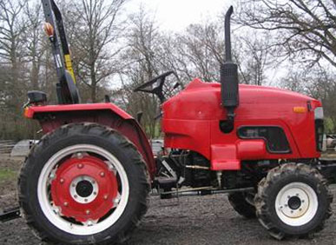
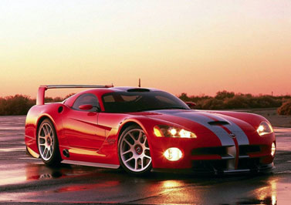
Concept of Gear Ratio
Siromer 204 Tractor
2004 Dodge Viper SRT-10
Sports cars go FAST (have speed), but cannot pull any weight
Big trucks and tractors can PULL heavy loads (have power), but cannot go fast
Notes:
You see gears in just about everything that has spinning parts. For example, car engines and transmissions contain lots of gears. If you looked inside a VCR, you would see that it is full of gears. Wind-up, grandfather and pendulum clocks contain plenty of gears, especially if they have bells or chimes. You probably have an electrical power meter on the side of your house, and if it has a see-through cover, you can see that it contains 10 or 15 gears. Gears are everywhere that you find engines and motors producing rotational motion.

Slide 6
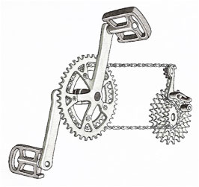
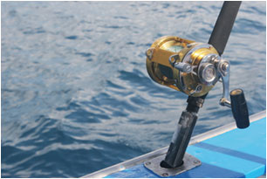
Concept of Gear Ratio
Gears are used for two basic purposes:
To increase or decrease rotation speed
To increase or decrease torque
Notes:
Introductory slide for rotational speed with gear ratios

Slide 7
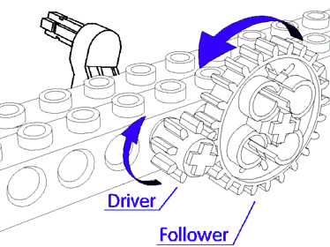
Concept of Gear Ratio
The smaller gear has 13 teeth; the larger gear has 21 teeth
Therefore, the gear ratio is 21/13 or 1.62/1 or 1.62.1
In other words, it takes 1.62 revolutions of the smaller wheel to make the larger wheel turn one revolution

Slide 8
Concept of Gear Ratio
⬅Gearing up
LARGE gear drives small gear
The small gear turns faster
speed torque
Gearing down ➔
Small gear drives LARGE gear
The large gear turns slower
speed torque
Notes:
To increase speed and reduce torque use a large drive gear coupled to a smaller driven gear.
To reduce speed and increase torque use a small Lego gear turning a larger gear.

Slide 9
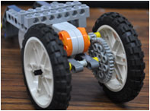
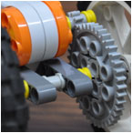
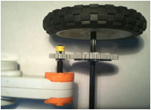
Concept of Torque
Torque is an applied force on a lever arm
point of rotation
Where is the torque on your robot?
The motor on your robot uses a set amount of torque to turn the wheels. The driver gear uses torque to turn the follower gear.
Notes:
The wrench acts like a lever. The longer the handle on the wrench, the less pushing you have to do to turn the nut. A wrench with a shorter handle is harder to turn.
So, in order to figure out how to make things turn easier you need to know:
1 - the distance from the end to the center of the thing you are trying to turn, and
2 –how much force you need to push on the handle in order to make it turn

Slide 10
Torque Discussed
Constant torque from the motor (driver gear), for example 25 N-m
Force exerted at the point of contact between gears is 25 N
Torque about center of follower gear is 125 N-m
5 m
1 m
driver
follower
Notes:
The wrench acts like a lever. The longer the handle on the wrench, the less pushing you have to do to turn the nut. A wrench with a shorter handle is harder to turn. So, in order to figure out how to make things turn easier you need to know:
1 - the distance from the end to the center of the thing you are trying to turn, and
2 –how much force you need to push on the handle in order to make it turn

Slide 11
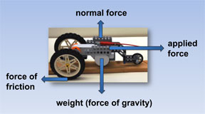
Concept of Force (and Motion)
Notes:
Force – an influence that causes an object to move

Slide 12
Concept of Weight and Normal Force
The weight of an object is not the same as its mass
The weight is defined as the force exerted by gravity
For an object to stay on the ground, the force of gravity must be offset by an equal force pushing back—we call this force the normal force—the Earth is pushing back against gravity

Slide 13
Concept of Force of Friction
Friction is the resistance encountered by two touching materials
No contact = no friction
Something with a lot of weight makes a lot of friction with the surface of the ground
Notes:
When you push on a surface with your hand, you notice that it becomes hard to slide your hand along
the surface. Why? The reason, of course, is friction. The harder you push, the harder it is to slide your
hand. It might get so difficult to slide it that it is altogether impossible to move!
The way the frictional force works is a little trickier than the others we've dealt with so far.
If the two objects are not pushing against each other, there is no friction at all. But, the
harder they're pushed together, the greater the friction.

Slide 14
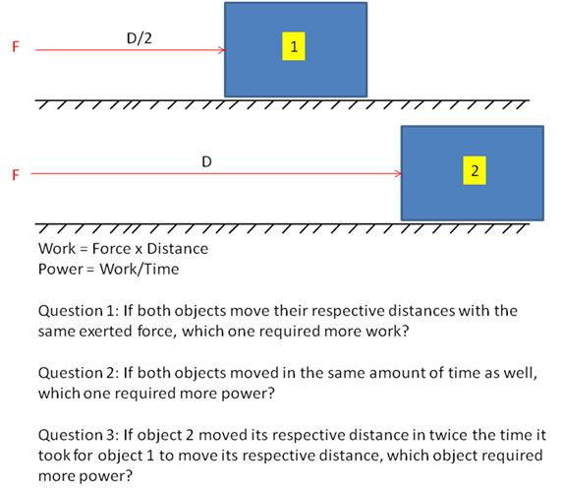
Concepts of Work and Power

Slide 15
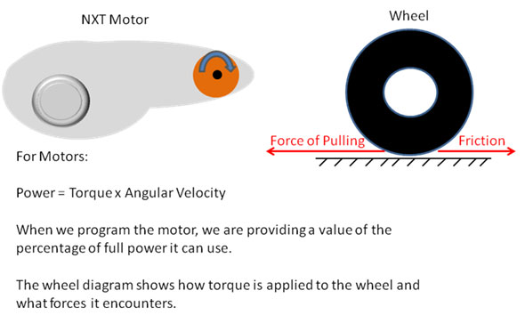
Concepts of Work and Power
EV3 Motor

Slide 16
The Game Rules
At the start:
Each team receives 50 points
All robot vehicles come with: large wheels, 1:1 gear ratio, no added weight, 75 power
Point allocation for robot modifications:
Points | Modification
10 | Gear ratio change
5 | Smaller wheels
2 | More motor power
1 | One sheet of weight
Notes:
Battle Bot Challenge: The Game Rules

