Slide 1
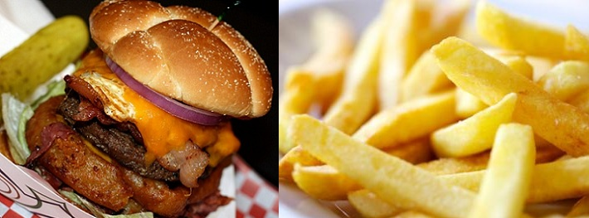
The Chemistry of Fats: All fat is not created equal!
Notes:
Image Sources:
Left: Indiana Insider Blog http://www.in.gov/visitindiana/blog/index.php/2012/09/18/national-cheeseburger-day-try-indianas-best-burgers/
Right: NIDA for Teens http://teens.drugabuse.gov/blog/post/addicted-french-fries-food-drug

Slide 2
All fat is not created equal!: Outline
Activity aims and scope
Introduction
Let’s talk molecules
The fats we eat
Robotics incorporation
Take home messages

Slide 3
All fat is not created equal!: Aims & Scope
Through the use of robotics, this activity teaches how physical properties of food are related to their chemical structures
Lesson aims include:
define what is meant by the term “melting point” and how it is related to chemical composition in fats
construct a Lego robot to perform a specific type of measurement
understand the basics of Lego MINDSTORMS Education NXT programming software and be able to implement it using Lego robots
understand how certain properties, such as melting point, can be determined through the measurement of others, such as translucency, of a material
The main learning goal of the lesson is to provide students with the tools necessary to make educated choices on the fats they eat

Slide 4
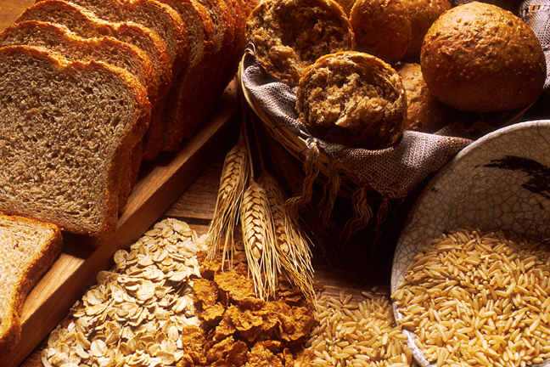
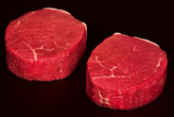
Introduction
The physical properties of all materials are related to chemical structures
This includes the materials that we put into our bodies
Foods interact differently with our bodies based on their chemical compositions
Fats represent one class of foods
Fat molecules are a very efficient way to store energy
Notes:
Images Sources (from left to right):
Steak: South Dakota Department of Health, https://doh.sd.gov/diabetes/Recipes/Steak.aspx
Green Beans: St Louis County Minnesota, http://www.stlouiscountymn.gov/ADULTFAMILIES/CommunityServices/Nutrition/FoodSafetyNutritionandPreservation.aspx
Bread: National Cancer Institute, http://visualsonline.cancer.gov/details.cfm?imageid=2441
Burger: Indiana Insider Blog, http://www.in.gov/visitindiana/blog/index.php/2011/05/05/indiana-state-fair/immersive/

Slide 5
Dietary fats
There are 4 groups of different fats which are divided based on their chemistry
Saturated fat: animal sources, including meat and dairy products. Raises cholesterol levels and increases risk of heart disease
Monounsaturated fat: found in a variety of natural foods and oils. Can improve cholesterol levels and decrease risk of heart disease
Polyunsaturated fat: found mostly in plant-based foods and oils.
Omega-3 fatty acids: beneficial to the heart
Trans fat: found in processed vegetable oils. Made during partial hydrogenation of unsaturated fats, associated with health risks
Humans need certain essential fatty acids for growth, eg/ linoleic acid
Many Americans consume 6-8 times the required amount of dietary fat

Slide 6
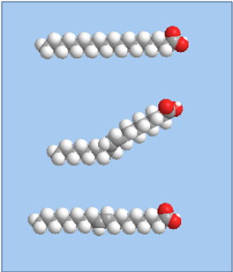
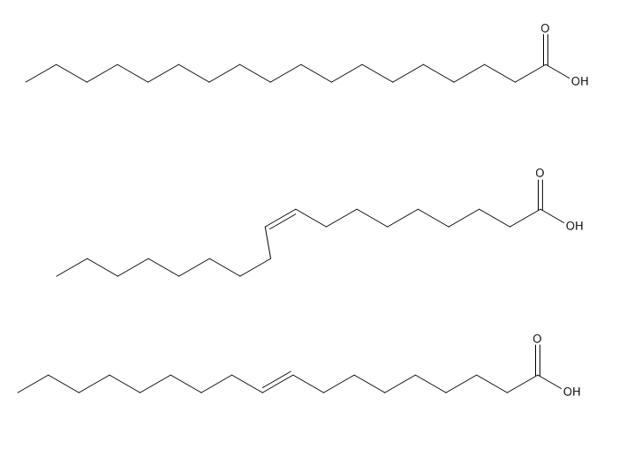
Fat molecules
Carboxylic acid
Saturated fat
Monounsaturated fat
Trans fat
Fatty acid chain
Notes:
All fats consist of fatty acids (chains of carbon and hydrogen atoms, with a carboxylic acid group at one end) bonded to a backbone structure
Images courtesy of Jasmin Hume, Polytechnic Institute of New York University

Slide 7
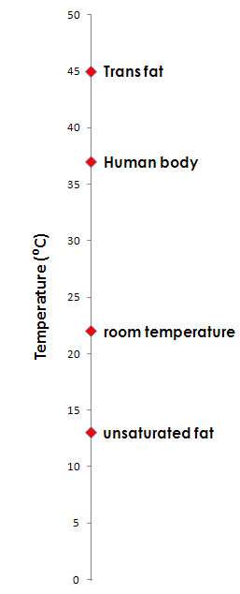
Fat compounds
Foods high in saturated and trans fat → solids at room temperature
Foods high in mono/poly unsaturated fats → liquids at room temperature
Physical properties, such as translucency and melting point, can be explained by molecular packing
Using a robot with sensors capable of measuring translucency and melting point, various fat samples will be studied to gather data based on their physical properties
Notes:
Image courtesy of Jasmin Hume, Polytechnic Institute of New York University

Slide 8
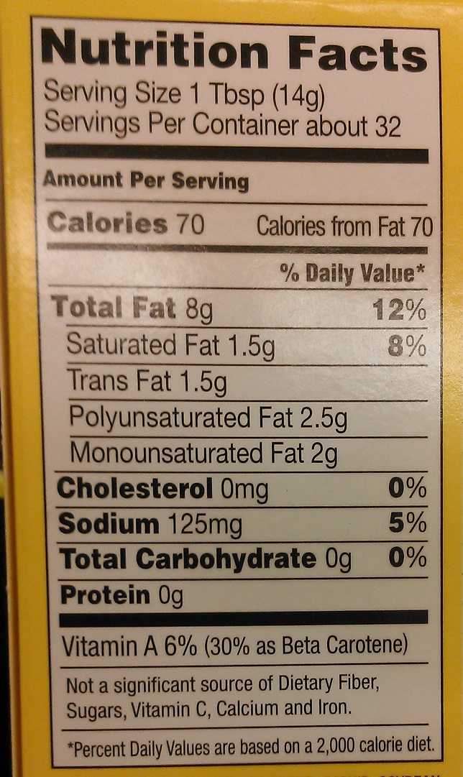
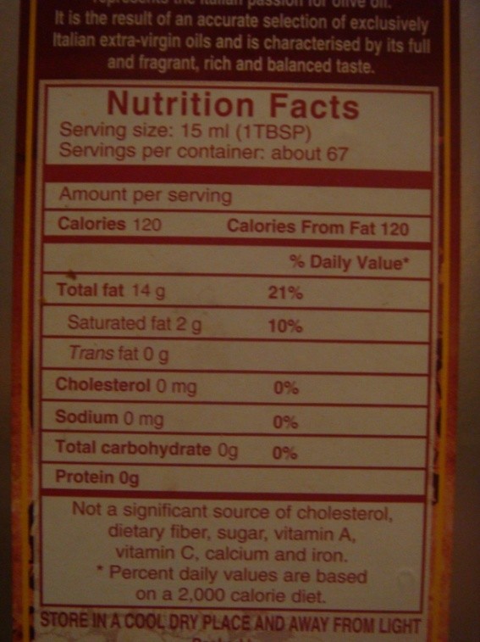
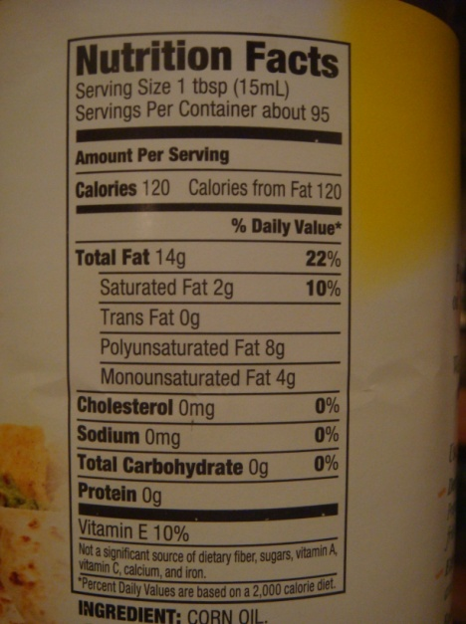
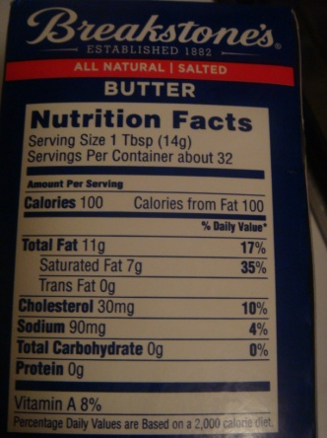
Pantry samples
Percentage (%) | Butter | Corn oil | Olive oil | Margarine
Saturated fat | 64 % | 14 % | 14 % | 19 %
Mono/poly unsaturated fat | 36 % | 29 % mono | 86 % | 25 % mono
 |  | 57 % poly |  | 31 % poly
Trans fat | - | - | - | 19%
Notes:
Photos courtesy of Jasmin Hume, Polytechnic Institute of New York University and Carleigh Samson, University of Colorado Boulder

Slide 9
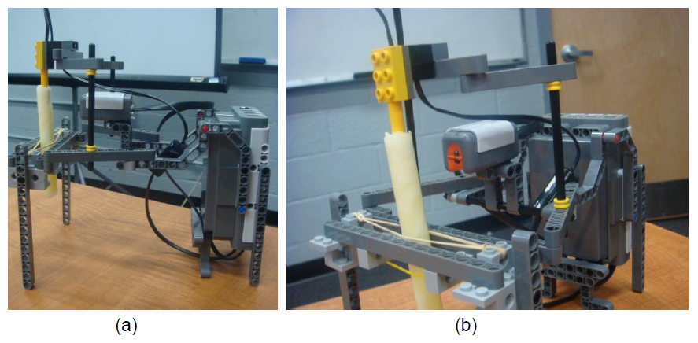
Robot design
Side view
Front view
Notes:
Image courtesy of Jasmin Hume, Polytechnic Institute of New York University

Slide 10
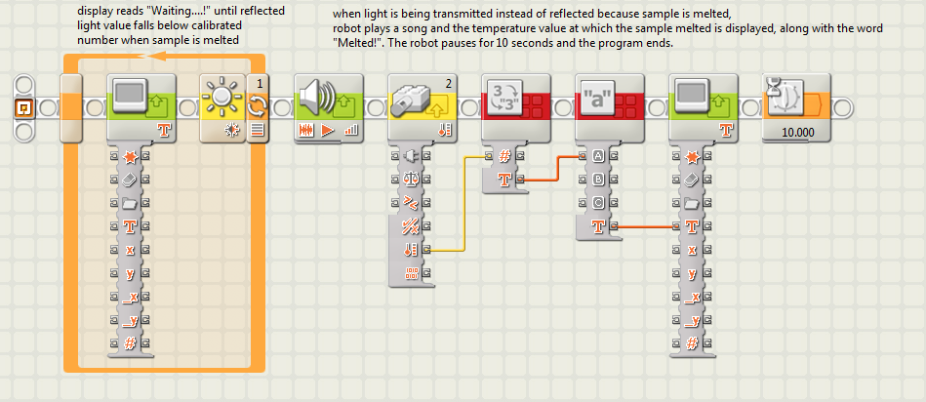
Programming the robot

Slide 11
Take home messages
We will understand which types of fats to watch out for in our diets
Equip with knowledge to analyze and scrutinize nutrition fact labels
Robots are employed to perform measurements that can provide us with useful data
Understand that physical properties of materials are directly related to their chemical structures
Stay healthy, happy and curious of the world around us!

Slide 12
Thank you!

