Slide 1
THE WATER AROUND US

Slide 2
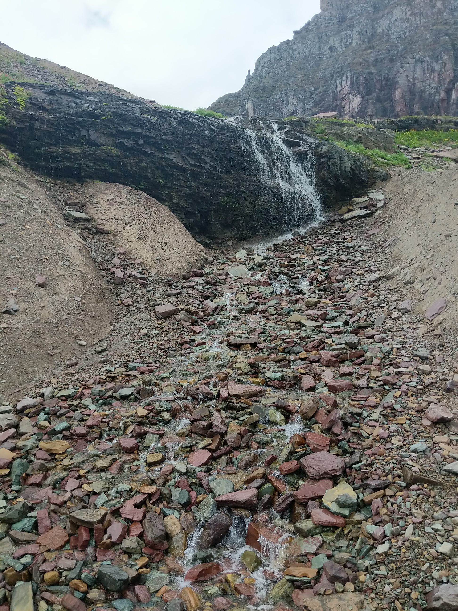
Where have you seen water outside? (Let’s think about this for a minute. Raise your hand to share your answer)

Slide 3
What makes natural water sources different from human-made sources? (You have 2 minutes to discuss this with your group.)

Slide 4
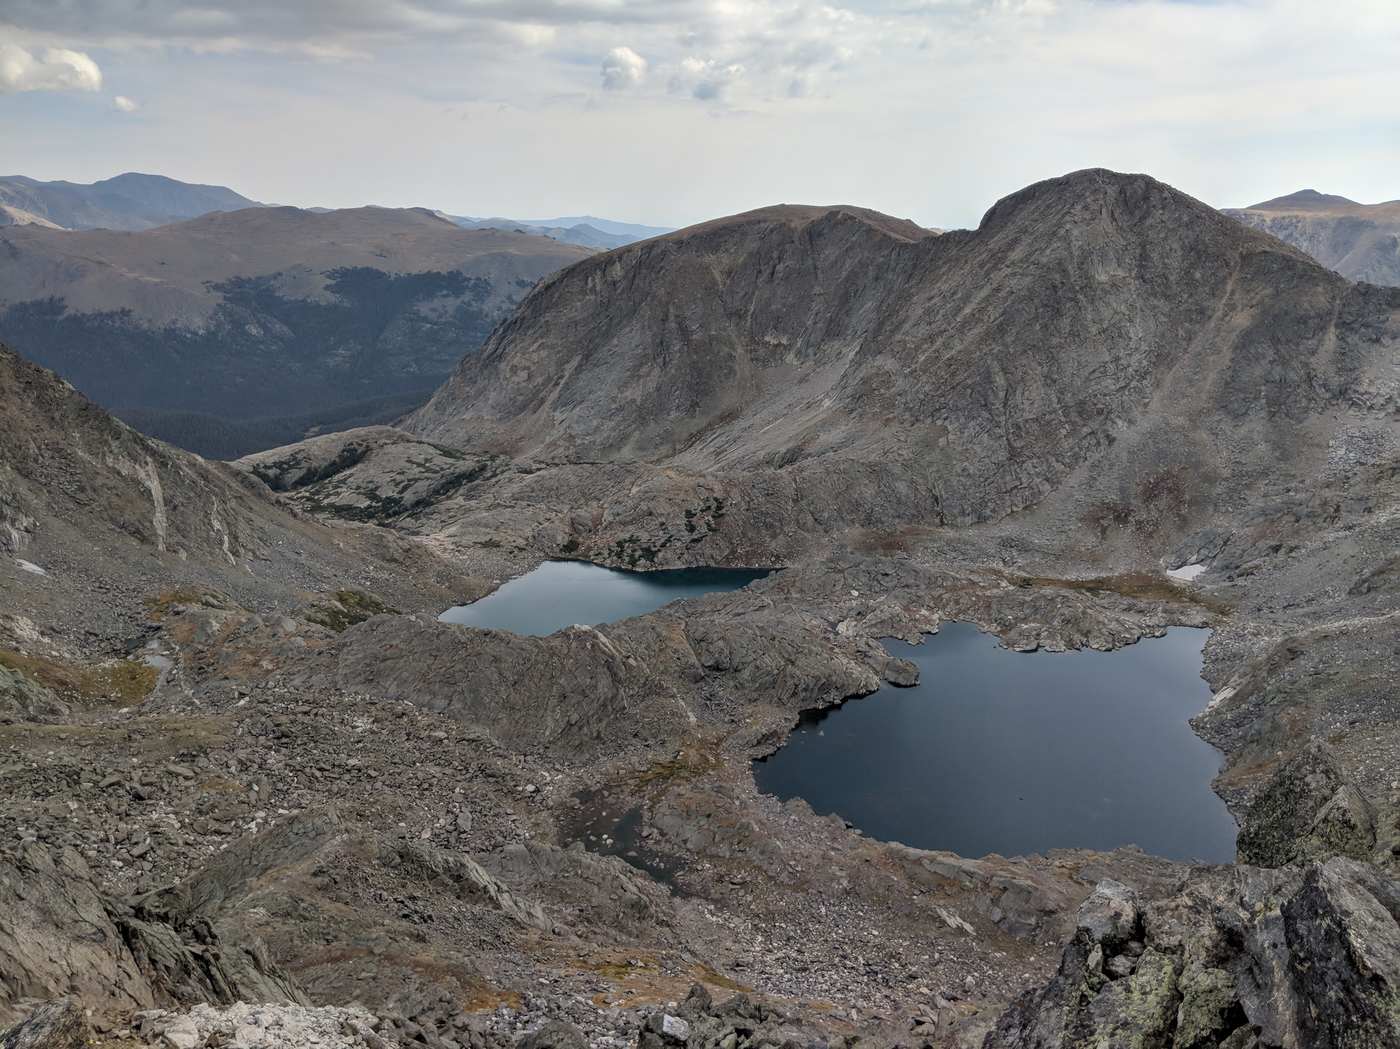
Natural – Anything that is derived from nature; not made or caused by humans.

Slide 5
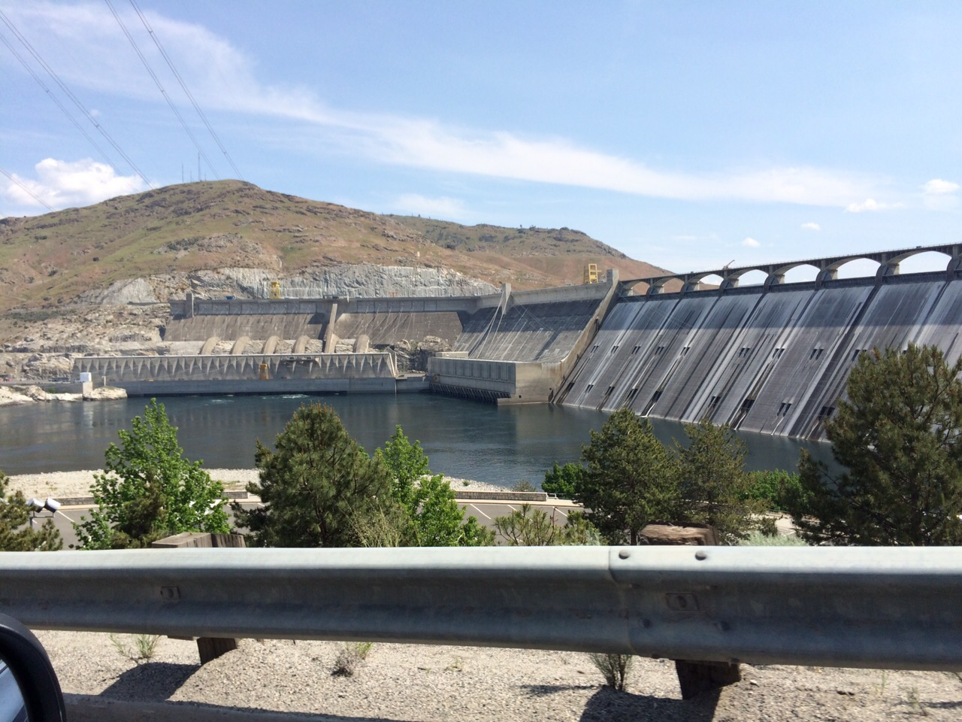
Human-made – resources made by humans; they do not occur naturally in the environment.

Slide 6
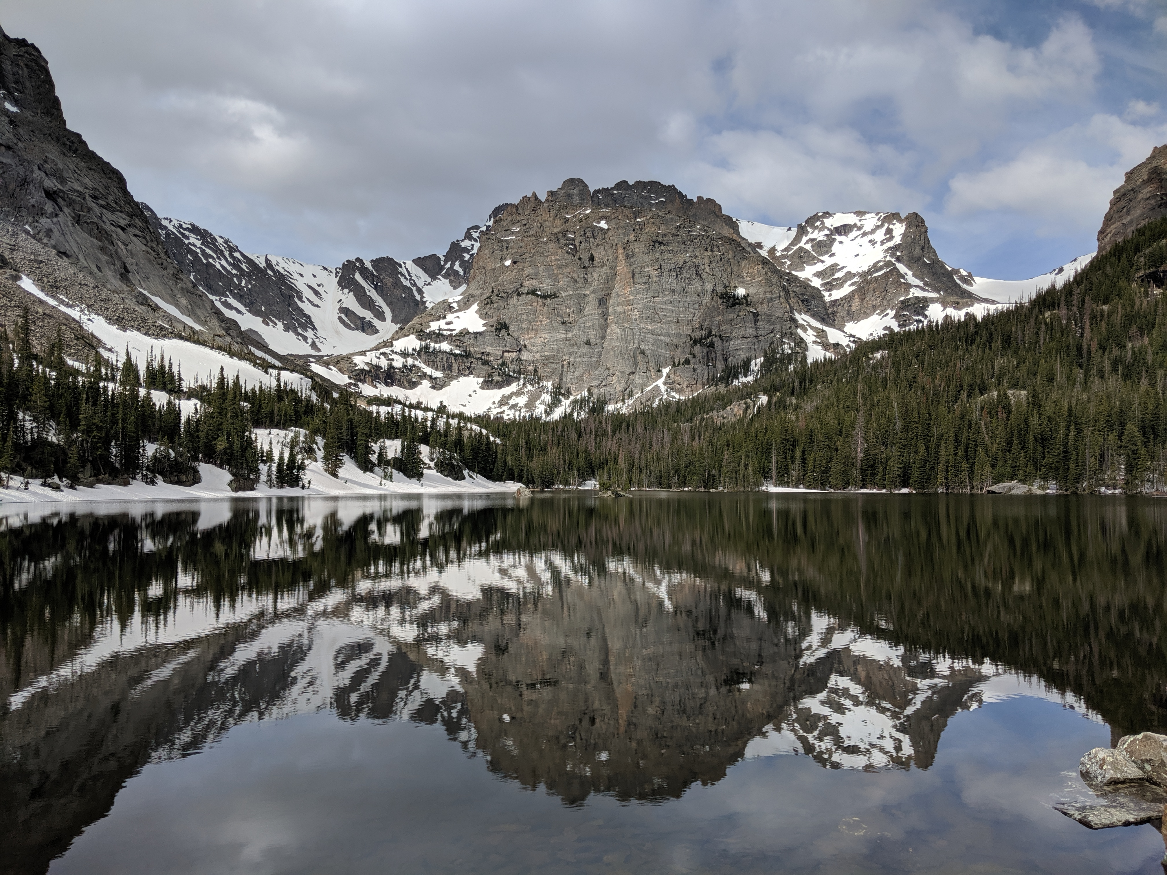
Fresh water – water that does not have salt

Slide 7
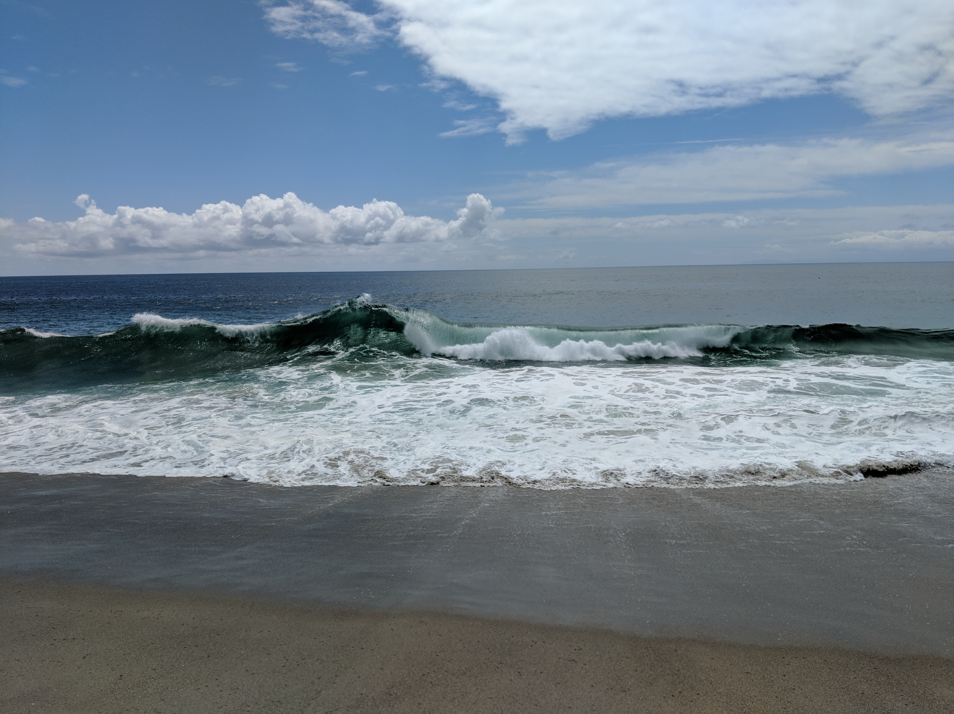
Salt water – water that has salt

Slide 8
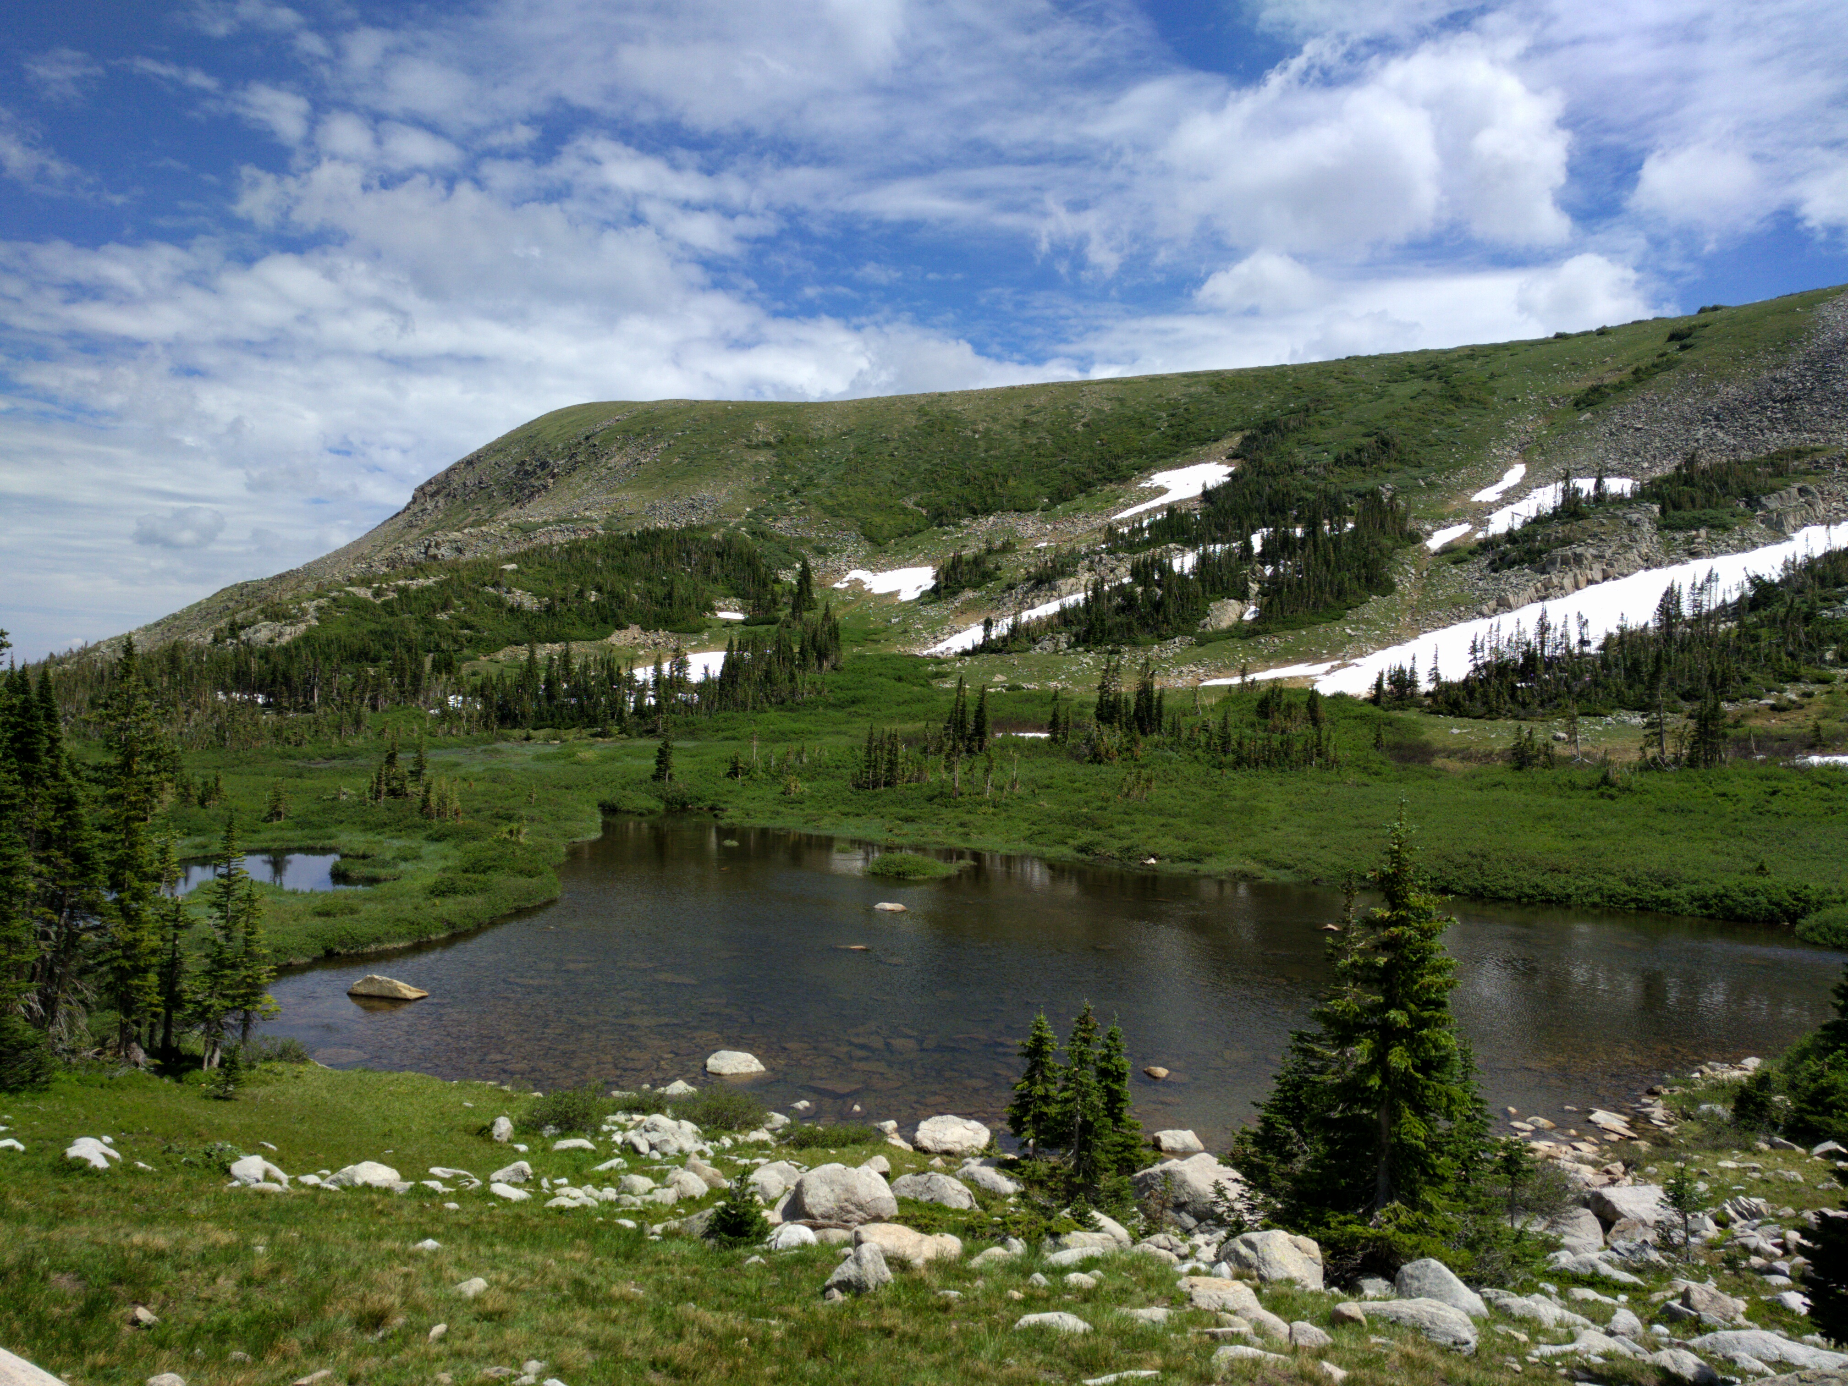
Pond – a small body of still (non-moving) water

Slide 9
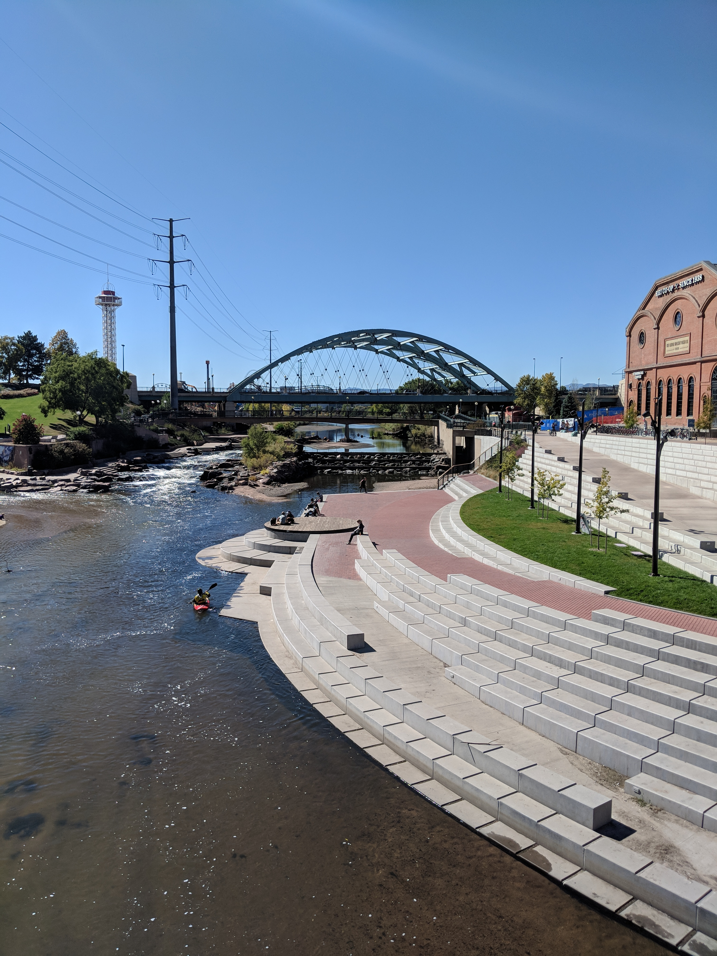
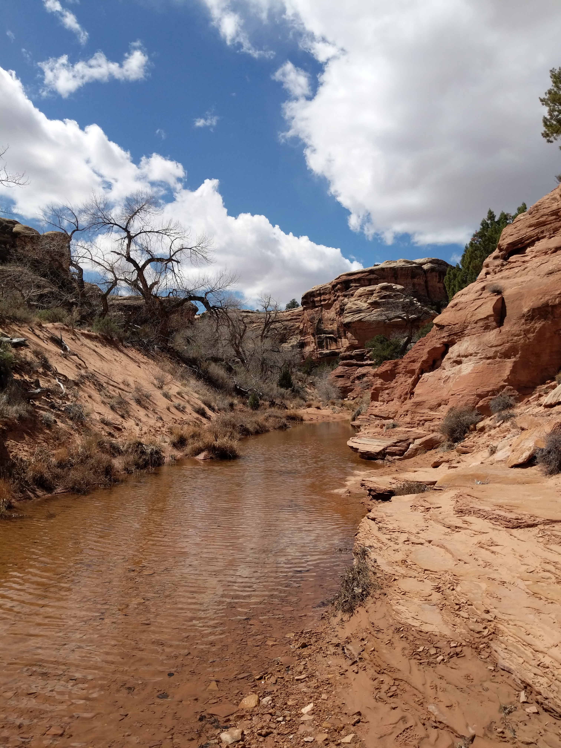
Stream – a small body of moving water

Slide 10
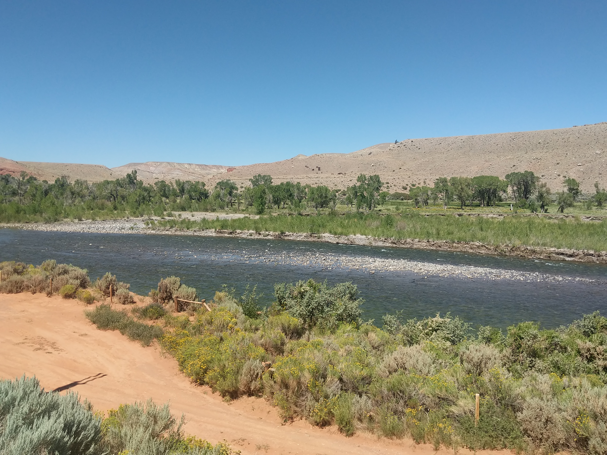
River – A large stream of water that runs into a lake, sea or another river.

Slide 11
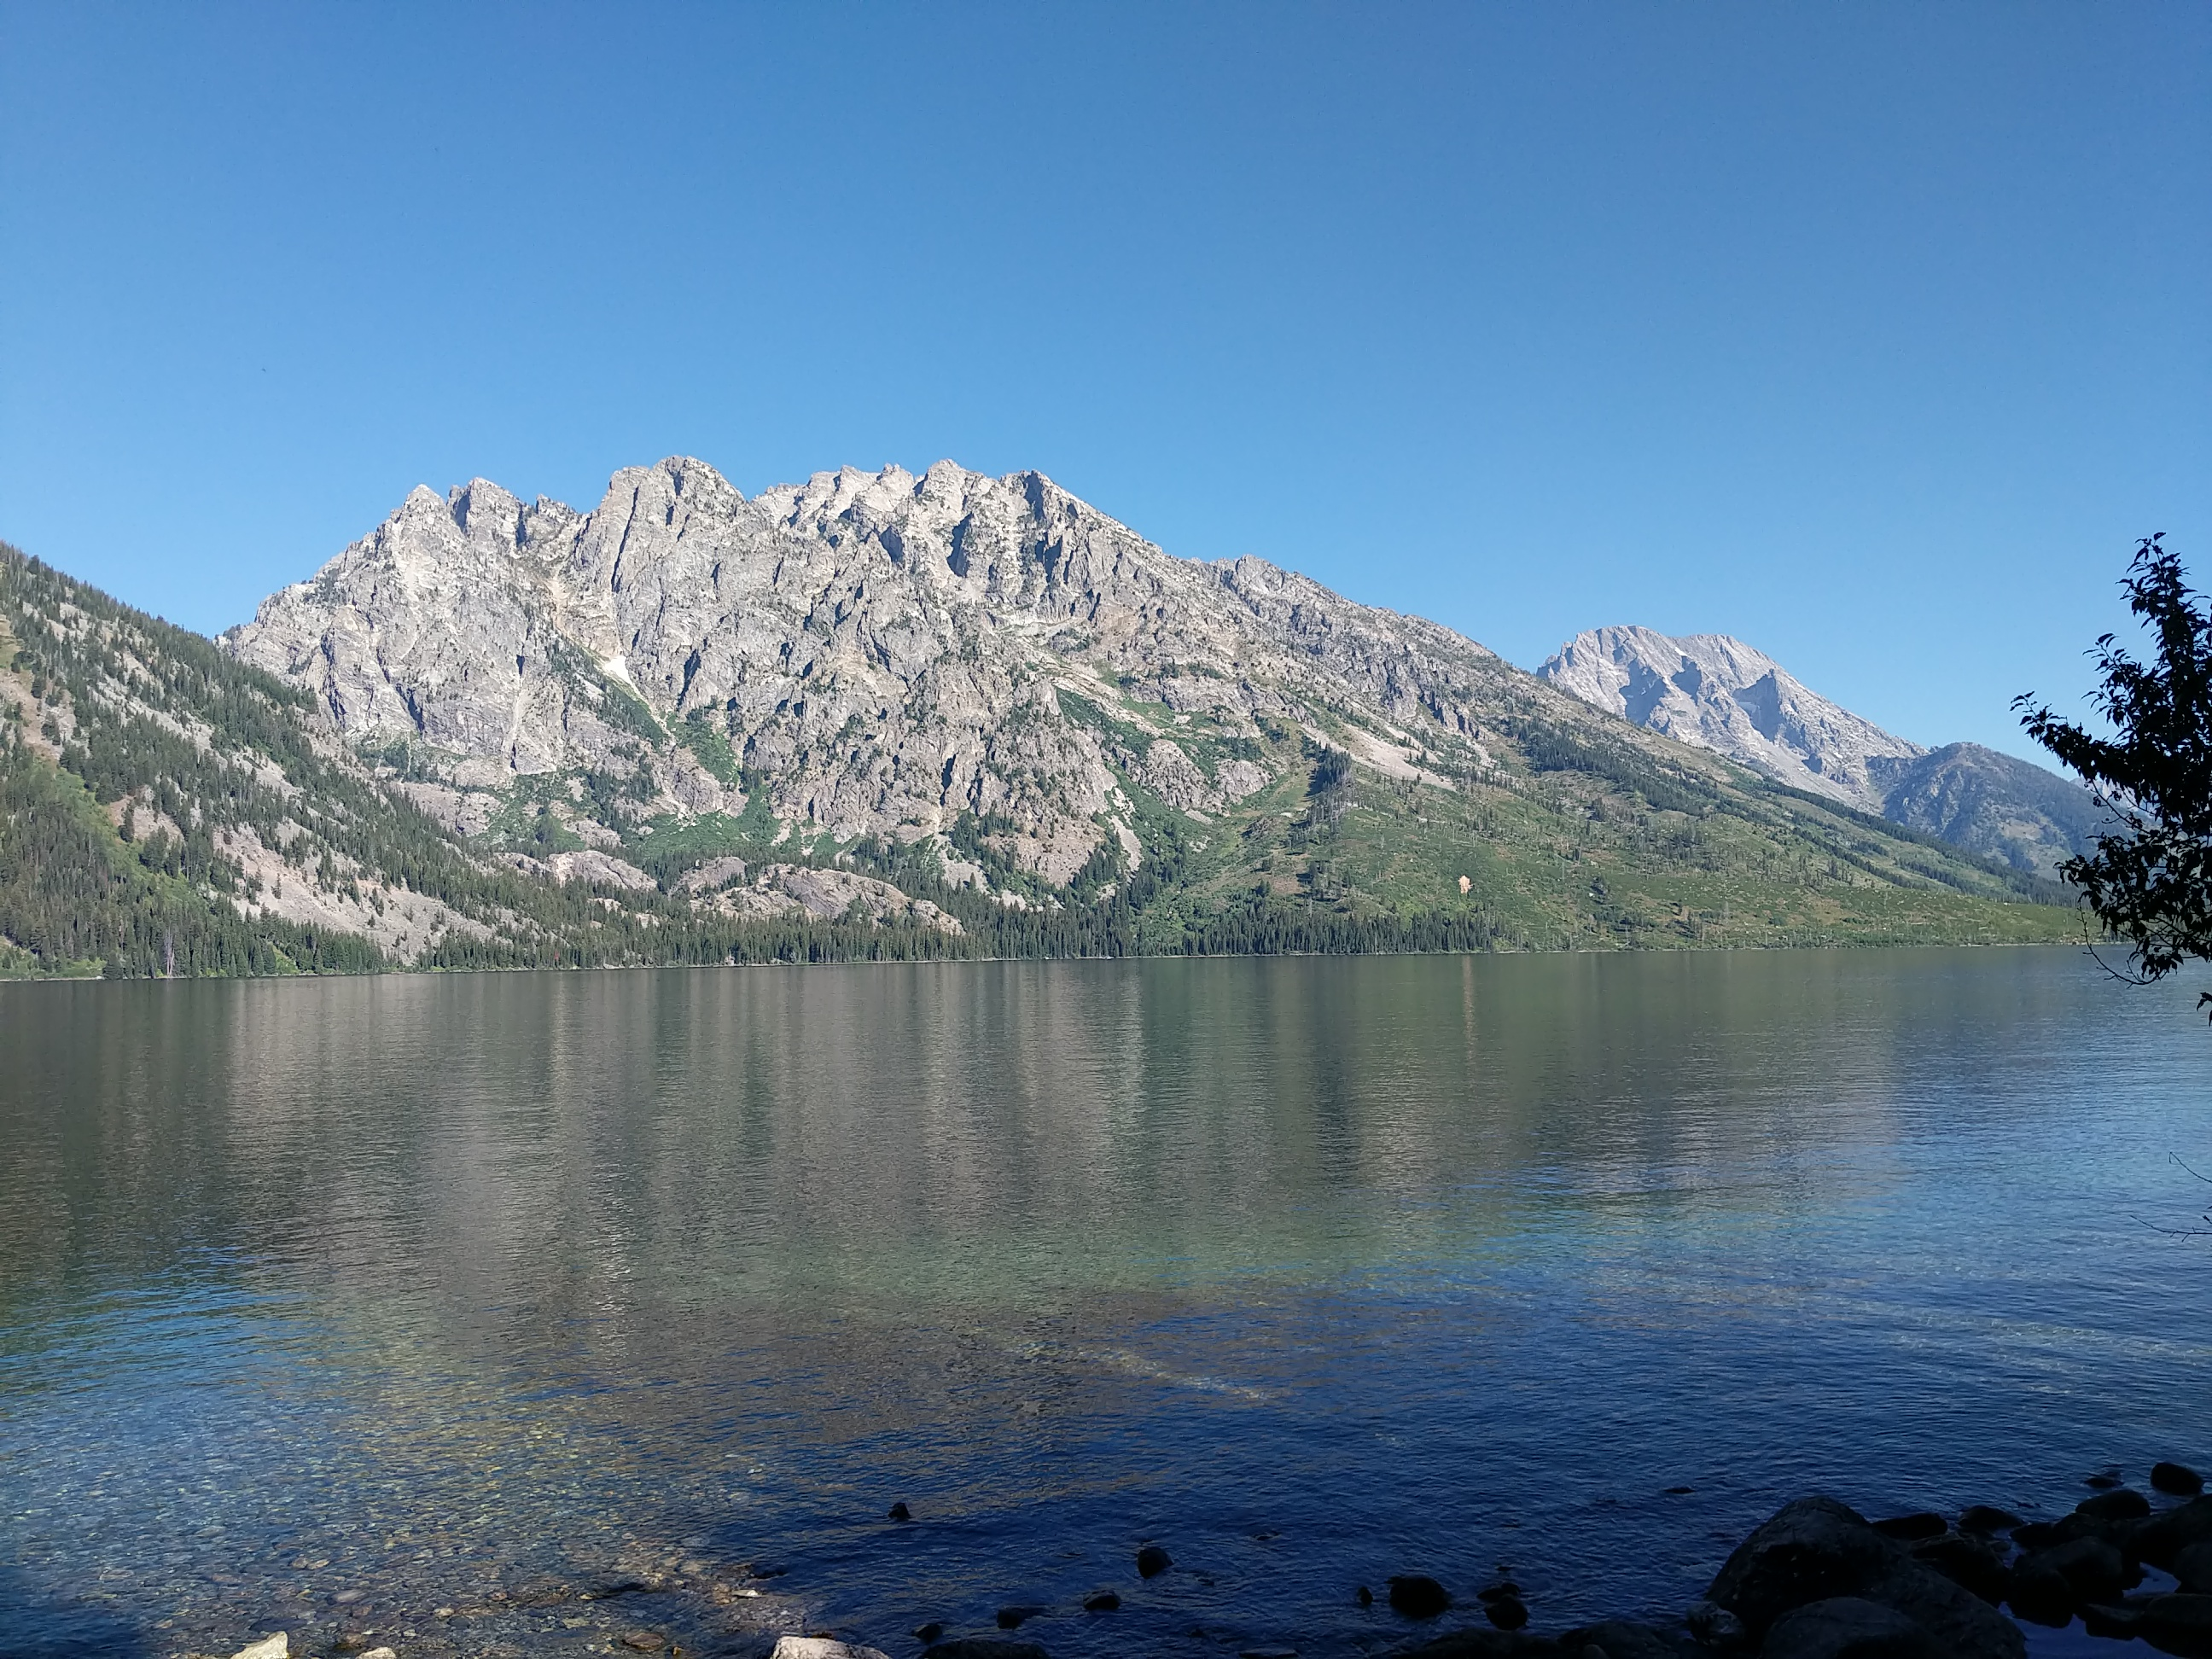
Lake – a large body of water surrounded by land

Slide 12
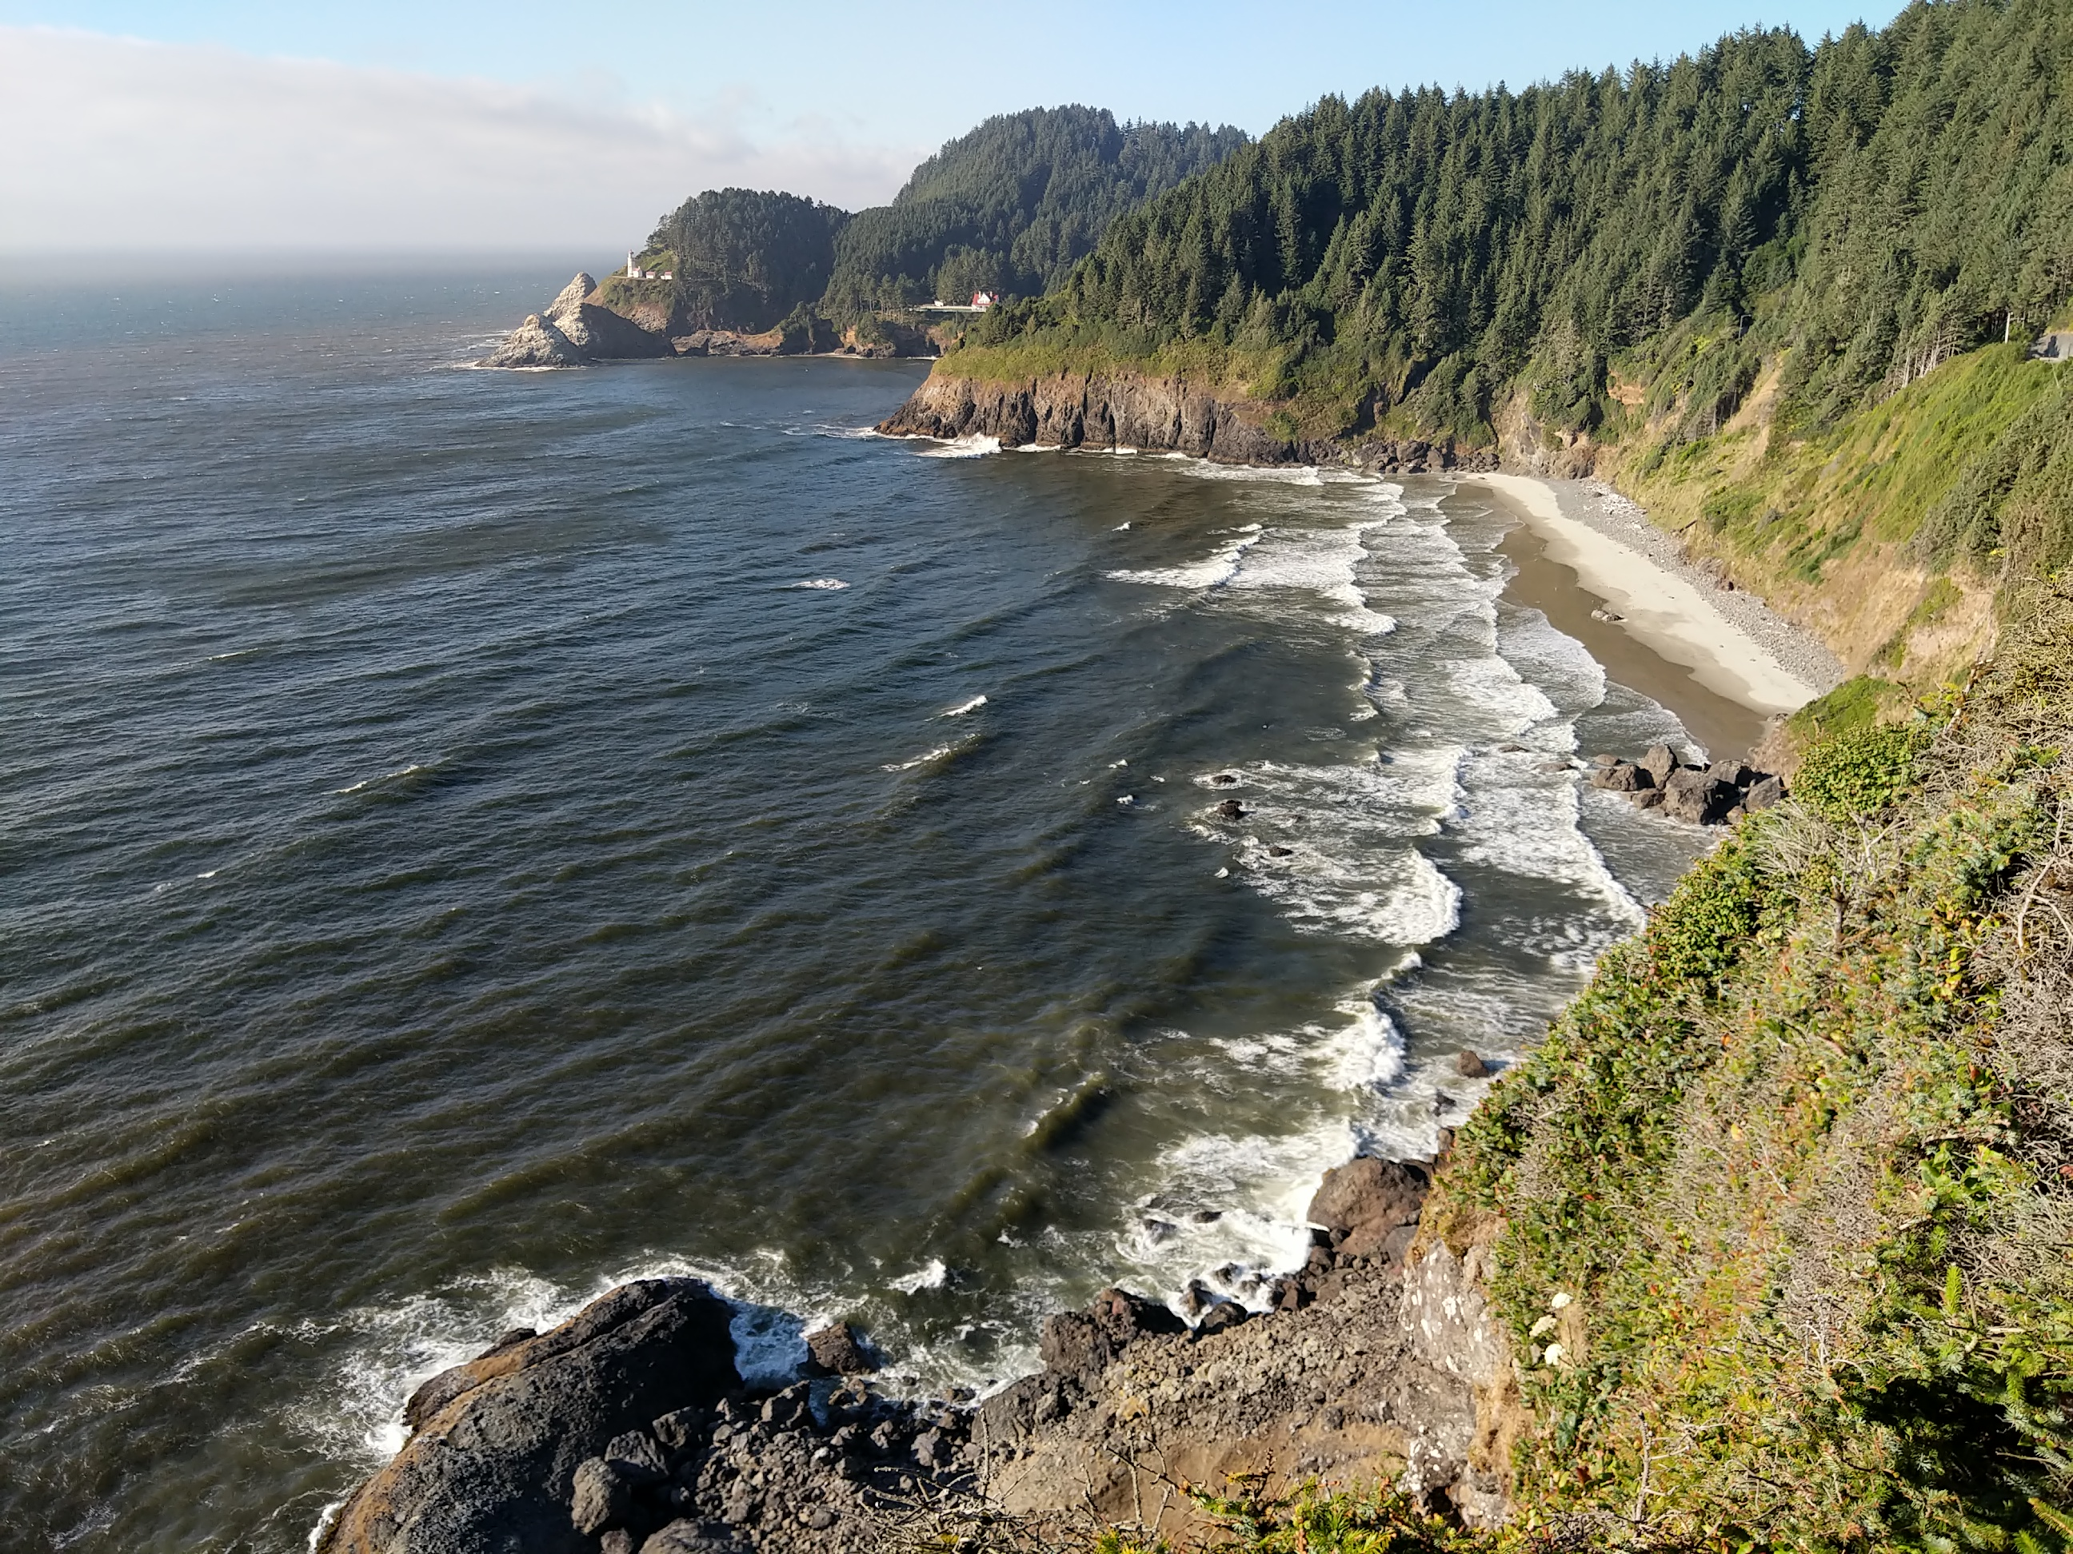
Ocean – a large expanse of sea

Slide 13
Time to explore!
You will be assigned a type of water source to design and build a model with the items and materials available. Plan with your group for what materials you need (5 minutes).
Sand (500 mL)
Dirt (500 mL)
Clay
Water (500 mL)

Slide 14
Lab safety!
Before we gather our materials, what equipment do we need to protect ourselves?

Slide 15
Time to create!
We will work on our models for the next 10 to 15 minutes. Our goal is to make our models as close to what the water sources look like in real life!

Slide 16
Time to share!
We will share our models of our sources of water.
What are the characteristics of your water model?
Is it fresh water or salt water?
Can we drink from your water source?

Slide 17
Exit ticket
Each student needs an exit ticket. Please answer the questions and turn them in when you have completed it. If you need help, please raise your hand.

