Slide 1
Bacteria Says What!

Slide 2
Nanotechnology

Slide 3
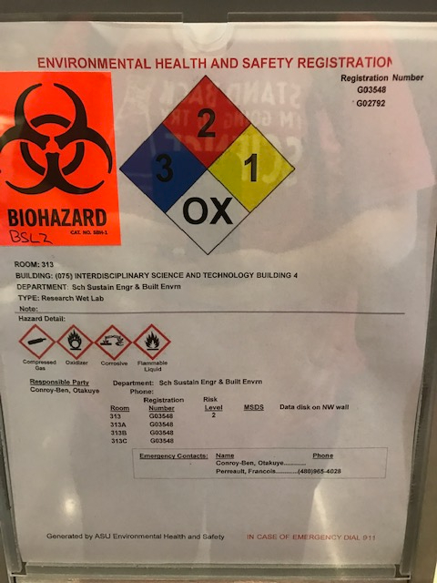
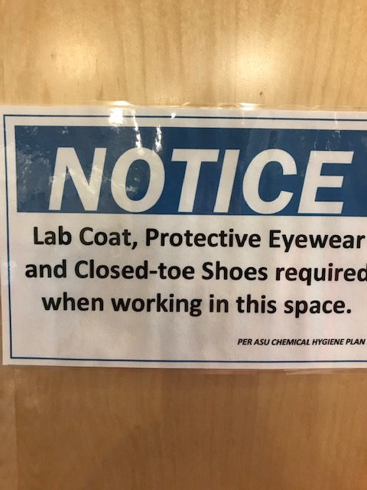
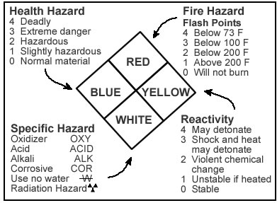
SAFETY SLIDE
Lab Coat
Safety Glasses
Gloves
Close-Toed Shoes
Long hair tied back

Slide 4
Let’s PPE!

Slide 5
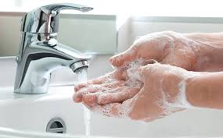
Introduction
Why is it you wash your hands before you eating and after using the bathroom?
How many times do you think you have you touched your face today?
Is there anything on the table in front of you?
Is there bacteria in front of you on the table??

Slide 6
Synopsis
Children are getting sick on a regular basis even though we could prevent many of these incidents. They need to know what is around them and how to handle the things around them they cannot see.

Slide 7
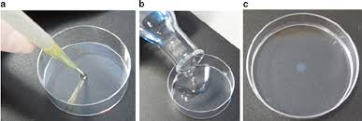
Making Agar Dishes
15 minutes to set:
On the bottom of the petri dish, draw a line dividing it in half and label the sides for each partner

Slide 8
Nanoparticles

Slide 9
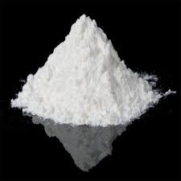
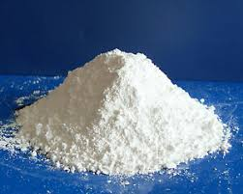
Our Nanoparticles!
Titanium Dioxide - Absorbs ultraviolet light
Places you can find titanium dioxide: sunscreen, paper, makeup, food, plastics, and rubber.
Zinc Oxide - Pain relief
Places you will find zinc oxide: rubbers, plastics, ceramics, glass, cement, lubricants, paints, ointments, adhesives, sealants, pigment, food, batteries, ferrites, and bandages.

Slide 10
Acquiring your sample:
Flip petri dish over and draw a line cutting the dish into fourths and label each side with initials.
Students will use their swab to take a sample of one item in the classroom. Each partner will then streak their half the dish.
Divide the dish into quarters. Apply a pinch of titanium dioxide to one quarter. On the other side put zinc oxide.
Close the petri dish and apply parafilm to seal the dish.
Place dish in incubator.

Slide 11
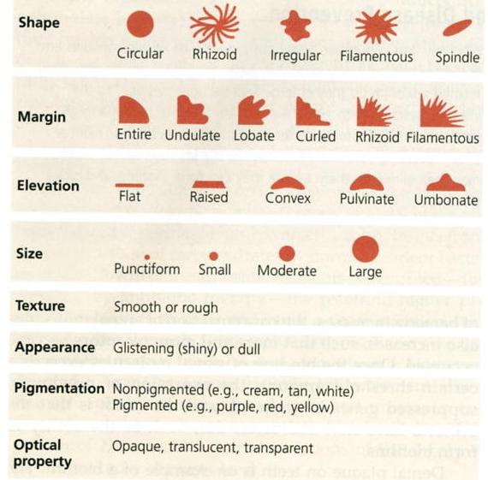
Making Observations
Create a data table in your notebooks.
Record observations of your petri dish.
- Observations should include color, shape, size, and any other interesting characteristics
Use the image to the right to assist with descriptions.
Compare your quarters with and without titanium dioxide/zinc oxide.

Slide 12
Discuss your Bacteria!
Compare your bacteria to your partners, including how are they alike, how are they different, and how the titanium dioxide affected their samples.
Find another pair oto share and discuss their results.
Complete the Exit Ticket!
Extension: Utilizing the internet discover what type of bacteria is on your petri dish along with what its purpose is.

Slide 13
Bacteria Links
Quick Follow-up Article #1 – The Five Dirtiest Things You Touch Everyday
Follow-up Article #2 – Your Towels Are Way Dirtier Than You Think
Follow-up Video – Cell-like nanorobots!

