Slide 1
Engineering Scaling Removal Using Citric Acid

Slide 2
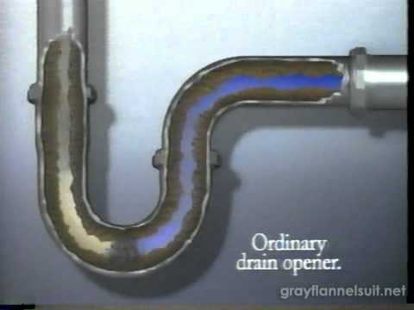
What’s Happening?

Slide 3
The Issue
Pipe cleaners are designed to clean the inside of pipes from all kinds of gross substances! This includes hair, scaling, and buildup of any kind. There is one major problem—these chemicals can be extremely toxic to humans and harmful to our environment.
Can we think of a better solution?

Slide 4
What is Citric Acid?
As you watch this video, be sure to write down some examples on your sheet.

Slide 5
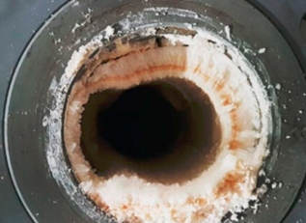
Protocol
You and your partner will work together to come up with a protocol to remove the scaling (buildup) from a pipe, using only the ingredients provided. You will have 5 minutes to brainstorm and write down your plan.
Use these points to help you!
pH of fruits
How long are you going to treat your pipe?
How many grams/mLs of citric acid?
Will you scrub or just apply topically?

Slide 6
Test Your Protocol!
Be sure you’re following your protocol. If you make changes, be sure to write them on your paper!
You have 10 minutes to test your theory. Be sure you get the mass of your pipe before you begin.

Slide 7
Reflection
You and your partner will spend 5 minutes reflecting on how your lab went today. Answer your reflection questions on your paper.

