Slide 1
Crystalline Cloth Presentation

Slide 2
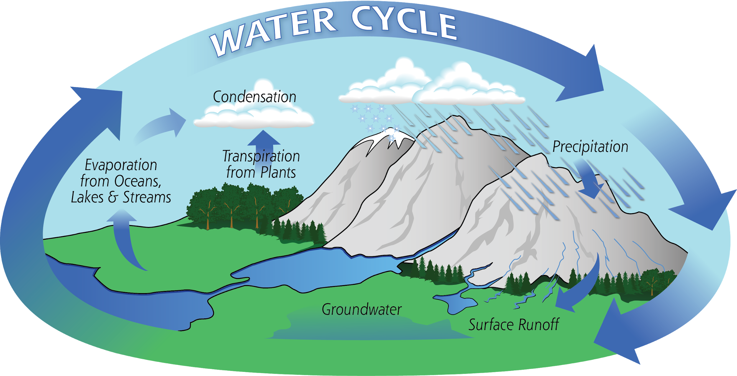
The water cycle is the continuous movement of water between Earth and its atmosphere.

Slide 3
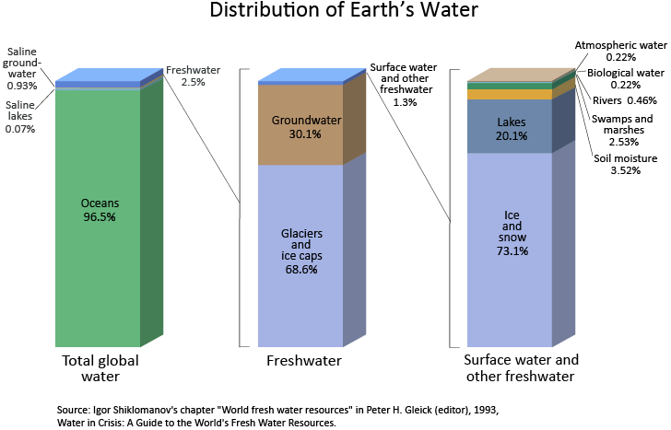

Slide 4
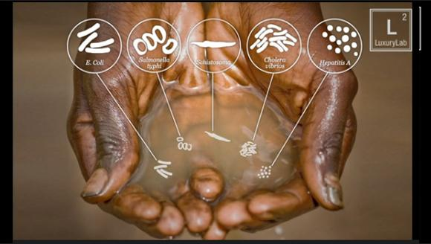
limitedwater.weebly.com

Slide 5
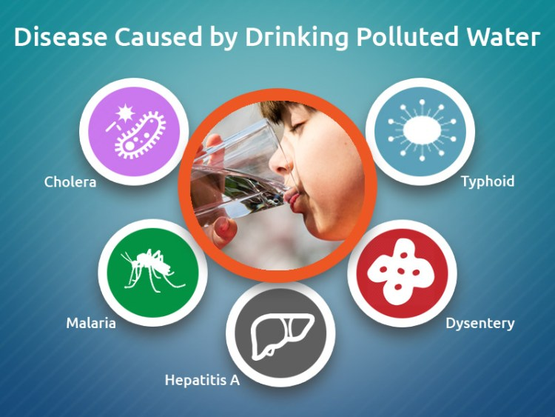
Why is it important to have clean water?
Medlifeweb

Slide 6
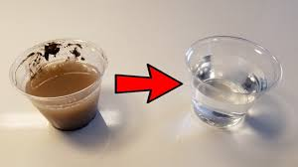
How can we make dirty water clean?
Membrane Distillation!

Slide 7
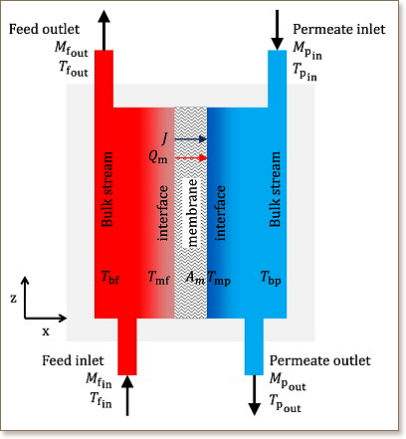
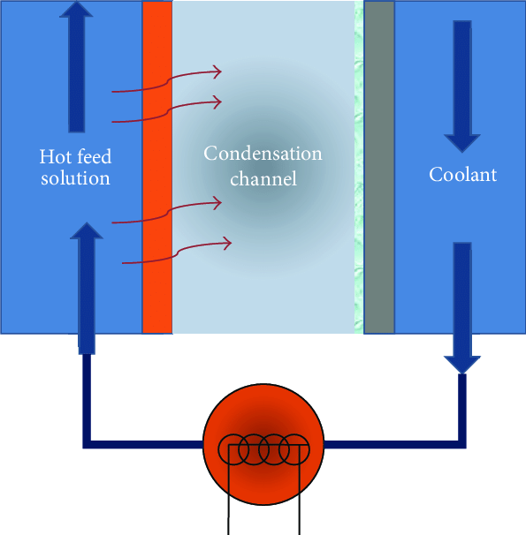
What is Membrane Distillation
Membrane distillation is when you separate a liquid based on temperature and phase changes (liquid to gas and gas to liquid).
A hydrophobic membrane presents a barrier for the liquid phase, allowing the vapor phase (e.g. water vapor) to pass through
the membrane's pores.
The driving force of the process
is a partial vapor pressure
difference commonly triggered
by a temperature difference.

Slide 8
Engineers and scientists use the “Engineering Design Process” to both solve existing problems and prevent future issues.
Today, we will be following part of this to create a solution to a problem common to water filtration and treatment.

Slide 9
Write on a sticky note one problem that you think can occur when trying to clean water in a membrane distillation system.
Post sticky note up at the front when complete.

Slide 10
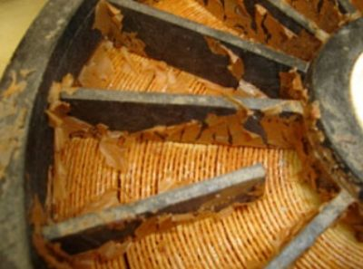
Challenges
Dissolved minerals form a layer of “scale” on the membrane itself, preventing the membrane distillation from functioning properly.

Slide 11
How do you think we think we could fix a membrane?
Take 45 seconds to confer with your group, then I will pick someone to report to the rest of the group.

Slide 12
How can you fix the membrane?
Stop running the MD system and clean the membranes by hand.
The downside is that the time spent taking the system down loses production of distilled water, a serious problem if the system is relied upon to provide water.

Slide 13
How can you fix the membrane?
2. Prevent the growth of the scaling in the first place. This can be done by adding a material to the membrane itself, or changing the type of material the membrane is made of.
The downsides of this could be the new membrane material would increase cost.

Slide 14
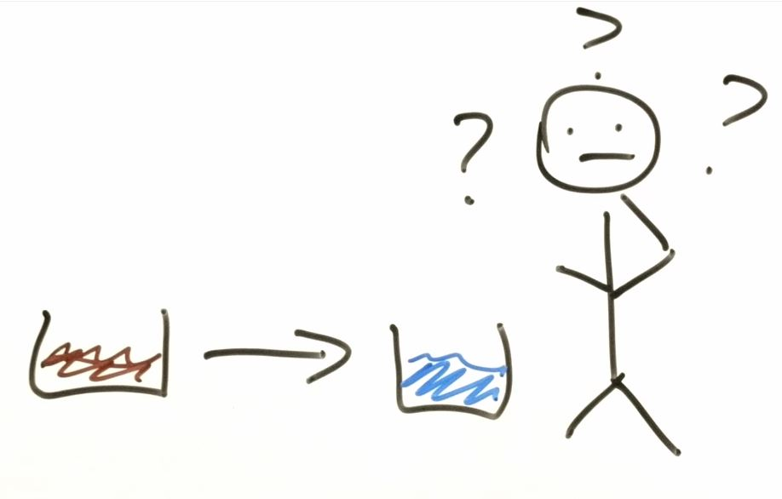
Let’s watch a video that explains membrane distillation!
Notes:
Video Transcript:
Have you ever wondered how we can take dirty, undrinkable water and turn it into clean, usable water? Why with membrane distillation! Membrane distillation is a separation process where we take non-drinkable water, which scientists call non-potable, force it through a membrane and clean potable water comes out the other side. Large membrane distillation systems can help people who do not have access to clean water regularly, such as people who live in the desert or people who live where their water is permanently contaminated. But you can actually have a small one right in your home to clean rainwater, greywater, or to use after a natural disaster when municipal or tap water isn't running. Sometimes the membrane distillation system stops working. This is usually because the membrane is blocked. We call this fouling or scaling. Some examples are precipitation fouling, which is when crystals grow on it, particulate fouling when things such as leaves get stuck on it, biological fouling such as by bacteria or viruses, and chemical membrane degradation. One major way the surface gets scaled is from precipitation fouling. Remember, this means that crystals are growing on the surface of the membrane. Some crystals are easy to remove. You can do this by washing the surface with lots of different chemicals, such as hydrochloric acid, citric acid, or even metal oxides. But others are harder to wash off. And if you can't clean your membrane, you need to get a new one. Sometimes this isn't possible because they cost too much or they're just not available where people live. Because of this, people go without clean, safe drinking water and sometimes they get sick from the dirty water. So nano enabled water treatment, or NEWT scientists, located at Rice, UT El Paso, Yale, and Arizona State University are researching how to make sure that the crystals don't grow on the surface anymore. To do this, the NEWT scientists are changing the membrane at the chemical level in all sorts of ways. They hope to engineer a nanotechnology based solution soon in order for people to have permanent access to clean water. Well, what would you do to help improve membrane distillation and bring clean water to more people all over the world? Thank you to NEWT, Dr. Li's lab, and the NSF.

Slide 15
Objective
Try to devise a way to keep dissolved particles (crystals) off your membrane (cloth).

Slide 16
Pre-Lab
Obtain a piece of cheese cloth, weigh it and write it in the mass of cloth box.
Follow instructions for how to create your crystal solution.
Complete the rest of the pre-lab instructions.

Slide 17
Lab
Obtain a piece of cheese cloth, weight it and write it in the mass of cloth box.
Choose from the provided materials what you would like to coat your cloth in and write it in the treated with box. Make sure you weight how much you are using before you coat your cloth.
Coat your cloth in your chosen substance.
Follow instructions for how to create your crystal solution.

Slide 18
Post Lab
Following the instructions, you should be filling out the following boxes:
Determine the Crystal Growth (GC) Reduction for your treatment.
Find at least two other groups and compare your Crystal Growth Reductions. What treatment did they use? Was your treatment more effective, or less?

