Slide 1
BACTERIOPHAGE BUILDER CHALLENGE

Slide 2
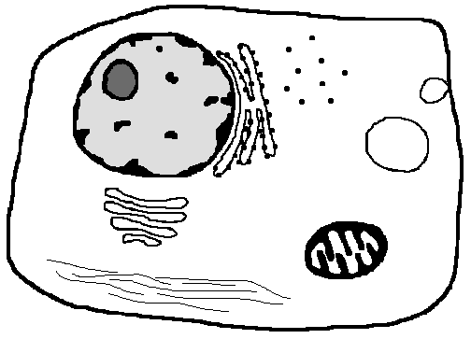
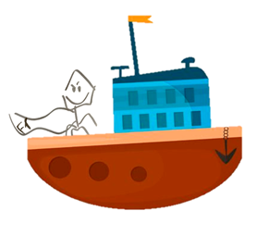
Bacteriophage Builder

Slide 3
Do First: Think of a time when you were sick…
1. Sit in groups of 3-4 people
2. Grab a worksheet and pen/pencil
3. On the paper:
Describe a time when you were sick. How did you feel?
What do you think caused you to feel sick?
Draw on the paper what you think the cause of your sickness looked like.

Slide 4
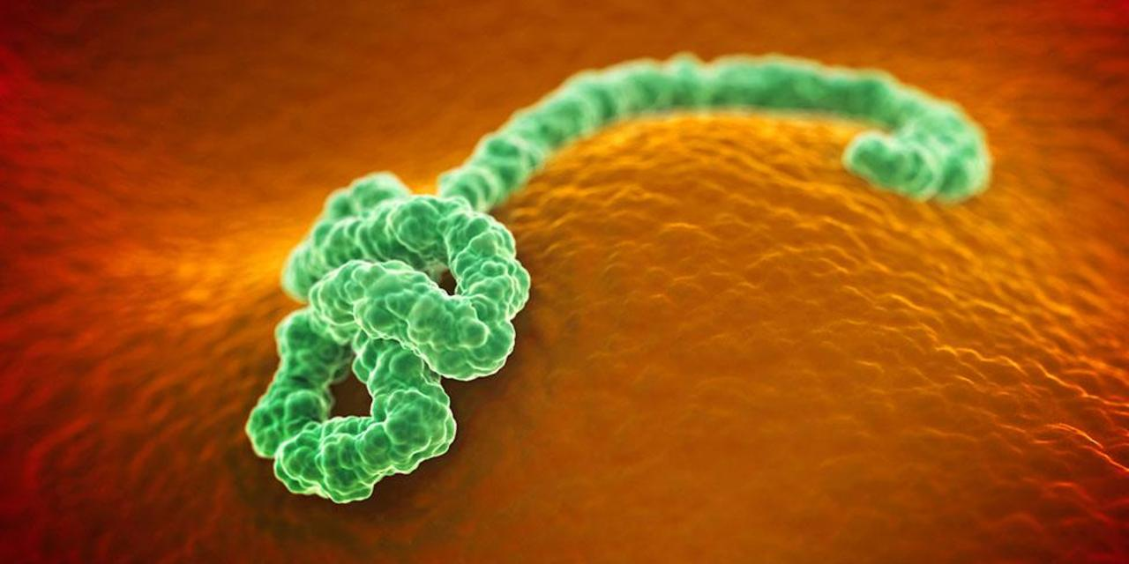
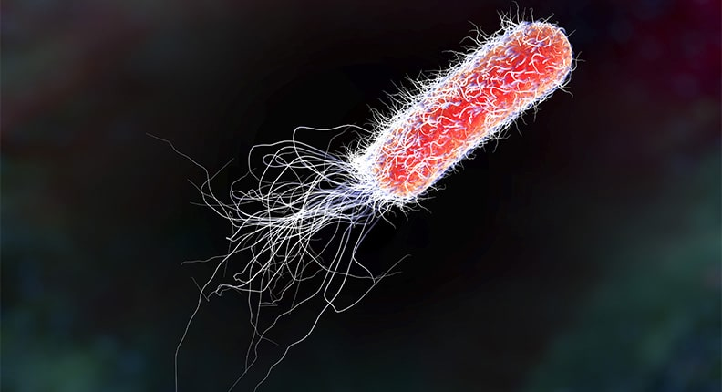
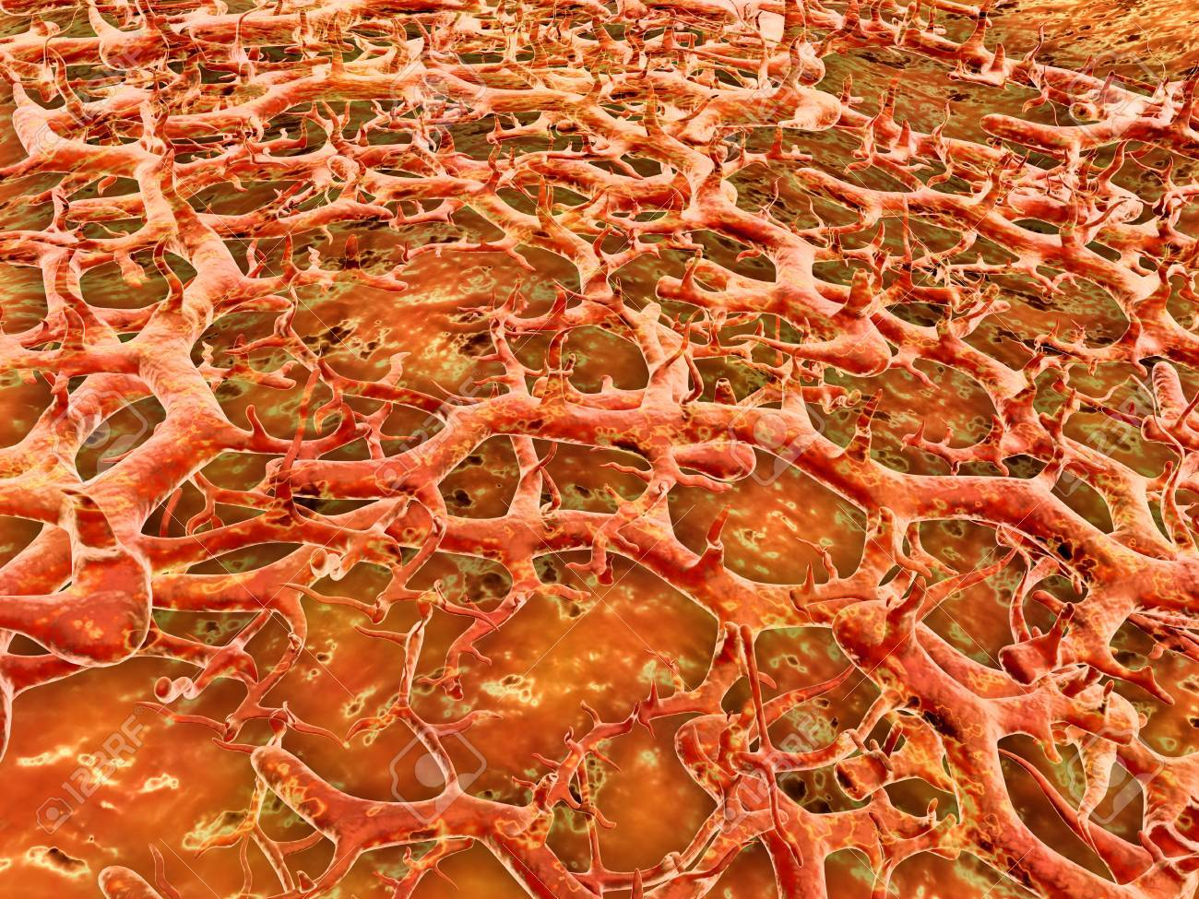
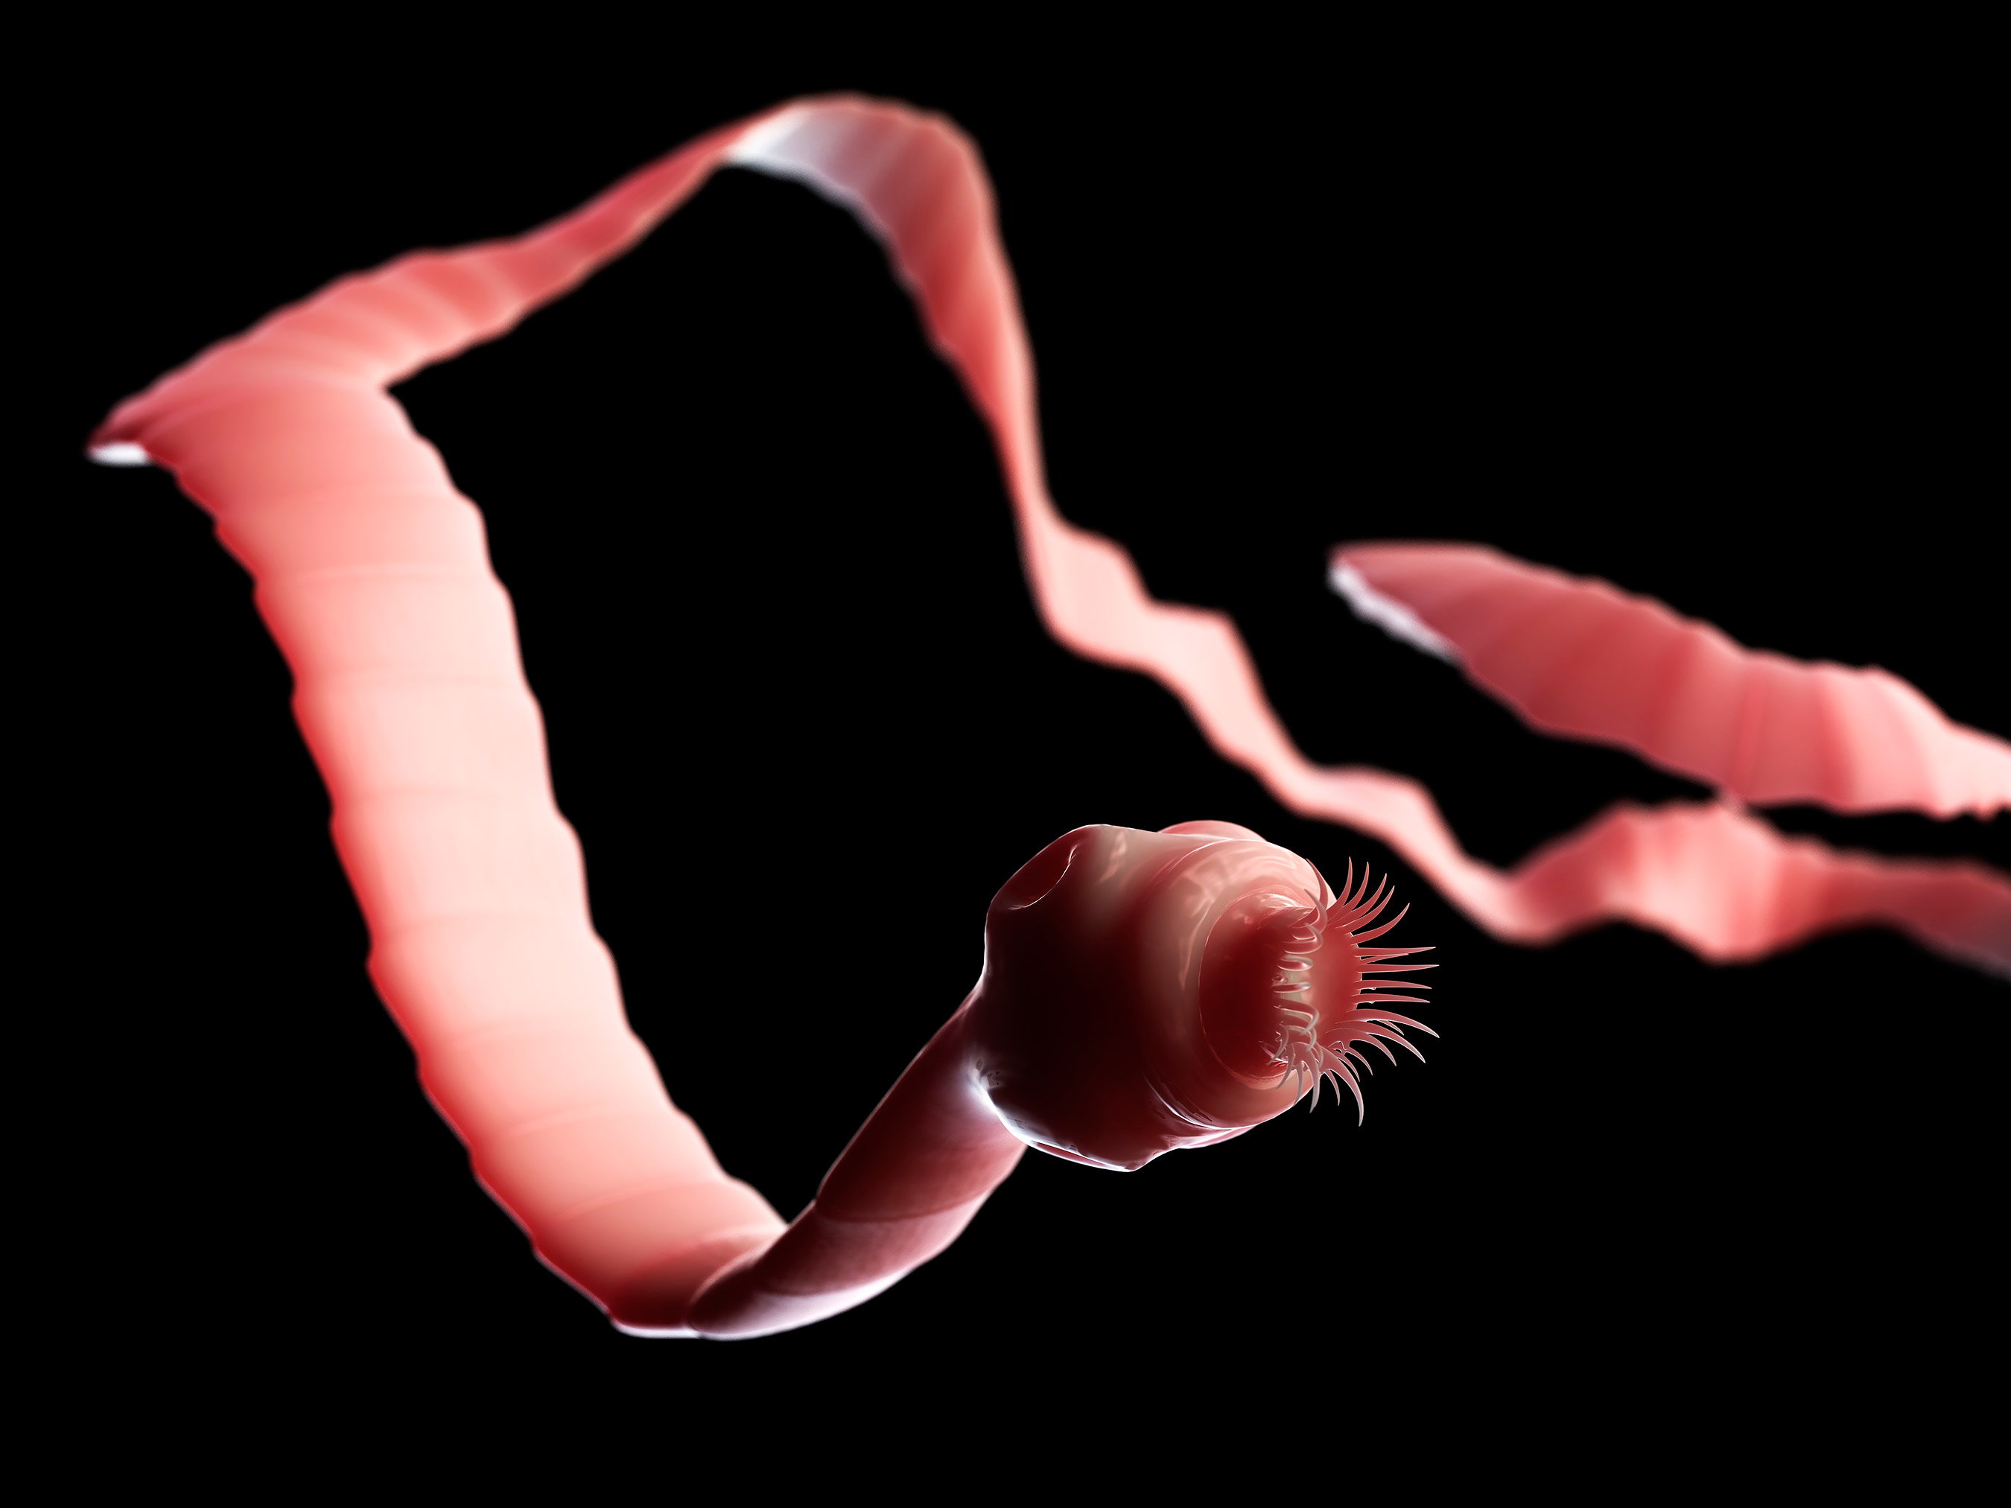
What causes sickness?
PATHOGENS!
Viruses
Bacteria
Parasites
Today we will be focusing on viruses and bacteria

Slide 5
Not all Viruses are bad!
Bacteriophages are viruses that infect harmful bacteria
Phages can be used to disrupt or kill biofilms made by bacteria

Slide 6
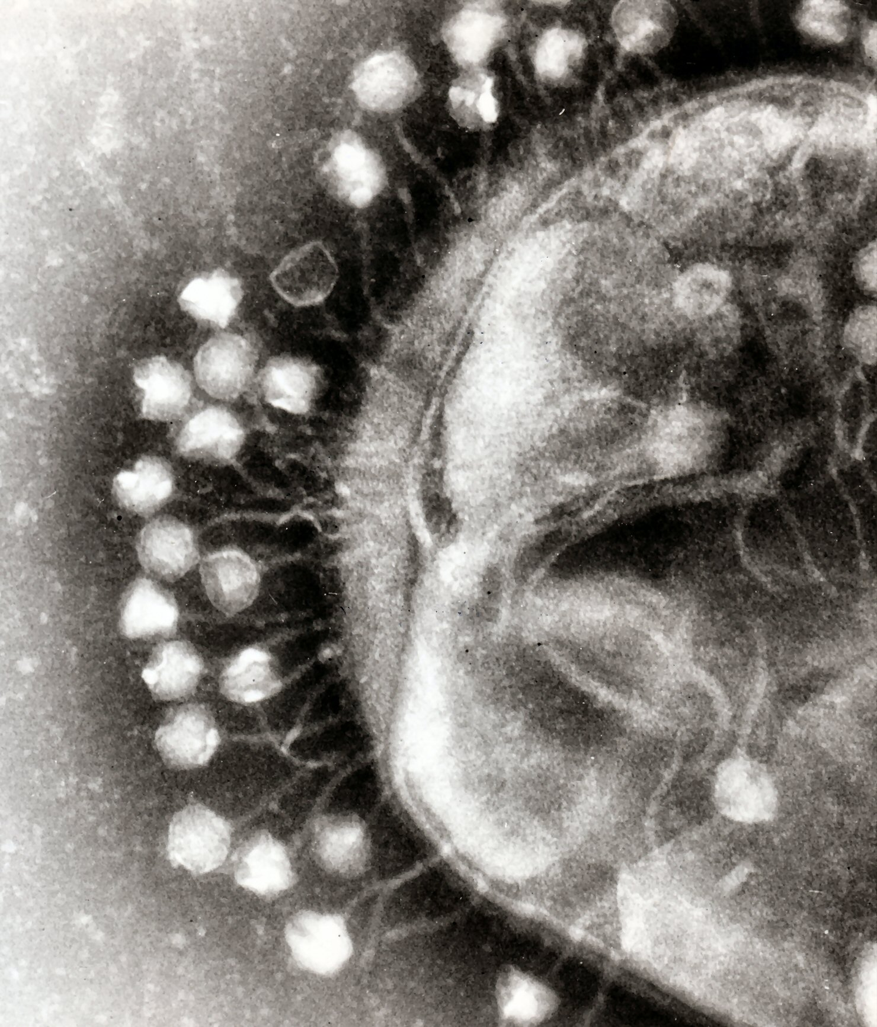
Define the Problem
On your paper, define the problem in your own words based on what you saw in the video “____ need a way to ____ in order to ___.”
Problem: we need a way to engineer viruses to infect as many bacteria as possible in order to eliminate harmful biofilms from water filters

Slide 7
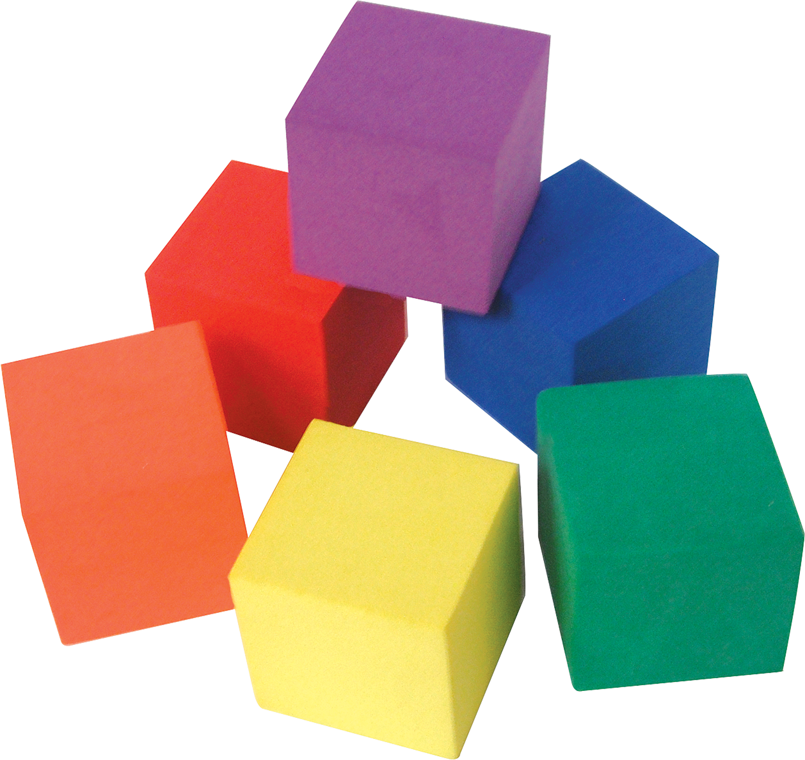
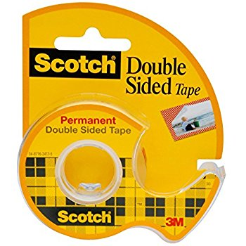
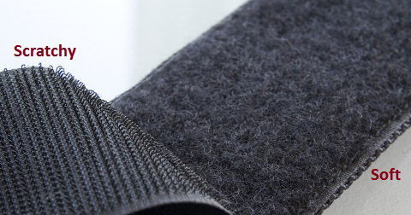
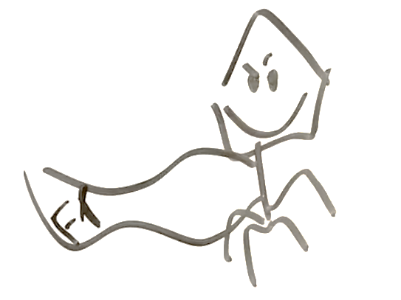
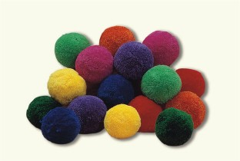
Building Materials
You will have access to these materials to build your virus in only 15 min
foam cubes
Styrofoam balls
soft Velcro
spiky Velcro
toothpicks
double-sided tape
fuzzy pom-poms
paper

Slide 8
Identify Criteria & Constraints
On your paper, identify at least TWO criteria “Our design must be able to ___.”
Think: how will you know your design is successful? ex. When building a ladder, one criteria is that it reaches at least 10 feet high.
On your paper, identify at least TWO constraints “When building our design, we are limited by __.”
Think: what limitations are there on your design? ex. When building a ladder, I’m limited to using only the materials from my garage.
Must be able to attach to at least 10 bacteria cells; Must be able to attach to at least 3 types of bacteria; etc.
We are limited by amount of time (15 min.) We are limited by size of the virus
Photo from Wikipedia commons

Slide 9
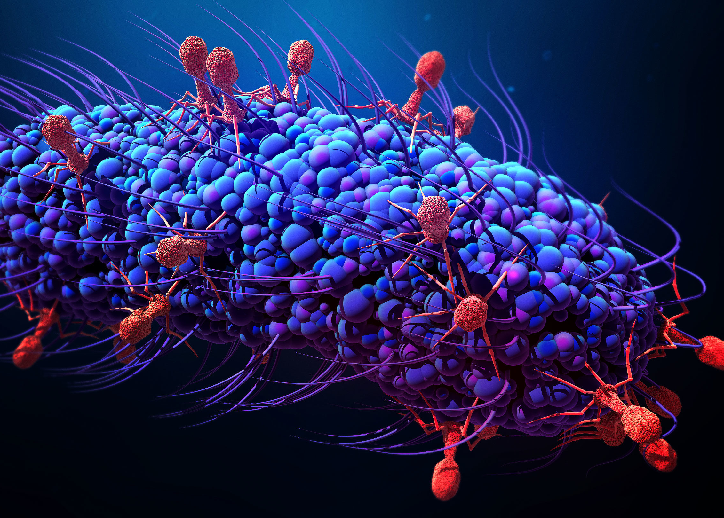
A quick note: These models are not to scale
The models you are making do not accurately represent the size difference between bacteria and phages.
Phages are much smaller than the bacteria they infect
However, this would make it difficult for you to engineer in this activity, so the size difference is switched.

Slide 10
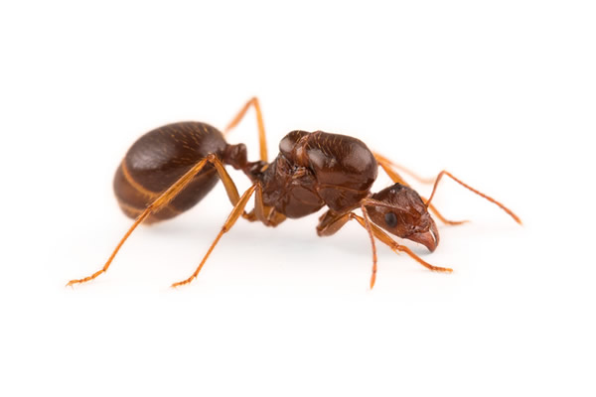
What is a nanometer?
Bacteria: 200-2,000 nm
Viruses: 20-400 nm
Nanometer
1 one-billionth of a meter
Imagine as a Meter
Would be nanometer

Slide 11
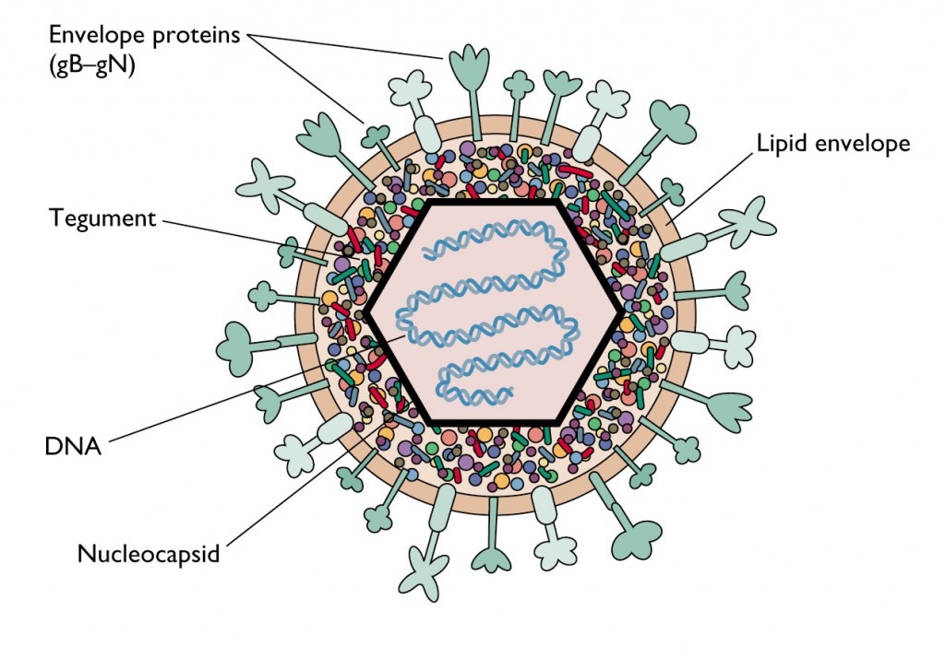
Brainstorm Design
On your paper, brainstorm a design
Draw a sketch of what it will look like
Identify the materials you will use
Consider these questions as you are making your design
What do viruses need to be able to do in order to infect the bacteria?
What materials do you think will fit/stick together the best?
How does the shape impact how it can infect the bacteria?
If we are trying to infect lots of harmful bacteria, should the virus have only one type of attachment?

Slide 12
Maker Time!
You have access to these materials to build your virus in only 15 min
foam cubes
Styrofoam balls
soft Velcro
spiky Velcro
toothpicks
double-sided tape
fuzzy pom poms
paper
When finished with first prototype, bring over your virus to the biofilms for testing! Not perfect? Make adjustments!

Slide 13
Communicate Solution
Okay, engineers, it’s time to communicate your solution! Pick a name for your virus & write it on whiteboard!
You will need to present the following items to the group.
Brainstorming Process
Initial Prototype
Iteration (changes to first prototype)
Final Design
Results from Testing (which biofilms did infect best?)
Ideas for the Future

Slide 14
Test your Solution
In order to isolate the fittest phage to destroy our biofilm, we need to pick the one that can survive & reproduce with multiple different bacterial hosts.
To find this fantastic phage, we will follow the same procedure that scientists use to pick their phages!
Fuzzy bacteria
Only Virus B, D, & E survive
Spiky Velcro Bacteria
Only Virus D & E survive
Paper Bacteria
Only Virus E survives

Slide 15
Reflection Questions
With your groupmates, answer the reflection questions
Did your model meet your criteria and constraints? Why/why not?
Did you make any changes to your model after testing?
In what ways was your design successful? What helped to make it successful?
In what ways could your design be improved?

