Slide 1
Exploring Bioluminescence in Aquatic Animals

Slide 2
Bioluminescent Organism Cards
Teacher Instructions:
Print cards (the full slides) front to back. This will result in the organism picture on the front and the organism’s information on the back.
Have students work in pairs.
Students can pick an organism, the teacher can assign organisms to students based on their level, or students can draw for an organism.
Students read about their organism and learn how they use bioluminescence to help them survive (for example, to warn and evade predators, to lure and detect prey, or to communicate between members of the same species.)
Students select the appropriate cut-out of their organism and then use the prototype design worksheet to plan their design.

Slide 3
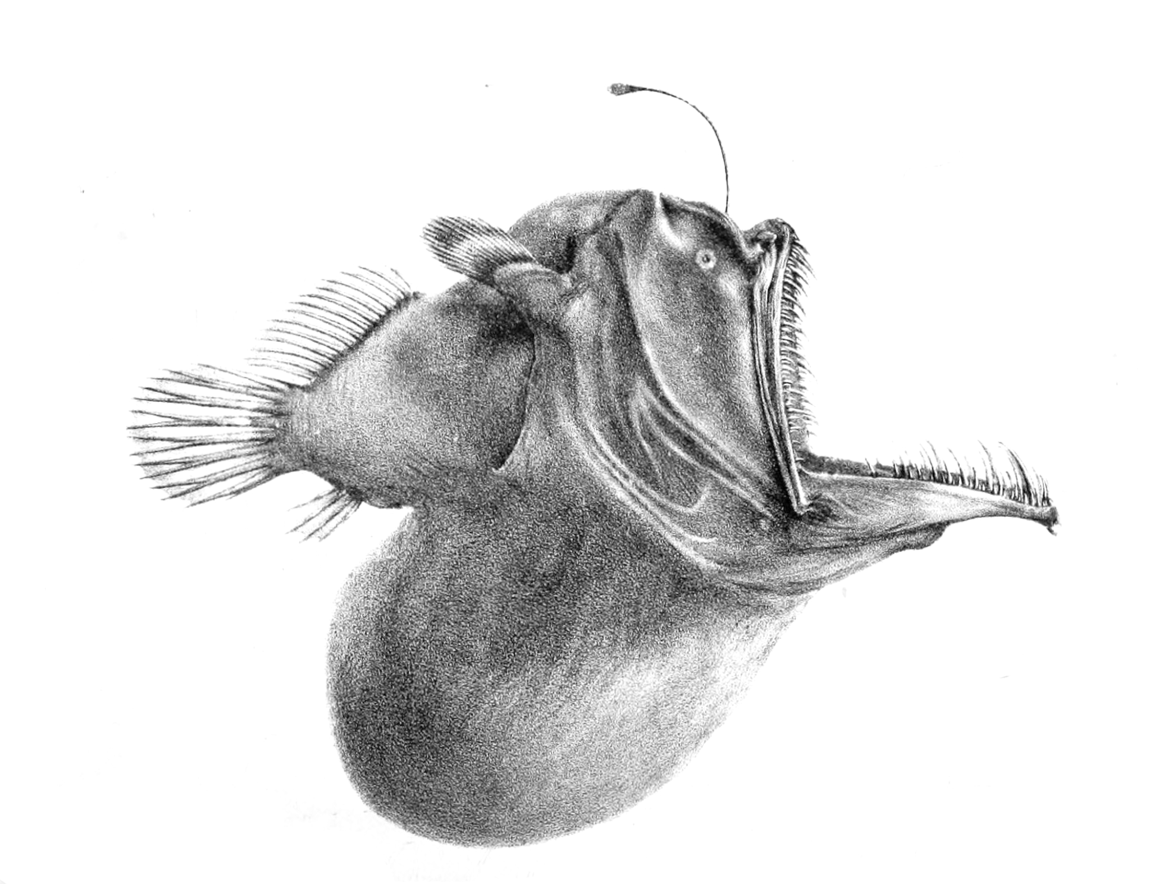
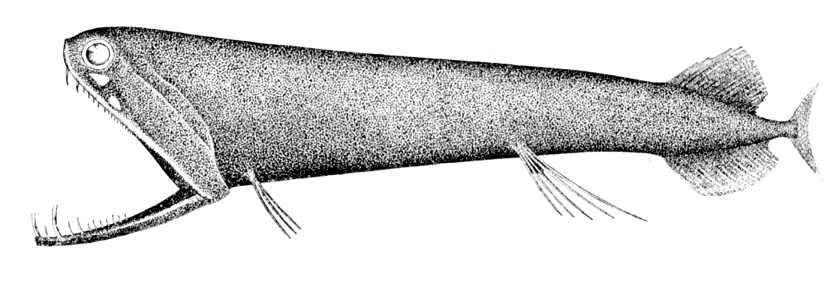
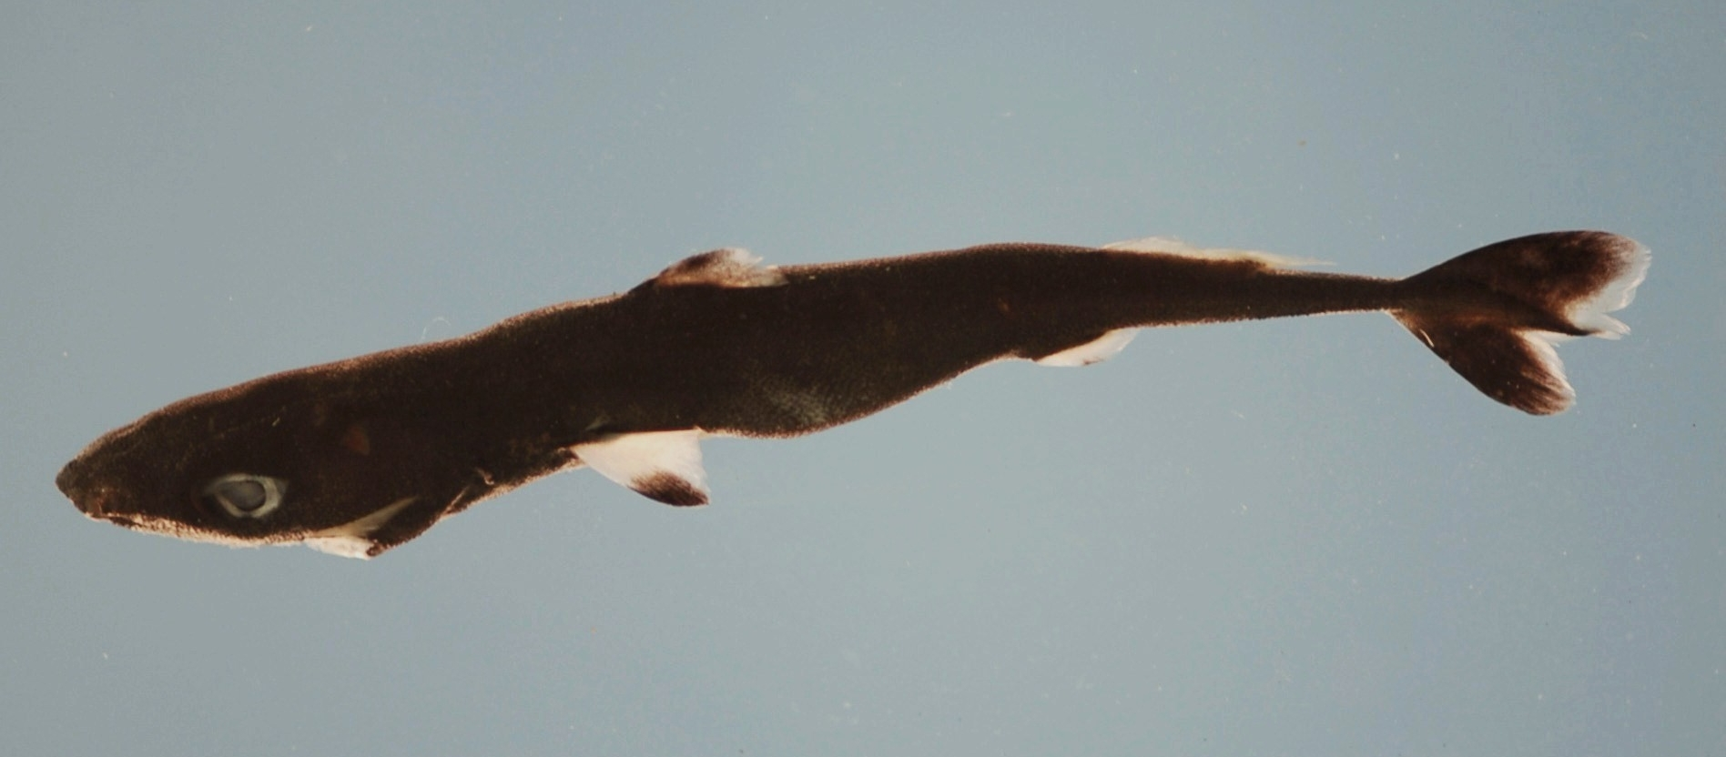
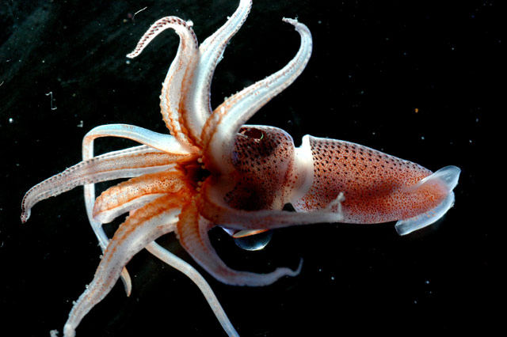
Deep-Sea Anglerfish
Consumer, Carnivore
Stoplight Loosejaw
Consumer, Carnivore
Spined Pygmy Shark
Consumer, Carnivore
Jewel Squid
Consumer, Carnivore
Notes:
Image Credits:
Deep-Sea Anglerfish: https://en.wikipedia.org/wiki/Deep-sea_fish#/media/File:MelanocetusJohnsoniiFord.jpg
Stoplight Loosejaw: https://en.wikipedia.org/wiki/Deep-sea_fish#/media/File:Malacosteus_niger.jpg
Spined Pygmy Shark: https://en.wikipedia.org/wiki/Spined_pygmy_shark#/media/File:Spined_pygmy_shark_nmfs.jpg
Jewel Squid: https://en.wikipedia.org/wiki/Histioteuthis#/media/File:Histioteuthis_NOAA.jpg

Slide 4
Deep-Sea Anglerfish
Consumer, Carnivore
What it is: bony fish containing fang-like teeth that has a unique mode of predation involving a modified fin ray
What it eats: shrimp, fish, crustaceans
Depth: 2,000 meters
Bioluminescent use: modified luminescent fin ray acts a lure for prey; luminescence comes from bacteria in seawater
Stoplight Loosejaw
Consumer, Carnivore
What it is: small, deep-sea dragonfish with an unusual open structure of its jaw that produces red bioluminescence near its eyes
What it eats: small fish and crustaceans
Depth: 500 - 4,000 meters
Bioluminescent use: shines “invisible” red light (stoplight) on prey; searching for undetectable food with an invisible beam of light
Spined Pygmy Shark
Consumer, Carnivore
What it is: small shark with long snout and large eyes; participates in vertical migrations to search for food depending on the time of day
What it eats: small bony fish, squid
Depth: 200 - 500 meters
Bioluminescent use: use photophores to match ambient light conditions to camouflage itself from predators
Jewel Squid
Consumer, Carnivore
What it is: also known as the cock-eyed squid because its right eye is small and used for detecting prey and its left eye bulges out at twice the diameter; larger eye used for sight
What it eats: fish, crustaceans, shrimp, other squids
Depth: 200 - 1,000 meters
Bioluminescent use: uses smaller eye to detect bioluminescence from prey animals

Slide 5
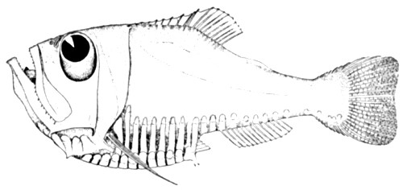
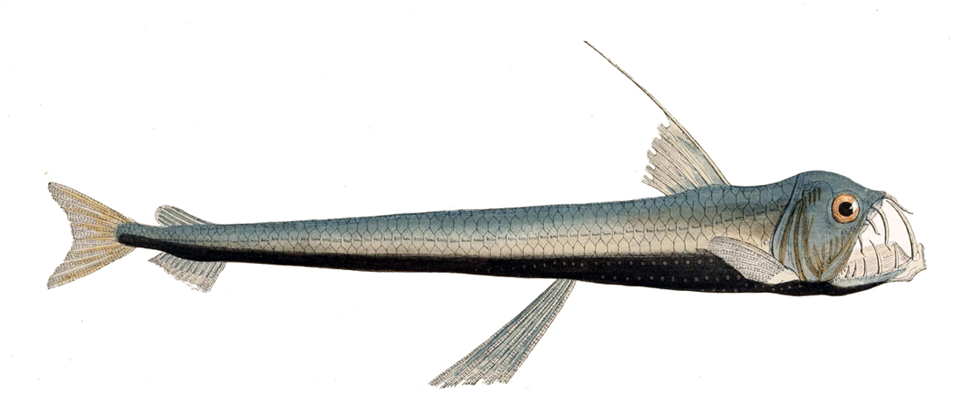
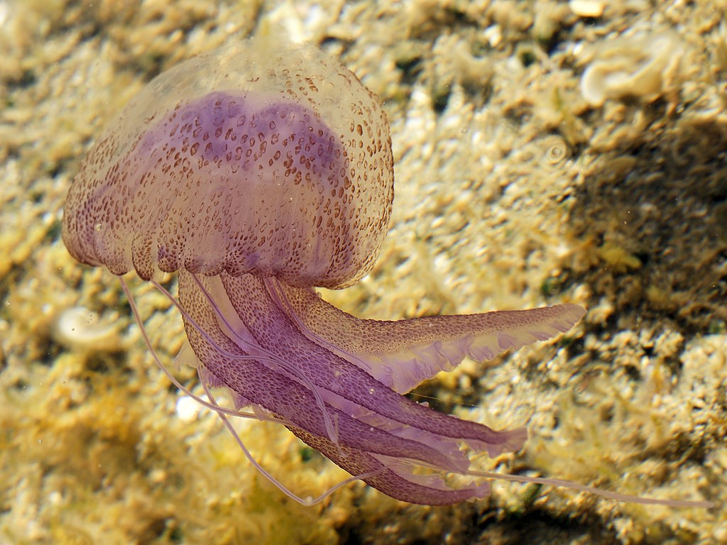
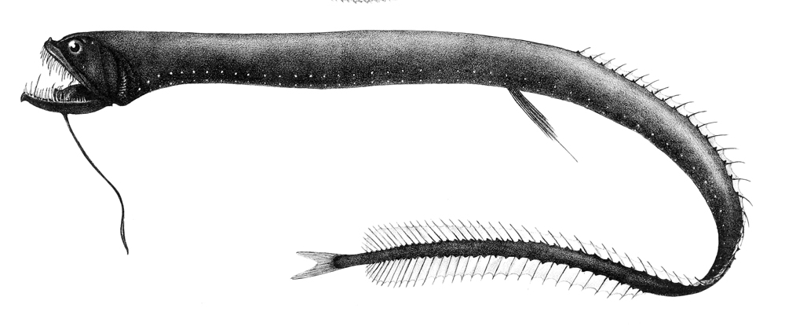
Hatchetfish
Consumer, Carnivore
Sloane’s Viperfish
Consumer, Carnivore
Mauve Stinger
Consumer, Carnivore
Black Dragonfish
Consumer, Carnivore
Notes:
Image Credits:
Hatchetfish: https://en.wikipedia.org/wiki/Marine_hatchetfish#/media/File:Messina_Straits_Argyropelecus_hemigymnus.jpg
Sloane’s Viperfish: https://en.wikipedia.org/wiki/Sloane%27s_viperfish#/media/File:Chauliodus_sloani_Gervais.jpg
Mauve Stinger: https://en.wikipedia.org/wiki/Pelagia_noctiluca#/media/File:Pelagia_noctiluca_(Sardinia).jpg
Black Dragonfish:https://en.wikipedia.org/wiki/Idiacanthus_atlanticus#/media/File:Idiacanthus_atlanticus.jpg

Slide 6
Hatchetfish
Consumer, Carnivore
What it is: deep sea fish that resembles the unique shape of a hatchet; they have tubular eyes that point upward to help them search for food falling from above
What it eats: plankton, crustaceans, and tiny fish
Depth: 200–1,000 meters
Bioluminescent use: light organs emit blue light and point downward to hide from predators through the process of counterillumination; Hatchetfish can adjust the intensity to make them invisible with the light above
Sloane’s Viperfish
Consumer, Carnivore
What it is: toothy dragonfish that can form a cage with its enormous teeth to trap prey by unhinging its jaw up to 90 degrees to catch prey up to 63% of its body size
What it eats: small fish and shrimp
Depth: 500 - 2,500 meters
Bioluminescent use: two rows of light flash in complex patterns to communicate with one another; light can also be used to trick or illuminate their prey or to confuse potential predators
Mauve Stinger
Consumer, Carnivore
What it is: jellyfish that catches prey in tentacles using poisonous stinging cells; also known as the purple-striped jellyfish
What it eats: zooplankton, crustaceans, fish eggs and larvae
Depth: 150 - 1,400 meters
Bioluminescent use: attracts food; light stimulating cells glow when stimulated
Black Dragonfish
Consumer, Carnivore
What it is: slender deep-sea fish that
What it eats: plankton, algae, shrimp, squid, and other marine invertebrates
Depth: 2,000 meters
Bioluminescent use: light emitting organs on lower part of its body and below its eye help it avoid predators through deceptive illumination; fleshy part growing from chin lures curious prey

