Slide 1
Exploring Bioluminescence in Aquatic Animals

Slide 2
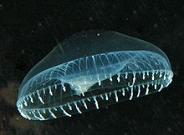
Magic or Science?
Did you know that some aquatic organisms glow, flash, and blink?
Bioluminescence is light produced by a living organism caused by a chemical reaction.
Essential Questions:
What are the conditions like in the deep ocean?
Is there an abundance of food available?
How have aquatic organisms adapted to these harsh conditions?
Crystal Jelly Bioluminescence
Notes:
Image link: https://commons.wikimedia.org/wiki/File:Aequorea4.jpg

Slide 3
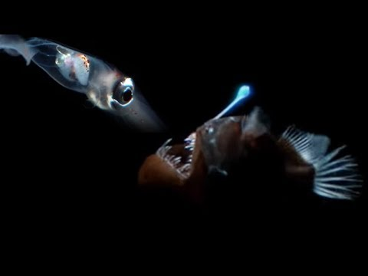
Research
Watch the video provided. Take notes in your student packet about any data or evidence you think might be important as to why these organisms produce their own light.
Notes:
What makes these creatures odd or weird? More than anything, it is the environment in which they live in the deep ocean - the peculiar conditions to which they’ve adapted. These include intense pressure far beyond our imagination, and lack of light. In fact, 99% of the sun’s light does not penetrate below the topmost 330 feet (100 m) of the surface of the sea.
The pressure at 3,280 feet (1 km), where no light penetrates and where some deep-sea creatures live, is 100 times greater than the pressure we feel at the surface.
Video link: https://www.youtube.com/watch?v=UXl8F-eIoiM

Slide 4
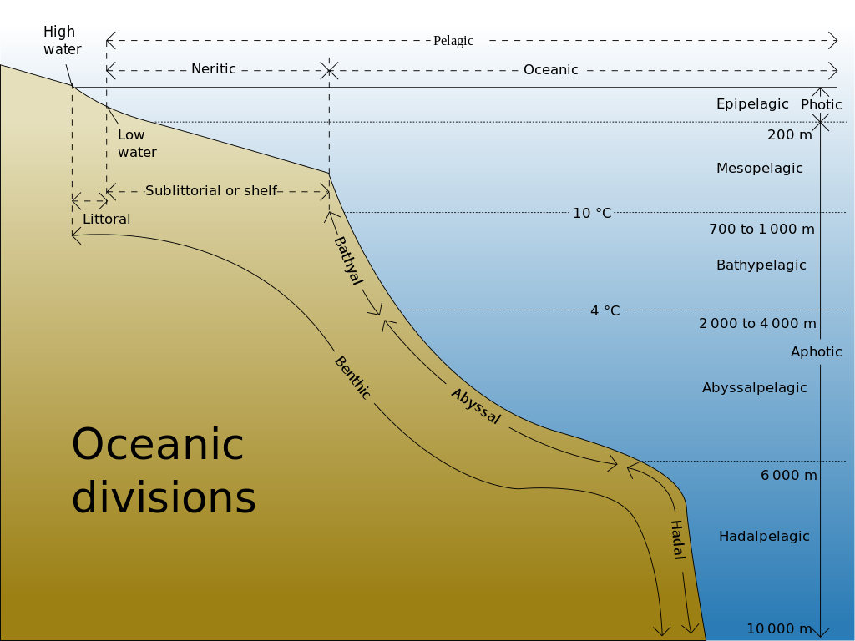
Ocean Zones
How do some aquatic organisms survive intense pressure, cold, and total darkness?
The solution can be found in special adaptations, or inherited traits, that enable a wide variety of aquatic organisms to live at great depths. Bioluminescence in the form of photophores or chromatophores.
Oceanic Divisions
Notes:
Image link: https://en.wikipedia.org/wiki/Oceanic_zone#/media/File:Oceanic_divisions.svg

